Slide 1

Customer Shopping
Behaviour Analysis
NAME
VARAD SANJAY SAWANT
Uncovering Insights from 3,900 Transactions to Drive Strategic Growth
TOOLS USED
DATASET
DATE
Python · SQL · Power BI
3,900 Records · 18 Features
April 2026
Data Analytics · Customer Intelligence · Business Strategy

Slide 2

Business Problem & Objective
Slide 02 — Why This Matters
THE PROBLEM
PROJECT OBJECTIVE
Retailers lack clear visibility into what drives customer purchase decisions
Analyse 3,900 transactions to understand spending patterns by gender, age, and category
Discount strategies are applied broadly without understanding their true impact
Identify customer segments: New, Returning, and Loyal buyers
Customer segmentation is rarely data-driven, missing revenue opportunities
Evaluate discount dependency and its effect on revenue margins
No structured view of subscription behaviour vs. non-subscriber patterns
Deliver actionable recommendations backed by SQL and Python analysis
02

Slide 3



Dataset Description
Slide 03 — About the Data
3,900
18
37
Total Records
Feature Columns
Missing Values
(Review Rating)
KEY FEATURES
Demographics
Age, Gender, Location, Subscription Status
Purchase Details
Item, Category, Amount, Season, Size, Color
Behaviour Signals
Discount Applied, Promo Code, Review Rating
Loyalty Metrics
Previous Purchases, Purchase Frequency
03

Slide 4



Tools & Technologies
Slide 04 — The Tech Stack
Python
MySQL
Power BI
DATA CLEANING & EDA
SQL ANALYSIS
DASHBOARD & VIZ
pandas, numpy for preprocessing; feature engineering and imputation
10 structured business queries covering revenue, segments, and product performance
Interactive dashboard for executive-level insights and KPI monitoring
04

Slide 5
Data Cleaning & Preprocessing
Slide 05 — Preparing the Foundation
01
Data Loading
02
Missing Value Handling
Imported dataset using pandas; verified shape (3,900 × 18) with df.info() and .describe()
Detected 37 nulls in Review Rating; imputed using median rating per product category
03
Column Standardization
04
Feature Engineering
Renamed all columns to snake_case for consistency and documentation clarity
Created age_group (binned) and purchase_frequency_days from existing transaction data
05
Redundancy Check
06
Database Integration
Verified discount_applied vs promo_code_used overlap; dropped promo_code_used as redundant
Loaded cleaned DataFrame into MySQL via Python connector for structured SQL analysis
05

Slide 6
Exploratory Data Analysis
Slide 06 — Reading the Data Story
Gender Distribution
Seasonal Trends
Male customers account for slightly higher transaction volume; both segments show comparable average spend
Purchase frequency peaks in Fall and Spring, with Summer driving the highest per-transaction amounts
Age Group Patterns
Discount Behaviour
Middle-aged customers (35-54) drive the highest revenue contribution across all product categories
~45% of purchases used a discount; discount users are not exclusively low-spend customers
Key Observation: Customers using discounts still spend above-average — suggesting discount does not erode quality-of-purchase.
06

Slide 7
SQL Analysis
Slide 07 — How We Answered the Business Questions
Q1
Revenue by Gender
Q2
High-Spend Discount Users
Compared total revenue generated by male vs. female customers
Identified customers using discounts but spending above-average
Q3
Top 5 Products by Rating
Q4
Shipping Type Comparison
Products with highest average review ratings
Average spend: Standard vs. Express shipping
Q5
Subscribers vs. Non-Subscribers
Q6
Discount-Dependent Products
Average spend and total revenue by subscription status
5 products with the highest % of discounted purchases
Q7
Customer Segmentation
Q8
Top 3 Products per Category
New, Returning, Loyal classification by purchase history
Most purchased products within each product category
Q9
Repeat Buyers & Subscriptions
Q10
Revenue by Age Group
Do customers with >5 purchases subscribe more?
Revenue contribution of each age group
07

Slide 8
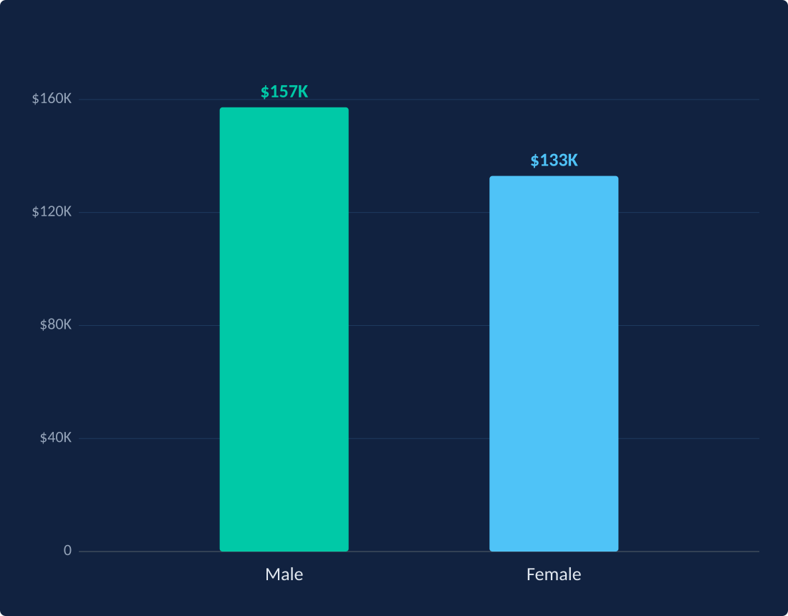
Key Insight: Revenue by Gender
Slide 08 — Who Spends More?
$157K
Male Revenue
54% of total
$133K
Female Revenue
46% of total
18%
Spend Difference
Male vs Female
08

Slide 9
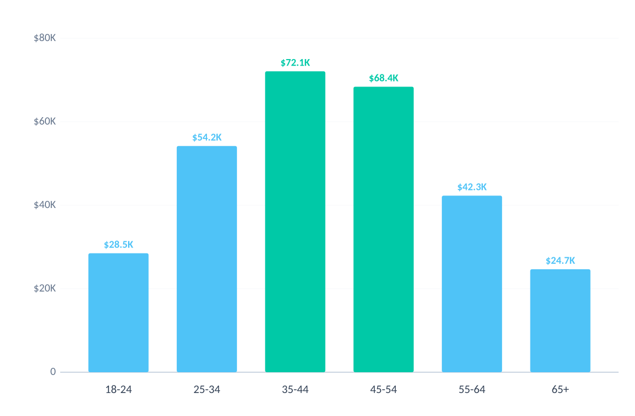
Key Insight: Revenue by Age Group
Slide 09 - Where Does Spending Concentrate?
TOP REVENUE SEGMENT
35-44 yrs
$72,100 total revenue
COMBINED 35-54 POWER
47% of total
$140,500 - highest concentration
EMERGING OPPORTUNITY
25-34 yrs
$54,200 - fastest-growing tier
Strategic Focus: The 35-54 cohort drives nearly half of all revenue - priority target for loyalty programmes and premium product placement.
09

Slide 10
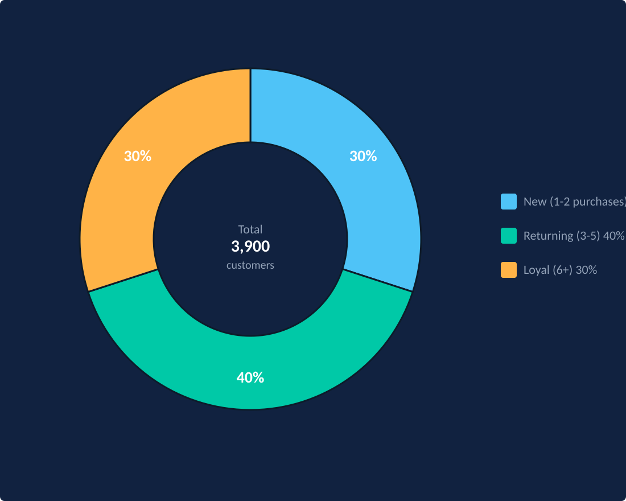
Key Insight: Customer Segments
Slide 10 — Who Are Our Buyers?
NEW
30%
~1,170 customers
1-2 purchases. Acquisition targets. Price-sensitive, respond well to welcome offers.
RETURNING
40%
~1,560 customers
3-5 purchases. Core base. Most likely to upgrade to subscriptions.
LOYAL
30%
~1,170 customers
6+ purchases. High LTV. Drive word-of-mouth and anchor subscription revenue.
10

Slide 11
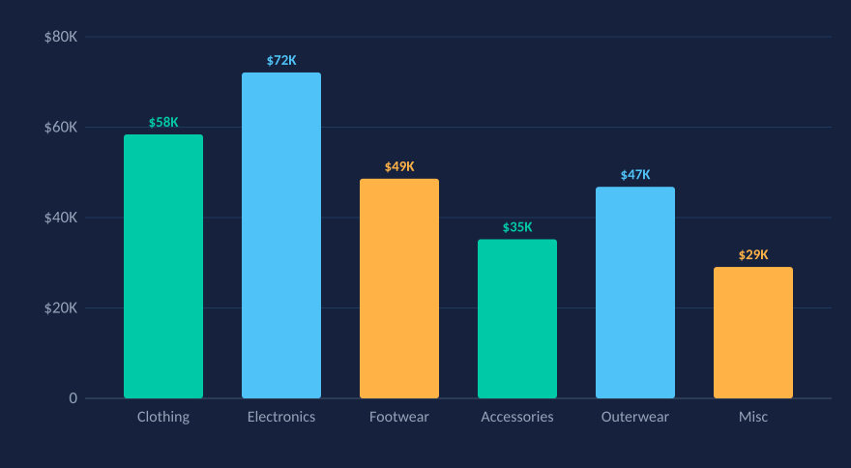
Interactive Dashboard — Power BI
Slide 11 — Bringing Insights to Life
⬛ Customer Shopping Behaviour — Power BI Dashboard
$290K
3,900
4.2★
41%
Total Revenue
Transactions
Avg. Rating
Discount Rate
REVENUE BY CATEGORY
CUSTOMER SEGMENTS
30%
40%
30%
New (1-2 purchases)
30% ~1,170 customers
Returning (3-5)
40% ~1,560 customers
Loyal (6+)
30% ~1,170 customers
11

Slide 12





Business Recommendations
Slide 12 — From Insight to Action
Boost Subscriptions
Product Positioning
Promote exclusive subscriber benefits — free shipping, early access, loyalty points — targeting the Returning segment with 3-5 purchases.
Promote top-rated and best-selling products in targeted campaigns. Leverage Q3 SQL findings to prioritise category investment.
Customer Loyalty Program
Targeted Marketing
Reward repeat buyers to accelerate movement from Returning → Loyal segment. Tiered rewards tied to purchase milestones.
Focus on 35-54 age group (highest revenue) and Express shipping users — both signal willingness to pay premium.
Rethink Discount Policy
High-spend discount users exist — apply strategic, category-specific discounts rather than blanket offers to protect margins.
12

Slide 13
Challenges Faced
Slide 13 — Navigating Obstacles
DATA ISSUE
Solution: Imputed 37 null values using median rating per product category — preserving distribution without introducing bias
Missing Review Ratings
DATA ISSUE
Solution: discount_applied and promo_code_used were nearly identical; statistical check confirmed redundancy, promo_code_used dropped
Redundant Columns
TECHNICAL
Solution: Established seamless DataFrame-to-MySQL pipeline using SQLAlchemy connector after resolving charset compatibility
Python–MySQL Integration
ANALYTICAL
Solution: No universal standard exists; binning thresholds (New: 1-2, Returning: 3-5, Loyal: 6+) calibrated to dataset distribution
Defining Loyalty Segments
13

Slide 14
Conclusion
Slide 14 — What We Learned
3,900
transactions analysed across 18 dimensions — Python cleaned, SQL queried, Power BI visualised
10
structured business questions answered through MySQL, covering revenue, segments, and product strategy
3
distinct customer segments identified (New, Returning, Loyal) enabling targeted engagement strategy
47%
of total revenue driven by the 35-54 age group — the highest-priority marketing segment
The analysis enables data-driven decisions in marketing, discount strategy, loyalty programmes, and product positioning.
14

Slide 15




Future Scope
Slide 15 — What Comes Next
Predictive Churn Modelling
RFM Segmentation
Apply ML classification (Random Forest, XGBoost) to predict which customers are at risk of churning before they lapse
Introduce Recency-Frequency-Monetary scoring to build a quantified customer value model beyond binary loyalty tiers
Recommendation Engine
A/B Testing Framework
Build a collaborative filtering model to suggest products to customers based on similar purchase history patterns
Design discount A/B tests to quantitatively measure the revenue impact of promotional strategies on different segments
15

Slide 16

Q & A
Thank You
Customer Shopping Behaviour Analysis · Python · SQL · Power BI · April 2026
GitHub Link For Project : https://github.com/svarad28/Customer-Shopping-Behavior-Analysis
Data tells the story. Strategy writes the future.

