Slide 1
Prosody Modification
Final BTP Presentation
Project Mentor: Dr. Kishore Prahallad
By,
Varshanjali Sayyaparaju (201030097)
Sravya Kanmanthareddy(201030155)

Slide 2
Project Overview
Title: Prosody modification on mobile devices
Description:Application (on mobile devices), that employs prosody modification algorithms including duration, intonation and spectral modifications. This project deals with faster and efficient implementation of such algorithms. Ex: TomCat
Deliverable: Real-time efficient prosody modification application by changing spectral parameters, duration and fundamental frequency.

Slide 3
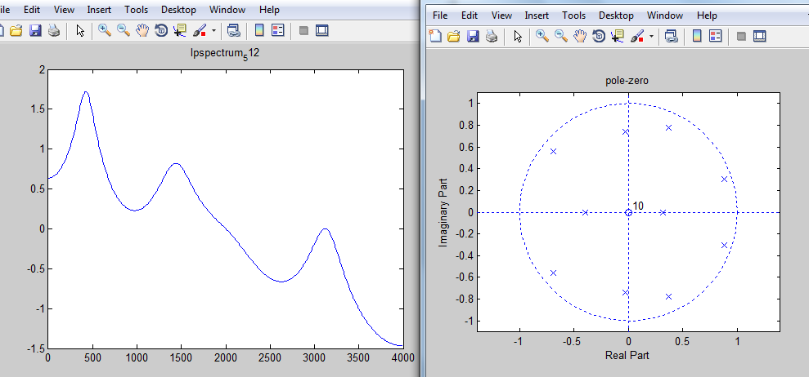
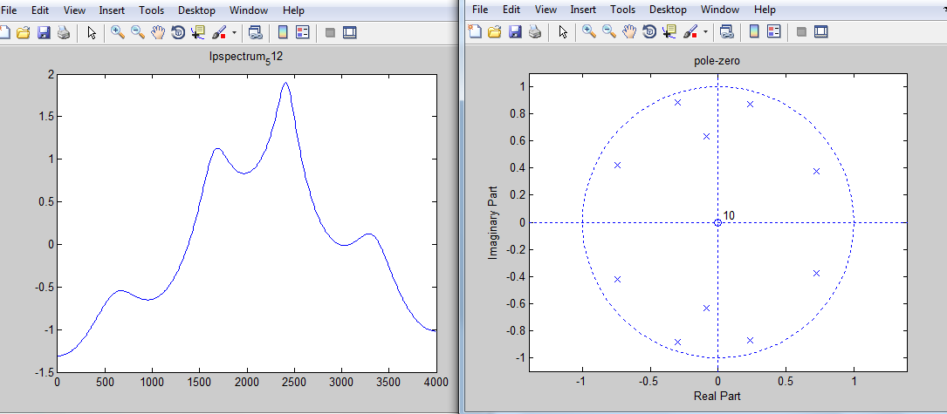
Stage I
Introduction to basic concepts of speech and prosody modification.
Resampling
Analyzing TomCat
LP spectrum Modification: modifying poles
Notes:
Speech, prosody:duration, pitch contour, spectral changes, method of pole-shifting

Slide 4
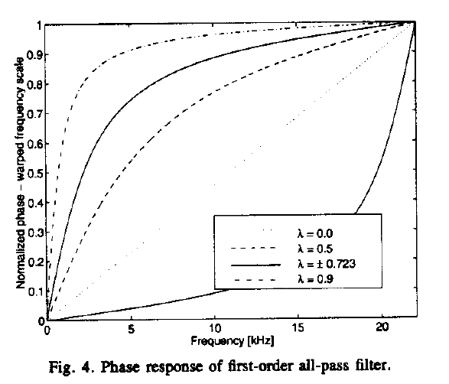
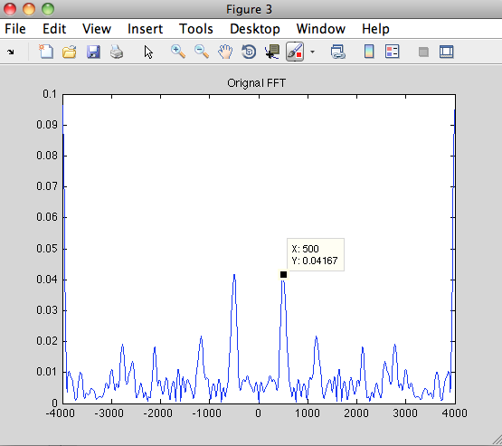
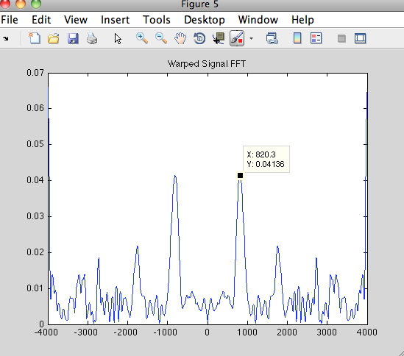

Stage II
Frequency Warping to Achieve Prosody Modification:

Slide 5
Work Done
Prosody modification through resampling
Pole-Zero Modification
Frequency Warping
Matlab Demo
ANDROID APP “TalkBak”

Slide 6
Thank You

