Slide 1
Prosody Modification
BTP Presentation
Project Mentor: Dr. Kishore Prahallad
By,
Varshanjail Sayyaparaju (201030097)
Sravya Kanmanthareddy(201030155)

Slide 2
Project Overview
Title: Prosody modification on mobile devices
Description:Application (on mobile devices), that employs prosody modification algorithms including duration, intonation and spectral modifications. This project deals with faster and efficient implementation of such algorithms. Ex: TomCat
Deliverable: Real-time efficient prosody modification application by changing spectral parameters, and increasing current limitations.

Slide 3
Project Description:
Speech: Excitation source + vocal tract response
Prosody: It is the rhythm, stress and intonation of speech.
Prosody modification includes modification in:
  Duration –How long each phone should be.
  Pitch contour
  Spectral changes
Method of pole-shifting is used to employ changes in vocal tract shape, which causes prosody modification.
We would like to explore the range of spectral (pole-zero locations) changes possible without loosing much information in speech.
contributes to change in voice quality

Slide 4
Current Scenario
Popular algorithms used for Prosody modification are:
  TD-PSOLA
  Sinusoidal models
  Harmonics + noise models
  STRAIGHT
These algorithms are for pitch, and duration modification, we are interested in spectral modification. Therefore, we use:
  LP Spectrum Modification using Pole-Zero Plot
  Mel-Cepstral
  LP-PSOLA
  Frequency-domain PSOLA
References:
  Gutierrez-Osuna, Ricardo. "Prosodic Modification of Speech." Introduction to Speech Processing. Reading.

Slide 5
Scope
Improvements in currently proposed methods
  Expanding range of prosody modification
  Speed and complexity of algorithm
Big Picture:
  Understanding speech prosody
  Understanding working of current algorithms, and trying to replicate effect.
  Designing a real-time algorithm on Desktop
  Creating Android application
End-Users:
  Mobile Users

Slide 6
Work Done

Slide 7



Resampling
“aaa”
Input High Low
“eee”
Input High Low
Sentence
Input High Low
Observations:
Resampling changes the voice characteristics
But rate of sampling can not be fixed because distortion is noticed for some sounds,and not others. This is clearly noticed in the higer pitch period of “aaa” vs “eee”.
Conclusion:
Resampling is the easiest method to implement prosody, but not the most efficient method.
Time duration decreases by a significant amount as pitch increases

Slide 8
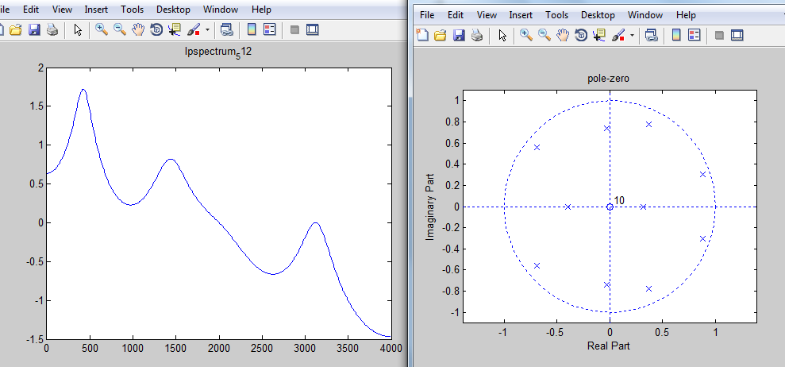
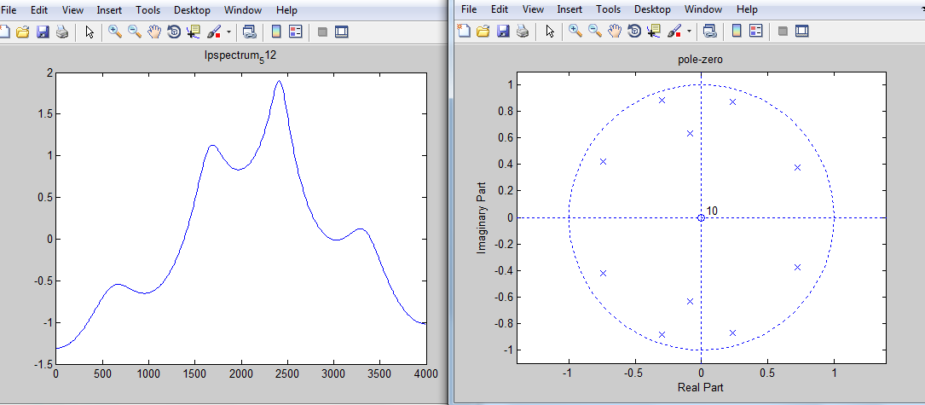
Analyzing TomCat
Input_vowel
Observations:
Poles have been moved
The spectrum has changed
Conclusion:
Vocal tract characteristics can be changed by shifting poles of LP spectrum
TomCat

Slide 9
LP Spectrum Modification
Theory:
  Implementing LP spectrum modification by changing Pole-Zero Plots:
    Method:
      Brief Description:
        The basic shape of vocal tract can be characterized by the gross envelope of Linear Prediction (LP) spectrum.
        LP spectrum can be approximated by a set of resonant frequencies(formants) and their associated bandwidths.
        For each speaker, the shape of the vocal tract will be unique, and correspondingly the set of formants and their bandwidths.
        The resonances and their bandwidths are related to the angle and magnitude of the corresponding poles in the z -plane. The formant frequencies can be changed by shifting the poles of a system transfer function in the z -plane.
    Reference:Rao, Sreenivasa K., and B. Yegnanarayana. Voice Conversion by Prosody and Vocal Tract Modification. Publication no. IIIT/TR/2006/35. Orissa: Proc. Ninth International Conference on Information Technology, 2006. Print.

Slide 10
Process
Speech
Pre-processing
Extract LP Coefficients
for each frame
Find corresponding
poles
Modify poles
Calculate new LPCs
Synthesis Speech
Using new LPCs
Output

Slide 11
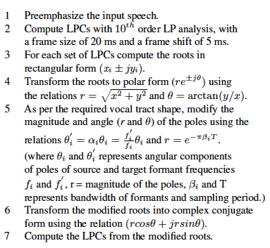
Modifying Poles
Steps for LPCs Modifications
Changing the values of θ and r changes the vocal tract characteristics (formants position and bandwidth)

Slide 12
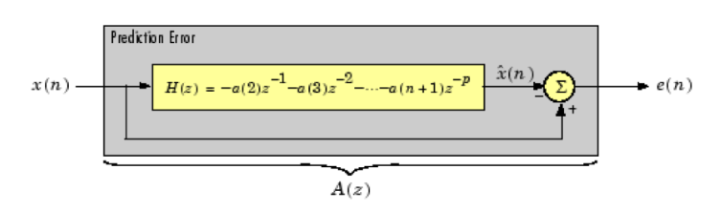
Speech Synthesis
Theory:
  Inverse-Filtering
    Method:
      Compute a_{k}’s (LPCs)
      Pass speech through all-pole filter to obtain LP residual
      Modify poles
      Pass residual through all-pole filter using modified poles to obtain synthesized speech

Slide 13
Results:
  Original
  Modifying θ of all poles
  0.75* θ 1.2*θ 1.5* θ
  Modifying R of all poles
  0.8*r 1.02*r
  Modifying some particular poles

Slide 14
Another Approach
  Pole-Shifting is not guaranteed to give results for prosody modification.
    Requires more research and computation
  Frequency Warping: Linear/Non-linear mapping to change frequency spectrum
    The frequency spectrum of a speech contains vocal tract characteristics.

Slide 15
Goals
Next Goal: Implementing real-time efficient prosody modification using Matlab by August 1st week.
Final Goal: Developing a real-time prosody modification application on android platform by end of the project.

Slide 16
Thank You

