Slide 1
Fatal Airplane Crash Analysis
Hunter Hildebrand, Nathan Schleisman,
Sam Tucker, Saul Varshavsky

Slide 2
Agenda
Introduction to Client and Data
Predictive Modeling
Descriptive Modeling
Lasso Regression
Interpretations and Conclusions

Slide 3
Introduction to Client and Data

Slide 4
Dataset
Airplane accidents severity dataset
Author: Abilash Cheruvathur
Source: Kaggle
Provides different factors recorded during plane crashes
Client: University Aviation Professor
Notes:
This dataset provides valuable insight on how different factors such as aircraft violations, max elevation, cabin temp, turbulence, safety complaints, days since inspection and adverse weather impacts whether a plane crash could be fatal or not.
Our client is a professor of aviation at a top-tier university in the U.S. Knowing and understanding how varying factors impact plane crash severity could be valuable when teaching future aviators.

Slide 5
Research Question
This project aims to investigate the model most effective at predicting the likelihood of the severity of a plane accident (1 representing fatal accident and 0 representing otherwise)

Slide 6
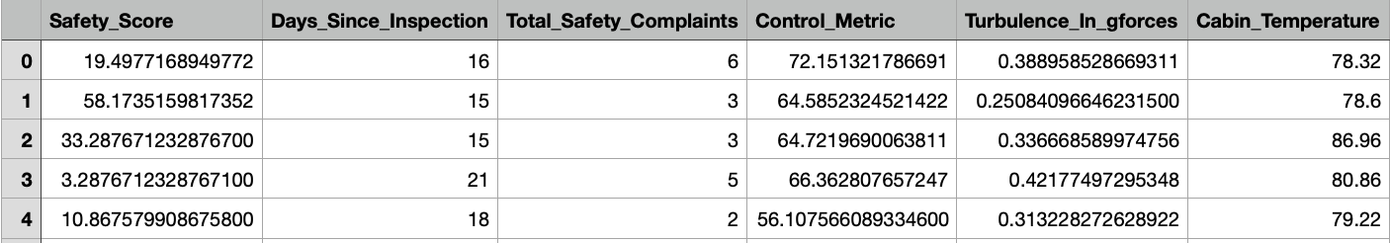
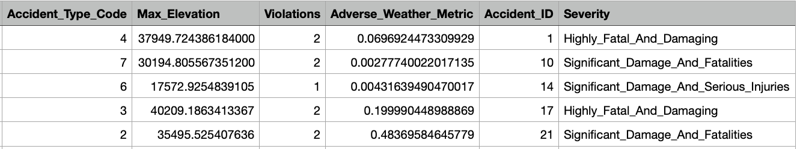
At a Glance
Notes:
Nathan

Slide 7
Variables
Explanatory variables
Violations
Max_Elevation
Cabin_Temperature
Turbulence_In_gforces
Total_Safety_Complaints
Days_Since_Inpsection
Adverse_Weather_Metric
Safety_Score
Control_Metric
Predictor variable
Severity_Binary
"Yes" if the plane accident was fatal
"No" otherwise; used for predictive modeling
Severity_Binary_2
1 if the plane accident was fatal
0 otherwise; used for descriptive modeling
Notes:
Nathan: 9 explanatory variables
Violations ( the number of violations the plane had during its inspection)
Max_Elevation (the highest altitude in feet of the plane at the time of its accident)
Cabin_Temperature (the most recent plane temperature recorded in degrees Fahrenheit before the accident)
Turbulence_In_gforces (the turbulence recorded at the time of the accident measured in Newtons)
Total_Safety_Complaints (the number of complaints received prior to the accident)
Days_Since_Inpsection (the number of days since the plane was last inspected leading up to the accident)
Adverse_Weather_Metric (The measured weather metric with regards to adverse weather conditions where the higher the metric, the more adverse the weather conditions at the time of the accident)
Safety_Score (The measured plane's safety score with regards to how safe the plane was deemed to be prior to the accident where the higher the score, the more safe the plane was deemed to be)
Control_Metric (The measured metric with regards to the extent the pilot was in control of the plane leading up to the accident where the higher the control metric, the more the pilot was in control)

Slide 8
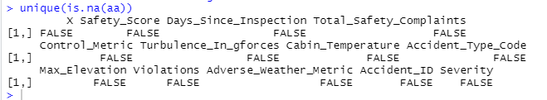
Cleaning and Preparation
Removed a couple unnecessary variables
Checked for missing values
Created Severity_Binary (Target variable)
"Yes" for any accident containing a fatality; "No" otherwise.

Slide 9
Predictive Modeling

Slide 10

Baseline Random Forest
Separated data into training/testing set using 80/20 split.
Fitted baseline random forest with the following parameters
Data: Training Data
# of trees: 1,000
# of features (x variables) to sample for each tree: 3
Evaluated baseline random forest
Overall accuracy: 92%
OOB error: 7.7%

Slide 11
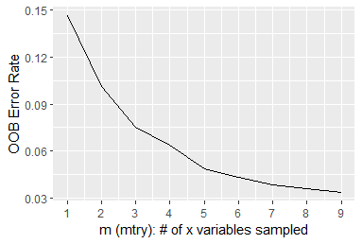

Tuning/Final Forest
Tuning the Random Forest
Goal of tuning: Minimize our OOB error.
"mtry": specify # of variables you want randomly sampled as candidates for each split.
Result: We found that randomly sampling from all 9 variables minimized our OOB error.
Final Forest
Fit Final Random Forest with tuned parameter: mtry = 9
Overall accuracy: 97%​
OOB error: 3.5%

Slide 12
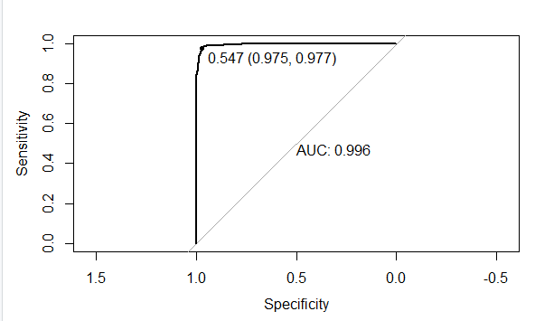
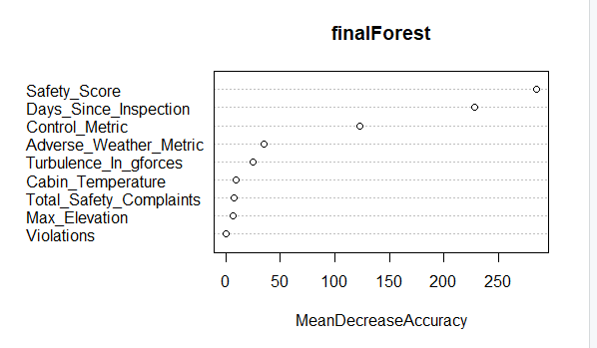
Interpreting Results
ROC Curve findings
When a plane accident is actually fatal, our model correctly predicts that there is indeed a fatal accident 98% of the time
When a plane accident is not actually fatal, our model correctly predicts that there indeed isn't a fatal accident 98% of the time
AUC (area under the curve of the graph) is 0.996
Variable Importance Plot
Safety_Score, Days_Since_Inspection, and Control_Metric

Slide 13
Descriptive Modeling

Slide 14

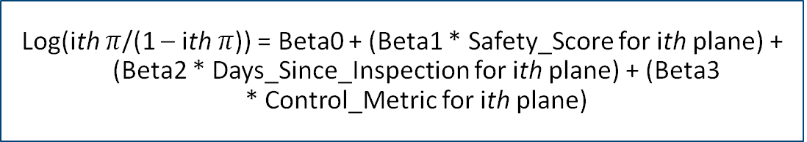
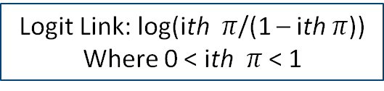
Model Specification
Yi = {1 if ith plane is in a fatal accident; 0 otherwise}
Logit Link: log(ith $π$/(1 – ith $π$))
Where 0 < ith $π$ < 1
Yi ~ Bernoulli(ith $π$)
Log(ith $π$/(1 – ith $π$)) = Beta0 + (Beta1 * Safety_Score for ith plane) + (Beta2 * Days_Since_Inspection for ith plane) + (Beta3 * Control_Metric for ith plane)

Slide 15




Determining Model
Using AIC to determine an effective yet simple model
1) Adding the most important variable from the Variable Importance Plot (Safety_Score)
2) Adding the second most important variable from the Variable Importance Plot (Days_Since_Inspection)
3) Adding the third most important variable from the Variable Importance Plot (Control_Metric)
4) Adding the fourth most important variable from the Variable Importance Plot (Adverse_Weather_Metric)
Decided to stick with m3 as our model

Slide 16
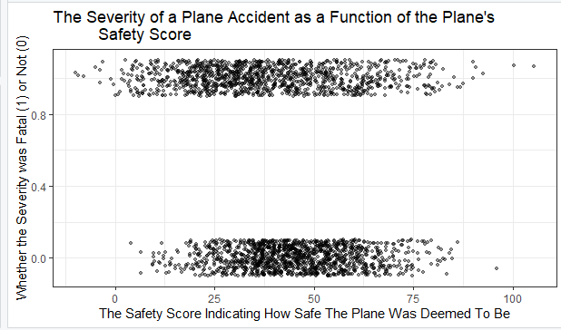
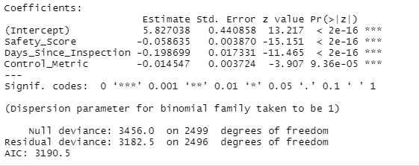
Checking for Complete Separation
Pre-Analysis
Checking to see whether there is separation between x values that have fatal (1) and non-fatal accidents (0)
Post-Analysis
Checking for large standard errors and large p-values

Slide 17
Determining Custom Odds Ratios
Safety_Score
Range: 0-100
Custom Odds Ratio: 10
Days_Since_Inpsection
Range: 1-23
Custom Odds Ratio: 1
Control_Metric
Range: 20.96627-97.99453
Custom Odds Ratio: 5

Slide 18
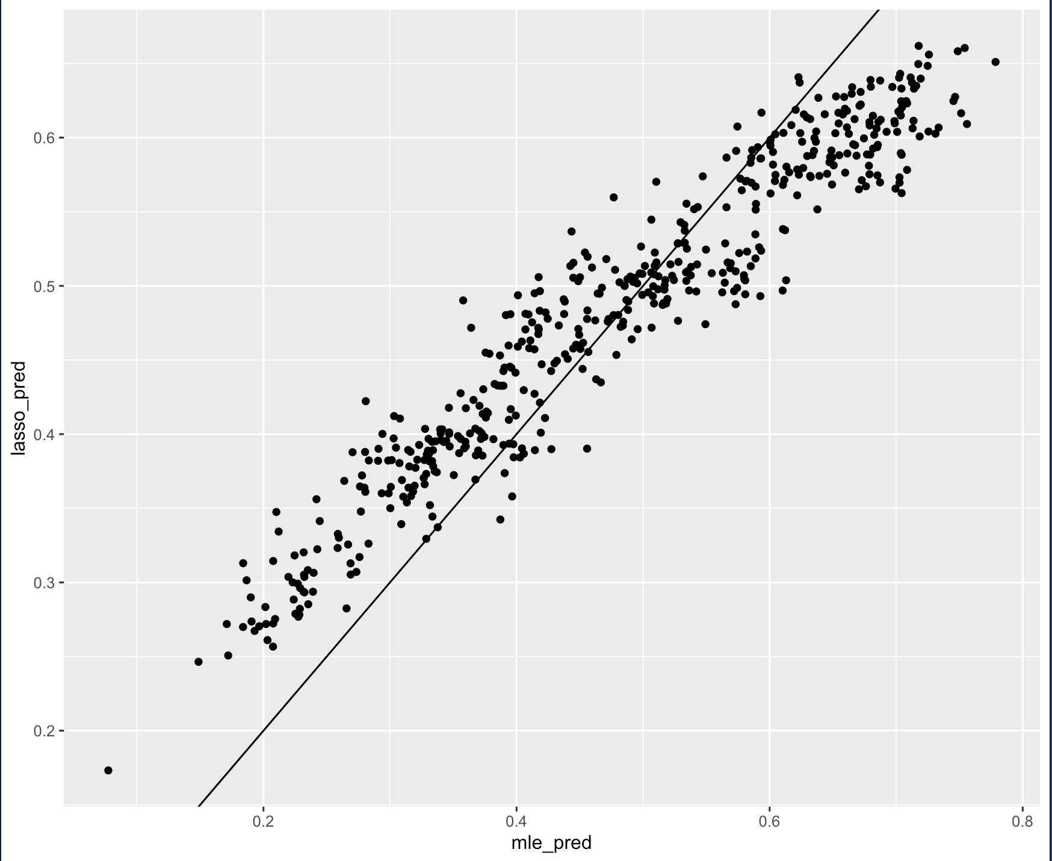
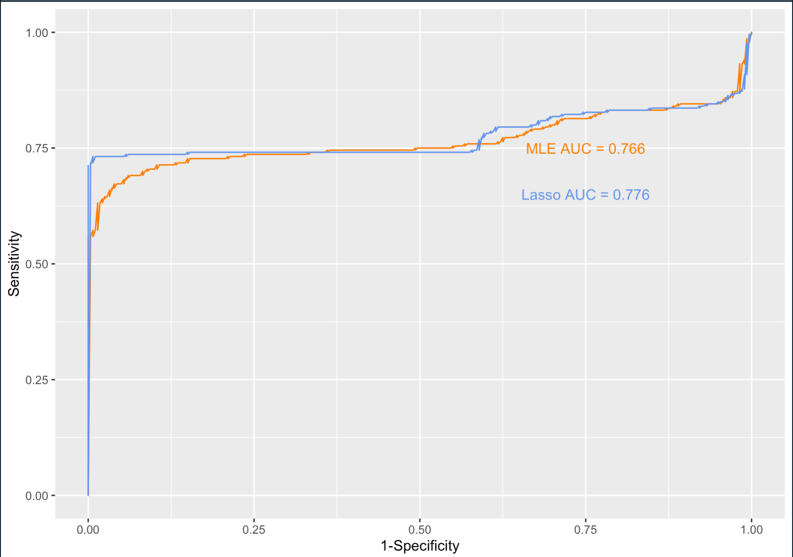
Lasso Regression
Observed variability between both our MLE and Lasso Model appears consistent
Our Lasso model performs slightly better than our MLE model based off the AUC value
Notes:
We also did try and fit lasso regression to see if we could observe any meaningful changes. First off, we charted their predicting values and see nothing is too crazy and different, so it’s a bit difficult to see a difference between the two.
Next comparing the two models via their AUC, we can see a sliver of an improvement with Lasso but overall, these findings don’t jump out enough to be overly noteworthy.

Slide 19
Interpretations & Takeaways

Slide 20
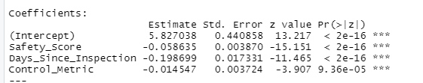
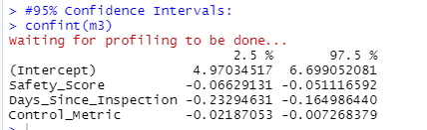
Interpretations
Safety_Score
For each 10 unit increase in the plane's safety score (as the score increases, the plane is deemed to be more safe for flight), the odds of a plane accident being fatal changes by a factor of e^(10*-0.058635), or rather decreases by a factor of around 0.556.
Days_Since_Inspection
For each 1 unit increase in the number of days since the plane was last inspected, the odds of a plane accident being fatal changes by a factor of e^-0.198699, or rather decreases by a factor of around 0.82.
Control_Metric
For each 5 unit increase in the plane's control metric (as the metric increases, the pilot has more control over the plane leading up to the accident), the odds of a plane accident being fatal changes by a factor of e^(5*-0.014547), or rather decreases by a factor of around 0.930.
Confidence Interval
Days_Since_Inspection: We are 95% confident that the odds of a plane accident being fatal changes by a factor between around e^-0.233 and e^-0.165 for each 1 unit increase in the number of days since the plane was last inspected.

Slide 21
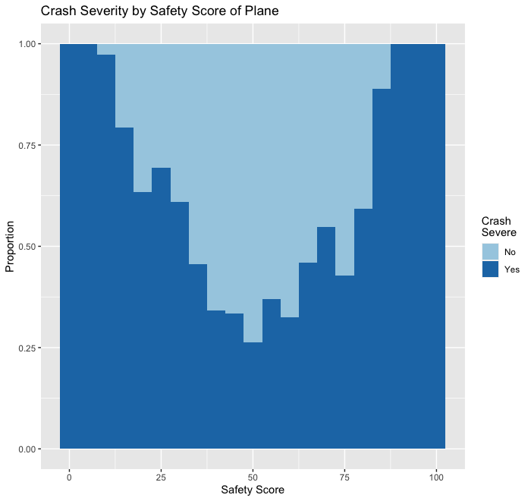
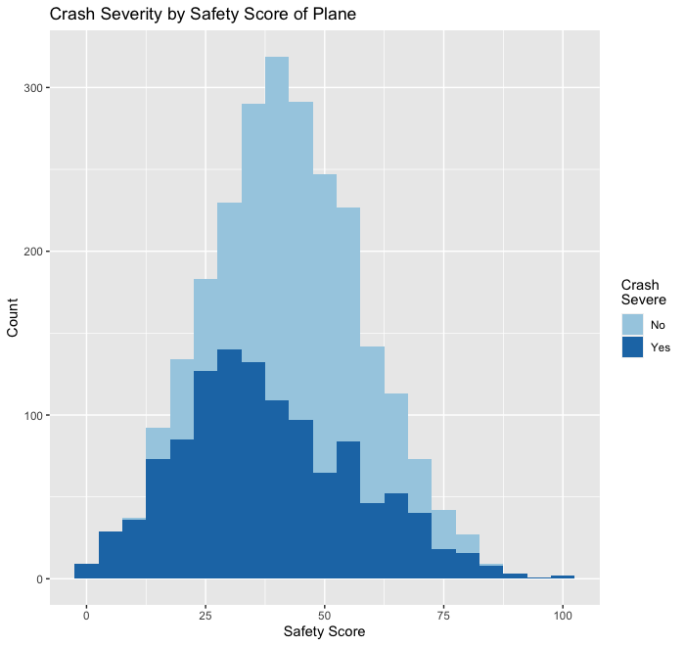
Takeaways
Notes:
Saul mentioned the odds of a severe plane accident decrease by a factor of .556 for every 10 unit increase in safety score
These visualizations display that
First graph is a filled histogram filled

Slide 22
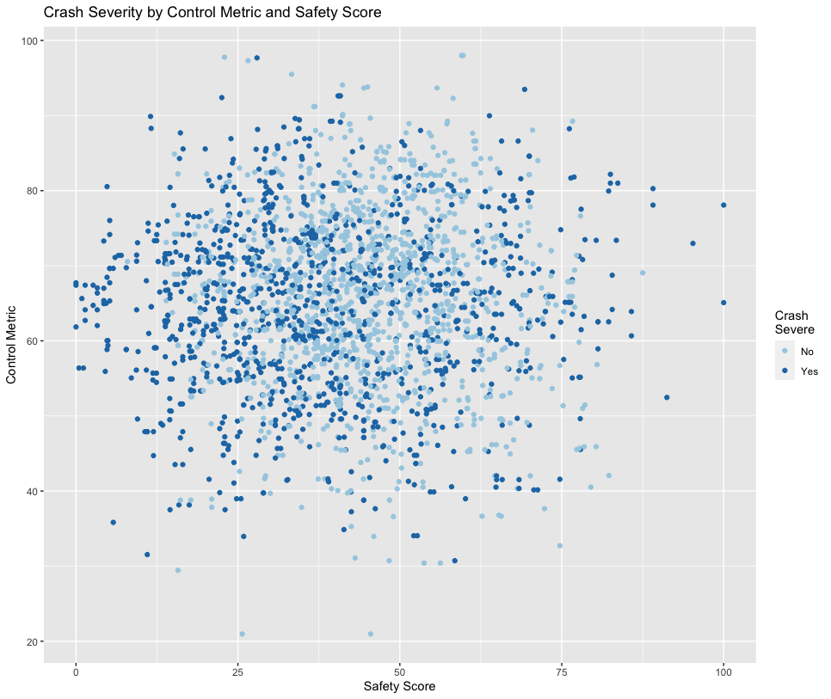
Takeaways (continued)

Slide 23
Thank You

