Slide 1

Basic Details of the Team and Problem Statement
Ministry/Organization Name/Student Innovation: Ministry of Law and Justice
PS Code: 1282
Problem Statement Title: Tech-Driven Solutions for Undertrial Prisoners in India
Team Name: NoobCoderException
Team Leader Name: Sobika Sree Ramesh
Institute Code (AISHE): C-16604
Institute Name: Sri Sivasubramaniya Nadar College of Engineering
Theme Name: Miscellaneous

Slide 2
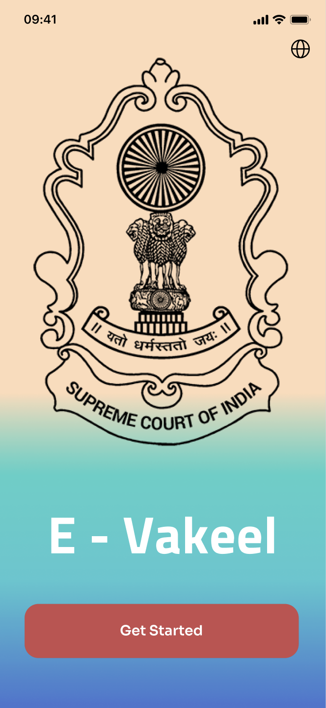
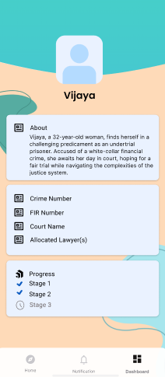
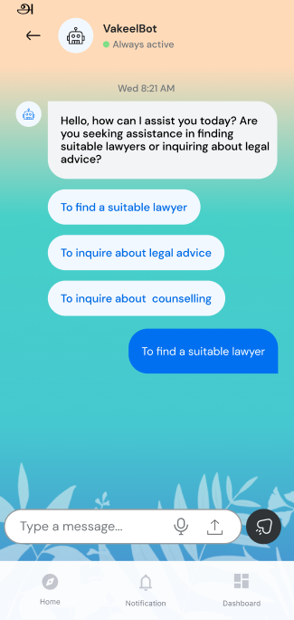
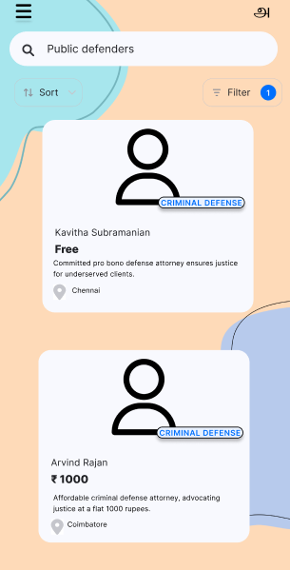
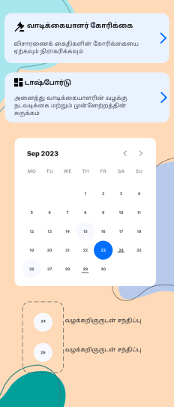
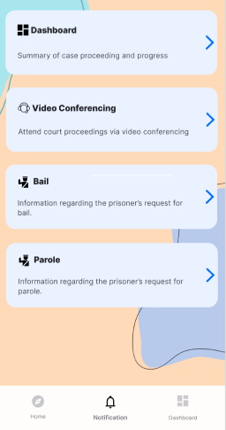
Idea/Approach Details
Describe your idea/Solution/Prototype here:
A mobile application (of two instances) with regional language support to simplify legal processes for undertrial prisoners (UTP), lawyers, and authorities:
1. E-Vakeel (For UTPs/Support Persons and Lawyers):
Automatically get assigned a lawyer using AI Suggestion System. [Alternative option to choose lawyer of choice based on filters and requirements from displayed list of lawyers].
Access a fully functional dashboard [ UTP Details, Allocated Pro-Bono Lawyers, Progress of case.]
Utilize an context-aware legal aid chatbot.
Digitalization of Bail & Parole application process.
Connect with therapists and counselors for Mental Health Support [ Legal Clinics ].
Explore a digital library of mental health and legal knowledge books and manuals.
Providing a post-trial list of volunteering services for undertrial prisoners upon their release for social reintegration.
2. E-Vakeel Admin (For Authorities/Under Trial Review Committees[UTRC] and Judges):
Priority Dashboard to fast-track cases of long serving UTP [ search with FIR number ]
Set up video calls for UTPs with judges for trials.
Grant or reject bail requests efficiently.
UTRC: Regulating personal bonds for those UTPs who have completed half of their sentence period.
Describe your Technology stack here:
Application Development:
ReactJS
Capacitor.js
Ionic framework
Database:
NotionDB
AI Chatbot:
LLM API
Langchain
Python3

Slide 3
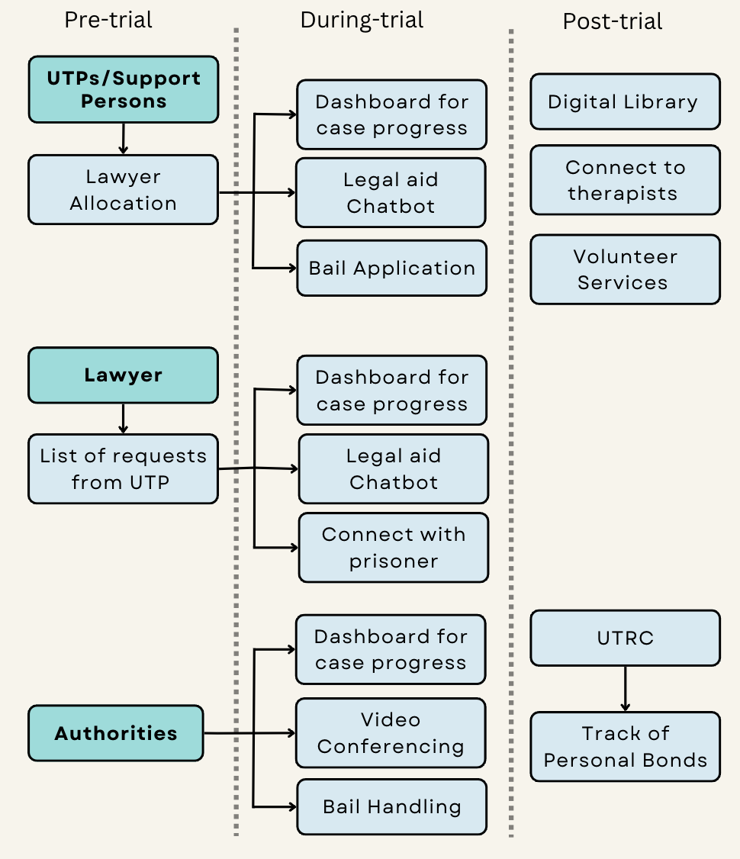
Idea/Approach Details
Describe your Use Cases here
E-Vakeel (For UTPs/Support Persons and Lawyers):
UTPs/Support Persons:
Lawyers:
View UTP requests for legal representation,
Access a consolidated dashboard for case management.
E-Vakeel Admin (For Authorities/Under Trial Review Committees and Judges):
Authorities/Judges:
Automatic lawyer Allocation within 24 hrs Receive legal Information from an AI chatbot, Track case progress through Dashboard, | Apply for bail or parole digitally, Access mental health support, Educational resources and post-trial volunteering services.
Monitor case progress under Jurisdiction Conduct speedy trials via video calls | Efficiently manage bail requests. UTRC members can regulate personal bonds to reduce prison overcrowding.
Describe your Dependencies / Show stopper here
Data Sources:
The Code of Criminal Procedure 1973 [ Legal Information ]
Bar Council of India [ List of Lawyers ]
e-Court Services Portal [ Status of Case-Dashboard ]
Model Prison Manual 2016 [ Legal Information-ChatBot ]
Standard Operating Procedure for UTRC
District Crime Records Bureau
Show Stoppers:
All users are required to use this application for effective implementation
Reliance of Government Data
Language & Literacy Barriers

Slide 4
Team Member Details
Team Leader Name: Sobika Sree Ramesh
Branch : Btech Stream : IT Year : IV
Team Member 1 Name: Gunanicaa Arun
Branch : Btech Stream : IT Year : IV
Team Member 2 Mayuri Balajee
Branch : Btech Stream : IT Year : IV
Team Member 3 Name: Lekha Chenguttuvan
Branch: B.E Stream : CSE Year : IV
Team Member 4 Name: Varsha Sivaramakrishnan
Branch : B.E Stream : CSE Year : IV
Team Member 5 Name: Sruti K A
Branch : B.E Stream : ECE Year : IV
Team Mentor 1 Name: Dr. K.S. Gayathri
Category : Academic Expertise : AI/ML Domain Experience : 21 years
Team Mentor 2 Name: A. Akilan [ Advocate ]
Category : Legal Industry Expertise : Criminal Law Domain Experience : 3.5 years

