Slide 1



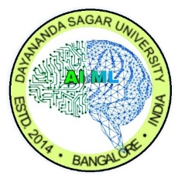
Dayananda Sagar University (DSU) - Main Campus
School of Engineering
Devarakaggalahalli, Harohalli Kanakapura Road, Bengaluru South Dist., Karnataka 562112
DEPARTMENT OF
COMPUTER SCIENCE AND ENGINEERING
(ARTIFICIAL INTELLIGENCE AND MACHINE LEARNING)
Capstone Project Phase-I(23AM4701)
Review-1
Title: “Myopia Digital Twin: Agentic AI-Based Progression Prediction System with Biomarkers and Ergonomics”
Under the Supervision of
Ankita Thakkar, Assistant Professor
Pragnya Mishra, Assistant Professor (Co-Supervisor)
Department of CSE (AI&ML), SOE, DSU.
T Kundana Svarsha
Sneha Suman
Srishti Gupta
Reese Jayaprakas Pallath
ENG23AM0201
ENG23AM0196
ENG23AM0198
ENG23AM0178
Academic Year: 2026-2027
SDG TITLE ALIGNED: SDG 3 – Good Health and Well-Being

Slide 2
Contents
1. Introduction
2. Domain & SDG Mapping
3. Problem Statement
4. Objectives
5. Project Scope
6. Source of Data Collection
7. Expected Outcomes
8. Tools & Technologies
9. Methodology / Approach
10. Timeline (Gantt Chart)
11. References
Capstone Phase-1 – 1st Review – 12.09.2026
School of Engineering, Department of CSE (AI&ML), Dayananda Sagar University, Bengaluru - 562112.

Slide 3
Introduction
• Background: Myopia progression is tracked through periodic clinical visits, so a patient's current prescription alone does not reveal how the condition is evolving.
• Motivation: Longitudinal ocular measurements, lifestyle behaviour and ergonomic factors are rarely combined into a single, continuously updated patient-specific model.
• Proposed approach: A Myopia Digital Twin — a continuously updated computational representation of each patient's ocular biomarkers (spherical equivalent, axial length), lifestyle factors (screen time, outdoor exposure) and ergonomic factors (viewing distance, posture).
• AI relevance: Supervised ML for progression prediction, a counterfactual simulation engine for what-if scenarios, SHAP for explainability, and an agentic AI layer that orchestrates prediction, evidence retrieval and monitoring.
• Current status: A working end-to-end prototype — “Iiris” — is already running: a React web application over a FastAPI Digital Twin service with 61 endpoints, trained models, a counterfactual simulator and a LangGraph agent layer.
Capstone Phase-1 – 1st Review – 12.09.2026
School of Engineering, Department of CSE (AI&ML), Dayananda Sagar University, Bengaluru - 562112.

Slide 4
Domain & SDG Mapping
• Primary Domain: Healthcare AI / Medical AI — Clinical Decision Support.
• Predictive AI: Gradient-boosted models over 33 engineered longitudinal features predict 6- and 12-month spherical equivalent, axial length and progression risk.
• Explainable AI: SHAP TreeExplainer produces per-prediction feature attribution, presented with an explicit non-causal disclaimer.
• Agentic AI: A LangGraph graph (route → plan → execute → check → compose) drives 12 declared tools; the agent can obtain facts only through those tools.
• Knowledge & Retrieval: RAG over Europe PMC / PubMed with a bundled offline corpus fallback, so every retrieved claim carries a citation.
• Interoperability: HL7 FHIR mapping of Patient and Observation records so the twin can exchange data with standard healthcare systems.
• SDG Alignment: SDG 3 — Good Health and Well-Being, supporting personalised, preventive eye-care decision support.
Capstone Phase-1 – 1st Review – 12.09.2026
School of Engineering, Department of CSE (AI&ML), Dayananda Sagar University, Bengaluru - 562112.

Slide 5
Problem Statement
• Problem: Existing myopia management relies on periodic measurements and population-level risk factors, without a continuously updated, patient-specific model of disease progression.
• Real-world challenge: A clinician can see the current prescription but has no simple way to explore how modifiable factors — outdoor time, screen exposure, viewing distance — might change that patient's future trajectory.
• Research gap: Heterogeneous datasets, limited external validation, and insufficient integration of longitudinal ocular biomarkers with behavioural and ergonomic factors.
• Proposed solution: A Digital Twin that maintains each patient's evolving state, predicts short- and long-term progression with uncertainty, and runs model-based counterfactual simulations of lifestyle and ergonomic change.
• Boundary: A clinical decision-support tool with the clinician in the loop — it does not diagnose and does not autonomously prescribe treatment.
Capstone Phase-1 – 1st Review – 12.09.2026
School of Engineering, Department of CSE (AI&ML), Dayananda Sagar University, Bengaluru - 562112.

Slide 6
Objectives
• O1 — Implement a Myopia Digital Twin holding a continuously updated, versioned, patient-specific state. [ACHIEVED — immutable version written on every visit]
• O2 — Prepare a structured longitudinal dataset with patient-level splitting, temporal feature engineering and principled missing-value handling. [ACHIEVED on the synthetic cohort; real-data onboarding in progress]
• O3 — Develop and compare ML models to predict 6- and 12-month spherical equivalent, axial length and progression risk (MAE, RMSE, R², ROC-AUC, PR-AUC). [ACHIEVED — five model families compared on identical splits]
• O4 — Build a counterfactual simulation engine with a plausibility gate, and apply SHAP for per-prediction explainability. [ACHIEVED — plus a 1–8 year projection engine with compounding uncertainty]
• O5 — Develop a LangGraph agentic layer with RAG evidence retrieval, exposed through a FastAPI Digital Twin API and a dashboard. [ACHIEVED — 61 endpoints, 12 agent tools, 58 automated tests passing]
• O6 — Validate on approved, de-identified clinical data and report external performance. [IN PROGRESS — the remaining objective for Phase-II]
Capstone Phase-1 – 1st Review – 12.09.2026
School of Engineering, Department of CSE (AI&ML), Dayananda Sagar University, Bengaluru - 562112.

Slide 7
Project Scope
• Covered — Data: Pre-processing of longitudinal clinical, behavioural and ergonomic data; 33 engineered temporal features; patient-level splitting to prevent leakage.
• Covered — Modelling: HistGradientBoosting deployed, benchmarked against XGBoost, LightGBM, Random Forest, Ridge and a carry-forward baseline, with conformally calibrated prediction intervals and SHAP explanations.
• Covered — Twin & API: Versioned twin state (current, historical, predicted) behind a 61-endpoint FastAPI service with per-user accounts, JWT sessions and FHIR export.
• Covered — Simulation & Agents: Counterfactual engine with a plausibility gate, a 1–8 year projection engine, and a LangGraph agent layer over 12 declared tools with RAG evidence retrieval.
• Optional Extension: Camera-based ergonomic estimation (MediaPipe) and LSTM/Transformer temporal models, if sufficient longitudinal sequences are available.
• Not Covered: Causal treatment claims, autonomous prescription, OCT/fundus imaging pipelines, and real clinical deployment — left to future phases.
• Application Domain: Healthcare AI — paediatric ophthalmology decision support (SDG 3).
Capstone Phase-1 – 1st Review – 12.09.2026
School of Engineering, Department of CSE (AI&ML), Dayananda Sagar University, Bengaluru - 562112.

Slide 8
Literature Review
Paper Title | Algorithm | Dataset | Metrics | Research Gap
[1] Huang et al. (2023), Scientific Reports — Time-aware deep learning [BASE PAPER] | Time-aware deep learning over sequential visits | Longitudinal paediatric refraction records | Future myopia status prediction | Black-box model; no behavioural or ergonomic layer; no way to test hypothetical interventions
[2] Liu et al. (2026), npj Digital Medicine — AI-guided personalized myopia predictions (MPPM) | Transformer: natural-progression + intervention modules, causal ML | 1,109,827 refractive records from 304,353 children and adolescents | SE R² 0.94, MAE 0.35 D; AL R² 0.91, MAE 0.16 mm | Population-scale predictor; no persistent per-patient state, no prediction interval, no clinician-facing API
[3] Kang et al. (2026), JAMA Network Open — deep learning myopia progression | ResNet-34 CNN + LSTM on fundus image sequences | Anyang cohort with Lhasa and Beijing external validation; fundus images + baseline refraction | AUC for progression and high-myopia risk | Requires fundus imaging; no behavioural or ergonomic layer; no what-if simulation
[4] Li J et al. (2024), Precision Clinical Medicine — ML prediction of myopic progression | Multivariate linear regression | 612,530 records from 227,543 patients across five cohorts | R² 0.964, MAE 0.119 D internal; high-myopia AUC 0.99 | Single-shot prediction; no intervention simulation and no evolving patient state
[5] Gao et al. (2025), Frontiers in Medicine — myopia onset in premyopic children | Machine learning with SHAP interpretation | 320 premyopic children aged 6–12, 12-month follow-up | AUC-ROC 0.963 for 1-year myopia onset | Onset only at a 1-year horizon, single centre; no continuing twin state
[6] Hu et al. (2025), Scientific Reports — biometric + multimodal imaging | Deep feature extraction from OCT and fundus photography + XGBoost | 472 eyes from 347 subjects aged 6–14; OCT, CFP and biometry | AUROC 0.845 ± 0.050 | Needs imaging infrastructure; predicts onset only, with no trajectory or simulation
[7] Zhang X et al. (2025), Scientific Reports — fundus imageomics | LASSO selection + Random Forest / XGBoost / LightGBM | 2,184 colour fundus photographs, children aged 6–10 | RF AUC 0.798; specificity 0.80, sensitivity 0.59 | Cross-sectional and imaging-dependent; no longitudinal state or uncertainty
19 of the 20 works reviewed are from 2024–2026; [1] is retained as the base paper. Full citations, with DOI links, are listed under References.
Capstone Phase-1 – 1st Review – 12.09.2026
School of Engineering, Department of CSE (AI&ML), Dayananda Sagar University, Bengaluru - 562112.

Slide 9
Literature Review
Paper Title | Algorithm | Dataset | Metrics | Research Gap
[8] Liang et al. (2025), British Journal of Ophthalmology — global prevalence to 2050 | Systematic review, meta-analysis and projection modelling | Pooled global studies, 1990–2050 projection | Global prevalence estimates and 2050 projection | Epidemiological motivation only; produces no individual predictive model
[9] Lawrenson et al. (2025), Cochrane Database — myopia control network meta-analysis | Living systematic review + network meta-analysis | Pooled randomised trials of myopia-control interventions | Relative efficacy ranking across interventions | Average treatment effects; no way to estimate the effect for one patient before it is tried
[10] Yam et al. (2025), Progress in Retinal and Eye Research — interventions review | Comprehensive evidence review | Surveyed intervention trials in children and adults | Not applicable (review) | Review only; does not build a predictive or patient-specific system
[11] Kido et al. (2024), Cochrane Database — time spent outdoors | Systematic review of randomised interventions | Trials increasing children's outdoor time | Effect on myopia incidence and progression | Population effect; offers no mechanism to estimate it for one child
[12] Chen et al. (2024), JAMA Network Open — smartwatch outdoor exposure | Prospective cohort with objective wearable sensing | STORM sub-study, Shanghai schoolchildren wearing smartwatches ≥6 h/day | Association of outdoor exposure pattern with myopic shift | Observational association; no predictive or simulation system built on it
[13] Zougheib et al. (2026), PLOS ONE — screen time and outdoor activity | Observational association analysis | Children with recorded screen-time and outdoor-activity exposure | Association with myopia progression | Population association; no individual-level model
[14] Biswas et al. (2024), Journal of Physiological Anthropology — environment and lifestyle | Narrative review | Surveyed environmental and lifestyle literature | Not applicable (review) | Justifies which exposures to capture but implements nothing
19 of the 20 works reviewed are from 2024–2026; [1] is retained as the base paper. Full citations, with DOI links, are listed under References.
Capstone Phase-1 – 1st Review – 12.09.2026
School of Engineering, Department of CSE (AI&ML), Dayananda Sagar University, Bengaluru - 562112.

Slide 10
Literature Review
Paper Title | Algorithm | Dataset | Metrics | Research Gap
[15] Laubenbacher et al. (2024), Nature Computational Science — digital twins in medicine | Conceptual overview of medical digital twins | Not applicable | Not applicable (review) | Focused on oncology and cardiology; no ophthalmic instantiation
[16] Sadée et al. (2025), The Lancet Digital Health — medical digital twins | Health-policy framework: five components of a medical digital twin | Not applicable | Not applicable (framework) | Defines the concept but implements no domain-specific twin
[17] Mehandru et al. (2024), npj Digital Medicine — LLM agents in the clinic | Evaluation framework for LLM-based clinical agents | Clinical agent evaluation scenarios | Agent evaluation criteria | General clinical agents; no myopia grounding and no numeric guardrail on output
[18] Ferber et al. (2026), Nature — autonomous medical AI agents | Architectures for autonomous medical AI agents | Not applicable | Not applicable (perspective) | Forward-looking; no concrete paediatric ophthalmology implementation
[19] Ponce-Bobadilla et al. (2024), Clinical and Translational Science — SHAP in practice | SHAP (Shapley additive explanations) applied to clinical models | Drug-development model examples | Attribution consistency and interpretation guidance | Method guidance only; no myopia application and no causal guarantee
[20] Parreño et al. (2026), Computer Methods and Programs in Biomedicine — conformal XGBoost | Conformal prediction wrapped around XGBoost | Sepsis survival cohort under Sepsis-3 criteria | Calibrated coverage with minimal clinical features | Demonstrates calibrated uncertainty in another specialty; not applied to myopia or to a longitudinal twin
19 of the 20 works reviewed are from 2024–2026; [1] is retained as the base paper. Full citations, with DOI links, are listed under References.
Capstone Phase-1 – 1st Review – 12.09.2026
School of Engineering, Department of CSE (AI&ML), Dayananda Sagar University, Bengaluru - 562112.

Slide 11
Base Paper and Novelty of the Proposed Work
Base Paper
Paper Title | Algorithm | Dataset | Metrics | Research Gap
[1] Huang et al. (2023), “Myopia prediction for children and adolescents via time-aware deep learning,” Scientific Reports, vol. 13, 5430 | Time-aware deep learning over sequential visits | Longitudinal paediatric refraction records | Future myopia status prediction | Black-box model; no behavioural or ergonomic layer; no uncertainty interval; no way to test hypothetical interventions; no persistent patient state or API
Novelty of the Proposed Work
• Evolving, versioned twin — state is re-versioned at every visit and any past state can be replayed; the base paper predicts once per input table.
• Uncertainty-aware — conformally calibrated prediction intervals validated on unseen patients, not a single point estimate.
• Behavioural + ergonomic digital phenotype — screen time, near work, outdoor exposure, viewing distance, posture and session length as model inputs.
• Counterfactual what-if engine with a plausibility gate — implausible scenarios are rejected, not answered with a confident-looking number.
• Explainable and evidence-grounded — SHAP attribution per prediction plus RAG-retrieved citations, both explicitly labelled non-causal.
• Agentic orchestration and a reusable API — LangGraph tool-using agents behind a FHIR-mapped FastAPI Digital Twin API, not a dashboard around a model.
Capstone Phase-1 – 1st Review – 12.09.2026
School of Engineering, Department of CSE (AI&ML), Dayananda Sagar University, Bengaluru - 562112.

Slide 12
Source of Data Collection
• Stage 1 — Synthetic data (in use now): A purpose-built generator produces 600 patients over 8 six-monthly visits, so the whole pipeline can be built and tested before any real data is available. It is labelled synthetic everywhere it appears.
• Stage 2 — Testing phase on public data: Open myopia datasets (Kaggle and public research repositories) are used to test the pipeline on real measurements and check that it holds up beyond the generator.
• Stage 3 — Real hospital data: De-identified longitudinal clinical records — spherical equivalent, axial length, visual acuity and treatment history across multiple visits — obtained under institutional approval and consent.
• One contract at every stage: patient_key, visit_date, spherical_equivalent and axial_length are required; behaviour and ergonomic fields are optional and stay missing when not collected. Moving between stages is one CSV and one retraining command — no code changes.
• Full traceability: every patient in the running application — including the two demo sign-in accounts — is loaded directly from that CSV, so any figure on screen can be located in the dataset submitted with this report.
• Ethics & privacy: De-identification at source, institutional approval for any hospital data, role-based access and encryption; outputs framed as decision support, never diagnosis.
Capstone Phase-1 – 1st Review – 12.09.2026
School of Engineering, Department of CSE (AI&ML), Dayananda Sagar University, Bengaluru - 562112.

Slide 13
Expected Outcomes
• Achieved — A functional Myopia Digital Twin prototype (“Iiris”) maintaining a versioned patient state that advances on every new observation.
• Achieved — Progression models for 6- and 12-month SE, axial length and risk, reported on patient-level held-out data against a carry-forward baseline and four competing model families.
• Achieved — A counterfactual simulator and a 1–8 year projection engine producing baseline-versus-scenario trajectories with calibrated, widening intervals and an explicit non-causal disclaimer.
• Achieved — The ablation study comparing clinical-only, +behaviour and +ergonomics feature sets on identical splits.
• Achieved — A 61-endpoint Digital Twin API with FHIR Patient/Observation export, per-user accounts and a clinician-facing dashboard, covered by 58 automated tests.
• Remaining (Phase-II) — Validation on approved, de-identified clinical data; external performance reporting; and a capstone technical report plus a manuscript draft on patient-specific digital twins for myopia decision support (SDG 3).
Capstone Phase-1 – 1st Review – 12.09.2026
School of Engineering, Department of CSE (AI&ML), Dayananda Sagar University, Bengaluru - 562112.

Slide 14
Tools & Technologies
• Language & runtime: Python 3.11+ (backend, ML, simulation); JavaScript / JSX (frontend). No GPU required — everything trains and runs on a standard laptop.
• Machine learning: scikit-learn 1.6 (HistGradientBoosting — deployed), XGBoost 3.4 and LightGBM 4.7 (benchmark comparison), NumPy 2.2, Pandas 2.2, joblib.
• Explainability: SHAP 0.52 (TreeExplainer) for per-prediction attribution; permutation importance for global ranking.
• Backend & API: FastAPI 0.115 + Uvicorn 0.34, Pydantic 2.10 validation, SQLAlchemy 2.0 ORM, auto-generated OpenAPI/Swagger documentation.
• Security: PyJWT 2.10 session tokens, PBKDF2-HMAC-SHA256 password hashing (480,000 iterations), per-user record isolation, magic-byte file validation.
• Agentic & retrieval: LangGraph 0.6 orchestration over 12 declared tools; httpx clients for Europe PMC and PubMed E-utilities; optional local LLM via Ollama.
• Database & interoperability: SQLite for development, PostgreSQL for deployment; HL7 FHIR R4 JSON export of Patient and Observation resources.
• Frontend: React 18, Vite 6, React Router 7, Tailwind CSS 3, Chart.js 4 (react-chartjs-2) for trajectory and uncertainty visualisation.
• Tooling: pytest (58 tests), Docker + docker-compose, Git/GitHub, Google Colab for heavier training runs.
Capstone Phase-1 – 1st Review – 12.09.2026
School of Engineering, Department of CSE (AI&ML), Dayananda Sagar University, Bengaluru - 562112.

Slide 15
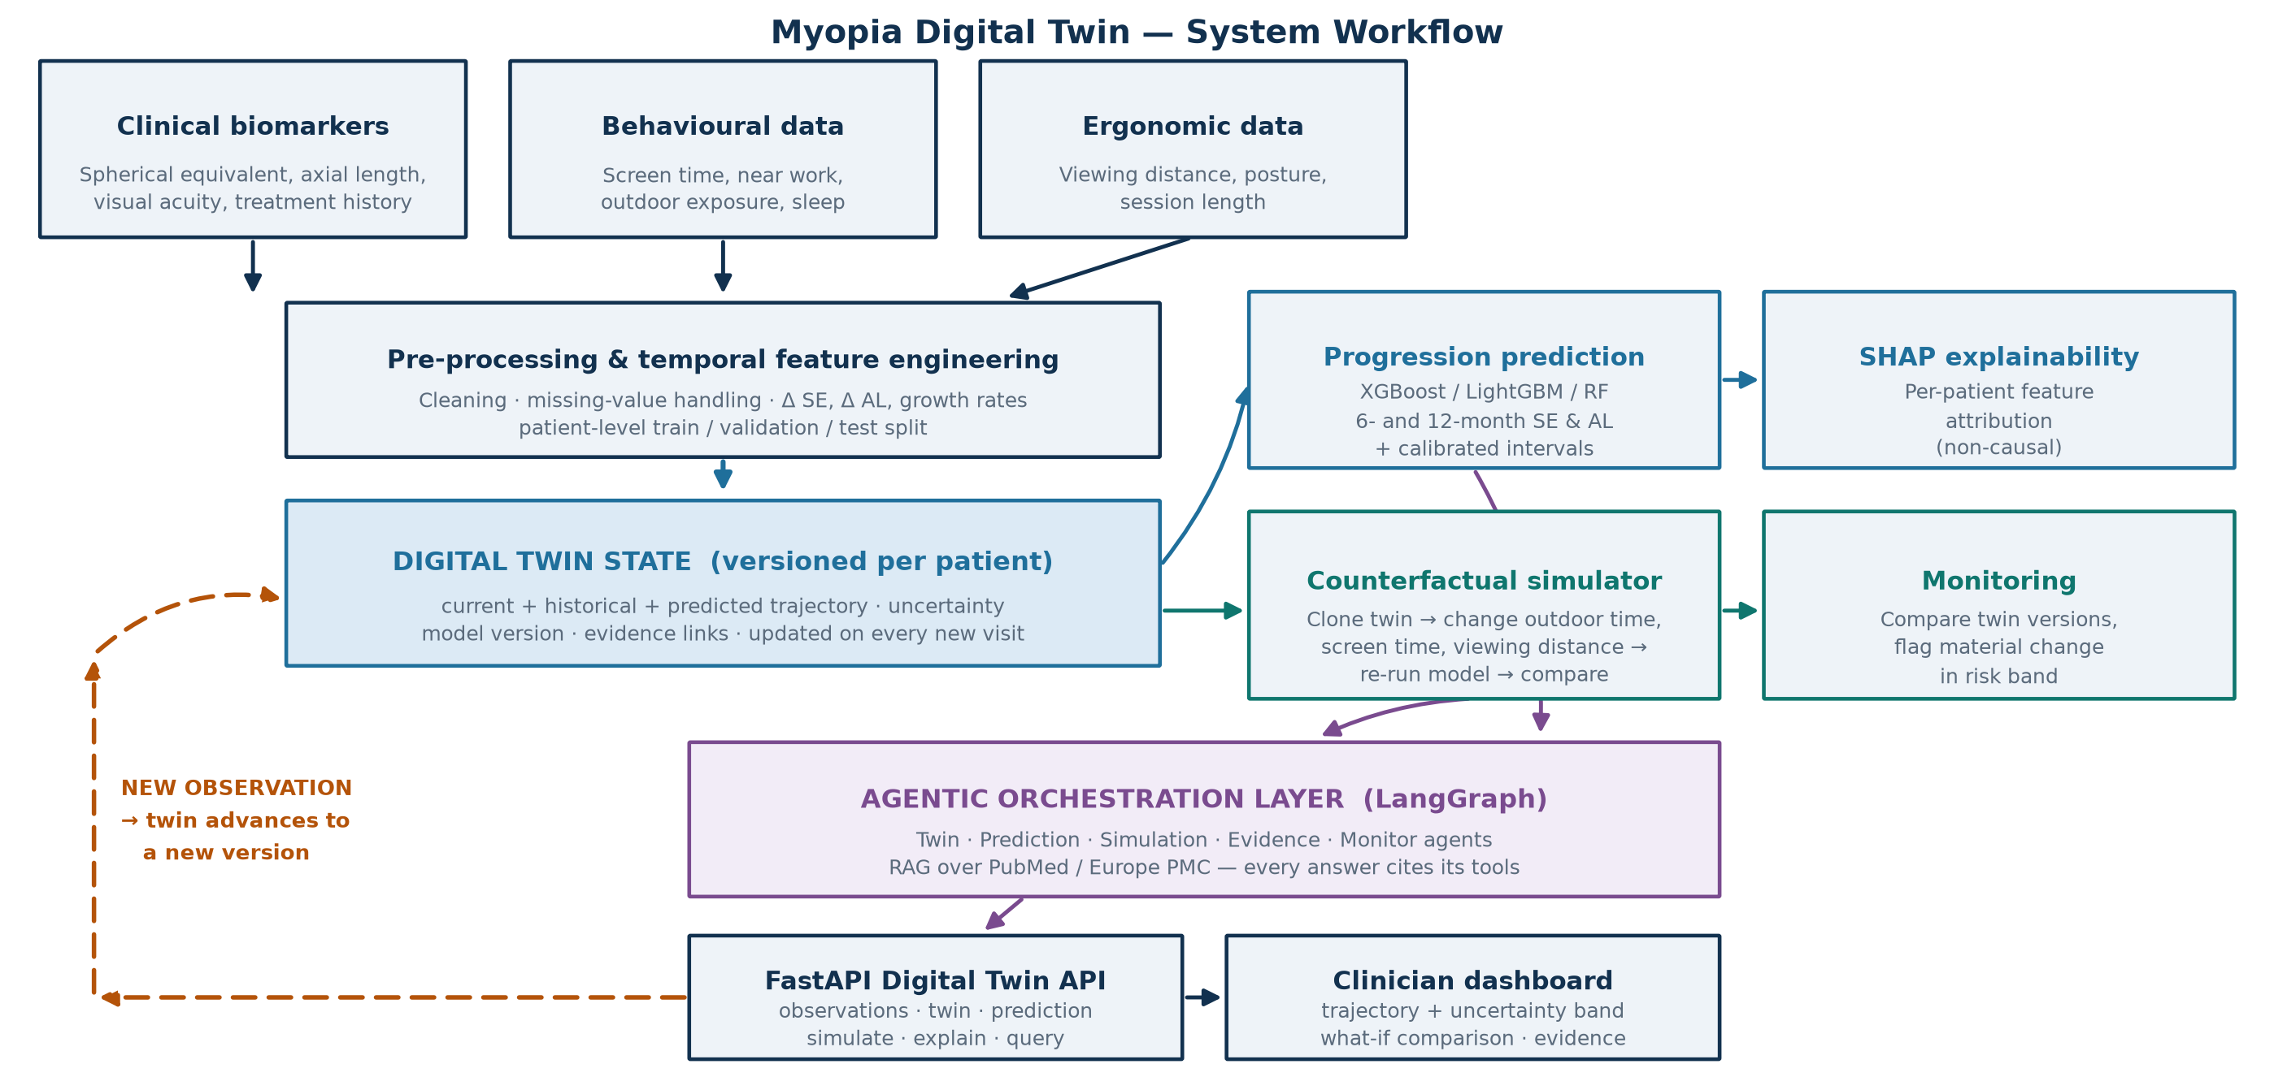
Methodology / Approach
• Ingest longitudinal clinical, behavioural and ergonomic observations
• Clean, validate, build temporal features; split by patient
• Update the versioned twin state on every new observation
• Predict 6/12-month SE and AL with intervals; attribute with SHAP
• Clone the twin, apply a what-if change, re-run the model, compare
• Orchestrate via LangGraph agents and RAG; expose through the API
Capstone Phase-1 – 1st Review – 12.09.2026
School of Engineering, Department of CSE (AI&ML), Dayananda Sagar University, Bengaluru - 562112.

Slide 16
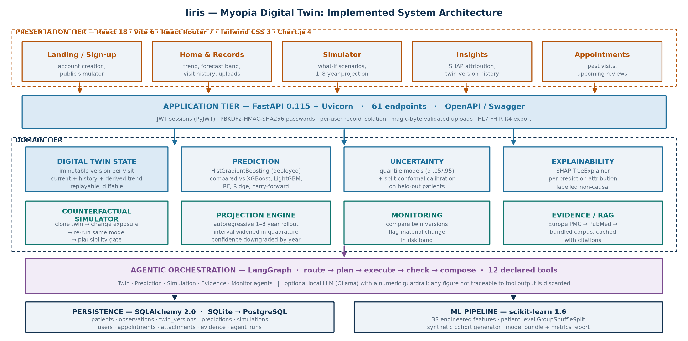
System Architecture (as implemented)
Capstone Phase-1 – 1st Review – 12.09.2026
School of Engineering, Department of CSE (AI&ML), Dayananda Sagar University, Bengaluru - 562112.

Slide 17
Implementation Status — What Runs Today
• Digital Twin state — every new observation writes an immutable version (v1, v2, v3 …). Any past state can be replayed exactly, and two versions can be diffed to flag a material change in the predicted trajectory.
• Prediction with honest uncertainty — quantile models are split-conformally calibrated on a held-out set of patients, lifting measured interval coverage from 0.72–0.77 to 0.91–0.93 against a nominal 0.90.
• Counterfactual simulator — clones the twin, applies an exposure change, rebuilds features with the same builder used in training and re-runs the same model. Implausible values are rejected with an error, never answered.
• Projection engine — rolls the twin forward 1–8 years autoregressively, widening the interval in quadrature at each step and downgrading the stated confidence from “modelled” to “projected” to “indicative”.
• Agentic layer — a LangGraph graph over 12 declared tools. The agent obtains facts only through tools; when a local LLM is attached, every number it writes must trace back to tool output or the generated text is discarded.
• Web application — accounts with JWT sessions, per-user record isolation, prescription photo upload with magic-byte validation, appointments, and FHIR export. 58 automated tests cover the whole loop.
Capstone Phase-1 – 1st Review – 12.09.2026
School of Engineering, Department of CSE (AI&ML), Dayananda Sagar University, Bengaluru - 562112.

Slide 18
Results Achieved So Far — Model Comparison
Target | Deployed (HistGB) | XGBoost | LightGBM | Random Forest | Ridge | Carry- forward
Spherical equivalent @ 6 m (MAE, D) | 0.070 | 0.067 | 0.067 | 0.067 | 0.052 | 0.188
Spherical equivalent @ 12 m (MAE, D) | 0.106 | 0.103 | 0.105 | 0.115 | 0.078 | 0.374
Axial length @ 6 m (MAE, mm) | 0.039 | 0.039 | 0.040 | 0.040 | 0.035 | 0.095
Axial length @ 12 m (MAE, mm) | 0.060 | 0.059 | 0.060 | 0.063 | 0.052 | 0.187
• Held-out test set of 120 patients (train 384 / validation 96), split by patient so no child appears in two splits. Progression-risk classifier: ROC-AUC 0.918, PR-AUC 0.812, Brier 0.093.
• Every model beats the carry-forward baseline (“assume nothing changes”) by a wide margin — the only comparison that shows a predictive model is worth having.
• Ridge currently has the lowest MAE because the synthetic generator is close to linear in its features. We report this rather than hide it; on real, noisier data the tree ensembles are expected to lead. HistGradientBoosting is deployed because it is the model that also supports quantile loss (needed for the interval) and NaN inputs (needed because behaviour is often unrecorded).
All figures on this slide come from the SYNTHETIC development cohort. They demonstrate that the pipeline works end to end; they are not clinical performance results.
Capstone Phase-1 – 1st Review – 12.09.2026
School of Engineering, Department of CSE (AI&ML), Dayananda Sagar University, Bengaluru - 562112.

Slide 19
Uncertainty Calibration and the Ablation Study
• Uncertainty calibration — raw quantile regression under-covered badly. A split-conformal correction fitted on validation patients repairs it:
  – Spherical equivalent @ 6 m: 0.754 → 0.912 Axial length @ 6 m: 0.773 → 0.926
  – Spherical equivalent @ 12 m: 0.722 → 0.908 Axial length @ 12 m: 0.731 → 0.918
• A stated “90% interval” now means approximately 90%. Without this step the system would have looked far more confident than it is.
• Ablation (identical splits, identical hyper-parameters) — does behaviour and ergonomics add value over biomarkers alone?
  – Clinical only: SE-12m MAE 0.109 · AL-12m MAE 0.060 · risk ROC-AUC 0.893
  – + behaviour: SE-12m MAE 0.112 · AL-12m MAE 0.062 · risk ROC-AUC 0.884
  – + ergonomics: SE-12m MAE 0.106 · AL-12m MAE 0.060 · risk ROC-AUC 0.915
• Reading it honestly: behaviour alone does not help regression on this cohort; the full set improves progression-risk classification. On synthetic data this demonstrates the experiment, not a clinical finding — the same protocol will be re-run on real data.
• Known limitation — the tail: the quantile and median models are fitted independently, so where the cohort thins out (below about −4 D) they begin to disagree and the point estimate sits near the edge of its own interval. Measured: well centred for 98% of rows between −1 and −3 D, off-centre for 55% below −4 D. The API detects and reports this per record rather than hiding it.
All figures on this slide come from the SYNTHETIC development cohort. They demonstrate that the pipeline works end to end; they are not clinical performance results.
Capstone Phase-1 – 1st Review – 12.09.2026
School of Engineering, Department of CSE (AI&ML), Dayananda Sagar University, Bengaluru - 562112.

Slide 20
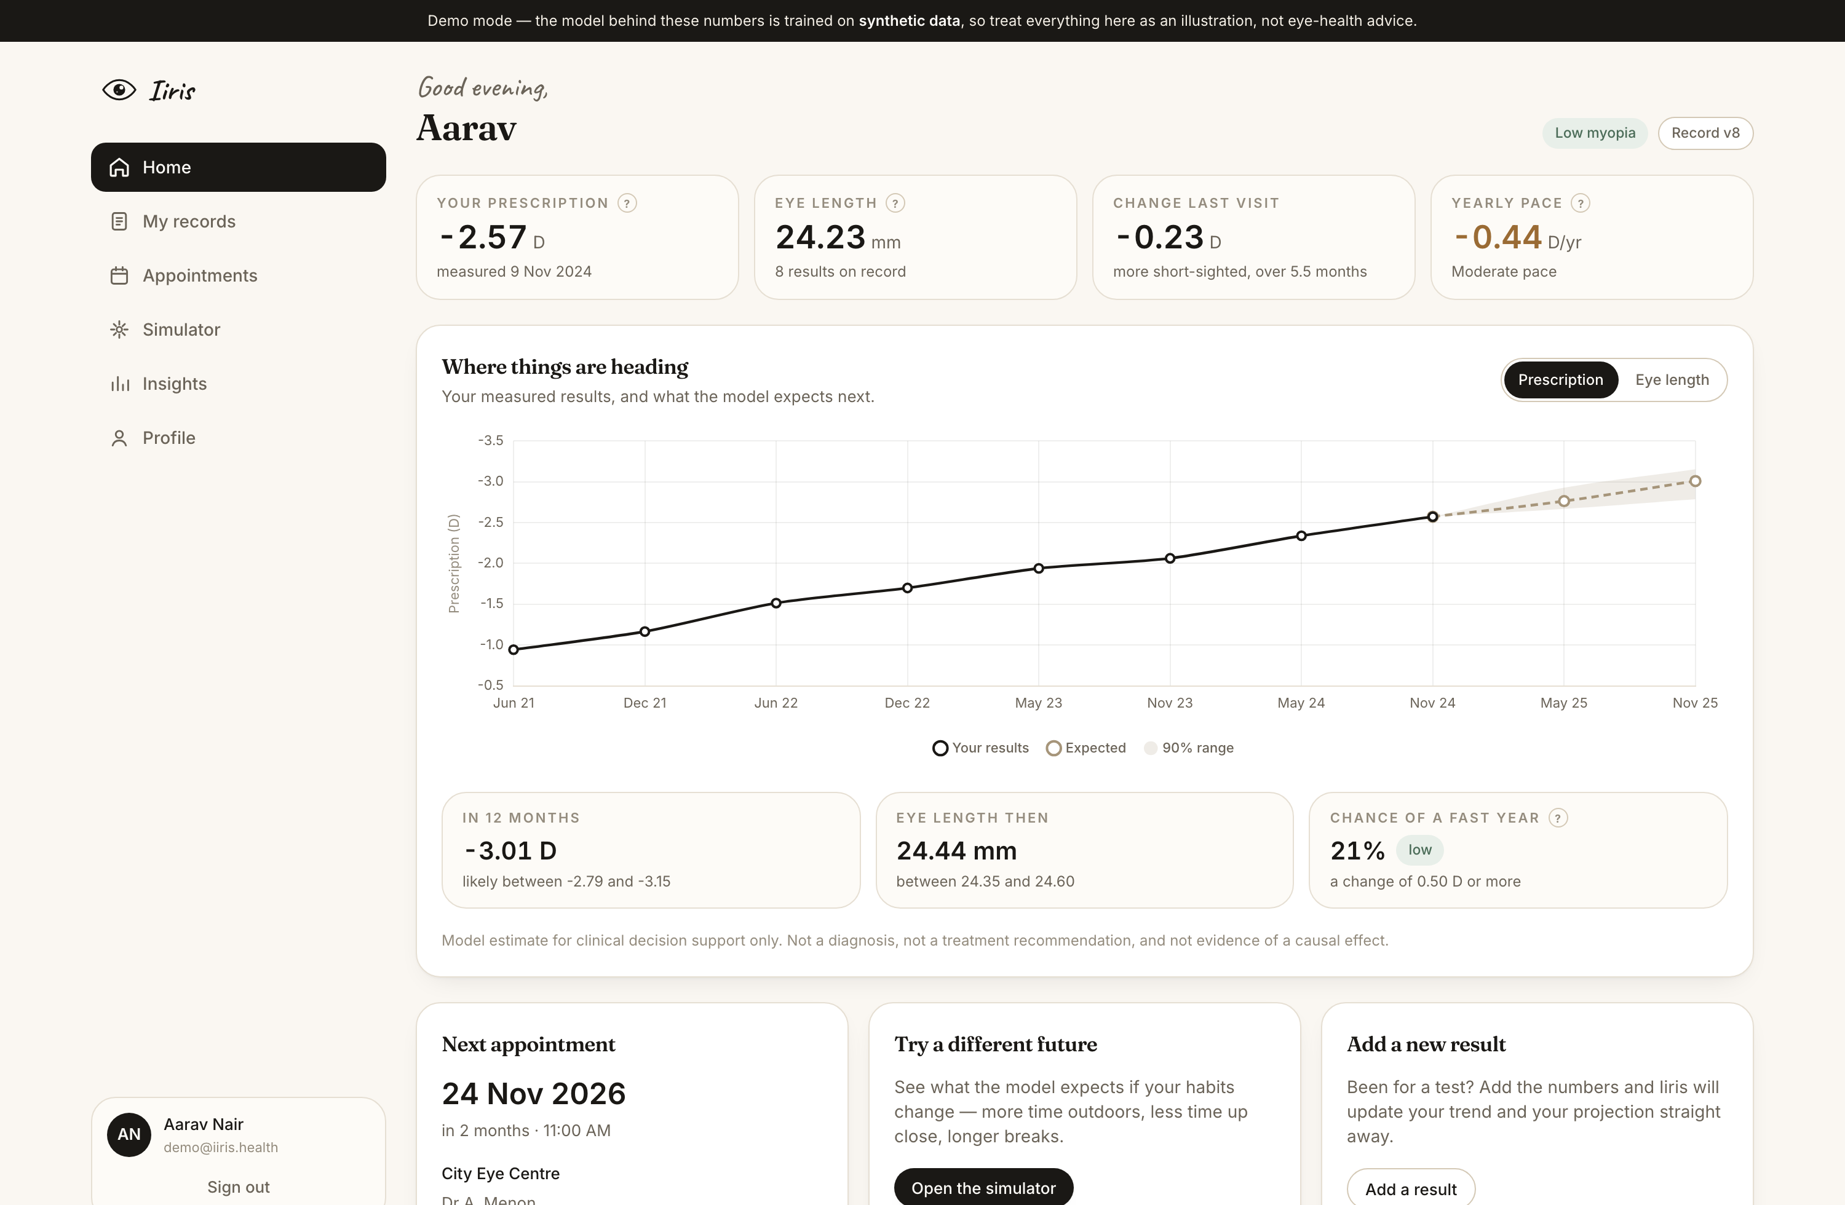
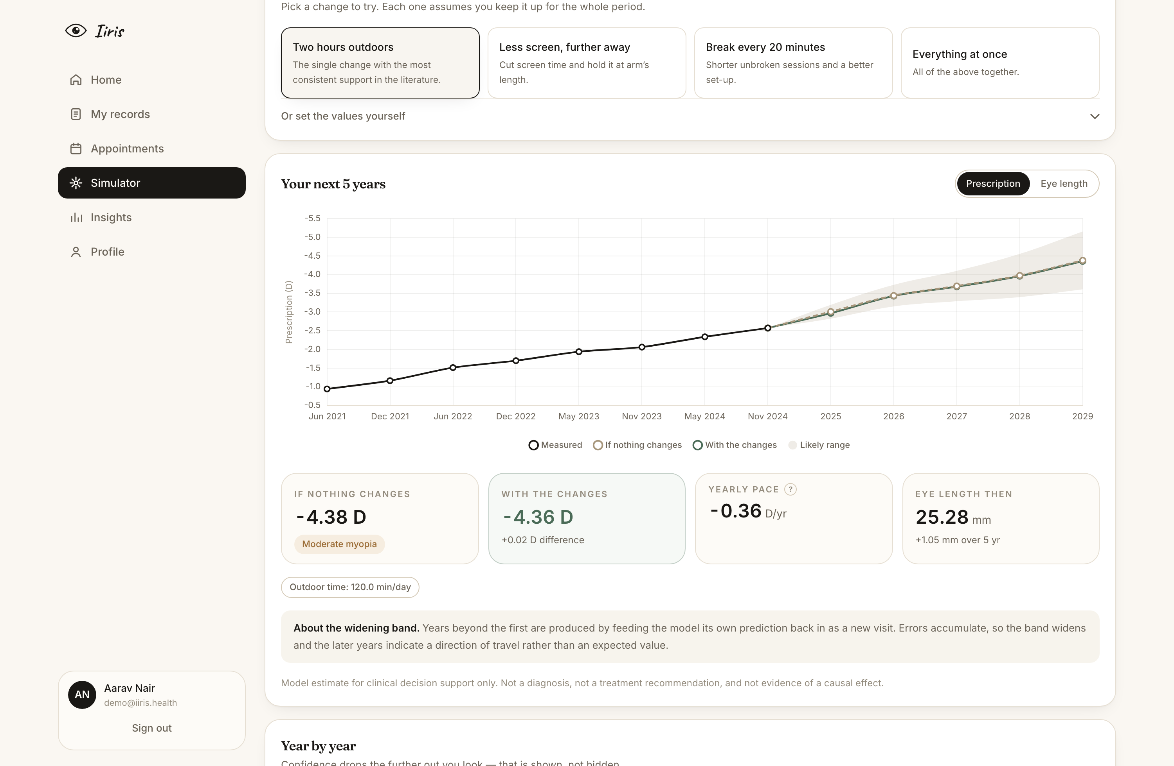
Prototype Walkthrough — “Iiris”
Home — cohort patient SYN00532: measured history, forecast with a 90% band, risk and next appointment
Simulator — baseline vs “two hours outdoors”, projected five years ahead
Live at http://localhost:5173 — the full loop (add a visit → twin version increments → predictions recompute) can be demonstrated in the review.
Capstone Phase-1 – 1st Review – 12.09.2026
School of Engineering, Department of CSE (AI&ML), Dayananda Sagar University, Bengaluru - 562112.

Slide 21
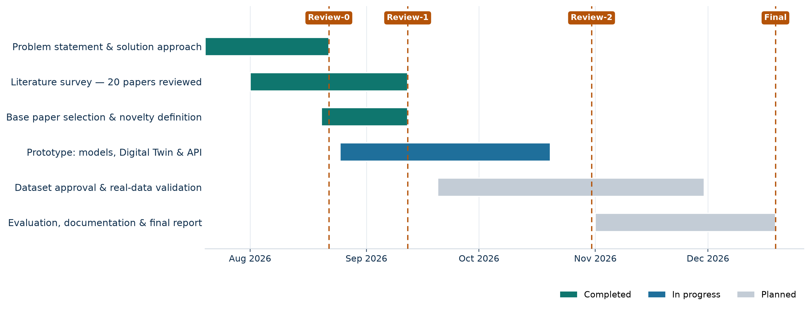
Timeline (Gantt Chart)
• Review-0 delivered the problem statement and the proposed solution approach.
• Review-1 delivers the literature survey (20 papers) and the base-paper selection with the novelty of the proposed work.
• Prototype implementation began early and is running ahead of plan; dataset approval is now the critical path to Phase-II.
Capstone Phase-1 – 1st Review – 12.09.2026
School of Engineering, Department of CSE (AI&ML), Dayananda Sagar University, Bengaluru - 562112.

Slide 22
References
[1] J. Huang et al., “Myopia prediction for children and adolescents via time-aware deep learning,” Scientific Reports, vol. 13, 5430, 2023. [BASE PAPER] doi.org/10.1038/s41598-023-32367-0
[2] S. Liu et al., “AI-guided personalized predictions on myopia progression and interventions,” npj Digital Medicine, vol. 9, 129, 2026. doi.org/10.1038/s41746-025-02308-4
[3] M. T. Kang et al., “Deep Learning Prediction of Childhood Myopia Progression Using Fundus Image and Refraction Data,” JAMA Network Open, vol. 9, e2553543, 2026. doi.org/10.1001/jamanetworkopen.2025.53543
[4] J. Li et al., “Accurate prediction of myopic progression and high myopia by machine learning,” Precision Clinical Medicine, vol. 7, pbae005, 2024. doi.org/10.1093/pcmedi/pbae005
[5] M. Gao et al., “Prediction of myopia onset and shift in premyopic school-aged children: a machine learning-based algorithm,” Frontiers in Medicine, vol. 12, 1646277, 2025. doi.org/10.3389/fmed.2025.1646277
[6] M. Hu et al., “Integrating biometric and multimodal imaging data for early prediction of myopia onset,” Scientific Reports, vol. 15, 31416, 2025. doi.org/10.1038/s41598-025-15605-5
[7] X. Zhang et al., “Predicting myopia risk using a machine learning model based on fundus imageomics,” Scientific Reports, vol. 15, 43729, 2025. doi.org/10.1038/s41598-025-27848-3
[8] J. Liang et al., “Global prevalence, trend and projection of myopia in children and adolescents from 1990 to 2050: a systematic review and meta-analysis,” British Journal of Ophthalmology, vol. 109, no. 3, pp. 362–371, 2025. doi.org/10.1136/bjo-2024-325427
[9] J. G. Lawrenson et al., “Interventions for myopia control in children: a living systematic review and network meta-analysis,” Cochrane Database of Systematic Reviews, vol. 2, CD014758, 2025. doi.org/10.1002/14651858.CD014758.pub3
[10] J. C. Yam et al., “Interventions to reduce incidence and progression of myopia in children and adults,” Progress in Retinal and Eye Research, vol. 109, 101410, 2025. doi.org/10.1016/j.preteyeres.2025.101410
Capstone Phase-1 – 1st Review – 12.09.2026
School of Engineering, Department of CSE (AI&ML), Dayananda Sagar University, Bengaluru - 562112.

Slide 23
References
[11] A. Kido et al., “Interventions to increase time spent outdoors for preventing incidence and progression of myopia in children,” Cochrane Database of Systematic Reviews, vol. 6, CD013549, 2024. doi.org/10.1002/14651858.CD013549.pub2
[12] J. Chen et al., “Smartwatch Measures of Outdoor Exposure and Myopia in Children,” JAMA Network Open, vol. 7, no. 8, e2424595, 2024. doi.org/10.1001/jamanetworkopen.2024.24595
[13] Y. Zougheib et al., “Effect of screen time and outdoor activities on myopia progression,” PLOS ONE, vol. 21, no. 5, e0347118, 2026. doi.org/10.1371/journal.pone.0347118
[14] S. Biswas et al., “The influence of the environment and lifestyle on myopia,” Journal of Physiological Anthropology, vol. 43, 7, 2024. doi.org/10.1186/s40101-024-00354-7
[15] R. Laubenbacher et al., “Digital twins in medicine,” Nature Computational Science, vol. 4, pp. 184–191, 2024. doi.org/10.1038/s43588-024-00607-6
[16] C. Sadée et al., “Medical digital twins: enabling precision medicine and medical artificial intelligence,” The Lancet Digital Health, vol. 7, 100864, 2025. doi.org/10.1016/j.landig.2025.02.004
[17] N. Mehandru et al., “Evaluating large language models as agents in the clinic,” npj Digital Medicine, vol. 7, 84, 2024. doi.org/10.1038/s41746-024-01083-y
[18] D. Ferber et al., “Towards autonomous medical artificial intelligence agents,” Nature, vol. 655, pp. 1282–1291, 2026. doi.org/10.1038/s41586-026-10675-5
[19] A. V. Ponce-Bobadilla et al., “Practical guide to SHAP analysis: Explaining supervised machine learning model predictions in drug development,” Clinical and Translational Science, vol. 17, no. 11, e70056, 2024. doi.org/10.1111/cts.70056
[20] S. J. Parreño et al., “Uncertainty-aware sepsis survival prediction using conformal XGBoost on minimal clinical features under Sepsis-3 criteria,” Computer Methods and Programs in Biomedicine, vol. 283, 109429, 2026. doi.org/10.1016/j.cmpb.2026.109429
Capstone Phase-1 – 1st Review – 12.09.2026
School of Engineering, Department of CSE (AI&ML), Dayananda Sagar University, Bengaluru - 562112.

Slide 24


