Slide 1
PromptGen
Divyansh Rajesh Jain, Varsha Sivaprakash
Notes:
problem statement, relevant prior work, your approach, and preliminary results. Has all

Slide 2
PromptGen: Problem Statement
Research Question:
Given a set of domain specific constraints, can we generate a large dataset of natural language question and answer pairs that can be used to verify or finetune an LLM?

Slide 3
Relevant Prior Work
VeriPlan:
A constraint based system for LLM auto self-verification for scheduling tasks. The user writes constraints, based on which the model schedules tasks and checks whether they meet constraints. Users on the loop to ensure correctness.
BERT Score:
Evaluation metric to compare natural language sentences semantically, ranging from 0-1, where higher the score means the more semantically close.

Slide 4
Preliminary Experiment Approach
Defined a set of constraints in a Prolog based system to declaratively generate question/answer datasets based on those constraints. The constraints were about United States geography
Evaluated over 400 prompts on the LLM, generated over 30000 prompts
Evaluation metrics:
BLEU scores and BERT precision, recall and F1 against baseline GeoBase
LLM evaluation on Llama 2 7B model

Slide 5
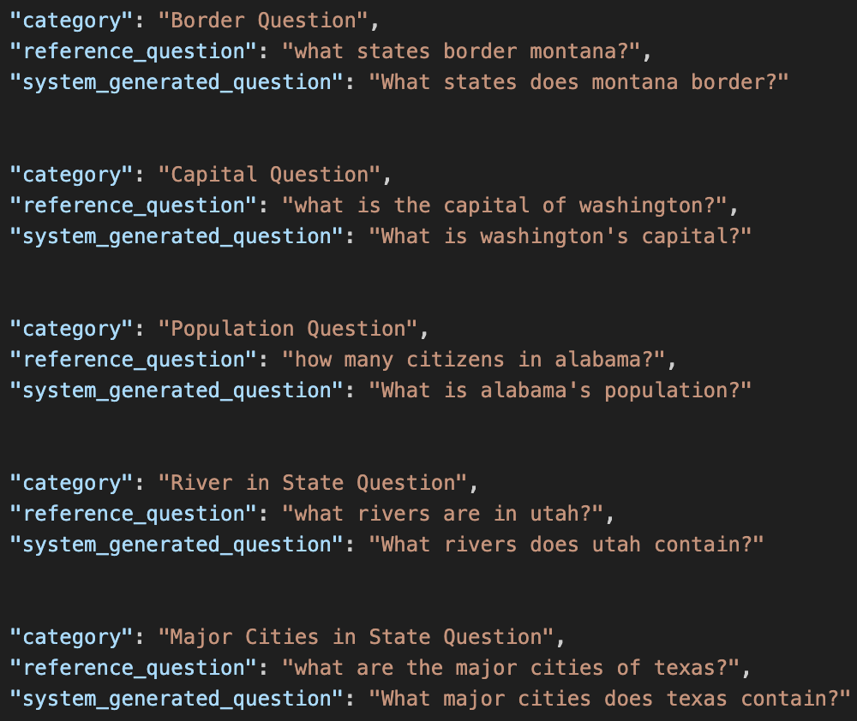
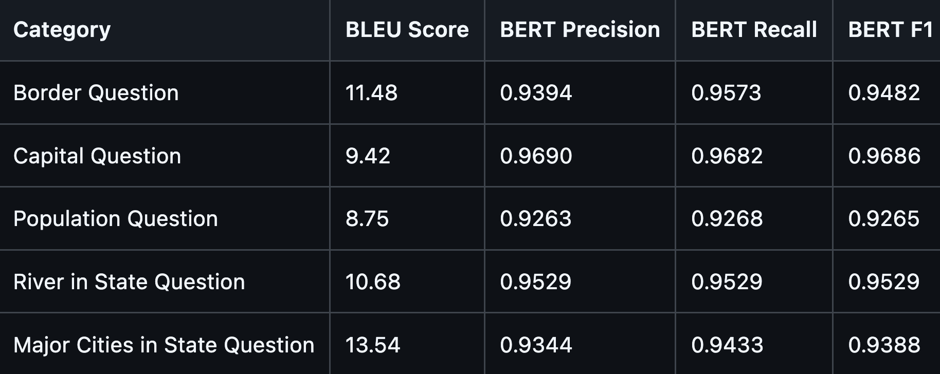
Preliminary Results 1: BLEU and BERT

Slide 6
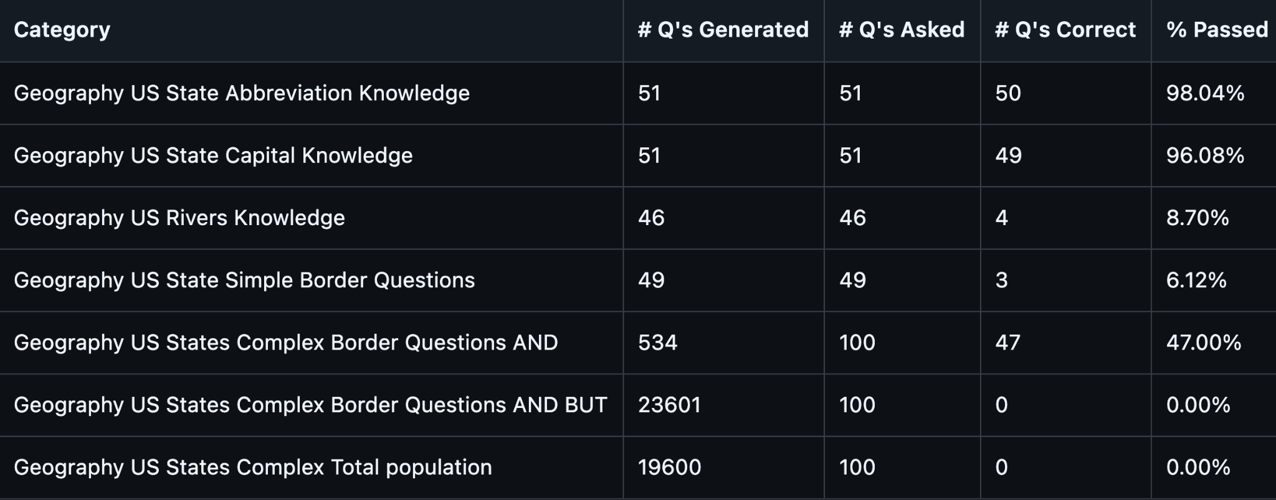
Preliminary Results 2: LLM Evaluation

Slide 7
LLM Evaluation Sample System Prompt
Category: Geography US Rivers Knowledge
System prompt: Please respond with answers formatted exactly like this (without quotes): the [River Name] river flows through [List of states river flows through in alphabetical order with an Oxford comma]. Replace [River Name] with the river mentioned in the prompt, and [List of states river flows through] with the actual states that the river flows through. Do not include any brackets, quotation marks, or other symbols in your answer. Respond with a single sentence only.

Slide 8
What do these results mean?

Slide 9
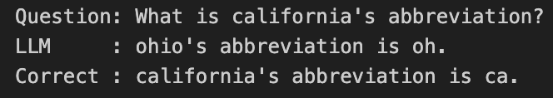
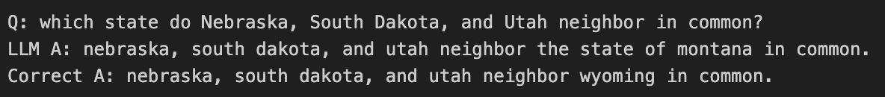
Example 1: LLM made a genuine mistake

Slide 10
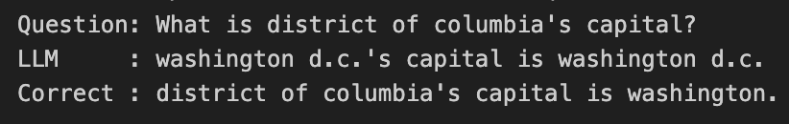
Example 2: Partially Correct Marked Wrong

Slide 11
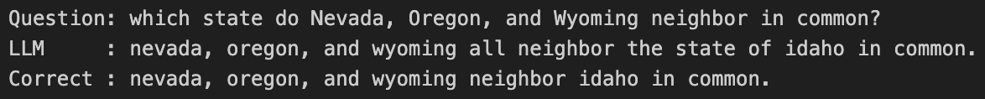
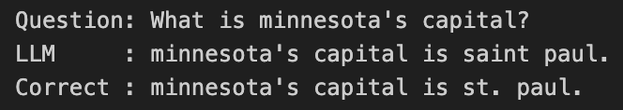
Example 3: Marked wrong even though correct

Slide 12
Thank You!

