Slide 1
PDF MultiModal Analysis
Turning Complex PDFs into Structured, AI-Ready Markdown
A reusable serverless pattern for extracting and describing
every chart, table, and figure — no images required.
Azure Durable Functions | Document Intelligence | GPT-5.2 Vision

Slide 2
The Problem
100+ Page PDFs
This Problem Is Everywhere
Enterprise documents are dense — clinical trials, financial reports, insurance claims, legal contracts.
Pharma — Clinical trial reports with dosage charts
Finance — Earnings reports with performance graphs
Insurance — Claims with damage assessment photos
Legal — Contracts with organizational charts
Healthcare — Lab results with diagnostic images
Manufacturing — Quality reports with spec diagrams
Government — Regulatory filings with statistical charts
Charts & Figures Everywhere
Critical data lives inside images: line charts, bar graphs, flow diagrams, annotated tables.
Text Extraction Isn't Enough
OCR and standard parsing miss the visual insights. Charts become empty placeholders.
Manual Review Doesn't Scale
Subject-matter experts can't review thousands of documents by hand.

Slide 3
The Solution
A serverless pipeline that converts any complex PDF into a fully self-contained Markdown file.
Parse
Describe
Assemble
Azure Document
Intelligence
GPT-5.2
Vision
Durable Functions
Orchestrator
Extract text, tables,
and crop every figure
as a PNG image.
Send each figure to a
multimodal LLM with
surrounding context.
Replace image placeholders
with AI descriptions.
Output: one .md file.
Output: A single Markdown file where every visual element has a precise textual description.
No images needed. Fully searchable. AI-ready.

Slide 4
Architecture: Fan-Out / Fan-In Pattern
1. HTTP Trigger — Client POSTs PDF bytes
Key Design Decisions
2. Upload to Blob Storage — pdf-input container
Durable Functions
No timeout limits. A 100-page PDF can take 30 min — the orchestrator checkpoints and resumes.
3. Parse PDF — Document Intelligence — prebuilt-layout model
Parallel Fan-Out
All figure descriptions run concurrently. Processing time = slowest single call (~15s), not N x 15s.
4. Fan-Out: Describe Figures — N parallel GPT-5.2 Vision calls (one per figure)
Context Window
~500 chars of surrounding text are sent with each figure, giving GPT crucial domain context.
5. Fan-In: Collect Descriptions — task_all() waits for all parallel calls
Metadata-Only Return
Full Markdown goes to blob storage, not through the orchestrator — avoids the 1 MB Table Storage limit.
6. Assemble Final Markdown — Replace placeholders with AI descriptions
Singleton Clients
SDK clients are initialized once per process, reused across invocations — reduces TCP/TLS overhead.
7. Save to Blob Storage — pdf-output container — return URL to client

Slide 5
A Reusable Pattern for Any Document-Heavy Workflow
Swap the domain prompt and the input format — the architecture stays the same.
1
Ingest
Example Adaptations
Accept document via HTTP or event trigger. Validate and store in Blob Storage.
Pharma
Clinical trial PDFs
Replace charts with
textual descriptions
2
Parse
Use Document Intelligence (or a domain-specific parser) to extract structure + visuals.
3
Fan-Out
Finance
Earnings reports
Extract KPIs from
graphs as structured data
Send each visual element to a multimodal LLM with surrounding context — all in parallel.
4
Fan-In
Insurance
Claims with photos
Describe damage
assessments in text
Collect all AI-generated descriptions. Handle failures gracefully with retry policies.
5
Assemble
Merge AI descriptions back into the structured output. Store final result.
Legal
Contracts + diagrams
Summarize org charts
and process flows

Slide 6
Azure Services at a Glance
Azure Durable Functions
Azure Document Intelligence
Azure OpenAI — GPT-5.2
Serverless orchestration with
checkpointing — no timeout limits
prebuilt-layout model extracts
text, tables, and figures as PNGs
Multimodal vision model describes
charts with pharma-grade precision
Azure Blob Storage
Azure Table Storage
Durable storage for input PDFs
and output Markdown files
Orchestration state checkpointing
(managed by Durable framework)
All services use connection-string auth locally and can switch to Managed Identity in production.
The pattern requires zero infrastructure beyond these five services.

Slide 7
Why This Matters
Fully Self-Contained Output
The Markdown file needs no images. A reader — human or AI — can understand the entire document from text alone. This makes the output ideal for RAG, search indexing, and downstream AI pipelines.
Scales to Any Volume
Serverless architecture means zero idle costs and automatic scaling. Process 1 PDF or 10,000 — the pattern handles both without infrastructure changes.
Domain-Agnostic Architecture
The fan-out/fan-in pattern is generic. Swap the system prompt from pharma to finance, insurance, or legal — the pipeline works unchanged.
Dramatically Faster Than Manual
A 100-page PDF with 30+ charts processes in under 5 minutes. A human analyst would need hours. Multiply by thousands of documents per quarter.
Production-Ready Resilience
Built-in retry policies, checkpoint-based orchestration, graceful fallbacks for failed figure extractions. No single failure kills the pipeline.

Slide 8
Next Steps
Improvements
The Key Takeaway
Use MarkItDown to support any document to Markdown
Use Vision GPT only for image processing
Every enterprise has complex PDFs.
This pattern — parse, fan-out, describe, fan-in, assemble — is the blueprint for turning any visual-heavy document into structured, AI-ready text.
It's not a one-off solution.
It's a reusable architecture.

Slide 9
Next Steps
Try It Today
The Key Takeaway
Deploy to your Azure subscription in under 30 minutes
Point it at your own PDFs — any industry, any domain
Customize the system prompt for your specific use case
Integrate the Markdown output into your RAG / search pipeline
Scale from proof-of-concept to production with zero architecture changes
Every enterprise has complex PDFs.
This pattern — parse, fan-out, describe, fan-in, assemble — is the blueprint for turning any visual-heavy document into structured, AI-ready text.
It's not a one-off solution.
It's a reusable architecture.
Built on Azure | Powered by AI | Ready for Production

Slide 10
File size limits
Due to HTTP transfer limits currently this pattern supports up to 200 MB file size.
For >200 MB files, either split up and upload or upload straight to blob storage and use blob events to trigger the process
Document intelligence support 500 MB files in paid (S0) tier.

Slide 11
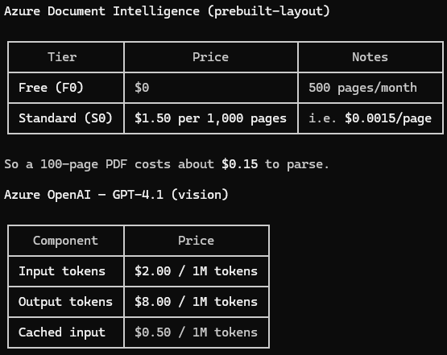
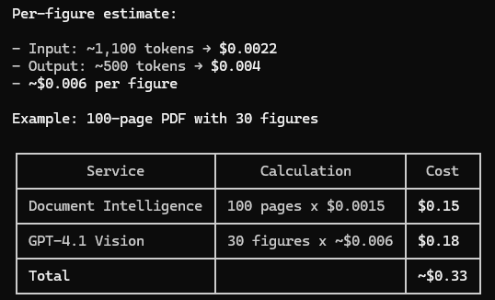
Pricing

