Slide 1
IT350-Presentation : Group 35
Real Time Image Caption Voice Generator
Presented by: -
Samyak Jain(201IT125)
Jatin Kholiya(201IT226)
Ajay Kumar(201IT106)
Under Guidance of :-
Dr. Anand Kumar M

Slide 2
Introduction
Real time image caption voice generator using deep learning involves using CNN to extract image features and a RNN to generate natural language descriptions.
It allows the model to learn underlying patterns and relationships between images and their descriptions, resulting in more accurate and natural language captions.
The technology has potential benefits for visually impaired individuals and researchers in fields such as healthcare and education.

Slide 3
Problem Statement
We are building a system that will first automatically generate an accurate and descriptive caption for an image in text format with the help of LSTM and CNN algorithms, and then we will convert that text into voice.
This type of system can be very useful for visually impaired people as they can understand the meaning of an image without actually seeing it.

Slide 4
Literature Survey
ICAC(2011) - Sumathi, Hemalatha “A combined hierarchical model for automatic image annotation and retrieval” used SVM and JEC. JEC for feature extraction and SVM for mapping important features.
URAI(2016) - Dong Kim, Donggeun Yoo, Bonggeun Sim, In So Kweon “Sentence Learning Deep CNN for image Generation” used CNN and RNN models. CNN for feature extraction and RNN for caption Generation.
GCAT(2019) - Varsha Kesavan, Vaidehi Muley, Megha Kolhekar “Deep Learning based Image caption Generation” used transfer learning approach(VCG16 algorithm) and RNN.

Slide 5
Dataset
It is consisting of 8,000 images that are each paired with five different captions which provide clear descriptions of the salient entities and events.
The images chosen from six different Flickr groups were manually selected to depict a variety of scenes and situations.
Flickr 8k Dataset

Slide 6
Methodology
Feature extraction
Tokenizing Vocabulary
Model building
Voice generation

Slide 7
Model
VGG16
LSTM

Slide 8
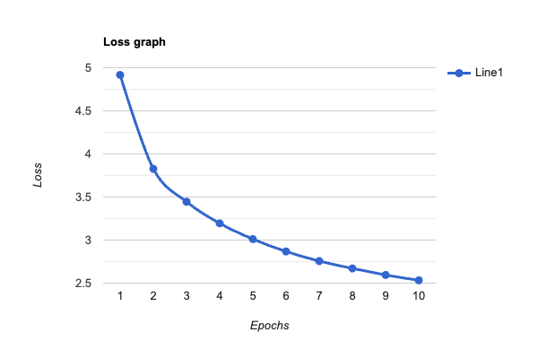
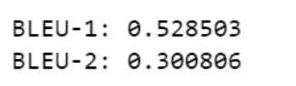
Results

Slide 9
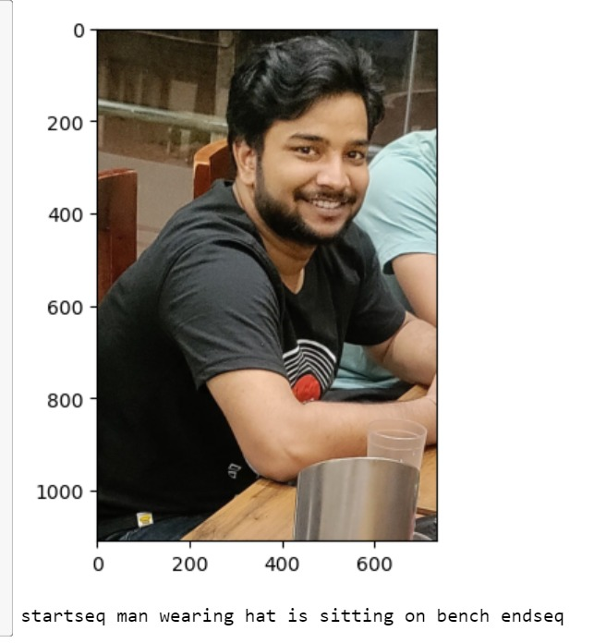
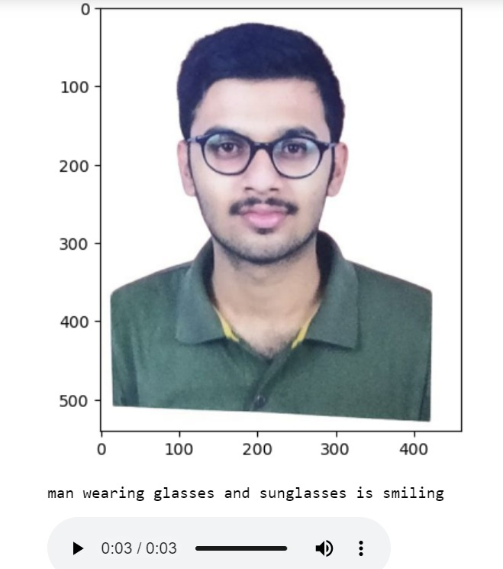
Results

Slide 10
References
T. Sumathi and M Hemalatha, "A combined hierarchical model for automatic image annotation and retrieval", ICAC-2011.
Dong-Jin Kim, Donggeun Yoo, Bonggeun Sim and In So Kweon, "Sentence Learning Deep convolutional neural Network for Image Caption Generation", 13th International Conference on URAI-2016.
Varsha Kesavan, Vaidehi Muley and Megha kolhekar, "Deep Learning based Image Caption Generation", GCAT-2019.
Ren C. Luo, Hsu Yu-Ting, Wen Yu-Cheng and Ye Huan-Jun, Visual Image Caption Generation for Service Robotics and Industrial Application, IEEE-2019.

Slide 11


