Slide 1
Silicon Valley User Group
Rick Flores
Meetup
23 Oct 2018, @ LG-Silicon Valley Lab
- AUTOSAR Confidential -

Slide 2
Agenda Overview
AUTOSAR Organization development
AUTOSAR Standards Roadmap
Working Group Reorganization
AUTOSAR Agreements – Intellectual Property Rights Review Proposal - Working Group in Silicon Valley
SV User Group

Slide 3


Geographical distribution of partners
Europe: 136
Core: 6
Premium: 29
Development: 30
Associate: 46
Attendee: 25
North America: 30
Core: 2
Premium: 6
Development: 4
Associate: 18
Attendee: 0
Asia: 100
Core: 1
Premium: 20
Development: 11
Associate: 67
Attendee: 1
Africa: 2
Core: 0
Premium: 0
Development: 2
Associate: 0
Attendee: 0
+ 14 candidates in progress

Slide 4
History and current state – Total: 268
+ 52 partners in 2018

Slide 5
Agenda Overview
AUTOSAR Organization development
AUTOSAR Platform Standards Roadmap
AUTOSAR Working Group Reorganization
AUTOSAR Agreements – Intellectual Property Rights Review
Proposal - Working Group in Silicon Valley
SV User Group

Slide 6
AUTOSAR Platform Roadmap
Acceptance
Tests
R1.2.0
Review of open RFCs
✓
Adaptive
Platform
R17-03
R17-10
R18-03
R18-10
R19-03
R19-10
✓
✓
✓
Classic
Platform
R4.3.0
R4.3.1
R4.4.0
R4.5.0
✓
✓
R1.0.0
R1.1.0
R1.2.0
R1.4.0
R1.5.0
Foundation
✓
✓
✓
✓
✓
R1.3.0
Q1/17
Q2/17
Q3/17
Q4/17
Q1/18
Q2/18
Q3/18
Q4/18
Q1/19
Q4/19
new contracts
✓
released
planned
on demand
Notes:
AUTOSAR
has new contracts since beginning of 2017 in order to consider source code development and an extended range for AUTOSAR applications
Classic Platform
In evolution mode w.r.t. lifecycle model
That means AUTOSAR still provides new features for the classic platform. There are several concepts planned for 4.4.0. (s. below)
Bugfixes are planned for Nov. 2017
Adaptive Platform
In development phase until Oct 2018. In contrast to the classic platform there are releases planned before the development phase ended. Each feature will have a quality attribute so that users can decide which features they already want to use.
Many features are planed for Oct. 2017.
First release is available since March 2017
Foundation
Foundation releases are related to both, classic and adaptive platform. In case of changes in one of these platforms the dependencies are checked and in case of a dependent change a foundation release is triggered on demand.
Since the foundation contains the meta model, many changes are expected during the development phase of the adaptive platform. Therefore a specific process has been defined by the modeling team.
Other parts of the foundation e.g. protocols are assumed to be very stable.
Acceptance Tests
The acceptance tests are in maintenance mode
Therefore a review of open RFCs is planned for mid of 2017 in order to decide whether a bugfix release is required.

Slide 7
Overview
AUTOSAR Organization development
AUTOSAR Standards Roadmap
AUTOSAR Working Group Reorganization
AUTOSAR Agreements – Intellectual Property Rights Review
Proposal - Working Group in Silicon Valley
SV User Group

Slide 8
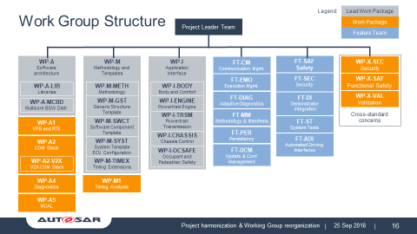
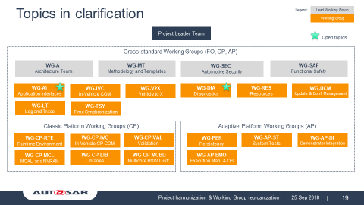
AUTOSAR Working Group Reorganization
Run the AUTOSAR organization with one system approach including synchronized Adaptive Platform and Classic Platform development
Merge of Work Packages and Feature Teams to Working Groups req. by process harmonization
Process & tooling harmonization
Reorganization is a basis for achieving a higher efficiency through a better resource assessment

Slide 9
Current AUTOSAR Organization
Support Functions
Project Organization
Project Management
Executive Board
Technical Management
Quality Management
Steering Committee
Specification Management
Change Management
Administration
Legal Team
Project Leader Team
Communication Team
Release Management
Quality Assurance
Requirements Mgnt
OSS-CB Open Source CB
CF-CCB Consensus Finding CCB
CCB
Change Control Board
Work Packages
Feature Teams
User Groups
Engineering
Technical Office
SW Dev. Engineering
Legend
Core Partner
Core Partner, Premium and Development Partner
All partners including Associate Partners
Subcontractor

Slide 10
AUTOSAR Organizational Structure in 2019
Support Functions
Only Working Groups, wording according to AUTOSAR Development Agreement
Project Organization
Project Management
Comm. Support added
Executive Board
Technical Management
Quality Management
Steering Committee
Specification Management
Change Management
Administration
Communication Support
Release Management
Legal Team
Project Leader Team
Communication Team
Quality Assurance
Requirements Mgnt
Engineering
OSS-CB Open Source CB
CF-CCB Consensus Finding CCB
CCB
Change Control Board
Working Groups
User Groups
Technical Office
SW Dev. Engineering
Legend
Core Partner
Core Partner, Premium and Development Partner
All partners including Associate Partners
Subcontractor

Slide 11
Work Group Structure
Legend:
Lead Work Package
Project Leader Team
Work Package
Feature Team
WP-A
Software architecture
WP-M
Methodology and Templates
WP-I
Application
Interface
FT-SAF
Safety
.
Cross-standard concerns
FT-CM
Communication Mgmt.
WP-X-SEC
Security
FT-EMO
Execution Mgmt.
FT-SEC
Security
.
WP-X-SAF
Functional Safety
WP-A-LIB
Libraries
WP-M-METH
Methodology
WP-I-BODY
Body and Comfort
FT-DIAG
Adaptive Diagnostics
FT-DI
Demonstrator
Integration
WP-X-VAL
Validation
WP-A-MCBD
Multicore BSW Distr.
WP-M-GST
Generic Structure Template
WP-I-ENGINE
Powertrain Engine
WP-I-TRSM
Powertrain Transmission
FT-MM
Methodology & Manifests
WP-A1
VFB and RTE
WP-M-SWCT
Software Component Template
FT-ST
System Tests
WP-I-CHASSIS
Chassis Control
FT-PER
Persistency
WP-A2
COM Stack
WP-M-SYST
System Template ECU Configuration
FT-ADI
Automated Driving
Interfaces
WP-I-OCSAFE
Occupant and Pedestrian Safety
FT-UCM
Update & Conf
Management
WP-A2-V2X
V2X COM Stack
WP-M-TIMEX
Timing Extensions
WP-A4
Diagnostics
WP-M1
Timing Analysis
WP-A5
MCAL

Slide 12
Legend:
Lead Working Group
New Work Group structure
Working Group
Project Leader Team
Cross-standard Working Groups (FO, CP, AP)
WG-A
Architecture Team
WG-MT
Methodology and Templates
WG-SEC
Automotive Security
WG-SAF
Functional Safety
WG-AI
Application Interfaces
WG-IVC
In-Vehicle COM
WG-V2X
Vehicle to X
WG-DIA
Diagnostics
WG-RES
Resources
WG-UCM
Update & Conf. Management
WG-LT
Log and Trace
WG-TSY
Time Synchronization
Classic Platform Working Groups (CP)
Adaptive Platform Working Groups (AP)
WG-CP-RTE
Runtime Environment
WG-CP-IVC
In-Vehicle CP COM
WG-CP-VAL
Validation
WG-PER
Persistency
WG-AP-ST
System Tests
WG-AP-DI
Demonstrator Integration
WG-CP-MCL
MCAL and NVRAM
WG-CP-LIB
Libraries
WG-CP-MCBD
Multicore BSW Distr.
WG-AP-EMO
Execution Man. & OS

Slide 13
New AUTOSAR Working Groups
Legend:
Lead Working Group
Working Group
Project Leader Team
Cross-standard Working Groups (FO, CP, AP)
WG-A
Architecture Team
WG-MT
Methodology and Templates
WG-SEC
Automotive Security
WG-SAF
Functional Safety
Refine architectural requirements with one concept process
Use one common change process for CP and AP
Release and Review CP and AP in parallel
Combine to System view in Working Groups
WG-AI
Application Interfaces
WG-IVC
In-Vehicle COM
WG-V2X
Vehicle to X
WG-DIA
Diagnostics
WG-RES
Resources
WG-UCM
Update & Conf. Management
WG-LT
Log and Trace
WG-TSY
Time Synchronization
Classic Platform Working Groups (CP)
Adaptive Platform Working Groups (AP)
WG-CP-RTE
Runtime Environment
WG-CP-IVC
In-Vehicle CP COM
WG-CP-VAL
Validation
WG-PER
Persistency
WG-AP-ST
System Tests
WG-AP-DI
Demonstrator Integration
WG-CP-MCL
MCAL and NVRAM
WG-CP-LIB
Libraries
WG-CP-MCBD
Multicore BSW Distr.
WG-AP-EMO
Execution Man. & OS

Slide 14
Platform specific teams - Rationale
Classic Platform Working Groups (CP)
RTE:
Abstracts standardized BSW interfaces, monolithic approach
for entire CP BSW implementation.
MCAL:
Stable hardware related interface with strong coherence to
Classic Platform.
Validation:
Specific approach to contract suppliers for CP validation
Libraries:
CP specific libraries
MCBD:
Multi-Core approach in Classic Platform
Adaptive Platform Working Groups (AP)
EMO:
Strong relationship to POSIX OS and abstraction of hardware
related technologies.
System Test:
Adaptive Platform specific tests based on Demonstrator
Implementation
Demonstrator Integration:
SW-Integration of Adaptive Platform Demonstrator code.

Slide 15
Definitions
WG (Working Group)
Tasks/responsibilities:
Expert statements
Responsibility for specifications (RS, SWS, TPS, AUX, EXP, …)
Controlling document ownerships
Maintenance of documents
Integration of new concept features
Assessment and focus on Working Group related concepts
Organization:
To be initiated by PL Team, to be approved by SC
Speaker required
PL Coach required
Regular reporting to Lead WP and PL Team

Slide 16
Definitions
Lead Working Group
Tasks/responsibilities:
Tasks/responsibilities as defined for “WG”
Harmonize technical contents, resolve technical conflicts of working groups and concepts
Definition of technical tasks
Controlling of technical work progress
Evaluation of technical work results
Assignment and assessment of all standard related concepts
Mandatory vote in CCB
Organization:
To be initiated by PL Team, to be approved by SC
Speaker required
PL Coach required
Regular reporting to PL team

Slide 17
Definitions
Control Board
Tasks/responsibilities:
Controlling task within AUTOSAR processes (e.g. CM, QM, RM), defined with process description
Organization:
To be initiated by PL Team or SC
Representatives from WGs for required expertise
Supervised by Change Management
Reporting according to defined escalation path in process description

Slide 18
Overview
SV User Group
AUTOSAR Organization development
AUTOSAR standard Roadmap
AUTOSAR Working Group Reorganization
AUTOSAR Agreements – Intellectual Property Rights Review
Proposal - Working Group in Silicon Valley

Slide 19
AUTOSAR Agreement: Intellectual Property Rights
22.08.2018
- AUTOSAR Confidential -

Slide 20
AUTOSAR Agreement: Management Summary
This document supports the reading of the original AUTOSAR Agreement, but it does not replace it. The AUTOSAR Agreement remains the legally valid document and overrides any inconsistencies in this document.
Contrary to Open Invention Network (OIN), AUTOSAR develops a whole standard with partners from the industry, instead of buying project-related patents for free use.
The activity of the AUTOSAR development cooperation focuses on software platform development. The scope of a release will be detailed in specific project plans in advance to a project start.
Due to the working and cooperation partner structure, the AUTOSAR agreement covers the topics of IP rights, License for Development, License for Exploitation and Non-Assertion. The aim is to ensure all AUTOSAR products (exemplary software, specifications) are available for all partners.
Other AUTOSAR partners are not in general allowed to use your IP. In fact only Essential IP, and/or IP in your contribution to the AUTOSAR Software Implementation can be used royalty-free by other partners in commercial products.

Slide 21





AUTOSAR Agreement: Cooperation partner structure
A tier structure, proven in similar initiatives, is implemented for the development cooperation. Appropriate rights and duties are allocated to the various tiers. The Associate and Development Partnership are most likely of interest to you:
CORE PARTNERS
PREMIUM PARTNERS
ASSOCIATE PARTNERS
DEVELOPMENT PARTNERS
ATTENDEES
Make only use of the AUTOSAR standard
An opportunity for start-ups to contribute with expertise in working groups

Slide 22
AUTOSAR Working Structure
Exemplary Software
A
SW
B
SW
Released for use for all AUTOSAR Partners
SW
C
SW
D
Company D contributes its own software
Company D decides what they want to contribute
Company D gives the IP rights from their software contribution to the Core Partners
AUTOSAR companies don‘t claim IP Rights among each other (Non-Assertion)
Contributor from Company x
x

Slide 23
AUTOSAR Working Structure
Specifications
Released for use for all AUTOSAR Partners
Requirement in AUTOSAR Specifications
AUTOSAR companies don‘t claim IP Rights among each other (Non-Assertion)

Slide 24


AUTOSAR Agreement: IP Handling Differences – Overview and comparison with OIN*
 | Development/Premium Partner | Associate Partner | OIN
License for development
License for exploitation
Non-Assertion
* OIN is a patent pool and community of patent non-aggression which enables freedom of action in Linux.

Slide 25

The fineprint for your favorite legal representative

Slide 26
OIN: Intellectual Property Rights
“[…] OIN, grants to You and Your Subsidiaries a royalty-free, worldwide, nonexclusive, non-transferable license under OIN Patents to make, have made, use, import, and Distribute any products or services. […]”
“[…] You, on behalf of yourself and your Affiliates, (a) grant to each Licensee and its Subsidiaries that are Subsidiaries as of the Eligibility Date a royalty-free, worldwide, nonexclusive, non-transferable license under Your Patents for making, having made, using, importing, and Distributing any Linux System; and (b) represent and warrant that (i) You have the full right and power to grant the foregoing licenses and the release in Section 1.4 and that Your Affiliates are and will be bound by the obligations of this Agreement; and (ii) neither You nor any of Your Affiliates has a Claim pending against any Person for making, having made, using, importing, and Distributing any Linux System”
See https://www.openinventionnetwork.com/joining-oin/oin-license-agreement/

Slide 27
AUTOSAR Agreement: IP Handling Differences – Intellectual Property Rights
“All Intellectual Property Rights created solely by employees of the <Attendee/Development/Premium Partner> in pursuance of this Agreement shall belong exclusively to that partner and it shall have the right to make applications for protection.”
“All Intellectual Property Rights created jointly by employees of the <Attendee/Development/Premium Partner> together with any Core Partner or any other partner or Attendee, in pursuance of this Agreement (“Joint IPR”) shall be jointly owned by those having at least one joint creator (the “Participating Parties”). The Participating Party which becomes first aware thereof, shall inform the other Participating Party or parties on a confidential basis about this fact and each Participating Party shall ensure that all rights necessary to fulfill this Agreement have been or will be acquired from its co-creator(s).”
ATTENDEES
DEVELOPMENT
PARTNERS
PREMIUM PARTNERS
See “Licensing of Intellectual Property Rights” in the agreement
Notes:
Intellectual property (IP) is a category of property that includes intangible creations of the human intellect. That “means inventions, patents, designs, (registered or otherwise), Know-how, copyrights and respective use and exploitation rights deriving therefrom, other works of authorship and similar rights, statutory or otherwise, together with applications therefor.”

Slide 28
AUTOSAR Agreement: IP Handling Differences – License for Development
“Each Core Partner grants to the Attendee and the Attendee grants to each Core Partner, Premium Partner, Development Partner and Attendee, during the term of this Agreement, a non-exclusive, non-transferable license, without the right to grant sublicenses, under all of its Intellectual Property Rights for the purpose of the development of AUTOSAR. No party shall be obliged to specify which of its’ Intellectual Property Rights could be used for the development of AUTOSAR.”
The Development and Premium Partner as well as the Attendees work together with the Core Partners on the development of the AUTOSAR software standard, while Associate Partners only use it. Thus, Associate Partners don’t need a License for Development.
ATTENDEES
DEVELOPMENT
PARTNERS
PREMIUM PARTNERS
See “Licensing of Intellectual Property Rights” in the agreement

Slide 29
AUTOSAR Agreement: IP Handling Differences – License for Exploitation
“Licensing of Intellectual Property Rights
The <Attendee/Development/Premium Partner> grants to each Core Partner, a non-exclusive, non-transferable license, with the right to grant sublicenses solely as set forth in clauses 5.5 / 5.9 and 5.6 / 5.10, under its Essential Intellectual Property Rights and its Intellectual Property Rights resulting from its contributions to the AUTOSAR Software Implementations, for the purpose of commercially exploiting AUTOSAR / AUTOSAR Work for Automotive and Derived Applications […]”
“Each Core Partner grants to the Associate Partner a non-exclusive, non-transferable license, with the right to grant sublicenses solely as set forth in clause 4.9, under its Essential Intellectual Property Rights and its Intellectual Property Rights resulting from its contributions to the AUTOSAR Software Implementations, for the purpose of commercially exploiting AUTOSAR Work for Automotive and Derived Applications. […]”
ATTENDEES
DEVELOPMENT
PARTNERS
PREMIUM PARTNERS
ASSOCIATE PARTNERS
See “Licensing of Intellectual Property Rights” in the agreement

Slide 30
AUTOSAR Agreement: IP Handling Differences – Non-Assertion
“The Associate Partner agrees not to assert any Intellectual Property Rights against any Core Partner, any Premium Partner, any Development Partner, any Attendee and against any other party licensed by the Core Partners in respect of the development of AUTOSAR.”
“The <Associate/Attendee/Development/Premium> Partner agrees, for Automotive and Derived Applications, not to assert,
any Essential Intellectual Property Rights and its Intellectual Property Rights resulting from its contributions to the AUTOSAR Software Implementations against the commercial exploitation of AUTOSAR Work; and/ or
any of its trademarks, brand, logo, or similar rights, against the use of the AUTOSAR trademark against any Core Partner, any Premium Partner, any Associate Partner, any Development Partner and against any other Third Party licensed by the Core Partners to exploit AUTOSAR Work commercially.”
“Any beneficiary of this non-assertion may enforce it for its own benefit, provided that it grants similar non-assertion commitments to the <Attendee/Development Partner/Premium Partner> or properly obligated successors in rights to the respective intellectual property.”
ATTENDEES
DEVELOPMENT
PARTNERS
PREMIUM PARTNERS
ASSOCIATE PARTNERS
See “Licensing of Intellectual Property Rights” in the agreement

Slide 31
Definitions
Intellectual Property (IP) Rights
means inventions, patents, designs, (registered or otherwise), Know-how, copyrights and respective use and exploitation rights deriving therefrom, other works of authorship and similar rights, statutory or otherwise, together with applications therefor.
Know-how
means technical information relating to AUTOSAR.
Essential
means, with respect to Intellectual Property Rights, those claims or elements of such Intellectual Property Right which are necessary for a product to be in accordance with the requirements (including none, some or all optional requirements) of AUTOSAR Specifications.
For the purpose of clarification, Intellectual Property Rights necessary for implementing supplementary and exemplary elements (e.g. reference models, "use cases", and/or references to exemplary technical solutions, devices, processes or software) of AUTOSAR Specifications are not Essential.

Slide 32
© 2018 by AUTOSAR All rights reserved. Confidential and proprietary document.
This document and all information contained herein is the sole property of AUTOSAR. No intellectual property rights are granted by the delivery of this document or the disclosure of its content. This document shall not be reproduced or disclosed to a third party without the express written consent of AUTOSAR. This document and its content shall not be used for any purpose other than that for which it is supplied.
The statements made herein do not constitute an offer. They are based on the mentioned assumptions and are expressed in good faith. Where the supporting grounds for these statements are not shown, AUTOSAR will be pleased to explain the basis thereof.

Slide 33
Overview
SV User Group
AUTOSAR Organization development
AUTOSAR standard Roadmap
AUTOSAR Working Group Reorganization
AUTOSAR Agreements – Intellectual Property Rights Review
Proposal - Working Group in Silicon Valley

Slide 34
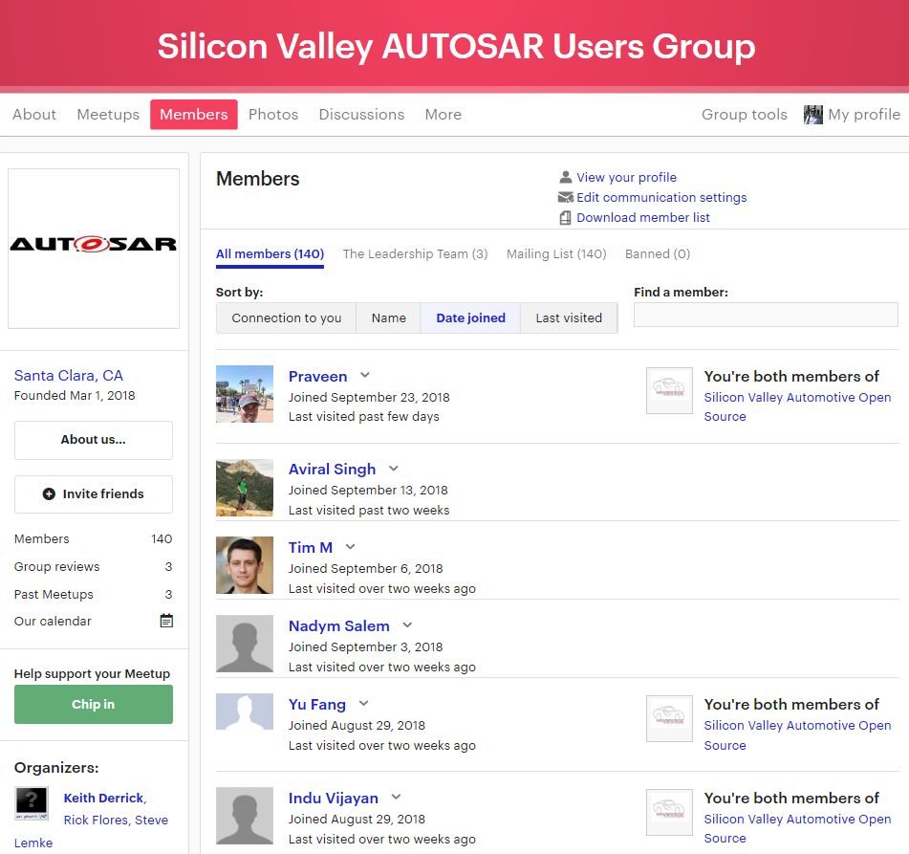
Getting Started
In Silicon Valley, ‘Meetups’ are the most common method of forming groups with like-minded individuals to discuss/ share experiences, etc.
Silicon Valley AUTOSAR User Group initiated to discover user interests
Initially, more open on the technical topic before getting into a clear technical focus

Slide 35
Silicon Valley Users Group
Kickoff meeting - April 3, 2018, LG, Santa Clara, CA
Spokesperson – Keith Derrick, LG Silicon Valley Labs
Three meetings (Meetups) held in 2018 with 139 members

Slide 36
Silicon Valley Users Group
Next meeting to be held on October 23rd
We will describe the recent changes in Working Group structure, and to launch active recruiting for a new working group based in Silicon Valley.
Rick Flores will be one of the presenters
AUTOSAR Agreement: Intellectual Property Rights prepared by AUTOSSAR Comm Support team
The SV UG Mailing list will also go live at that time, allowing questions from all User Group members (regardless of AUTOSAR membership).

Slide 37
Working Group in SV Next Steps
After considering potential areas of focus for a Silicon Valley-based Working Group, the topic of Cloud Services has been identified – WG-AP-CLD
Takes advantage of the wide skill set available in this area
There are other standardization bodies in the area that are interested in collaborating e.g. Industrial Internet Consortium
There is a need to define appropriate Visions
At present there is only AP-383, which is vague.
Additional visions will give direction to to the new working group

