Slide 1
Inventory Management
From Marēana

Slide 2
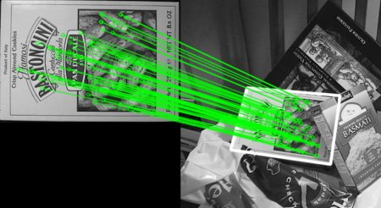
Object Detection
Using feature matching algorithms
Scale & perspective invariant
Notes:
Firstly, we use computer vision and feature-matching algorithms (such as SIFT or SURF) to determine whether a given item is present in both images (a ’training’ image and the ‘testing’ image). If the algorithm finds a sufficient number of matches, we know that the item is present in both images.
The key benefit of the feature matching technique is that it would be scale and perspective invariant, making it easier to correctly detect an object even when the item in the training and testing images have a different scale or rotation.

Slide 3
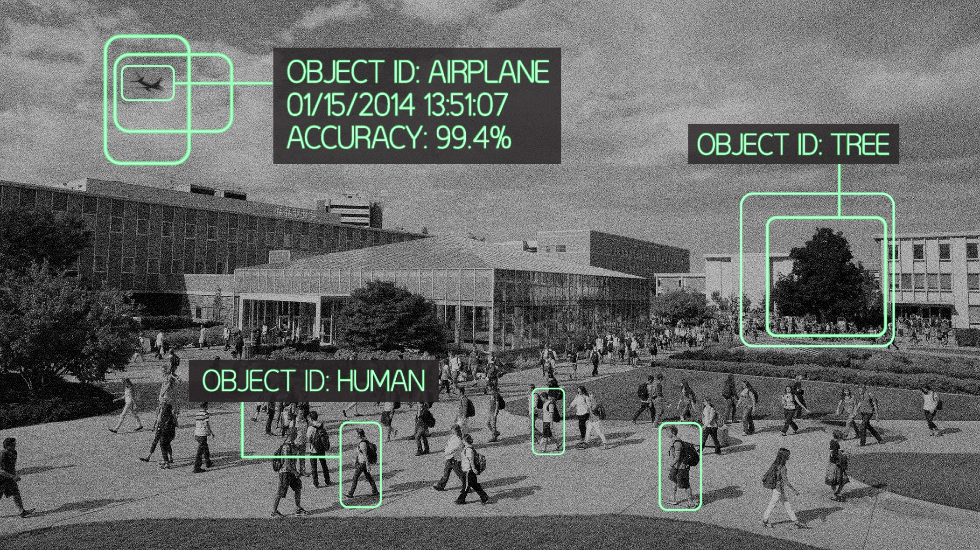
Object Recognition
Simple pairwise matching
Classifier training *
Notes:
Once the objects are detected, we need to correctly identify the object – what the object is (e.g. a screwdriver), what type it is (a Philips-head screwdriver), and how many instances of the object are present in the image.
This can be done with a rote simple pairwise comparison of training images with a single tested image; determining which of the training images has the highest number of matches with the tested image.

Slide 4
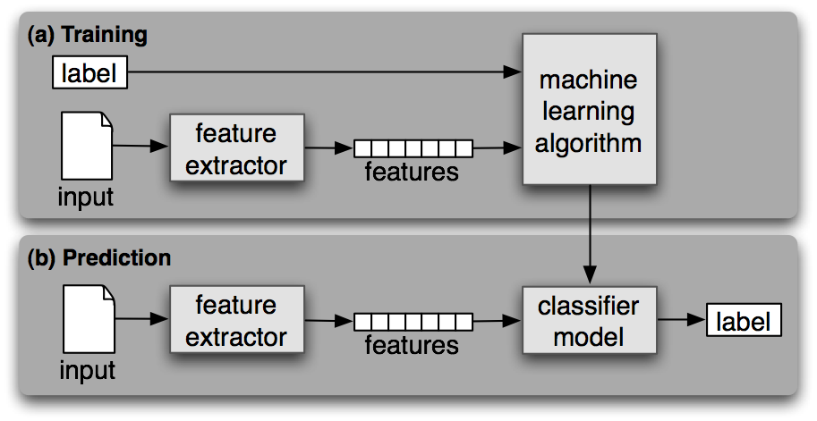
Object Recognition
Simple pairwise matching
Classifier training *
Notes:
Alternatively, one could build a robust classifier using supervised machine learning techniques. While there would likely be a gain in detection accuracy; there will also be a corresponding increase in the magnitude of training data required. Hence, this step would be optional.

Slide 5
Determining Used Inventory
Pre-op
Detect initial items
Confirm items & quantity *
Save list
Post-op
Detect remaining items
Find difference in initial & final list of items
Notes:
The final implementation would work by taking the pre-operation image, determining what items are present, and saving this list of items. An optional intermediate step would be to have the user verify the items and quantities detected, to ensure accuracy.
Similarly, a list of items and their corresponding quantities would be generated from the post-operation image. This list will be compared to the initial list, to determine what items are no longer present (and hence presumably used).

