Slide 1

Lab Book 1.0. Waveguides
Student:

Slide 2
Instructions General
SCRIPTS
From GitHub →
Fork the repo: https://github.com/cccanvas-upv/cifoin-lab1.git
Clone the repo using VSCode
Run the Jupyter Notebook:
WAVEGUIDES_Student.ipynb
W (width)
W (width)
Core
Core
h_core
h
(height)
Cladding
Cladding
Slab
h_slab
deep waveguide
shallow waveguide

Slide 3
Learning outcome #1 – Effective index of a waveguide
INSTRUCTOR:
Present Python and GDSFactory: materials, output, results.
Explain how to run a simulation for a particular cross-section.
Showcase how to change between shallow and deep waveguide.
Describe how to change the wavelength and width for the waveguide analysis.
Describe the outputs.
ALL EXAMPLE #1: waveguide width 1.2 µm, deep wvg, wavelength start and end same 1.55 µm → all ”Run”
ALL: Follow instructor, that will show how to 1) plot mode, 2) explore the results (neff …)
For a deep waveguide with width 1.2 µm at λ = 1.55 µm, several guided modes are supported. The fundamental mode shows the highest effective index, which indicates the strongest confinement inside the core. Higher-order modes present lower neff values because a larger fraction of the field extends into the cladding. The field profiles confirm that the fundamental mode is more concentrated in the waveguide core, while higher-order modes are less confined and more spread out. In addition, the different polarizations show different effective indices, proving that the waveguide is birefringent and that TE and TM modes propagate differently for the same geometry.

Slide 4
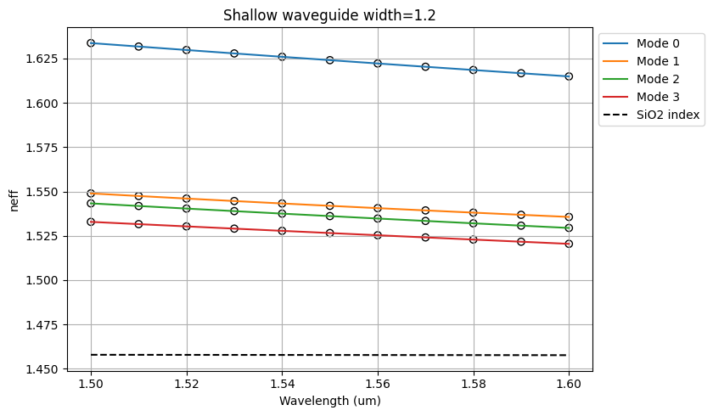
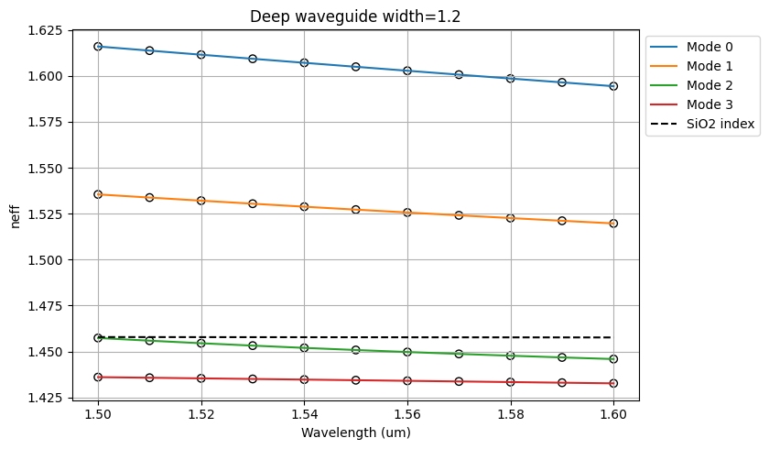
Learning outcome #2 – Wavelength behavior Wavelength 1.5-1.6 µm (step 0.01 µm) – width 1.2 µm
slab = 150nm
For both shallow and deep waveguides, the effective index decreases as the wavelength increases from 1.50 µm to 1.60 µm. This behavior is expected because at longer wavelengths the optical field becomes less confined in the core and extends more into the cladding, reducing neff. The shallow waveguide shows higher neff values for the upper modes than the deep waveguide in the plotted comparison, while the deep waveguide shows lower values for some higher-order modes. In all cases, mode 0 remains the most confined mode and therefore has the highest effective index. The separation between modes also shows that the waveguide cross-section strongly affects modal confinement and dispersion behavior.

Slide 5
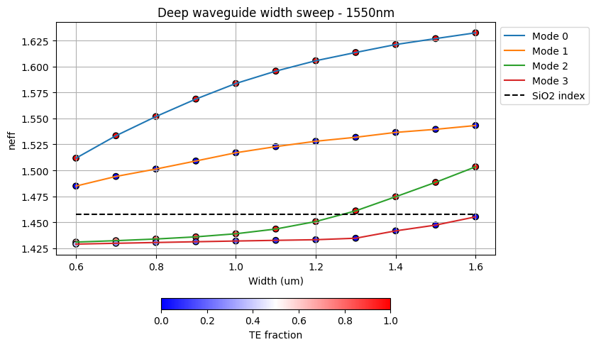
Learning outcome #3 – Width dependence Width 0.6 - 1.6 µm (step 0.1 µm) – Wavelength 1.55 µm
The effective index increases with waveguide width for all modes. As the width becomes larger, the optical field is better confined inside the core, which produces higher neff values. This increase is stronger for the fundamental mode and becomes more noticeable as the width exceeds about 1.0 µm. The graph also shows that wider waveguides support more guided modes, since higher-order modes become more clearly separated from the SiO2 index line. Regarding polarization behavior, the TE fraction indicates that some modes are predominantly TE-like while others are more TM-like, confirming that polarization depends on geometry and modal order. Therefore, waveguide width is a key parameter to control confinement, modal content, and polarization response.

Slide 6
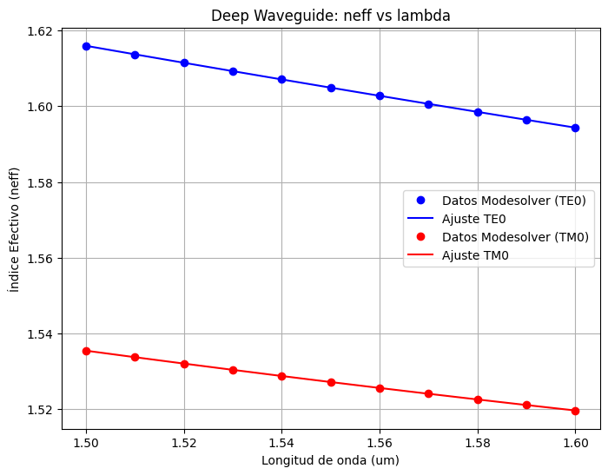
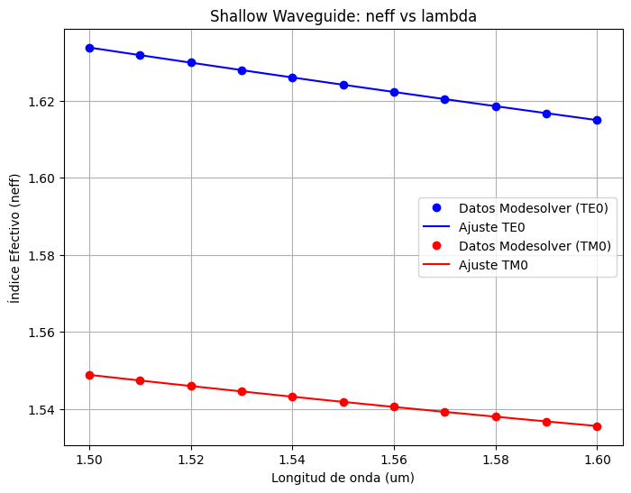
Learning outcome #4 – Waveguide compact model - Find the compact models of the following waveguides: Deep waveguide, h=300nm, w=1.2um - Shallow waveguide, core h=300nm, slab h=150 nm, w = 1.2um
slab: 150nm
The neff versus wavelength curves for both TE0 and TM0 can be well approximated by a second-degree polynomial, which makes it possible to build a compact model of the waveguide. In both deep and shallow waveguides, neff decreases almost linearly with wavelength, while the small curvature of the fit is related to chromatic dispersion. TE0 always has a higher effective index than TM0, which means that the TE fundamental mode is more strongly confined. In addition, the shallow waveguide presents slightly higher neff values than the deep one for both polarizations in the shown plots. From the polynomial coefficients, the first-order term is directly related to the group index, while the second-order term is related to the dispersion parameter D. Since the curvature is small, dispersion is moderate in the analyzed wavelength range, but it is still important for compact modeling and photonic circuit design.

Slide 7
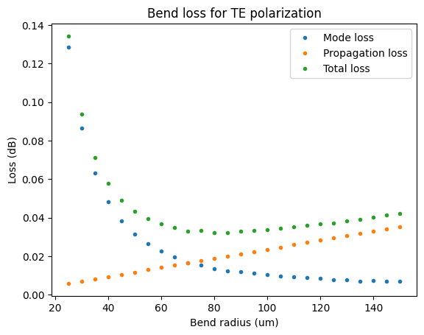
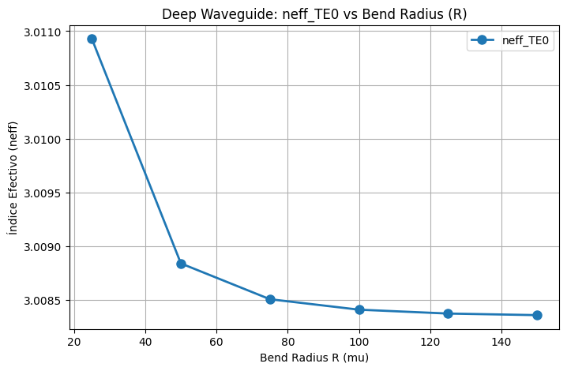
Learning outcome #5 – Bend waveguide radius vs. loss – deep Find neff_TE0 for wvl 1.55 µm, width 1.2 µm for R=25,50,75,100, 125,150 µm
The bend loss decreases sharply as the bend radius increases. For small radii, especially around 25–50 µm, the total loss is significantly higher because radiation loss is dominant. As the radius increases, mode loss decreases rapidly, while propagation loss increases slightly, resulting in a minimum, then a gradual increase in total loss. According to the graph, the total loss is clearly below 0.1 dB/90º from about 50 µm onward, so this can be considered a safe bend radius. A radius of 75 µm or more would be a more conservative design choice because it provides lower loss and more stable behavior. The neff_TE0 also decreases slightly with increasing bend radius and then tends to stabilize, which indicates that curvature has a stronger effect at small radii and becomes negligible for large-radius bends.

Slide 8

Thank you

