Slide 1


BADGER BUILDFEST 2026 · APPLIED AI & AUTOMATION
The manager for your AI agents
Agents earn their freedom with evidence
Built on Databricks
Notes:
0:00–0:05. Say: Assay helps managers decide which AI model to use and when an agent can act without approval. Pitch structure adapted from Pouya Mirzaei, How to Make a Winning 2-Minute Pitch.pdf, pages 4, 6, 7, 9 and 10. Timings are targets; rehearse with the live demo.

Slide 2
AI agents are growing. The risks are growing too.
Teams need evidence before they spend more or allow agents to act alone.
$7.8B to $52.6B
40%+
AI agents market estimate for 2025 and forecast for 2030
Gartner predicts cancellation by the end of 2027, citing cost, unclear value and weak risk controls.
MarketsandMarkets, AI Agents Market report
Gartner press release, 25 June 2025
Assay helps teams measure cost, quality and risk before granting more freedom.
Assay · Badger BuildFest 2026 · 2
Notes:
0:05–0:15. Say: The AI agents market is forecast to grow from about $8 billion to $53 billion, but Gartner predicts over 40% of agentic projects will be canceled by 2027 because of cost, value or risk. Both numbers are forecasts, not observed failures. The total agent market is context, not an estimate of Assay revenue or its addressable market. Sources: https://www.marketsandmarkets.com/Market-Reports/ai-agents-market-15761548.html ; https://www.gartner.com/en/newsroom/press-releases/2025-06-25-gartner-predicts-over-40-percent-of-agentic-ai-projects-will-be-canceled-by-end-of-2027 . Pitch structure adapted from Pouya Mirzaei, How to Make a Winning 2-Minute Pitch.pdf, pages 4, 6, 7, 9 and 10. Timings are targets; rehearse with the live demo.

Slide 3




The decision every manager faces
A suggestion arrives. Should the manager approve it, reject it, or let the agent act?
THE PROBLEM
WHAT ASSAY DOES
Checking every answer takes time. Trusting every answer lets mistakes through.
Sets limits on acting alone
Only where the checked record proves it.
77%
Chooses the model
The cheapest model that meets the quality rule.
of checkable answers rated 95%+ confident were wrong
Checks proposed corrections
Counts what each change fixes and breaks.
1,793 of 2,321 answers
8 models tested on 1,362 real tickets
Learns from people
Each human decision becomes evidence.
No model earned general permission to act alone.
Assay · Badger BuildFest 2026 · 3
Notes:
0:15–0:25. Say: A manager receives an AI suggestion. Checking everything takes time, but confidence is unreliable. In our evaluation, 77% of checkable answers rated at least 95% confident were wrong. Assay makes the approval decision from evidence. 1,793 of 2,321 pooled high-confidence checkable answers; not the error rate for all answers or the chosen primary. Source: docs/FINAL_HANDOFF.md sections 4.1 and 4.4. Pitch structure adapted from Pouya Mirzaei, How to Make a Winning 2-Minute Pitch.pdf, pages 4, 6, 7, 9 and 10. Timings are targets; rehearse with the live demo.

Slide 4
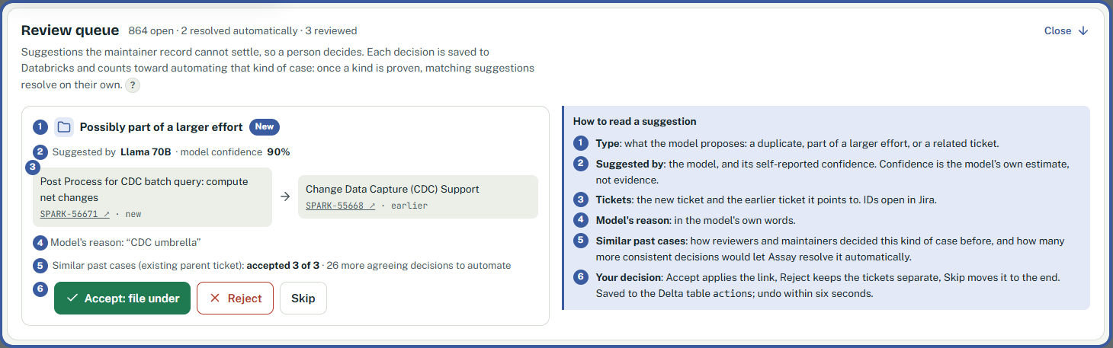
Assay in action
A Jira ticket is our example. Assay checks the proposal and asks a person when needed.
37,853 public tickets. 13,687 maintainer links to check the answers.
1 A ticket arrives
2 A model suggests
3 Assay checks
4 A person decides
The agent reads the task
A link to an earlier ticket
Evidence sets the limits
Each answer becomes evidence
Assay · Badger BuildFest 2026 · 4
Notes:
0:25–0:55. Switch to the live dashboard or a recorded demo. Show the version-upgrade ticket template. The cheap model suggests a duplicate; Assay catches a proven mistake. Then show an uncertain suggestion in the review queue, point to prior evidence, and show the Yes/No decision. Demo tickets stay in the sandbox. A screenshot is a fallback, not a substitute for showing actual product behavior. Outcomes may vary. Source: user-supplied review screenshot and docs/FINAL_HANDOFF.md demo guidance. Pitch structure adapted from Pouya Mirzaei, How to Make a Winning 2-Minute Pitch.pdf, pages 4, 6, 7, 9 and 10. Timings are targets; rehearse with the live demo.

Slide 5
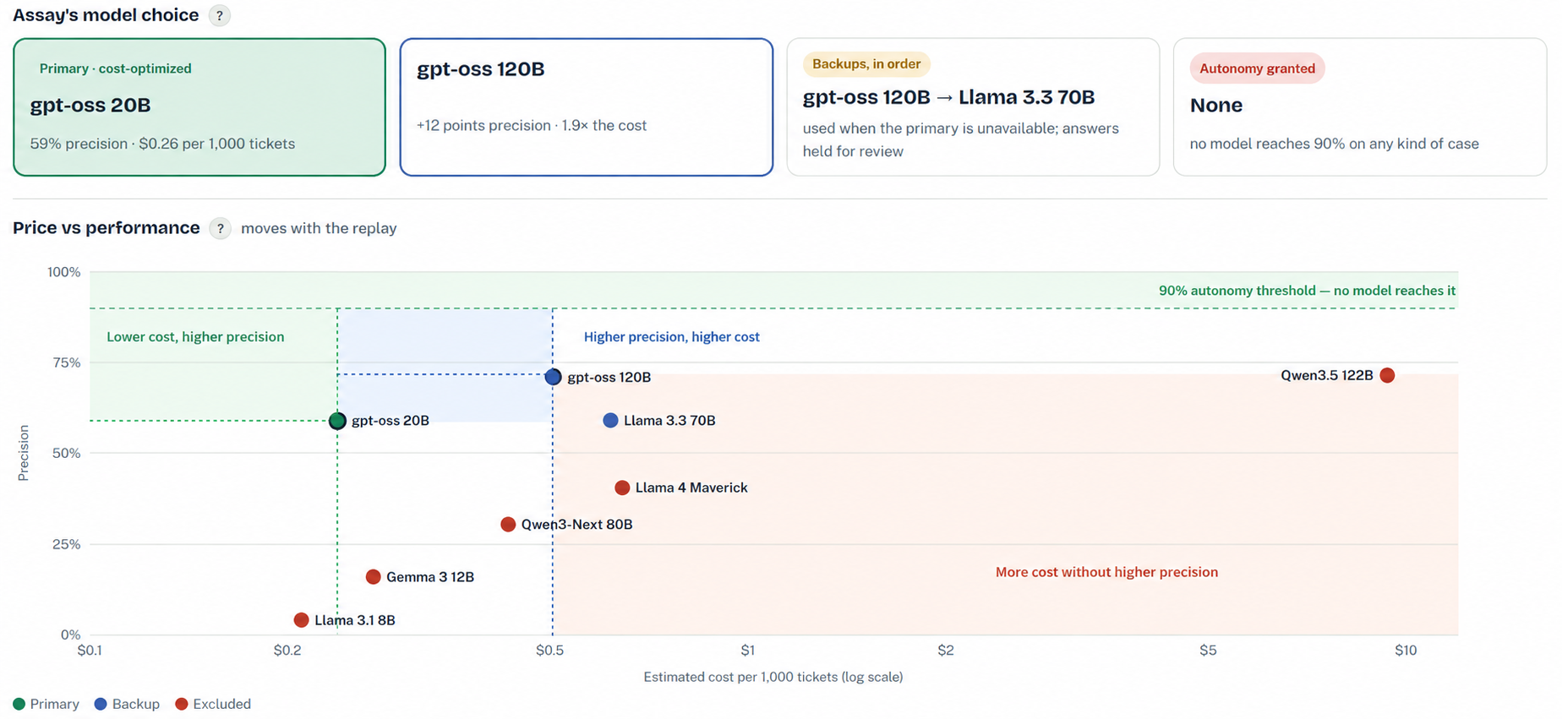
Model cost and precision
Assay · Badger BuildFest 2026 · 5
Notes:
0:55–1:15. During the demo, show model choice in the dashboard. The primary balances cost and checked quality, and the backup is more precise but more expensive. No model earned general autonomy. The graph is a visual annotation of a dashboard snapshot. Shading is neither a confidence interval nor a new safety classification; the autonomy rule requires a statistical lower bound. The snapshot shows 59%, while the final static report says 58%. Sources: supplied screenshot; docs/FINAL_HANDOFF.md sections 4.3 and 4.6. Pitch structure adapted from Pouya Mirzaei, How to Make a Winning 2-Minute Pitch.pdf, pages 4, 6, 7, 9 and 10. Timings are targets; rehearse with the live demo.

Slide 6
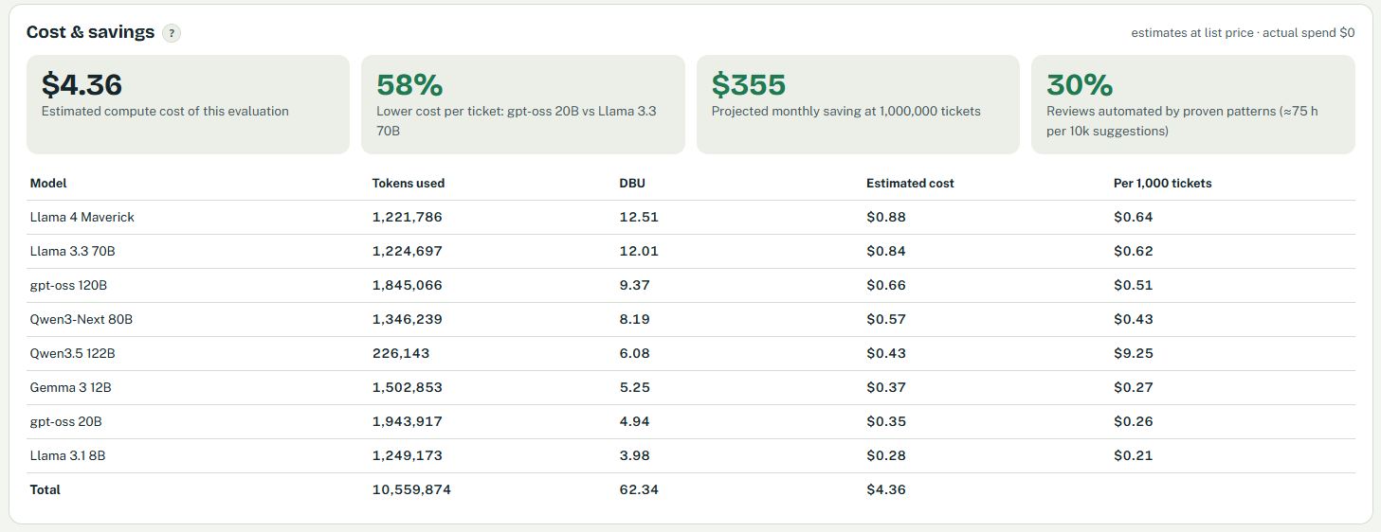
Measured cost. Evidence-based control.
Unity Catalog stores evidence. Foundation Models answer. Databricks Apps hosts the dashboard.
Estimates use list prices and an assumed $0.07 per DBU. Actual Free Edition spend: $0.
Assay · Badger BuildFest 2026 · 6
Notes:
1:15–1:25. Show the cost dashboard: $4.36 estimated evaluation compute cost, actual Free Edition spend $0. The $355 projection assumes one million tickets, not realized savings. 1:25–1:38. Explain differentiation: Assay checks real outcomes and only automates narrow proven patterns; evidence can revoke automation. We evaluated 8 models and checked 5,125 answers. Keep the data on screen while speaking. Avoid claiming no competitor has solved this. The static report says 57% savings and the screenshot says 58%; describe approximately 58%, not false exact agreement. Source: supplied screenshot and docs/FINAL_HANDOFF.md. Pitch structure adapted from Pouya Mirzaei, How to Make a Winning 2-Minute Pitch.pdf, pages 4, 6, 7, 9 and 10. Timings are targets; rehearse with the live demo.

Slide 7

The team and what comes next
Ananda GP, Mohith Nikesh and Soham Vazirani
We built the agent, evidence engine and Databricks dashboard, then tested eight models against real outcomes.
Proposed next 6–12 months
Close the documented security gaps
Connect more agents through a common API
Validate with a team using real review decisions
Code and evidence
github.com/Ananda-001/Badger-Build-Fest
Seeking a pilot team and a Databricks mentor
Agents earn their freedom with evidence
Assay · Badger BuildFest 2026 · 7
Notes:
1:38–1:50. Say: We are Ananda, Mohith and Soham. We built and tested the workflow end to end, combining the agent, statistical decisions and a manager dashboard. Cite demonstrated work rather than invented industry experience or customer validation. 1:50–2:00. Say: Next, we plan to close the security gaps, connect more agents and pilot with a team using real review decisions. We are looking for that pilot team and a Databricks mentor. These are proposed next steps, not completed work. Six security weaknesses remain open. Source: team credits and project limitations in README.md; pitch guide page 10. Pitch structure adapted from Pouya Mirzaei, How to Make a Winning 2-Minute Pitch.pdf, pages 4, 6, 7, 9 and 10. Timings are targets; rehearse with the live demo.

