Slide 1
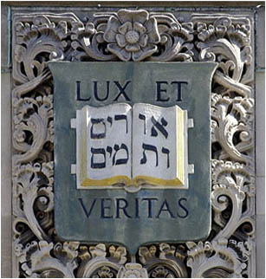
Characteristic Point Maps
Hongzhi Wu Julie Dorsey Holly Rushmeier
(presented by Patrick Paczkowski)
Computer Graphics Lab
Yale University
Notes:
Greetings.

Slide 2
Outline
Introduction
Previous Work
Characteristic Point Maps
  Derivation
  Preprocessing
  Usage
Results
Conclusions
Future Work
Notes:
To first give you a brief outline of what I’ll be talking about:
I’ll start by introducing the problem that we’ve been trying to solve, and list several previous approaches that we’ve taken.
Following this, I’ll describe our proposed solution, namely characteristic point maps, and go into some detail regarding how we implemented this method.
Next, I’ll show you the results of several experiments we conducted to test this solution.
And finally, I’ll wrap it up with some conclusions and a few of the future directions we’d like to take in this project.

Slide 3
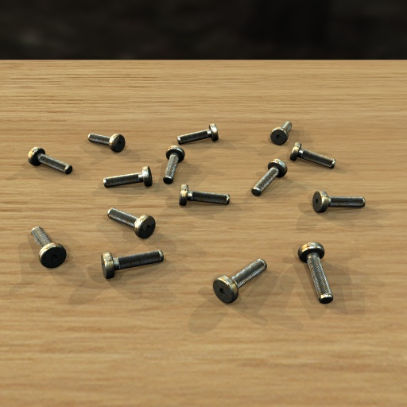
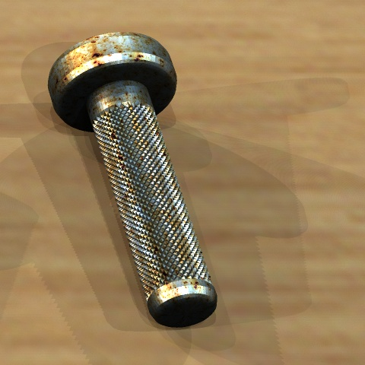
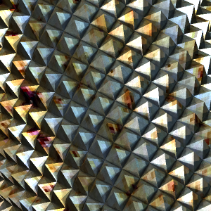
Motivation
Challenging to Render
  Highly complex geometry + materials
  High sampling rate to avoid aliasing
  Viewed at multiple scales
Notes:
0. As motivation for our problem, consider the scene here with many bolts of highly complex geometry and materials, rendered at several different scales.
The geometry consists of many small-scale diamond-shaped bumps on the body of each bolt (as shown on the right).
The material is a high-frequency captured metallic paint BRDF taken from Matusik et al’s paper on “A Data Driven Reflectance Model.” [MPBM03]
This material is modulated by a tainted metal texture map to simulate weathering effects.
1. This scene is challenging to render in a Monte-Carlo ray-tracer.
2+3. Due to the high complexity of the geometry and materials, the appearance itself becomes complex, thus requiring a very high sampling rate. This, however, is very time-consuming.
4. In addition, the scene is viewed at multiple scales, which motivates an efficient hierarchical appearance representation.

Slide 4
Introduction
We present Characteristic Point Maps (CPMs)
  A hierarchy of points on the original model
    Preserves appearance (i.e. 6D filtered SV-BRDF) at multiple scales
  Precomputed object-space adaptive sampling
Notes:
0-1. To tackle these challenges, we present Characteristic Point Maps, or CPMs, which are…
2. a hierarchy of points on the original model, chosen to preserve appearance at multiple scales. In other words, we make use of 6D filtered SV-BRDFs.
3. As I’ll describe near the end of this talk, one can also view our method as a precomputed object-space adaptive sampling approach.

Slide 5
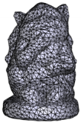
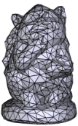
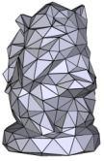
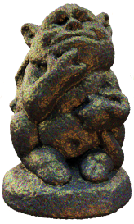
Introduction
Mesh Hierarchy
original model
simplified meshes
……
Preprocess
Render
+
Output
Image
Characteristic Point Maps
level 0 level 1 level n
Original Model
……
Notes:
0. Now, let me give you a brief overview of CPM pipeline.
1-3. Starting from an original model, we build a mesh hierarchy using existing geometric simplification techniques…
4. …and we build the characteristic point maps hierarchy to represent spatially-varying average reflectance functions across multiple scales.
5. Each texel in a CPM corresponds to a few points on the original model.
6. After preprocessing, our representation is used to accelerate the rendering of the output image.

Slide 6
Previous Work
Texture Mipmap [Wil83]
  Pre-filtering textures
Mesh Simplification [GH98, LT00, SSGH01]
  Minimizing texture-mapping distortion
Appearance-Preserving Mesh Simplification [COM98]
  Missing small-scale shadowing and masking effects
  For textures, not general BRDFs
BTF LOD representation [MCT*05]
  Dense sampling of 6D BTF for high-frequency effects
Notes:
0. Before I go on, let’s look at some previous work done in this field. I’ll start off by outlining some proposed LOD representations.
Texture Mipmap: Generates a texture hierarchy by pre-filtering textures at different scales.
Mesh Simplification: Various techniques are introduced to create a geometry hierarchy at different scales (which we also employ in our preprocessing stage). But in terms of preserving appearance, they focus only on minimizing texture-mapping distortion.
So-called “appearance-preserving” mesh simplification: Normals are sampled on the original mesh into a normal map to represent fine-scale appearance. However, small-scale shadowing and masking effects are missing as they cannot be represented by normals. Further, the technique handles Lambertian textures, and not general BRDFs.
BTF LOD representation: Does captures all fine-scale appearance using BTF; however, this requires a dense sampling of 6D BTF for high-frequency effects, thus it requires a huge amount of storage.

Slide 7
Previous Work
 | Arbitrary BRDF | Arbitrary Geometry | Shadowing and Masking Effects | Small footprint
Reflectance Filtering [TLQ*08] | X | X | O | √
Normal Map Filtering [HSRG07] | X | X | X | √
BTF [DvGNK99] | √ | √ | √ | X
Ours [WDR09] | √ | √ | √ | √
Notes:
0. The most related category of papers to our paper is reflectance filtering.
Existing techniques [TLQ*08] and [HSRG07] can only handle limited classes of BRDFs, while our method can handle arbitrary BRDFs.
In addition, they require that fine-scale details are represented using normal maps only, which means shadowing and masking effects cannot be reproduced.
[TLQ*08] does simulate shadowing and masking effects by attenuating the unmasked appearance. However, this is only a crude approximation which isn’t applicable for general cases.
By comparison, a BTF, the general 6D appearance function, can handle all small-scale details. However, the biggest problem, as I mentioned, is its huge storage requirement. By contrast, in our approach, the 6D spatially-varying average reflectance function is implicitly defined at a small number characteristic points; thus, we avoid the huge storage requirement from explicitly tabulating the 6D function.
In other words, it creates a small footprint, like the first two methods, but at the same time works for arbitrary BRDFs and geometries, and incorporates shadowing and masking effects.

Slide 8

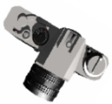
Derivations
Reflected radiance at x
incident radiance
BRDF
reflected radiance
visibility term
cosine term
ω_{o}
dL(x, ω_{o})
ω_{i}
L_{i}(x, ω_{i})
x
Notes:
0. Alright, let’s move on to discussing our approach in more detail. We’ll start by deriving our definition of characteristic points from the general rendering equation.
1. As you may well know, this is the equation to compute the reflected radiance at a point x, and consists of the of the integration of a product of four terms, where
2. L_i is the incident radiance at x,
3. V is the visibility term, which is 0 or 1,
4. f_r is the bidirectional reflectance distribution function,
5. and lastly, we have the cosine term, which reflects the angle between the normal at x and the viewing ray.

Slide 9


Average reflected radiance
ω_{i}
ω_{o}
a_{vis}
A_{vis}
A
Notes:
0. Now, using the rendering equation, we can define the average reflected radiance for a surface patch A along a view direction omega_o.
1. This is just the integration of all reflected radiance from individual visible points on A along omega_o, …
2. …divided by the visible projected area of A, denoted as a_vis.

Slide 10



Derivations
After a sequence of transformations,
where
apparent reflectance function
Notes:
0. After a short sequence of transformations, we arrive at the following alternative equation for average reflected radiance. (Again, please refer to the paper for details of the derivations).
1. Here, what we are concerned with is f_r^bar, which is a 6D spatially-varying average reflectance function.
2. In this equation, f is defined as the apparent reflectance function, which has two visibility terms in its product. These account for shadowing and masking effects, which are not handled in normal-map based reflectance filtering methods.

Slide 11
Derivations
Average reflectance function
  6D function
  Brute-force precomputation is impossible!
    No analytical model => huge storage
      E.g. 64² for A, 6x64² for both ω_{i} and ω_{o}
      64²x(6x64²)x(6x64²) = 2473 Billion!
    Difficult to compress numerically
Notes:
0. Let’s take a closer look at this average reflectance function.
1. First, it’s obviously a high-dimensional function. So, since directly computing this function on the fly is time-consuming, one natural idea is to precompute it.
2. However, brute-force precomputation is virtually impossible for two reasons:
3-5. Since there is no analytical model to fit the native data, a huge amount of storage is required. To give you a simple example, if you used these relatively small sampling values for A, omega_i and omega_o, you would have to compute about 2.5 trillion values, which is infeasible.
6. Second of all, the average reflectance function is effectively a BTF, and it is well-known in graphics community that BTF is difficult to compress numerically.

Slide 12
Derivations
Discretize integration into summation
Notes:
0. Well, so what do we do? Here’s where our key contribution comes in – in figuring out how to efficiently compute and represent this 6D average reflectance function.
1. What we first do is discretize the integration into a summation.

Slide 13

Derivations
Visible projected area term
Visible Projected Area Term
  a 2D spherical function
  Precompute on GPU and compress using Haar wavelets
Notes:
0. Now, as you can see, the equation is composed of two terms.
1. The first term is the visible projected area term, representing the visible projected area of a surface patch along different view directions.
2. Note that for a given surface patch, this is just a 2D spherical function; thus, in our paper, we precompute it efficiently on the GPU and we compress the result using Haar wavelets. We choose this compression scheme for its simplicity, good compression rate (4%~6.5%) and its rapid signal reconstruction.

Slide 14
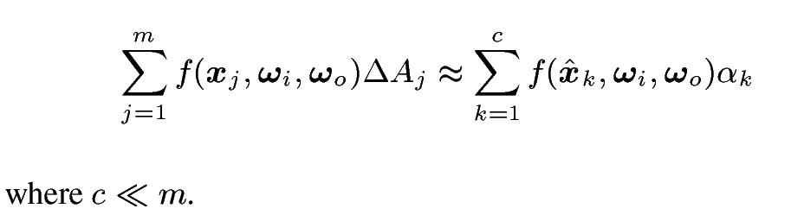
Derivations
Summation term
Summation Term
  Want to reduce the number of items
  (i.e. find the characteristic points)
  Use Randomized Matrix Column Sampling
Notes:
0-1. The second term of the equation is the summation term, whose number of items, m, is typically large in order to approximate the original integration well.
2. What we want to do is reduce m to a small number c in order to accelerate the computation of the summation while at the same time maintaining acceptable approximation quality.
These c points chosen from the original m-point discretization of the surface patch, are called characteristic points.
Well, how do we find them? We employ a method called randomized matrix column sampling to do the job.

Slide 15
Illustration
ω_{i1},ω_{o1}
ω_{i2},ω_{o2}
……
x₁ x₂ …...
ω_{id,}ω_{od}
Notes:
0. Before I explain this method, however, let me show you a quick graphical illustration of the whole process I just outlined.
1-3. So first, we start by discretizing the continuous surface patch into many points.
4-5. We then sample an appropriate number of view and lighting directions.

Slide 16
Illustration
x₁
x₂
…...
ω_{i1},ω_{o1}
ω_{i2},ω_{o2}
……
…
x₁ x₂ …...
ω_{id,}ω_{od}
Notes:
0. Now, for each point in the discretization, we evaluate the apparent reflectance function at this point and at sampled view and lighting directions.
1-2. The results are stored as a vector.
3-6. We sample the apparent reflectance function for each point and put all the resulting column vectors into a matrix.

Slide 17
Illustration
x₁
x₂
…...
ω_{i1},ω_{o1}
…
ω_{i2},ω_{o2}
…
……
…
x₁ x₂ …...
ω_{id,}ω_{od}
…
Notes:
0-1. Another way to think about this matrix is that each row stores samples of the apparent reflectance function defined at different points of the surface patch, for fixed view and lighting directions.

Slide 18
Illustration
x₁ x₂ …...
ω_{i1},ω_{o1}
α₁
×
ω_{i2},ω_{o2}
+
…
α₂
×
……
+
x₁ x₂ …...
ω_{id,}ω_{od}
α₃
×
α₁
α₂
α₃
Notes:
0-2. Now, once we have the matrix, we apply the aforementioned randomized matrix column sampling to select a few representative columns, and we can easily compute the corresponding weights of each column.
3-4. The columns, together with the weights, are then used to approximate the original summation term.
So, note that now, we just need to record the characteristic points along with weights – we can discard the aforementioned matrix entirely. To summarize, the average reflectance function can now be reconstructed by a weighted sum of apparent reflectance functions evaluated ONLY at a limited number of characteristic points.

Slide 19
Randomized Matrix Column Sampling
Use [DMM06] to sample columns (i.e. to find characteristic points)
  Compute a prob. distribution for choosing a column from the matrix
  Randomly select m columns according to the prob. distribution
  Compute the weights for these m columns
Notes:
0. Now, what is randomized matrix column sampling?
1. Well, this method is described in [DMM06], and as I mentioned, we use it to select our characteristic points.
2. On a very high level, what this involves is: first, computing a probability distribution for choosing a column from the matrix.
3. Once this is done, m columns are randomly selected according to this probability distribution.
4. Lastly, the corresponding weights can now be computed for these m columns.
It is important to note that this sampling method produces optimal results for general input. Again, for details about the formal proof, please refer to the original paper.

Slide 20
Randomized Matrix Column Sampling
  Measure error as L2 norm
  Iterate to “boost” the probability of getting the optimal result
  Exploit spatial coherence in apparent reflectance functions
    Determine the number of CPs as the minimum number to achieve certain approximation quality
      High spatial coherence => small number of CPs
      Low spatial coherence => large number of CPs
Notes:
0. A few more details about randomized matrix column sampling.
1. We measure approximation error in L2 norm. Note that similar measure appears in Lafortune’s classical BRDF paper [LFTG97].
2. Like other typical randomized algorithm, we run the column sampling several times to “boost” the probability of getting the optimal result.
3. Essentially we are exploiting the spatial coherence in apparent reflectance functions. Several similar apparent reflectance functions are “clustered” into an apparent reflectance function defined at ONE characteritstic point. Note that the number of CPs is determined as the minimum number to achieve certain approximation quality (i.e. high spatial coherence => small number of CPs, low spatial coherence => large number of CPs)

Slide 21
Preprocessing
Mesh Hierarchy
Preprocess
original model
simplified meshes
……
Original Model
Build a mesh hierarchy
  Simplify geometry using existing techniques [GH97]
  Establish a mapping from each simplified mesh to CPM u-v space
Notes:
0. Ok, lets move to preprocessing. I’ve given you a brief introduction to the core algorithm for selecting characteristic points; now I’ll describe the processing pipeline.
1-2. Given the original model, we first build a mesh hierarchy using one of several mature geometric simplification techniques. As I mentioned, we used Garland and Heckbert’s simplification. [GH97]
3. For each simplified mesh in the mesh hierarchy, we establish a mapping from the geometry to CPM UV space so that, in rendering, when a ray hits the simplified mesh, we’ll know which texel the intersection point corresponds to.

Slide 22
Preprocessing
Mesh Hierarchy
Characteristic Point Maps
Preprocess
original model
simplified meshes
level 0 level 1 level n
……
……
+
Original Model
Build a CPM hierarchy
  For each texel in CPM, we store
    References to characteristic points
    Corresponding weights
    Wavelet coefficients for a_{vis}
  Bottom-up construction
α₁
×
+
α₂
×
+
α₃
×
Notes:
0-2. Next we build a CPM hierarchy for different levels of detail using the randomized matrix column sampling method we have just described.
3. For each texel in one level of the CPM hierarchy, we just store
4. References to characteristic points
5. Corresponding weights
6. Haar wavelet coefficients for reconstructing a_vis
7. We build the CPM hierarchy in a bottom-up construction due to the non-linearity of 1/a_vis in the equation of average reflectance function.

Slide 23
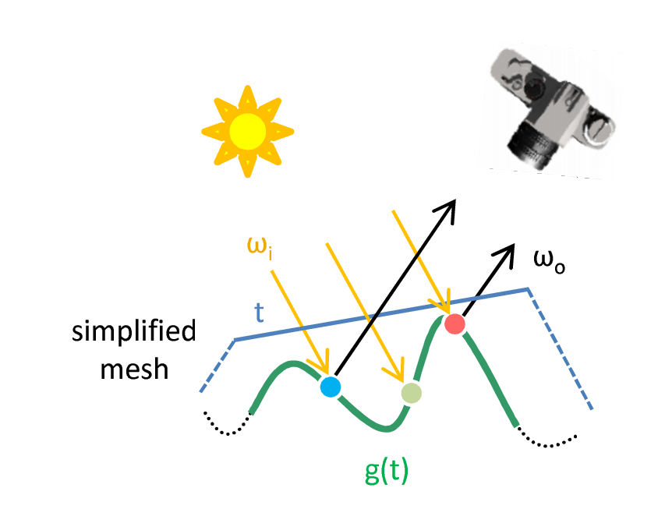
Using CPMs
Select a simplified mesh
Select CPM mip level
Look up a particular texel
Evaluate at characteristic points ONLY!
Notes:
0. After the preprocessing stage, it becomes straightforward to use the CPMs in rendering.
1. All we need is to first select a simplified mesh in the mesh hierarchy based on the view distance.
2. Then, select a CPM mip level based on the screen-space derivatives of CPM parameterization.
3. Lastly, we look up a particular texel in the current mip level of the CPM hierarchy.
4. Using this texel, we can compute the average reflected radiance using the weighted sum of the apparent reflectance functions evaluated only at the stored characteristic points.

Slide 24
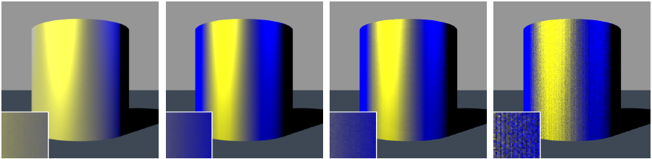
Results: Cylinder
Multi-sampled Normal Map
Ground Truth
CPMs
Equal-time Budget
ω_{i}
ω_{o}
Notes:
Now, let me move on to some results.
I’ll be showing you outcome of four different experiments. For details on timing, acceleration ratio and other statistics, please refer to our paper.
The first experiment involves a cylinder with small-scale sharp ridges with alternating reflectance on various facets.
The top view of an edge of the cylinder is illustrated in the bottom image.
The four methods that we tested, from left to right, are the following:
1. A multi-sampled normal map. This is the ground truth result for normal-map based filtering methods (e.g. [HSRG07])
2. A general ground truth, created by brute-force multi-sampling with a high number of eye rays per pixel to avoid aliasing.
3. A Rendering using our approach – CPMs.
4. A Brute-force multi-sampling using approximately the same amount of time as using CPMs.
There are two important things to note here:
First, the normal-map based methods generate inaccurate results by neglecting shadowing and masking effects. By contrast, using CPMs does successfully reproduce the appearance as compared to the ground-truth image.
In addition, please notice the different level of image quality between using CPMs and the equal-time budget method in the close-up view in the bottom-left corner of the images.

Slide 25
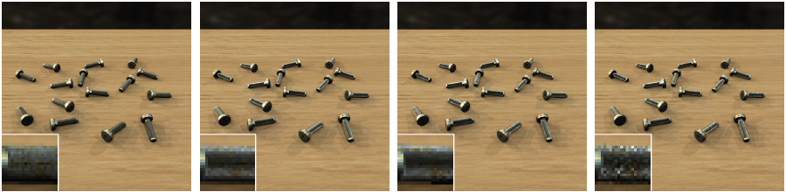
Results: Bolts
Multi-sampled Normal Map
Ground Truth
CPMs
Equal-time Budget
Notes:
This scene, which by now you should be familiar which, has bolts with many diamond-shaped bumps on their bodies, along with a high-frequency BRDF, silver-metallic-paint-2 , again from the Matusik paper [MPBM03].
In addition, the spatial variation of reflectance is modeled using a texture of tainted metal.
Our method preserves the complex shading variations along the silhouettes of the bolts, while the multi-sampled normal map method tends to produce a more uniform appearance over the body of the bolts.
Again, please note the difference in image quality between our method and the equal-time budget brute force sampling method.

Slide 26
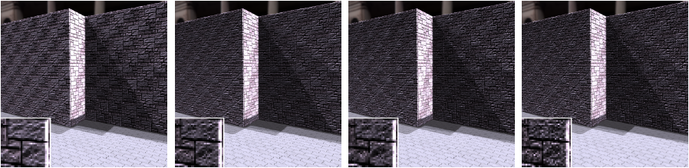
Results: Wall
Multi-sampled Normal Map
Ground Truth
CPMs
Equal-time Budget
Notes:
The third experiment involves a wall scene, in which a highly detailed geometry is used to model the fine scale features on the surfaces of the walls. Material-wise, a Lambertian BRDF model is used, along with a color texture.
Now, the challenge here is the high frequency spatial variation of visibility due to the small-scale geometric details.
Our method gives a good approximation by exploiting the spatial coherence of apparent reflectance functions, while the normal-map method produces brighter results due to the lack of support for subtle shadowing and masking effects.

Slide 27
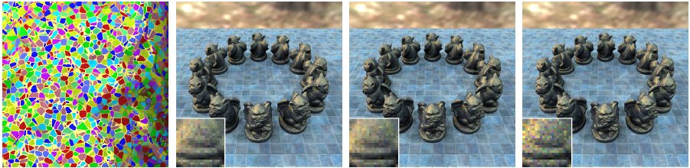
Results: Gargoyles
Close-up view
Ground Truth
CPMs
Equal-time Budget
Notes:
Finally, this scene consists of 12 gargoyles made up of a bumpy surface, and a highly complex procedural shader, as can be seen in the close-up view.
The shader employs a cellular texture [Wor96] to simulate Cloisonné.
Inside each cell, a Lambertian BRDF model with a particular color is defined.
Along the boundaries among cells, a high-frequency gold-metallic-paint BRDF is used. [MPBM03]
Now, normal-map based methods not only ignore shadowing and masking effects, but they also have a difficult time handling complex materials like this one.
By contrast, our representation is not tied to any specific type of BRDFs, and, as you can see, it can faithfully filter arbitrarily complex materials, resulting in images almost identical to the ground truth.

Slide 28
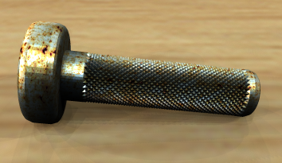
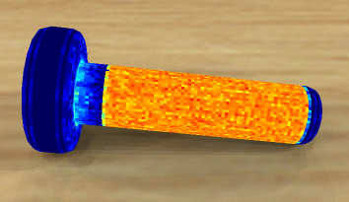

Results
Precomputed object-space adaptive sampling
  CP density adapts to the complexity of filtered SV-BRDFs
46
0
Notes:
Lastly, I’d like to show how CPMs adapt to the complexity of average reflectance functions. On the left you can see the original rendering of a bolt, and on the right, a characteristic point density distribution over a simplified mesh.
As expected, our method allocates a relatively large number of characteristic points in the middle part of the bolt, where the visibility and the normals change rapidly.
By contrast, there are only a few characteristic points at the other parts, where the variation in geometry is small and the reflectance functions only vary by a constant (a color fetched from the tainted metal texture).
We can thus view our method as a precomputed object-space adaptive sampling approach, which can be used for efficient rendering.

Slide 29
Conclusions
A general framework for efficiently computing and representing 6D spatially-varying average reflectance functions
  No assumptions on geometry or BRDFs
  Accelerates rendering
A precomputed object-space adaptive sampling method
Notes:
1. In conclusion, we have presented a general framework – Characteristic Point Maps – for efficiently computing and representing 6D
spatially-varying average reflectance functions both for highly detailed geometries and complex BRDFs.
2. Unlike existing reflectance filtering techniques, our method makes no assumptions on the underlying geometry or BRDFs.
3. CPMs can also be used to accelerate the rendering process while at the same time maintaining image quality.
4. And, as shown in the previous slide, we can also view CPMs as a precomputed adaptive sampling of the object-space.

Slide 30
Future Work
Apply a low-pass filter
Incorporate indirect illumination
Apply to deformable objects
Notes:
1. In our definition of the average reflectance function, we are essentially applying a box filter by giving equal weight to the contribution of each individual point. In the future, we’d like to apply a low-pass filter to this formulation to completely eliminate aliasing.
2. A lot of existing work on reflectance filtering, including ours, only handles direct illumination. What we’d like to do is to try to extend our idea and incorporate indirect illumination as well.
3. Finally, it would also be interesting to extend our framework to handle deformable objects.

Slide 31
Acknowledgements
National Science Foundation Grant #0528204
Yale Graphics Group
Sumanta Pattanaik (UCF)
Li-Yi Wei (Microsoft)
Ping Tan (NUS)
Notes:
Acknowledgements.

Slide 32
Thank you
Questions?
Contact: hongzhi.wu@yale.edu
Notes:
Thank you!

Slide 33
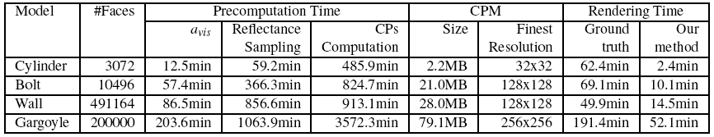
Back-up slides
Notes:
Statistics about our experiments.

Slide 34
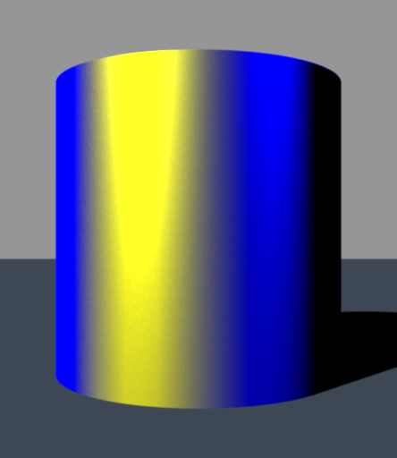
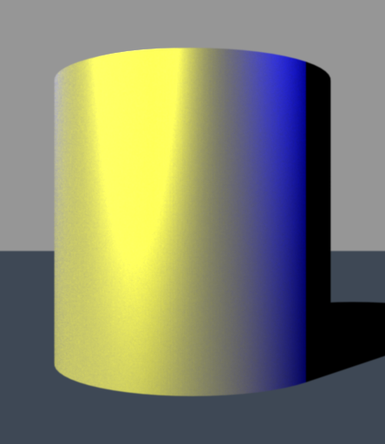

Back-up slides
Multi-sampled Normal Map
Characteristic Point Maps
Ground Truth
(a) (b) (c)
ω_{i}
ω_{o}
(d) (e) (f)
Notes:
Detailed figure for the cylinder scene, with masking effects shown in the left column, and shadowing effects shown on the right.

