Slide 1

AI4Legislation Tech Seminar 3

Slide 2
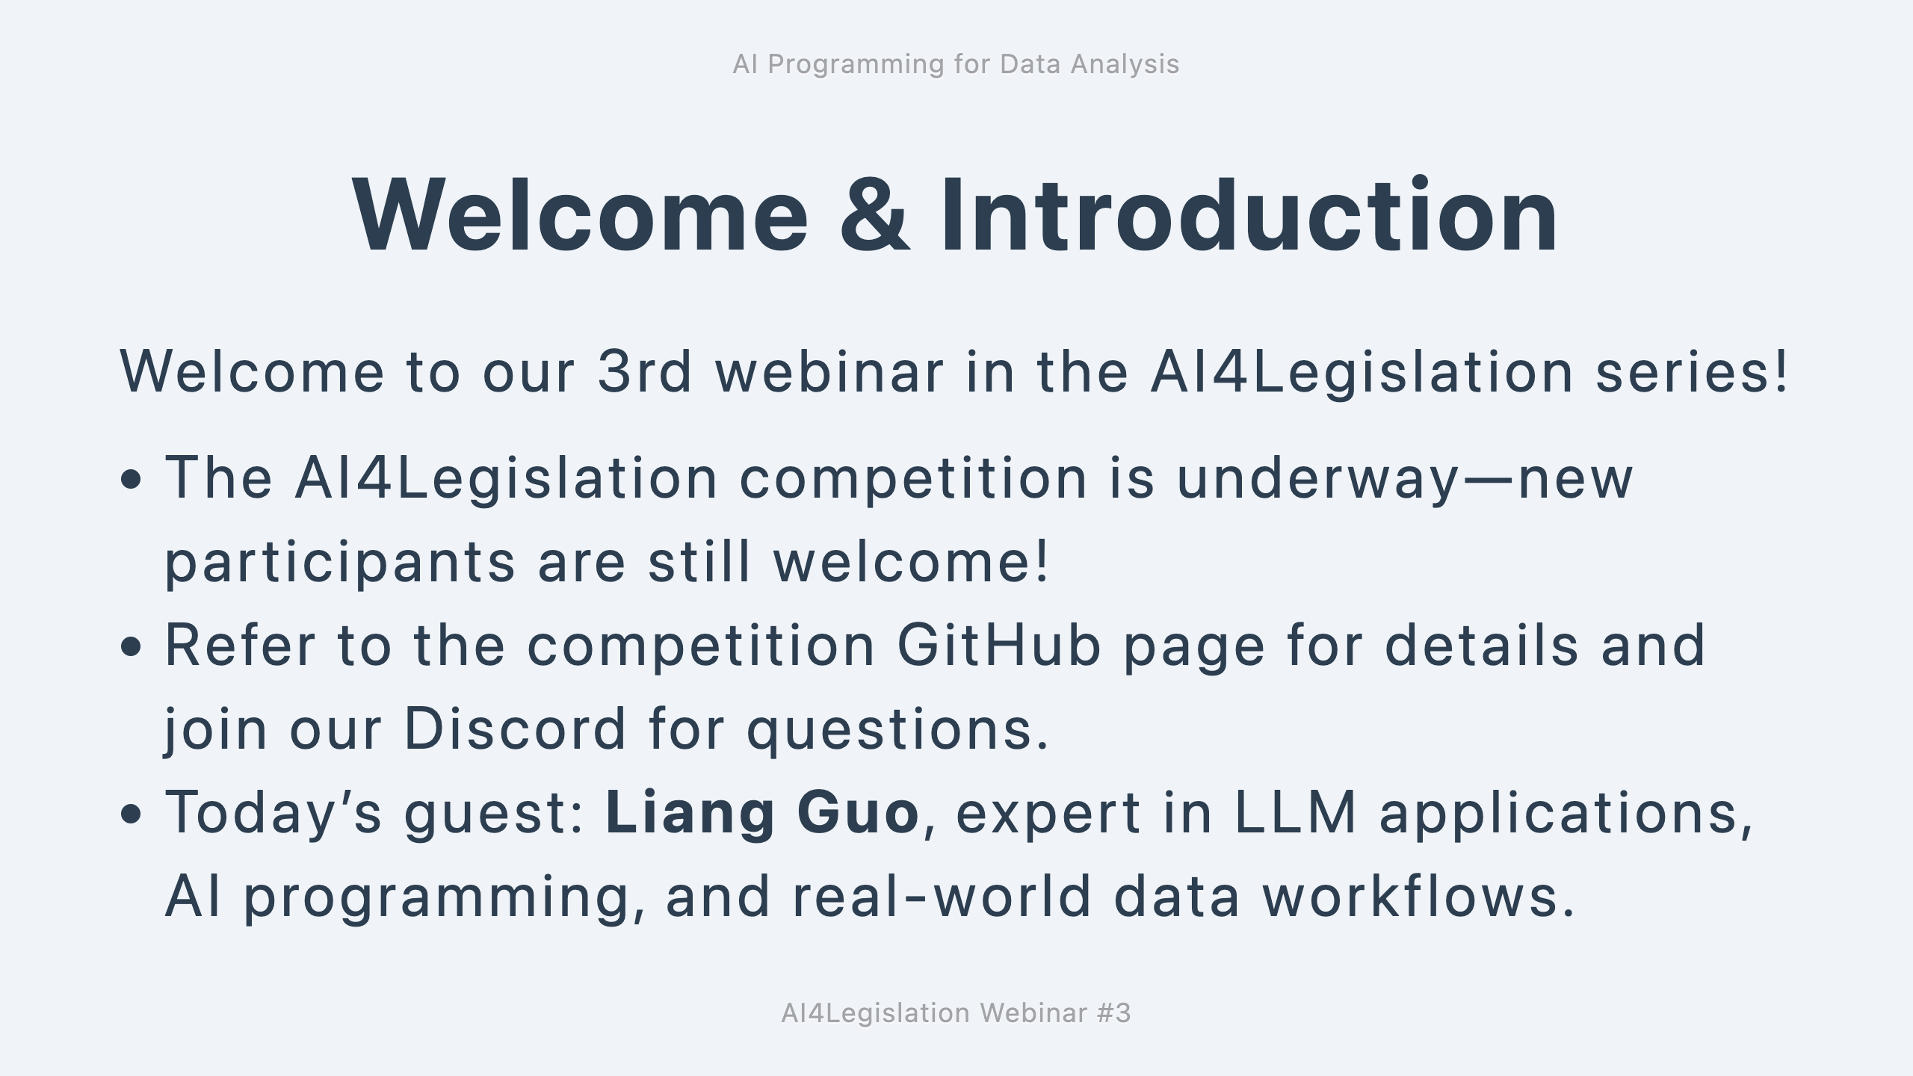

Slide 3
Degree in Computer Engineering - Stony Brook University, NY
Former JPMorgan investment banker with a passion for AI and technology
Co-founder of a B2B company that builds business solutions (currently based in China)
AI = god-given opportunity to achieve dreams that used to be impossible!

Slide 4
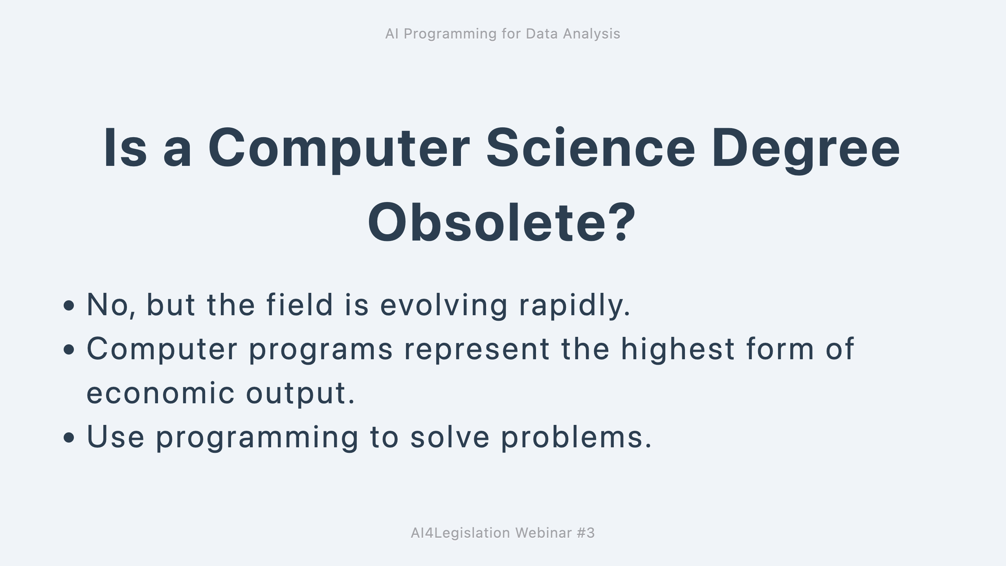

Slide 5
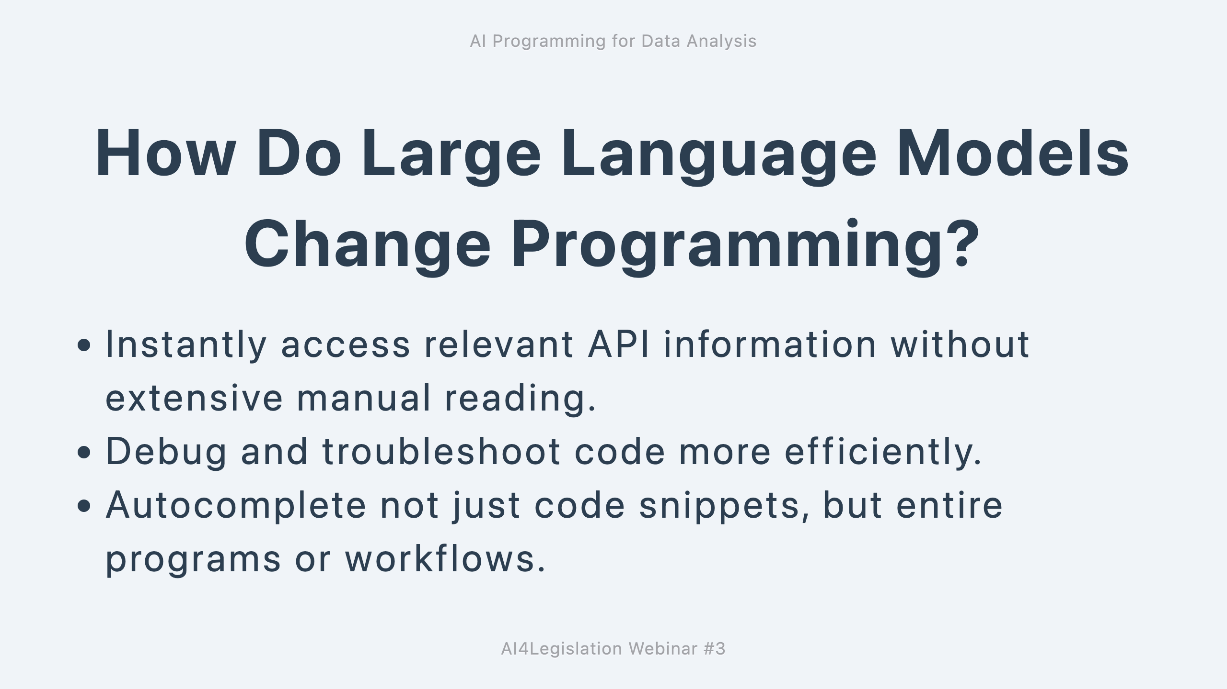

Slide 6
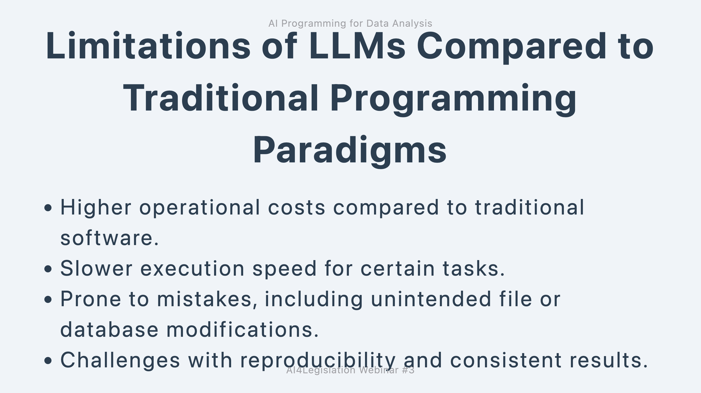

Slide 7
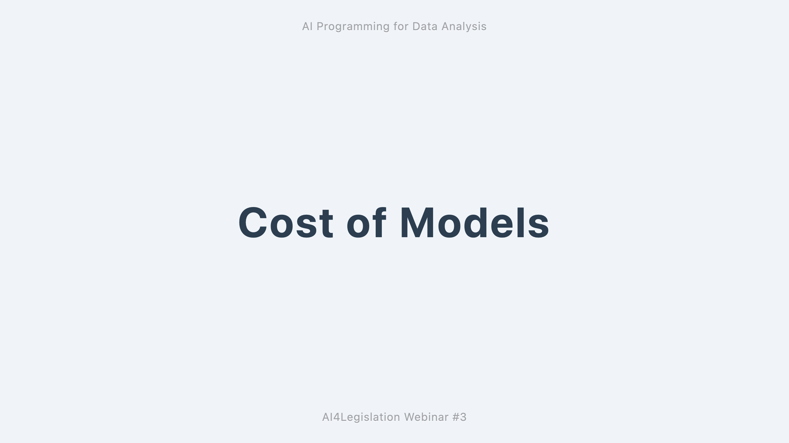
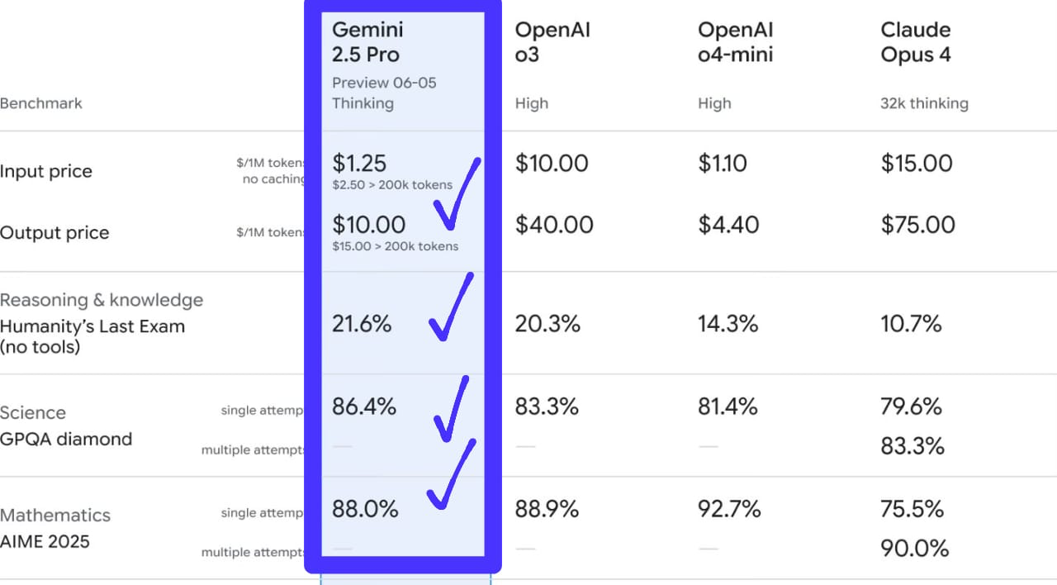
COST

Slide 8
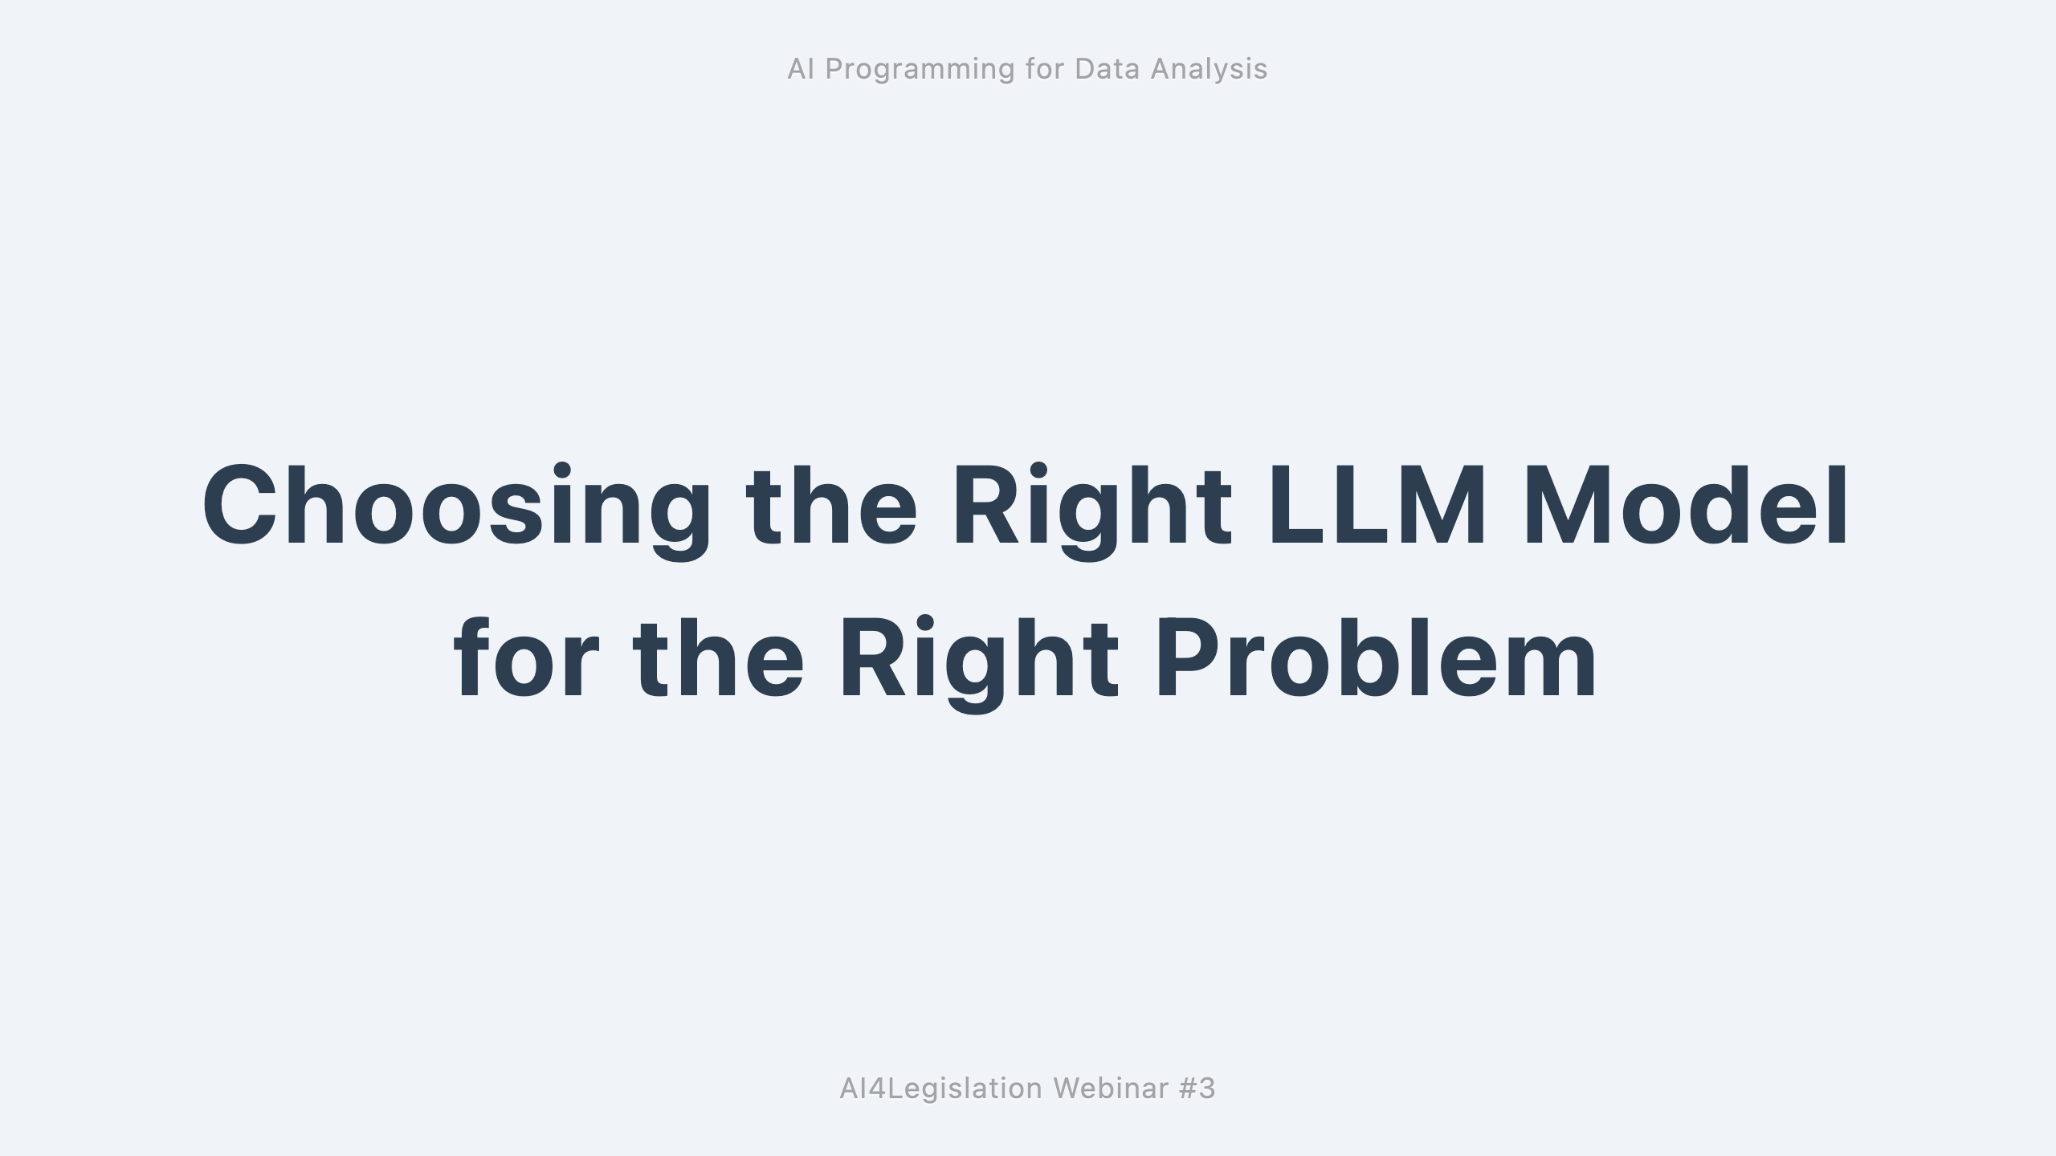
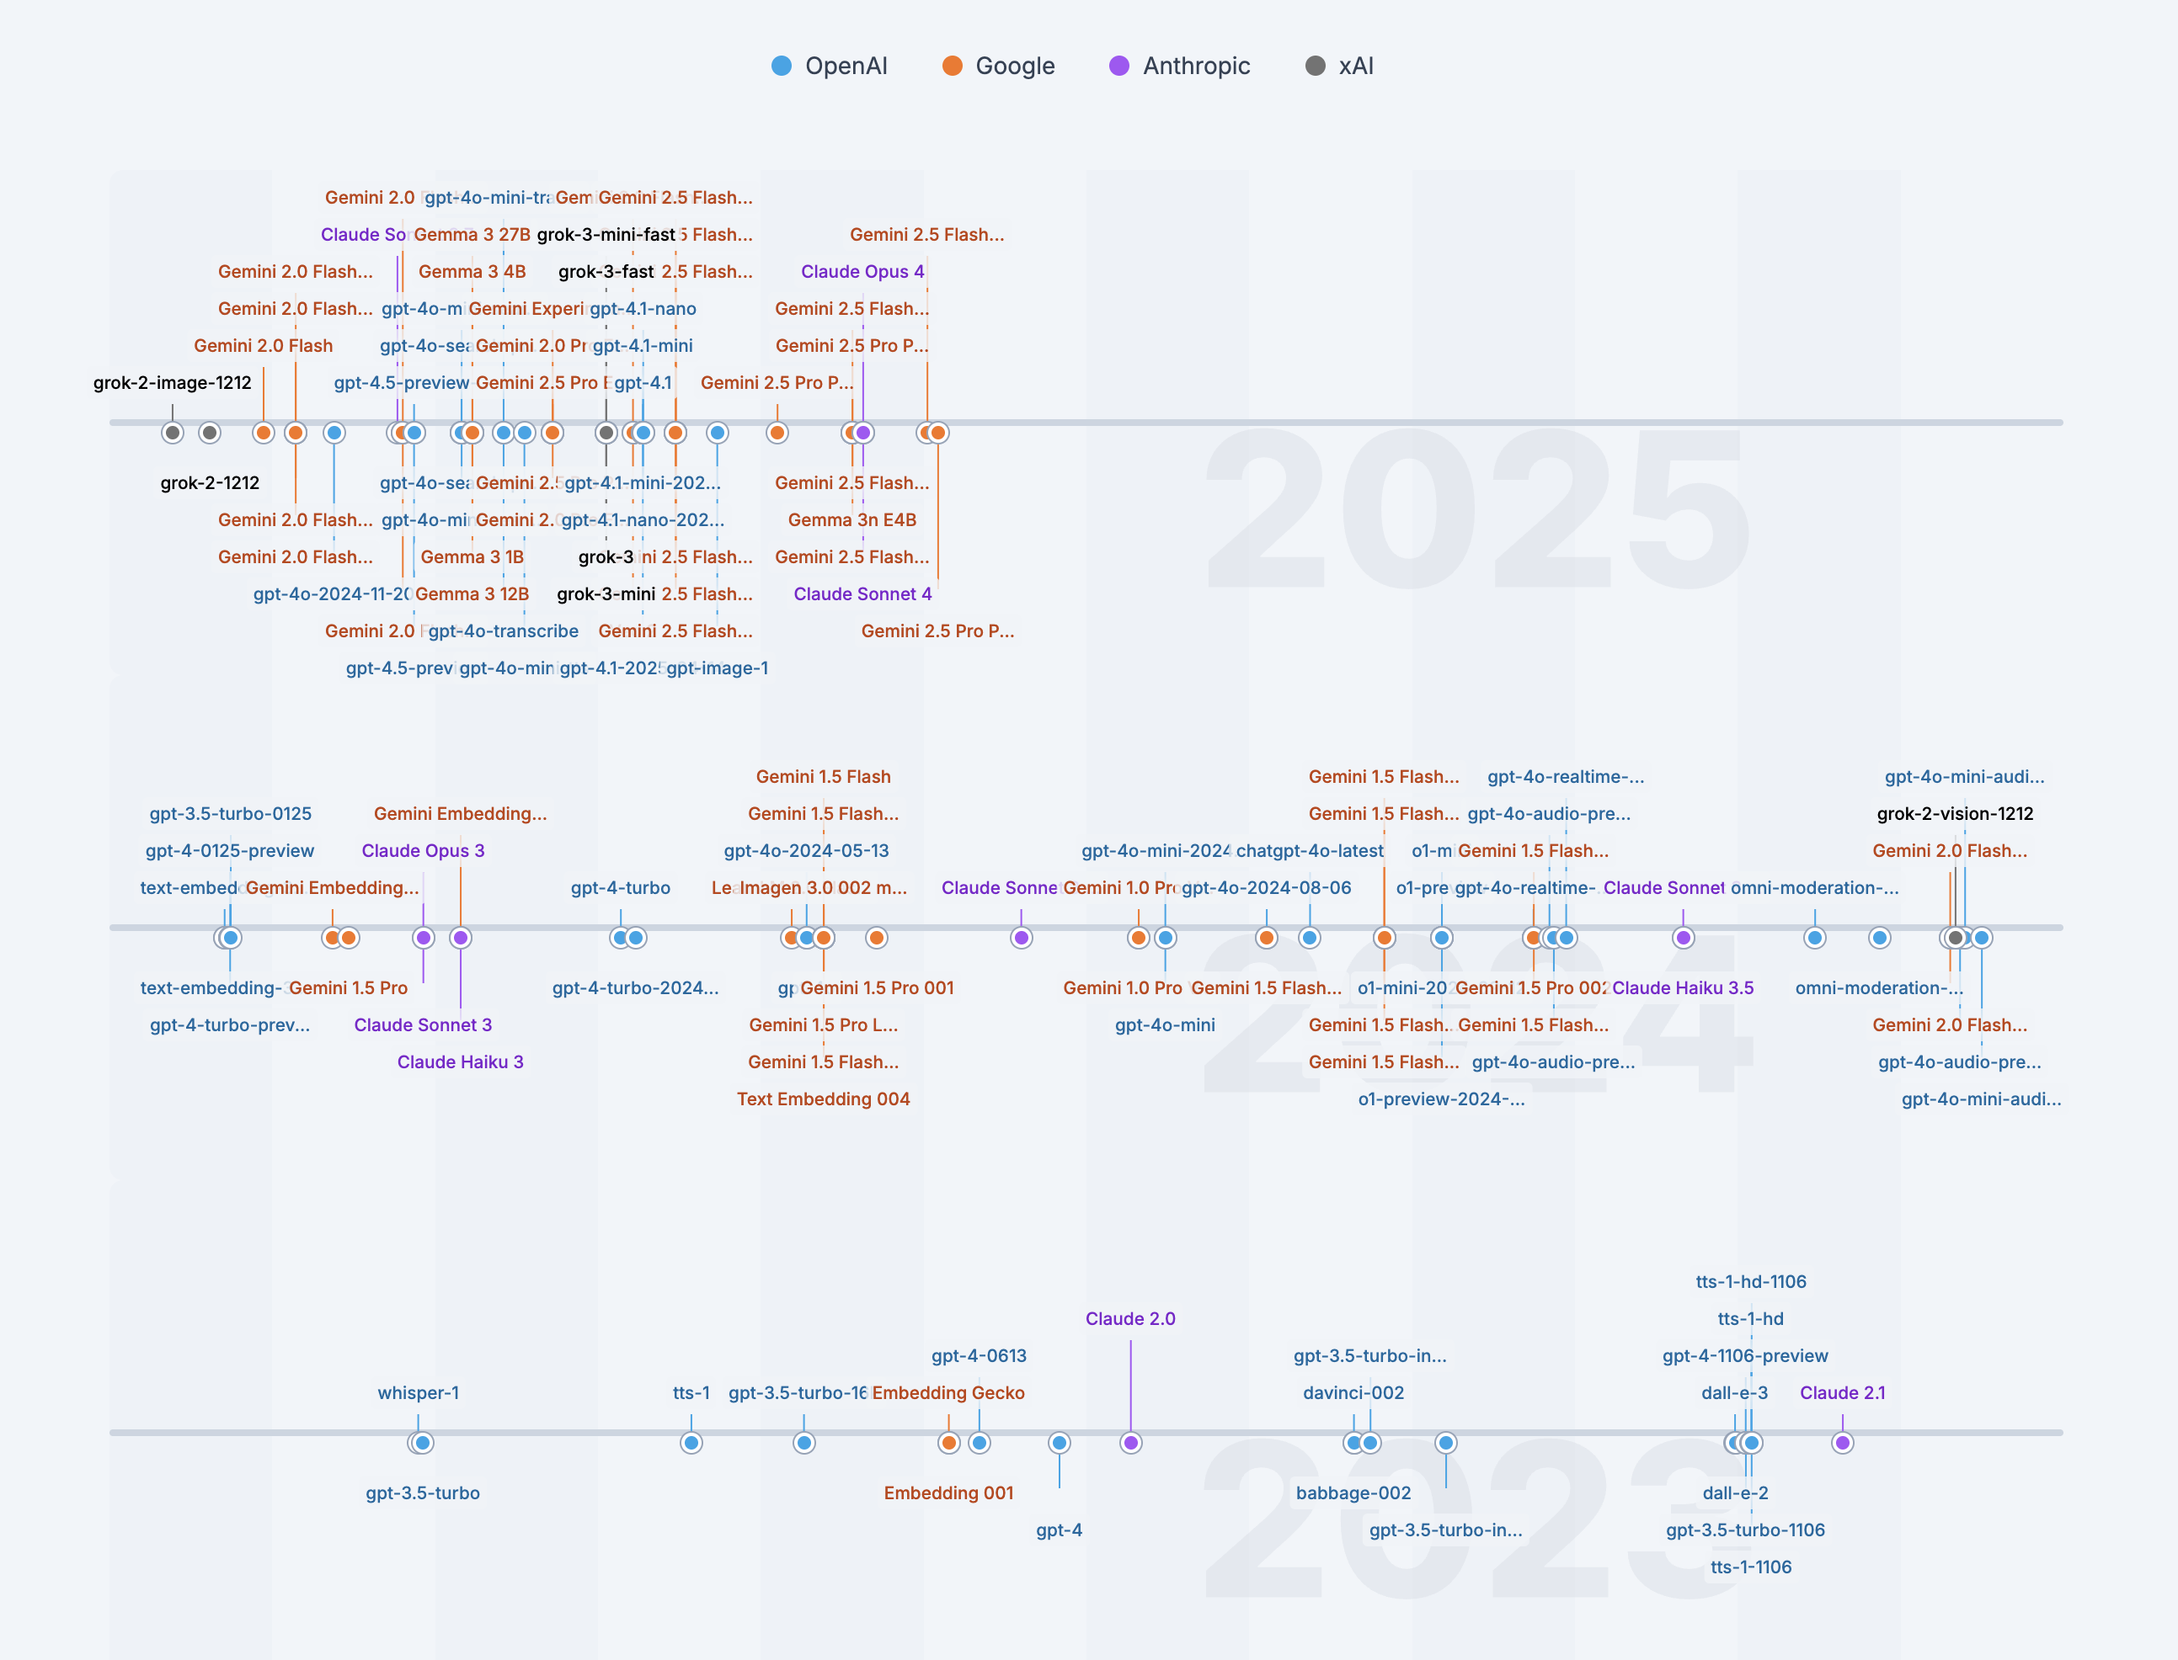
Notes:
[ai.lgnat.com/ai.html](https://ai.lgnat.com/ai.html)

Slide 9
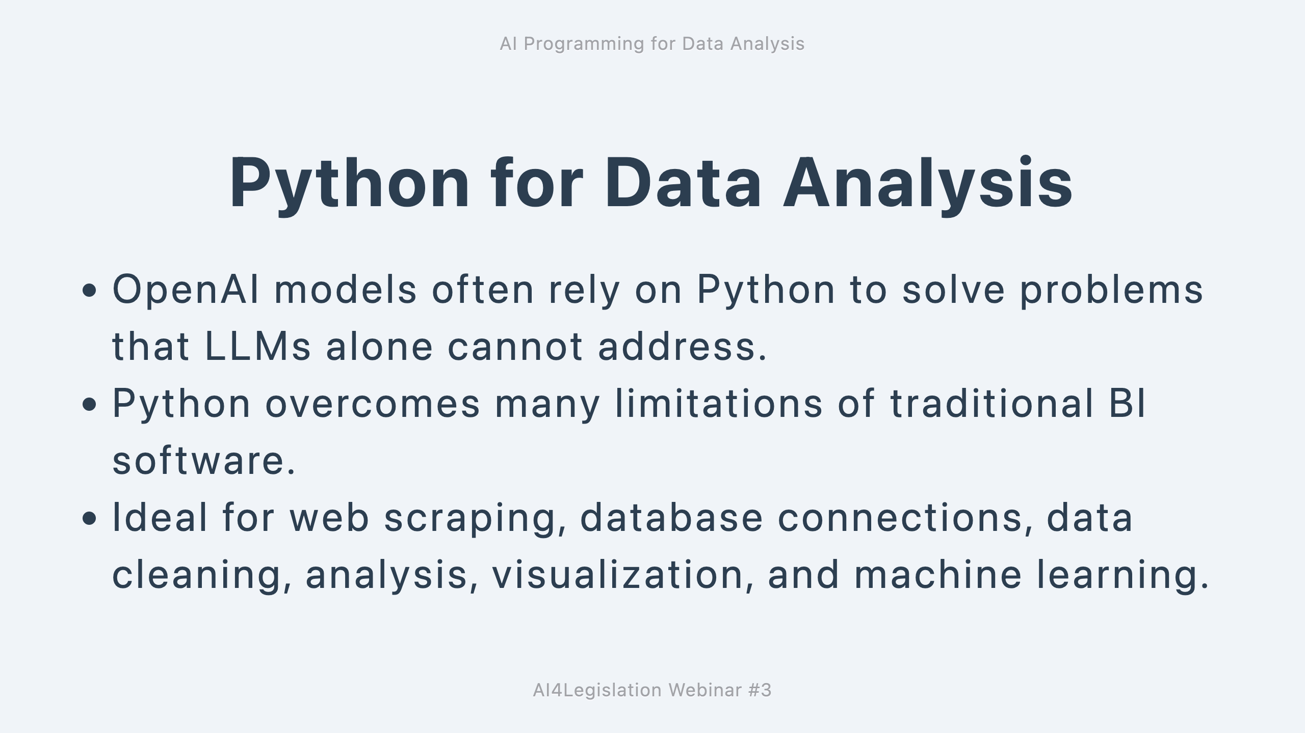

Slide 10
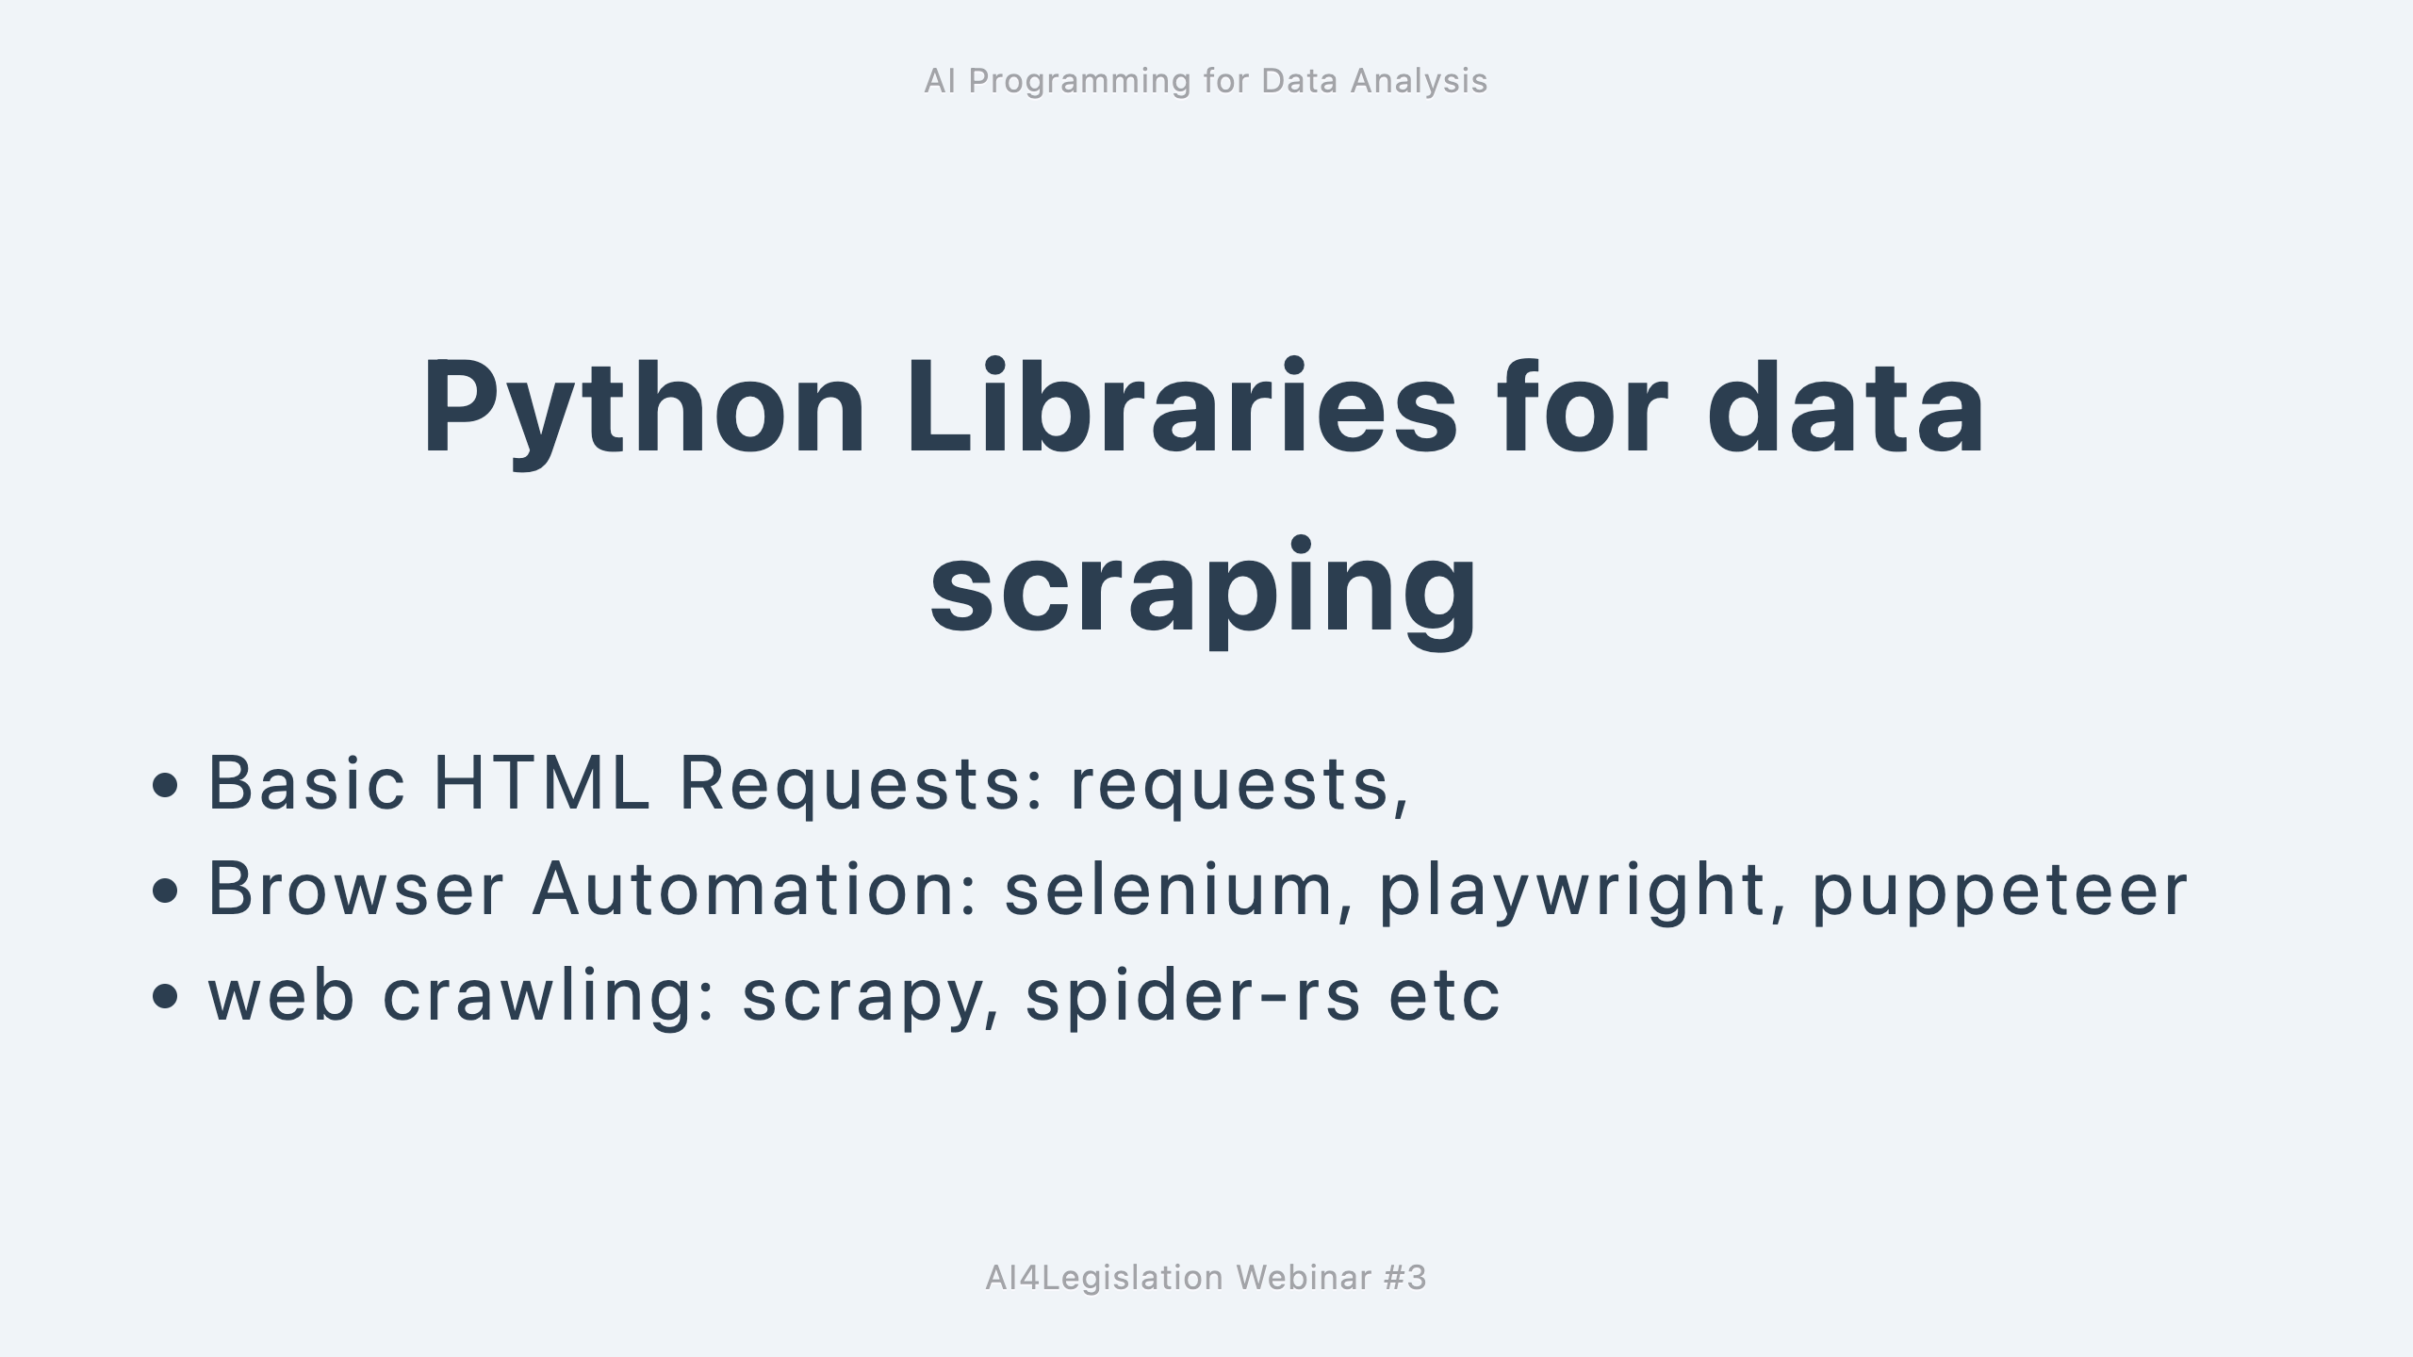

Slide 11
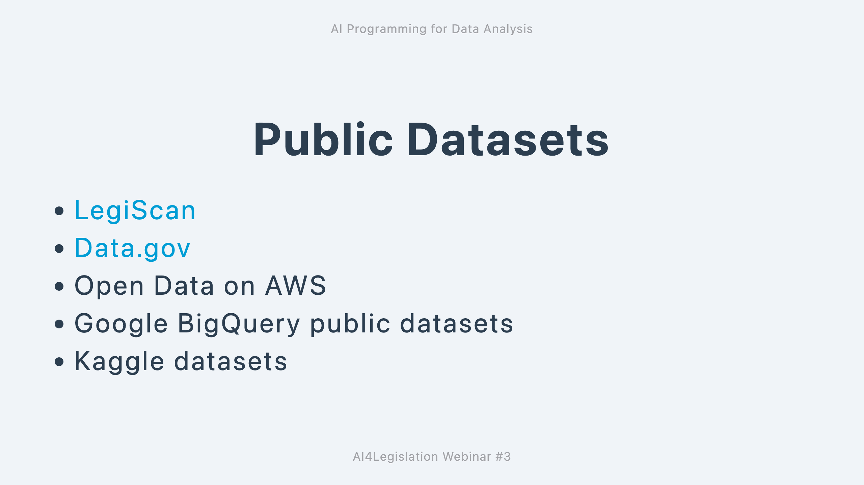

Slide 12
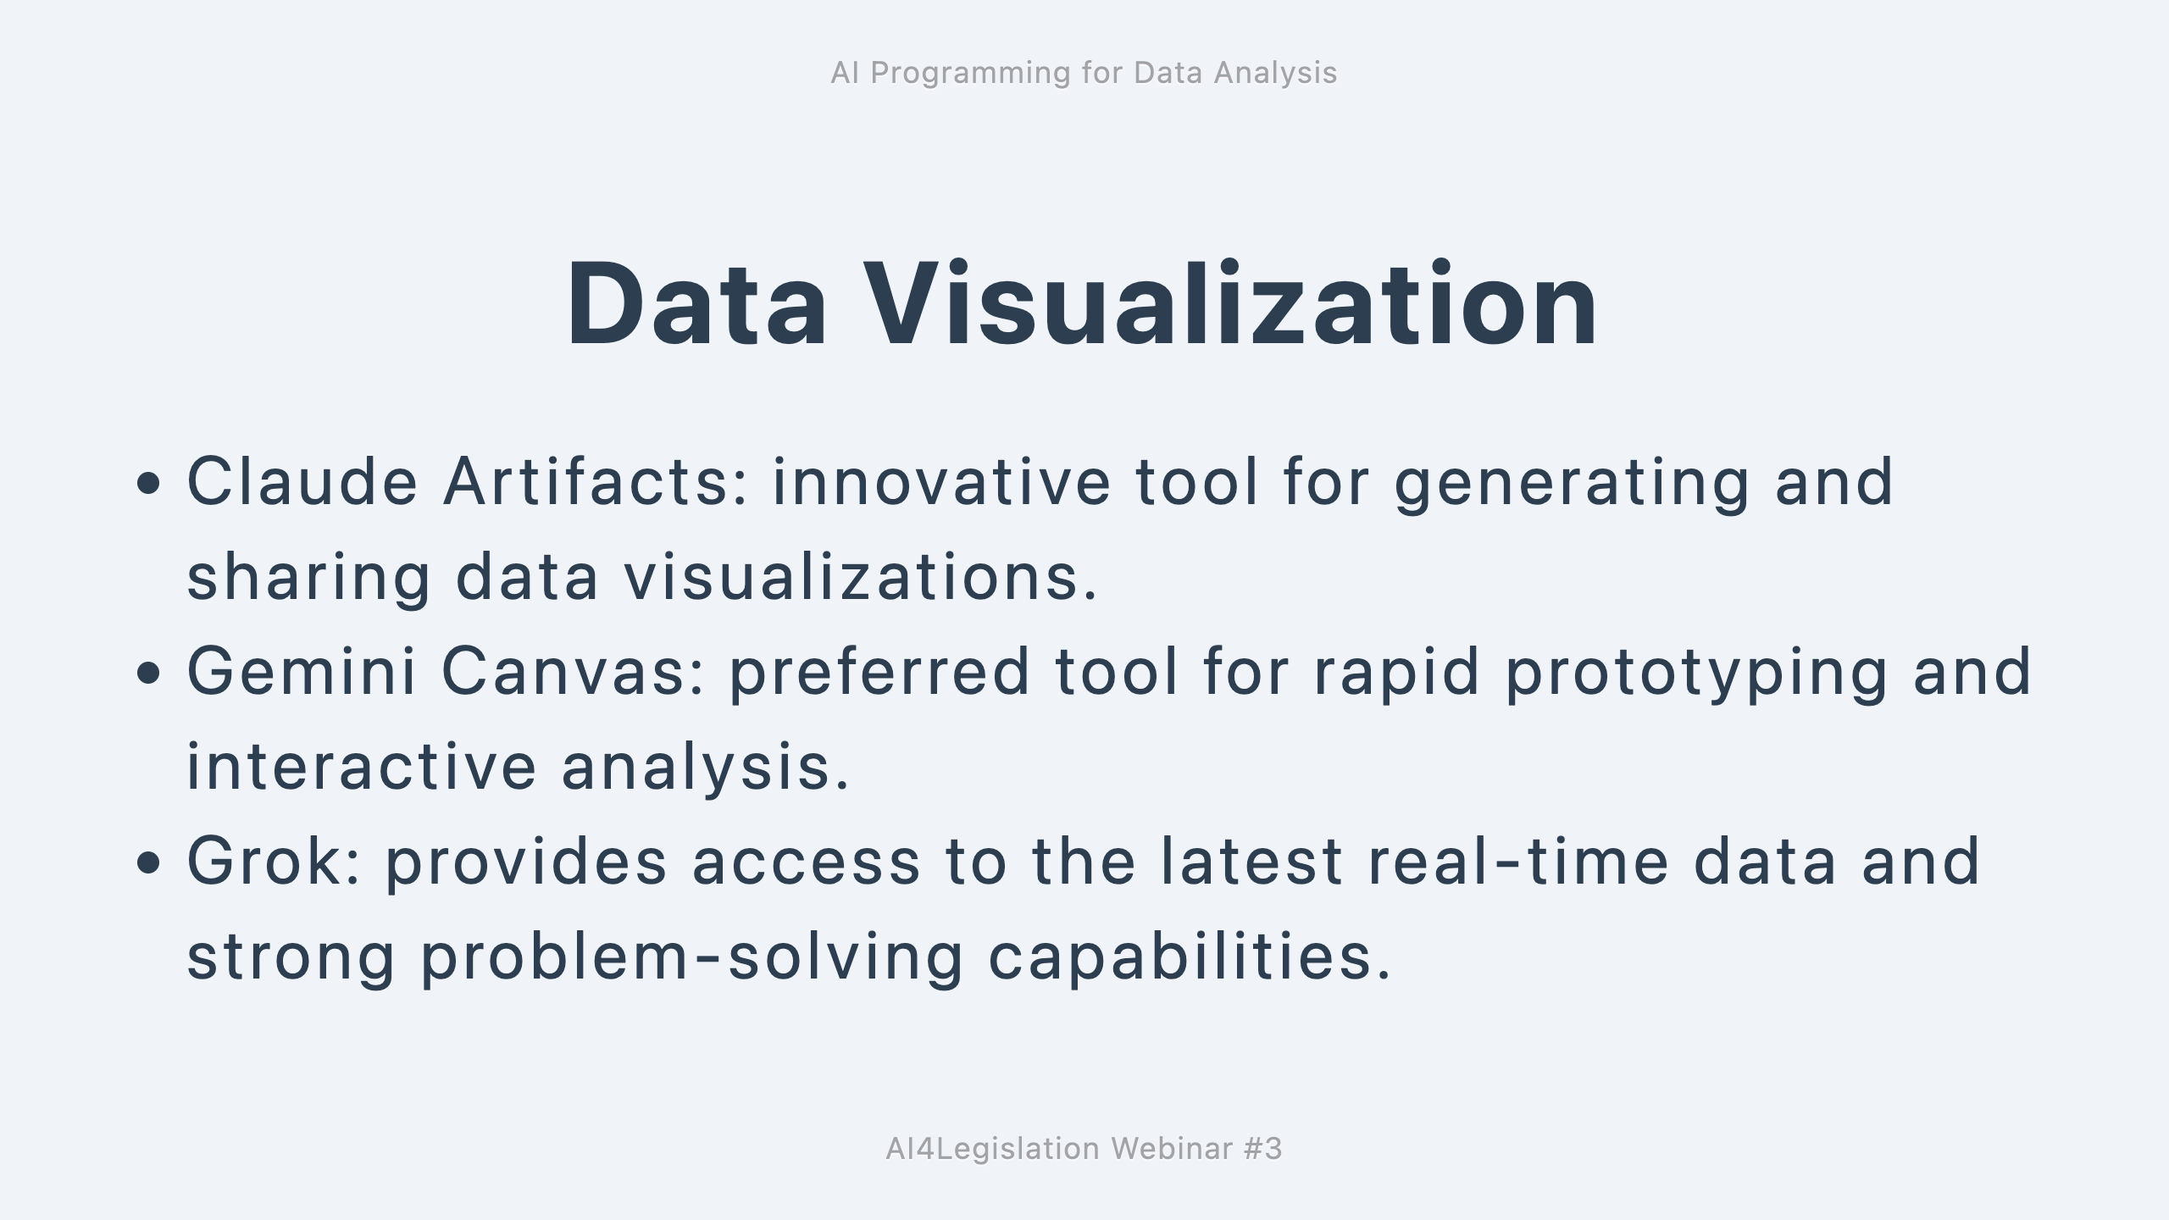

Slide 13
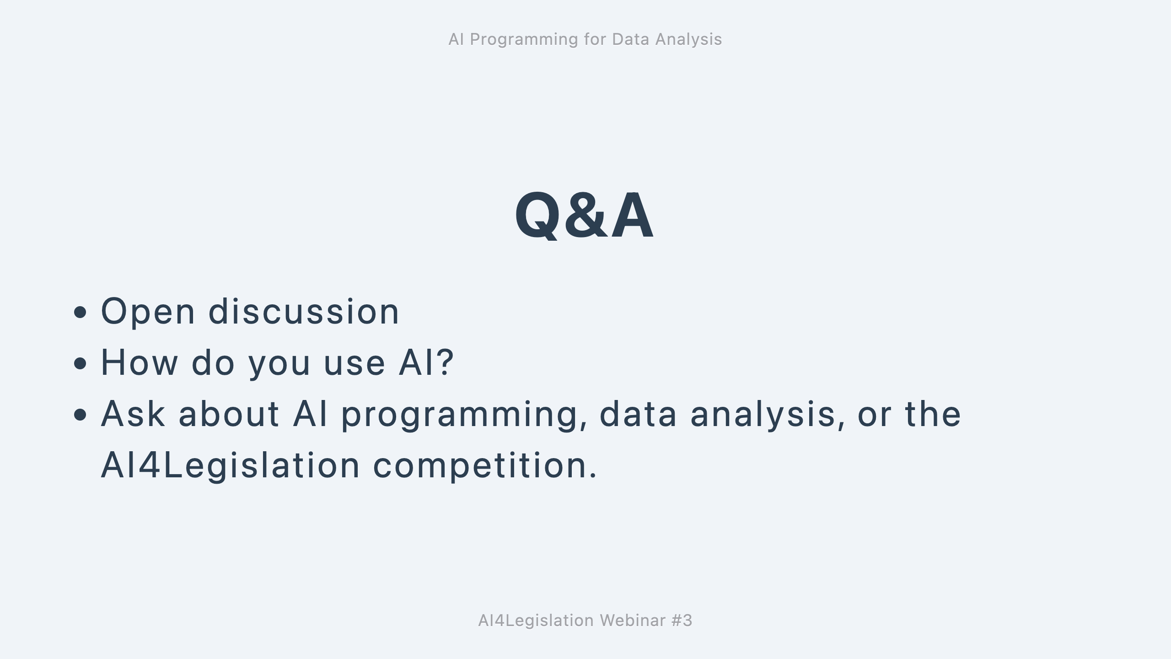

Slide 14
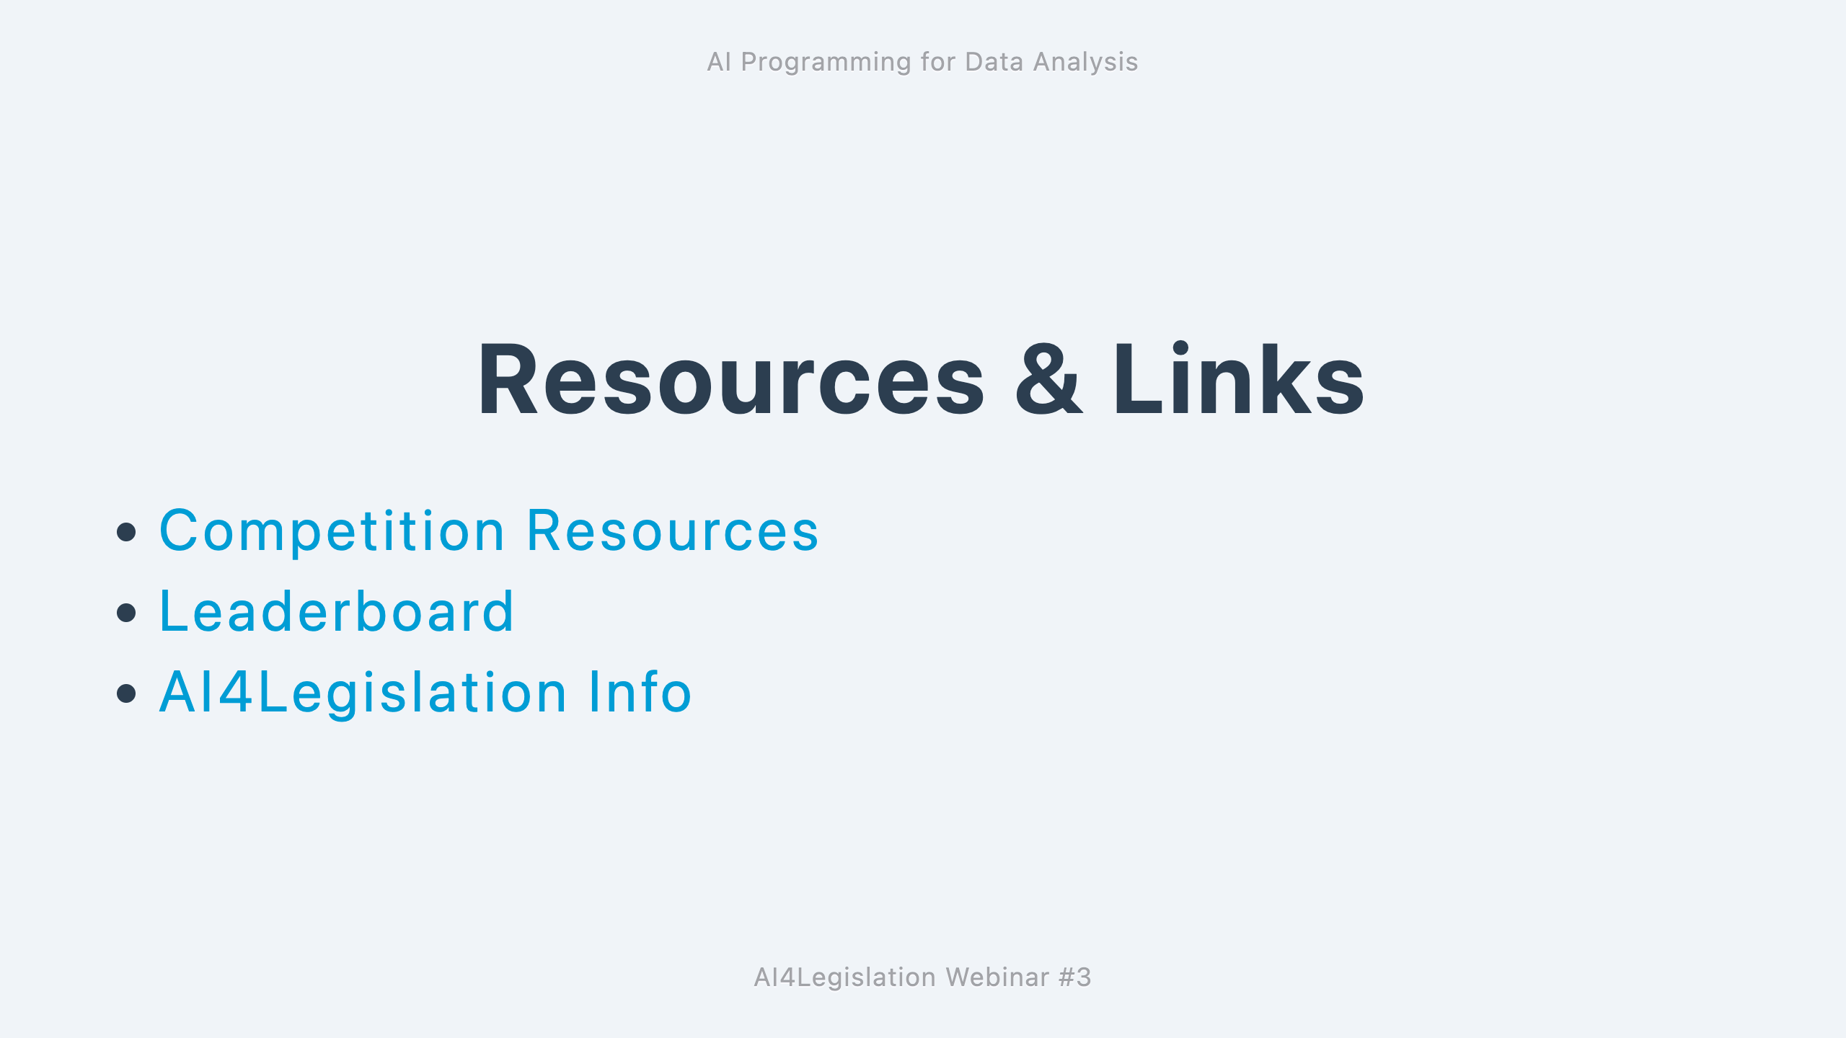

Slide 15
