Slide 1
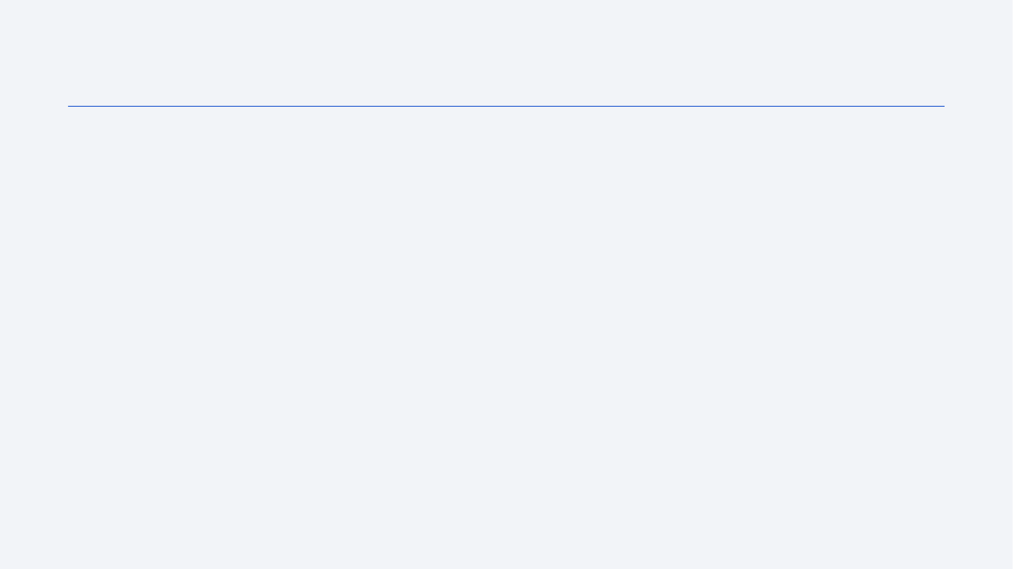
Data Collection
Data was combined from four independent sources — no single source contained every required feature.
LL2 API (primary, live REST calls) plus GCAT and course-provided JSON (static downloads) were merged into one launch dataset.
A Wikipedia launch table was scraped separately, used for the course's SQL and dashboard exercises.
All raw data is cached, transformed, and merged through a single reproducible pipeline (dataset.py).

Slide 2
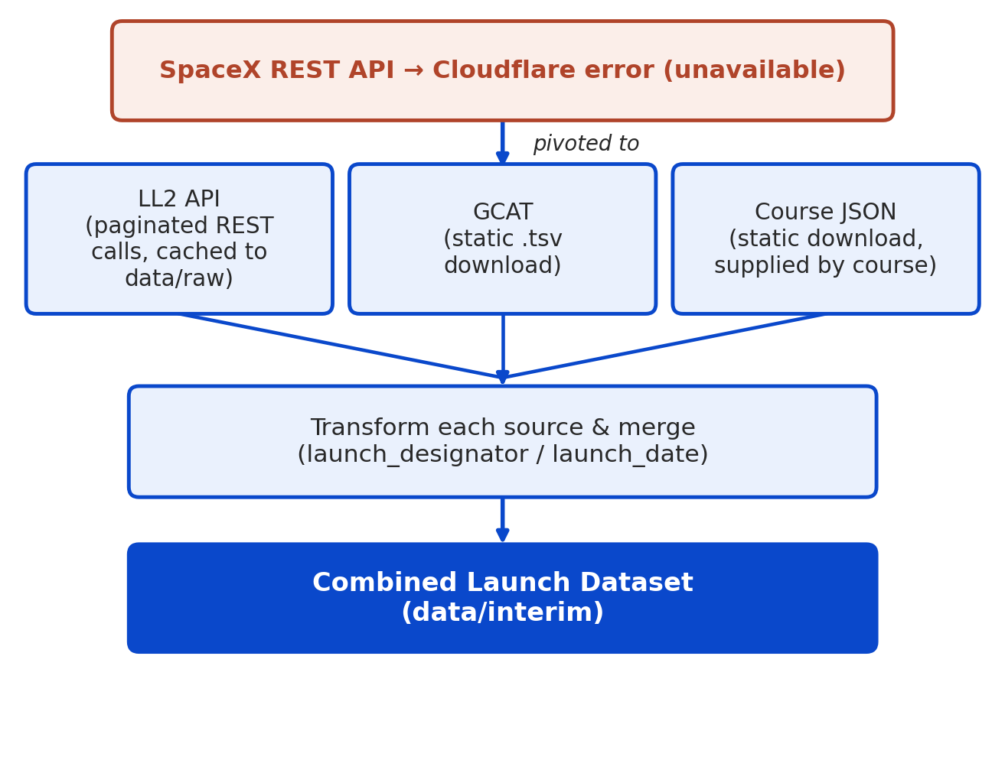
Data Collection – SpaceX API
Original plan: SpaceX REST API — returned a Cloudflare error, unavailable during collection.
Pivoted to Launch Library 2 (LL2) API — paginated REST calls (100 records/page), cached as JSON in data/raw.
Supplemented with GCAT (McDowell) and course-provided static JSON for payload capacity and landing-gear fields.
Sources merged on launch_designator / launch_date (dataset.py).
GitHub notebook: [insert URL]

Slide 3
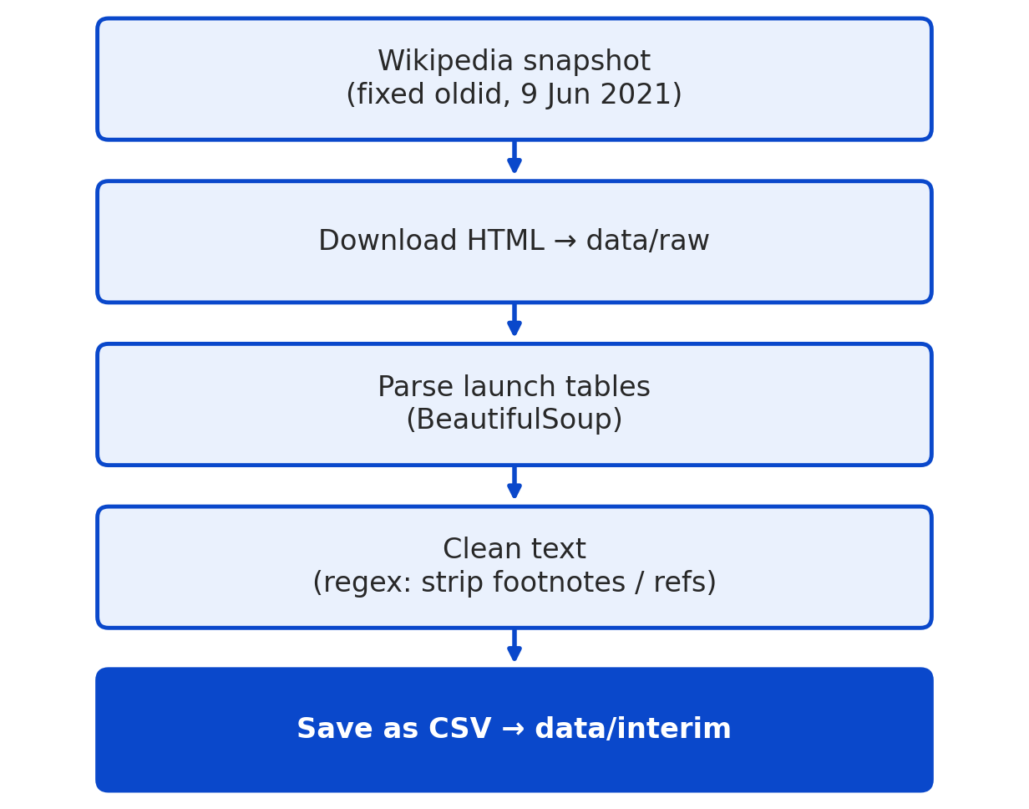
Data Collection - Scraping
Scraped “List of Falcon 9 and Falcon Heavy launches” — a fixed Wikipedia snapshot (oldid, 9 Jun 2021) for reproducibility.
Parsed launch tables with BeautifulSoup; regex removed footnote/reference markers.
Only unique field gained: the mission Description text.
Not used as a model feature — written after the outcome, so it would leak the label.
GitHub notebook: [insert URL]

