Slide 1
INVESTIGATING THE EFFECTS OF SOCIAL MEDIA USAGE ON MENTAL HEALTH
Deepak Subramani Velumani
dsubrama@ur.rochester.edu
Masters in Computer Science

Slide 2
Problem Statement
According to a survey done by Statista the number of people on the social media in 2020 were around 3.6 billion people and by 2025 the number is projected to be around 4.41 billion. In the same survey it has been estimated that the average user spends around 144 minutes per day. If this is the case then mining of the sentiment of social media is important as it can give us important correlation in the data with respect to sentiments on mental health.

Slide 3
Solution
In this proposed study, I am doing an Investigation on the effect of mental health using Twitter data.
I have taken random tweets of 3000 twitter users and using their tweets data as Input I have generated the sentiments of these 3000 people and classified them as happy and sad with value of 0 to 1 using the VADER sentiment analysis tool.
There are many attributes that I have taken into account for the sake of deriving a relationship between mental health and social media usage I will list them out

Slide 4
Challenges
A lot of user attribute had noises, detecting them and selecting a big set of 3000 was a big challenge
Another challenge was to determine the location from the twitter data as many people are not consistent while typing the location
Many people do not upload their own profile picture, eliminating wrong profile picture itself is a big problem.

Slide 5
Twitter Data
I have selected 3000 user’s twitter data and it had around 50 attributes.
To scrape the user’s data, twitter doesn't allow us to select a random set of users but it allows us to search for tweets so I searched for top 50 words used in twitter, and searched for tweets that contain any of them and selected the user name from that and scraped the user using the user name.
The timeline off the tweets of the 3000 people are from the past 12 years.

Slide 6
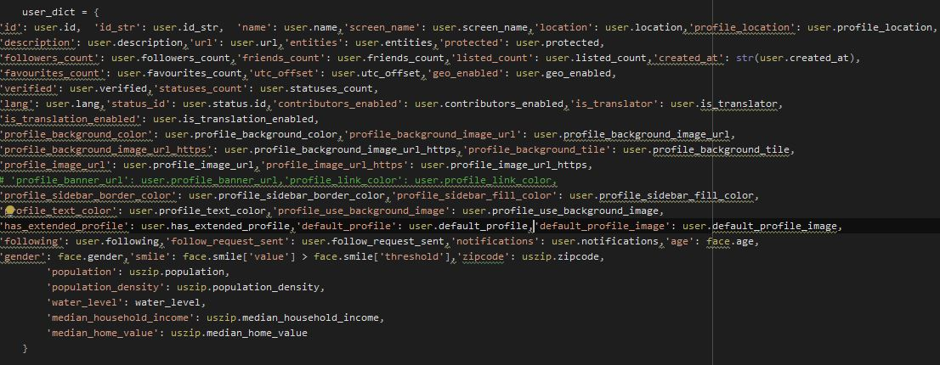
Twitter User Attributes

Slide 7
Experimental Results for Attributes
Below are the attributes which were evaluated based on the sentiments provided by the VADER sentiment analysis tool. I have evaluated the graphs and plotted them based on the results that I have received.
The X-axes in the graph represents the sentiments and the Y-axes is the frequency of variable that is specified in the title.

Slide 8
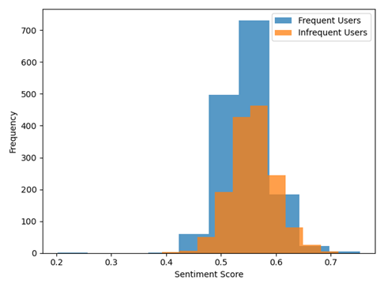
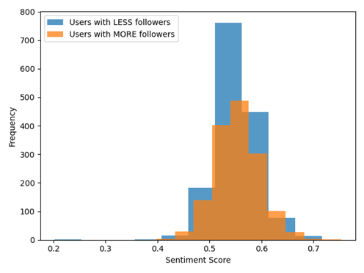
Frequency of user & Followers Attribute plots

Slide 9
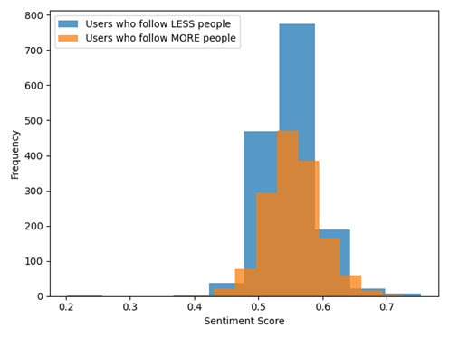
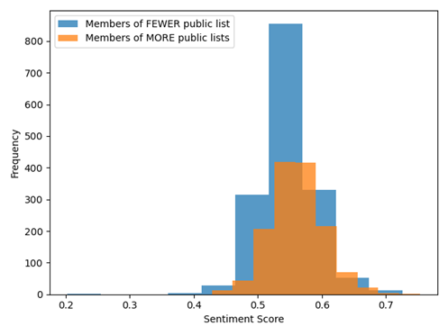
Number of Friends and Listed Attribute Plots

Slide 10
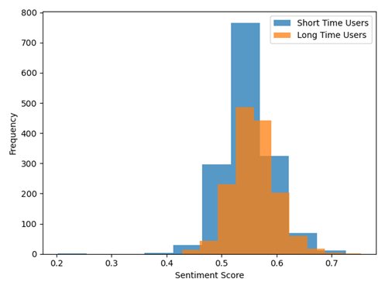
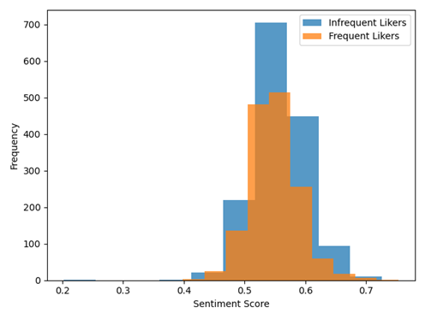
Duration and Likes Attribute Sentiment Plot

Slide 11
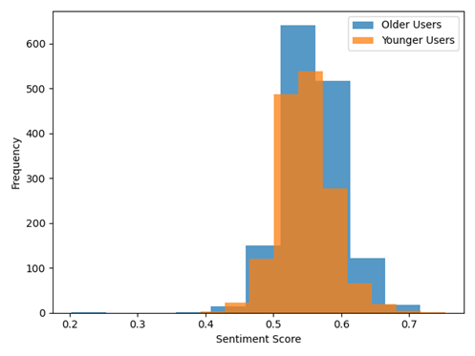
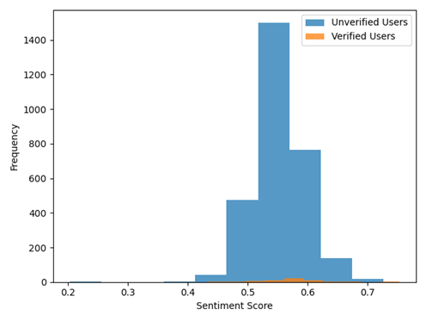
Verified and Age Attribute Sentiment Plot

Slide 12
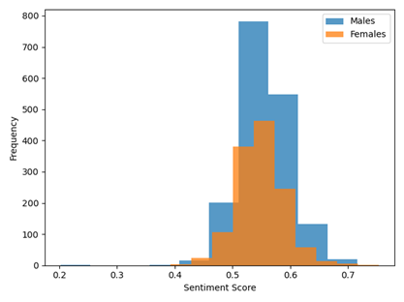
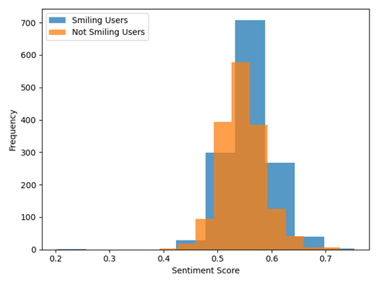
Gender and Smiling Attribute Sentiment Plot

Slide 13
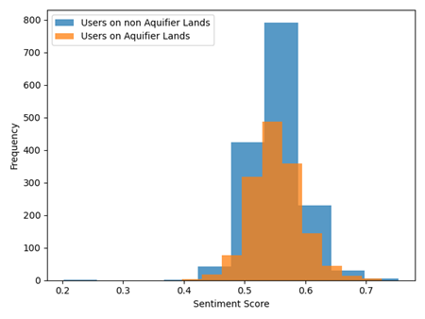
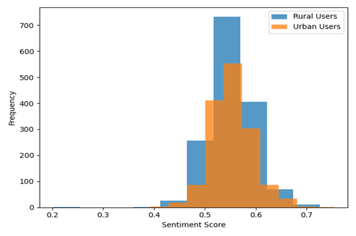
Population Density and Water Level Attribute Sentiment Plot

Slide 14
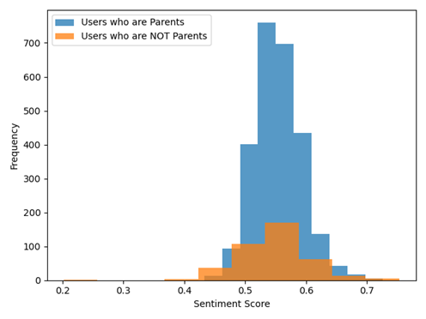
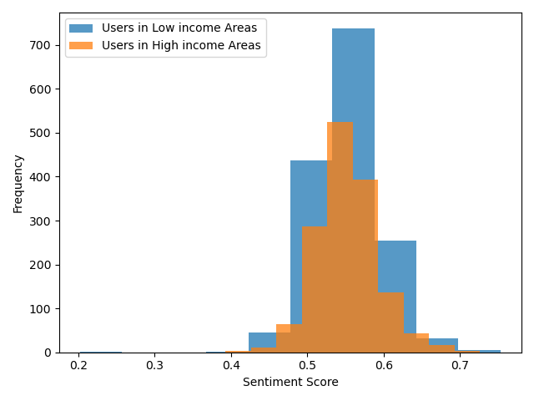
House Income and Parenthood Sentiment Plot

Slide 15
Summary
The aim of this study was to find out the correlation of the user attributes and the LIWC features with the emotional sentiment of the user. In which we were successful in getting the relationship between the attributes.

Slide 16
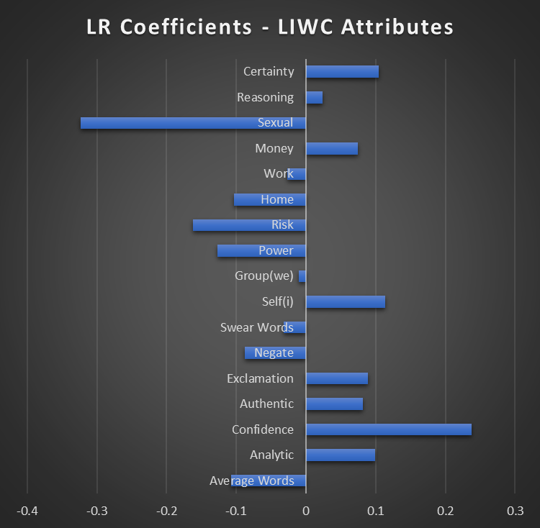
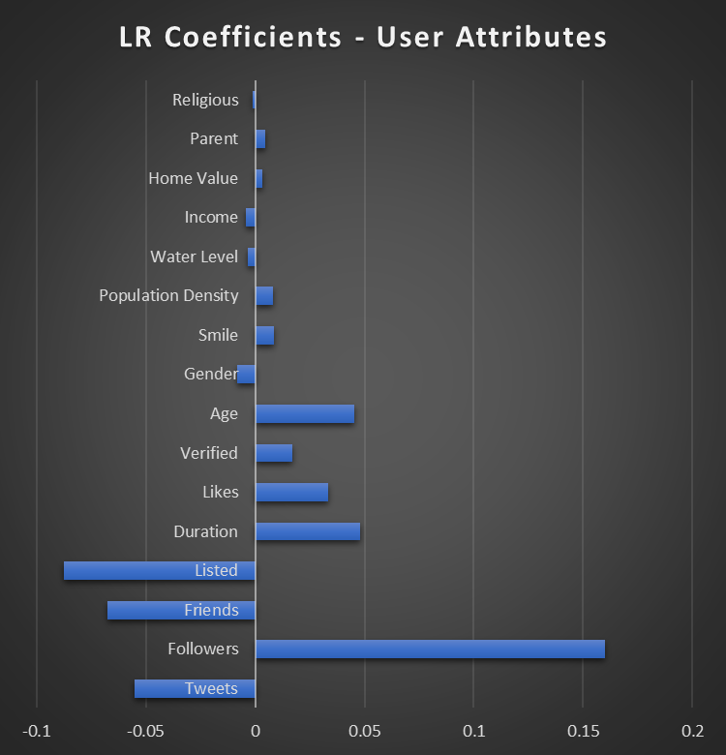
Linear Regression Coefficients

Slide 17
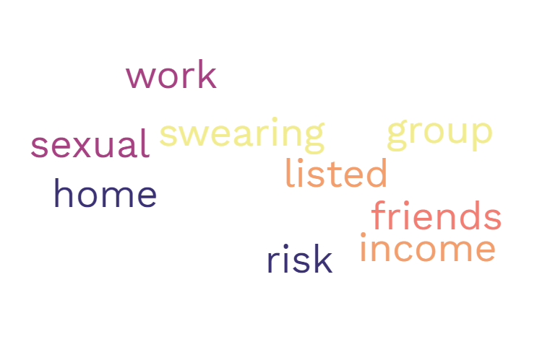
Word cloud of Attributes that contributed to the damage of mental health:

Slide 18
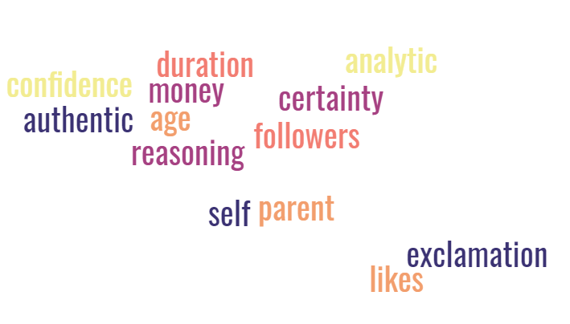
Word cloud of Attributes that contributed to the happiness sentiment:

Slide 19
Annexure
To visualize the raw correlation between the various attributes and the VADER sentiment values I have added the scatter plots in the next slides.

Slide 20
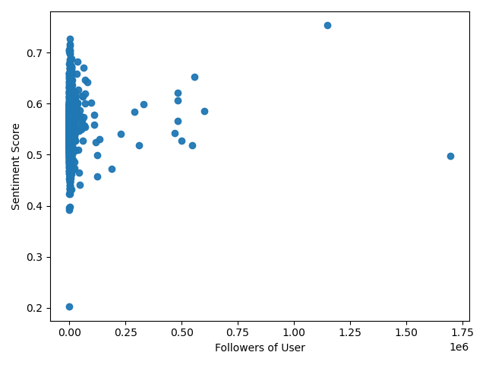
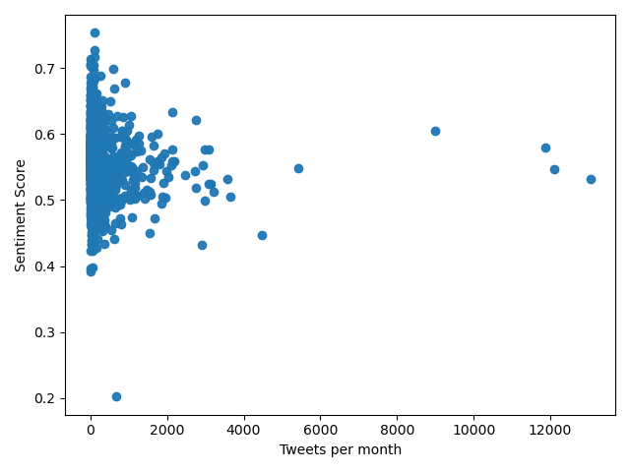
Frequency & Followers Attribute plots

Slide 21
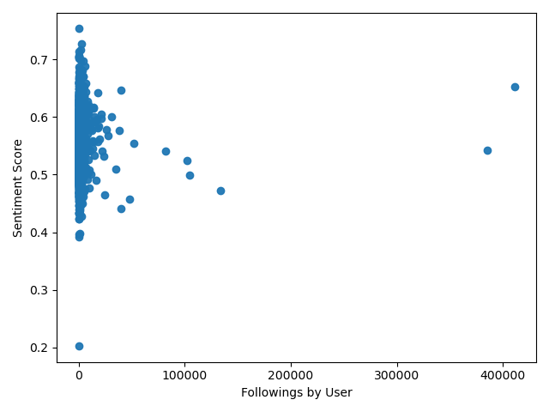
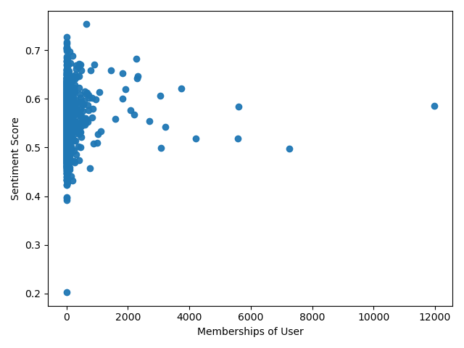
Number of friends and Listed Attribute plot

Slide 22
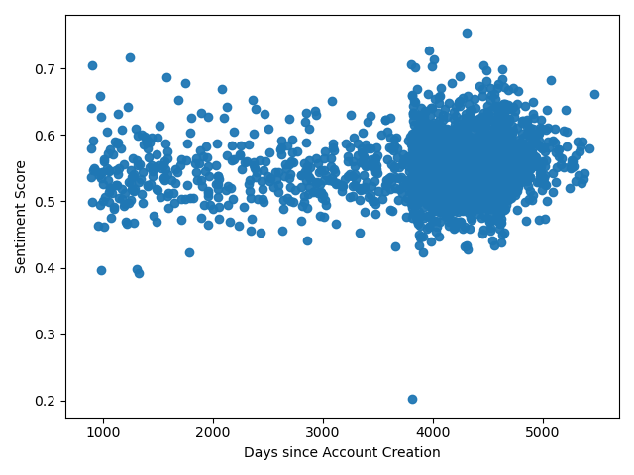
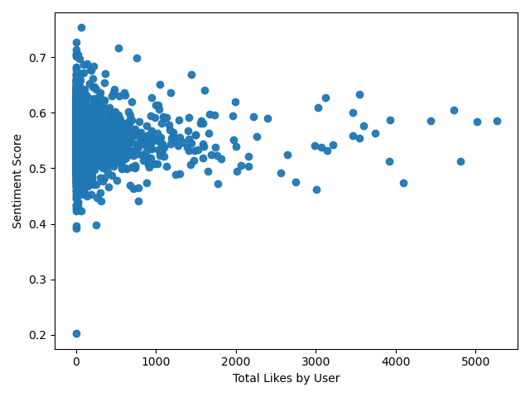
Duration and Likes Attribute sentiment Plot

Slide 23
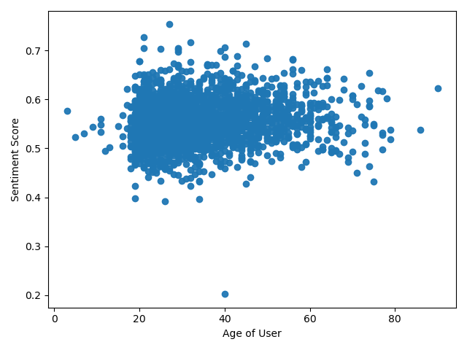
Age Attribute sentiment Plot

Slide 24
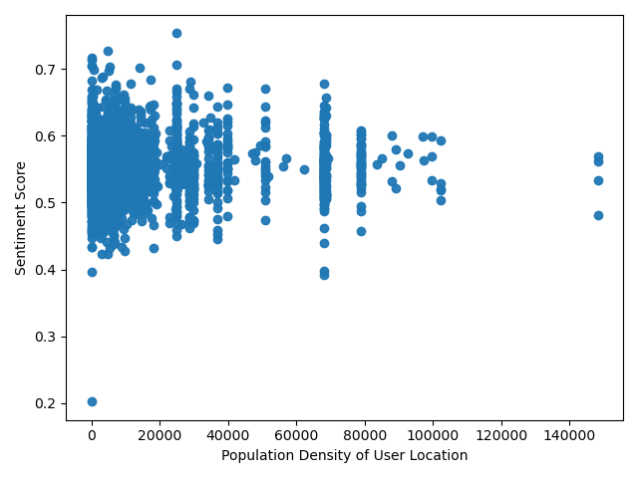
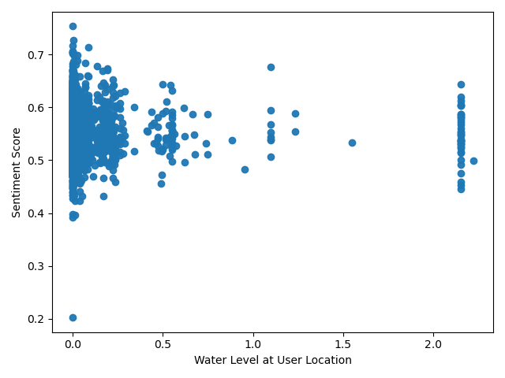
Population Density and Water level Attribute sentiment Plot

Slide 25
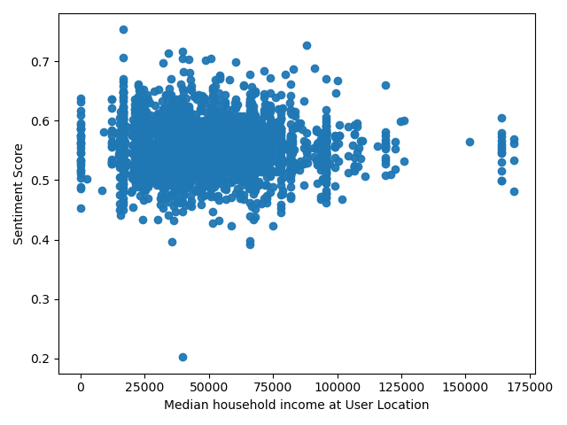
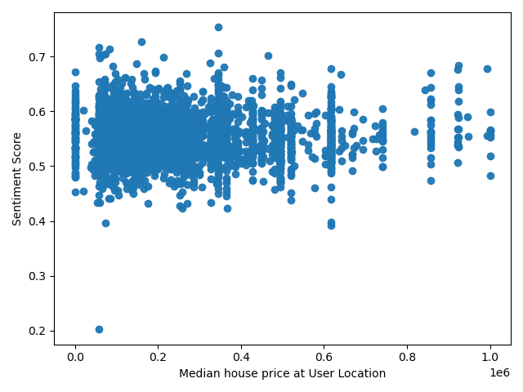
Income and Home value Attribute sentiment Plot

