Slide 1
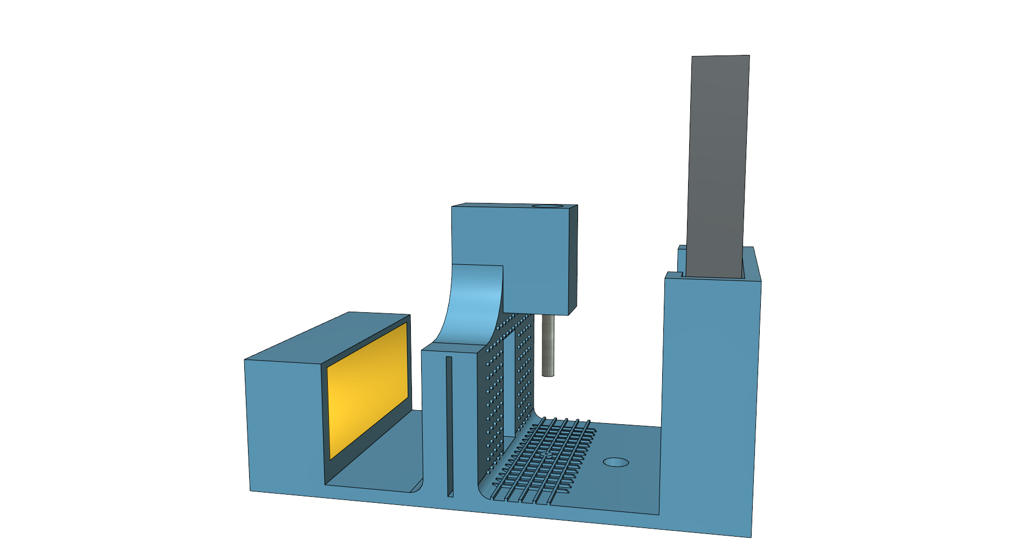
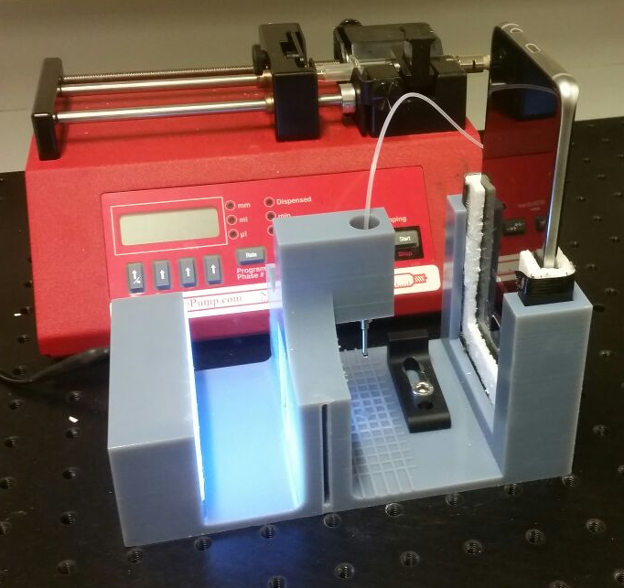
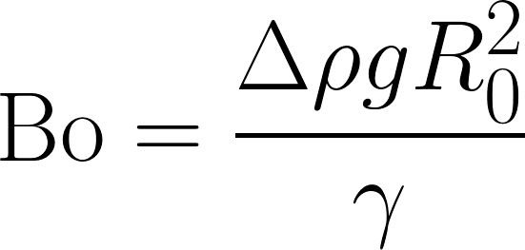

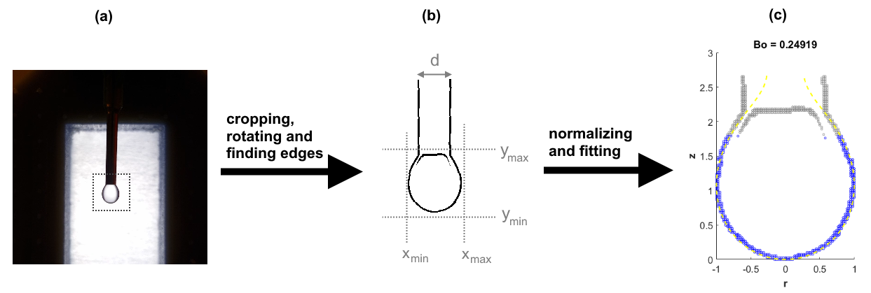
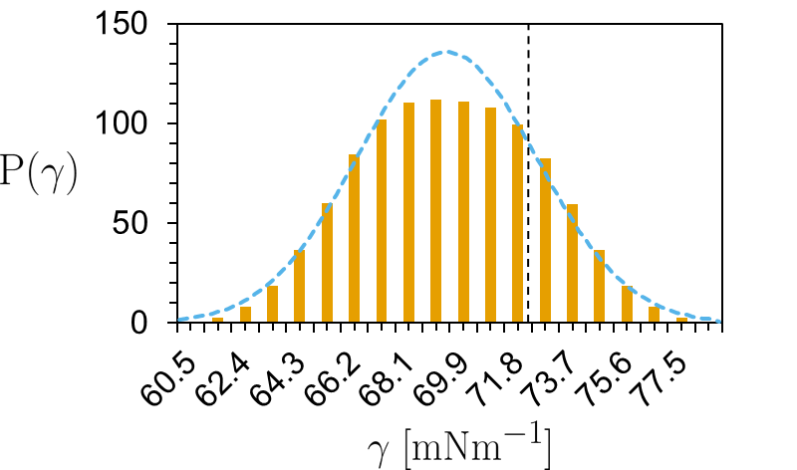
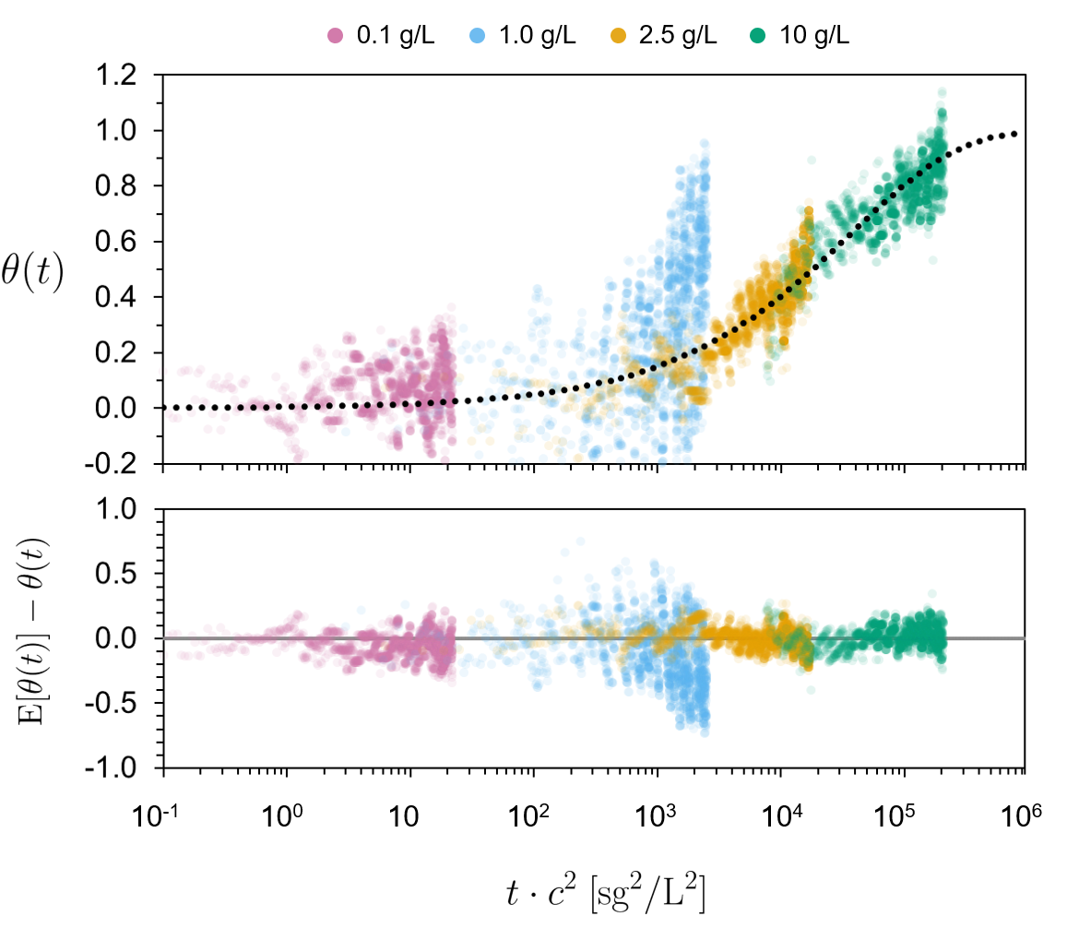
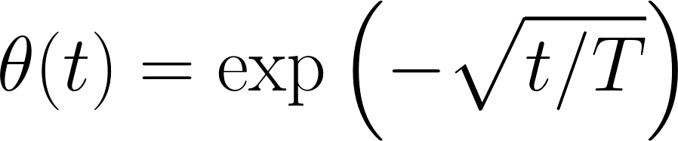


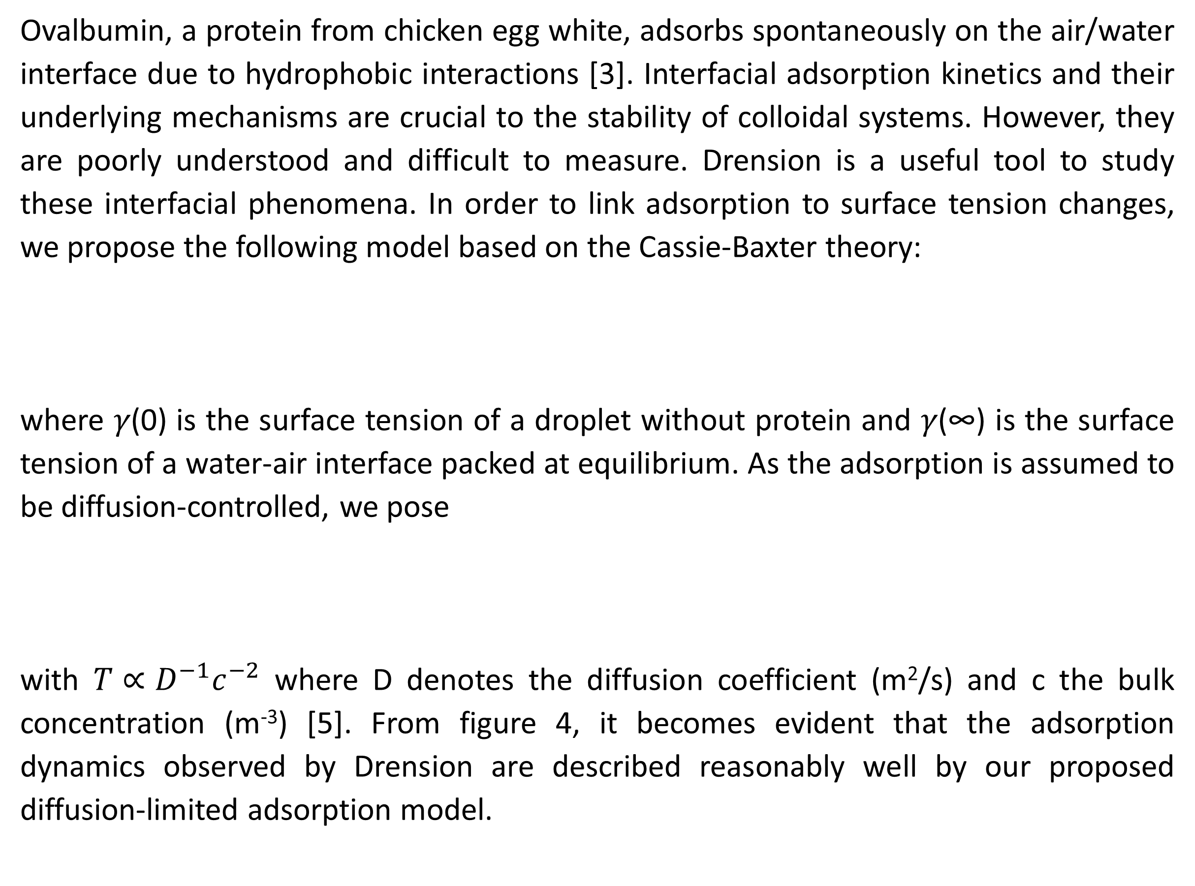
Drension: the low-cost, open-source
pendant drop tensiometer
Sjoerd van Dongen, Lars Kool, Zoë Peters
Aim
Surface tensiometry is widely used to study surfactants. However, due to the inherent inaccuracy of the Wilhelmy plate method [1] and the expensive and closed-source pendant drop setups, surface tensiometry is not used to its full potential [2]. We provide a low-cost, 3D printed pendant drop setup using a mobile phone as camera, shown in figure 1, with custom open-source data-processing software (written in MATLab). To show the power of this setup and software, we used this setup to study the adsorption kinetics of ovalbumin to the water/air interface.
Figure 1. 3D model of the pendant drop setup (left) and photograph (right).
Methodology
The shape of a pendant drop depends on the Bond number (Bo), which is a number describing the balance between the Laplace pressure and gravity.
The surface tension of a droplet can be calculated from the drop radius R0 at the apex and Bond number associated with the droplet.
Both the size and the bond number of the droplet can be calculated using pendant drop tensiometry. The size can easily be found by comparing the droplet to an object of known size (in our case the needle) and the bond number can be determined by fitting the droplet profile with the Young-Laplace equation. This fitting process is shown in figure 2. The accuracy of the measurement can be determined by averaging. With Drension, a very reasonable estimate for the surface tension of water was found after only 1.5 seconds (figure 3).
Bo = 0.24919
z
Sjoerd van Dongen, Lars Kool en Zoë Peters
r
Figure 3. Measured surface (orange) tension distribution of water (at 20°C). Using a normal approximation (blue), γ = 69.5 ± 6.2 (95%) mN/m is found, where 72.2 mN/m is expected (grey dotted line).
Figure 2. Method: (a) An image of a droplet is cropped to a pre-defined space and (b) analysed to find the edges of the droplet, which are used to (d) transform and fit the droplet to the Young-Laplace equation.
Adsorption kinetics of ovalbumin at the interface
Ovalbumin, a protein from chicken egg white, adsorbs spontaneously on the air/water interface due to hydrophobic interactions [3]. Interfacial adsorption kinetics and their underlying mechanisms are crucial to the stability of colloidal systems. However, they are poorly understood and difficult to measure. Drension is a useful tool to study these interfacial phenomena. In order to link adsorption to surface tension changes, we propose the following model based on the Cassie-Baxter theory:
where 𝛾(0) is the surface tension of a droplet without protein and 𝛾(∞) is the surface tension of a water-air interface packed at equilibrium. As the adsorption is assumed to be diffusion-controlled, we pose
with $T∝D^{−1}c^{−2}$ where D denotes the diffusion coefficient (m²/s) and c the bulk concentration (m⁻³) [5]. From figure 4, it becomes evident that the adsorption dynamics observed by Drension are described reasonably well by our proposed diffusion-limited adsorption model.
Figure 4. The adsorption of ovalbumin over time for different concentrations, with the residual between the measurement and the expected adsorption for diffusion limited adsorption below.
Conclusion
A low-cost, 3D printed, open-source pendant drop tensiometer was build, which can be employed to study complex phenomena like relatively fast interfacial adsorption kinetics of proteins relevant to food engineering.
Find our open-source code and 3D design on Github!
Physical Chemistry and Soft Matter
Wageningen University & Research
Stippeneng 4
6708 WE Wageningen
The Netherlands
References
[1] Harkins, William D., and Thomas F. Anderson (1937). JACS, 59:2189.
[2] Berry, Joseph D., et al (2015). J. Colloid Interface Sci., 454:226.
[3] Kudryashova, Elena V., et al (2003). European Biophysics J., 32:553.
[4] ​Cassie, A. B. D., and S. Baxter. (1944). Trans. Faraday Soc., 40:546.
[5] Rahn, J. R., and R. B. Hallock (1995). Langmuir, 11:650.

