Slide 1
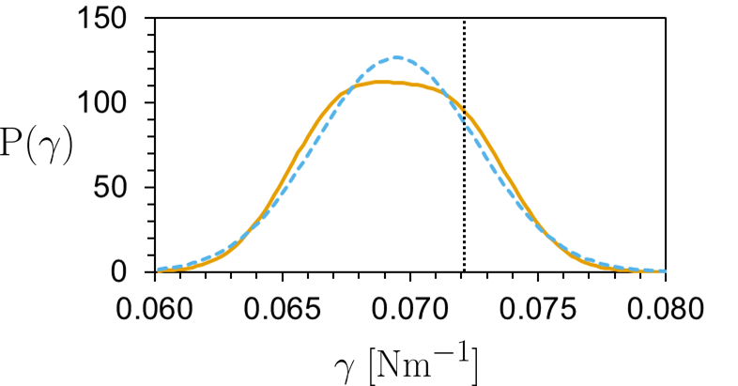

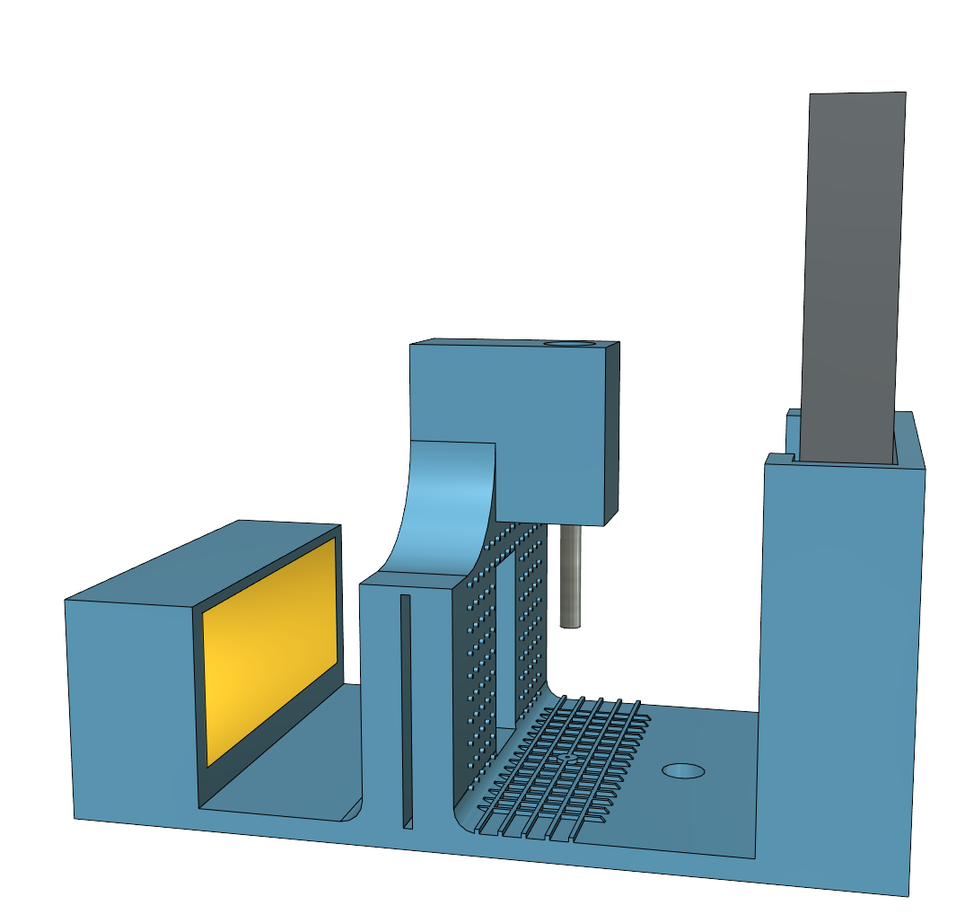
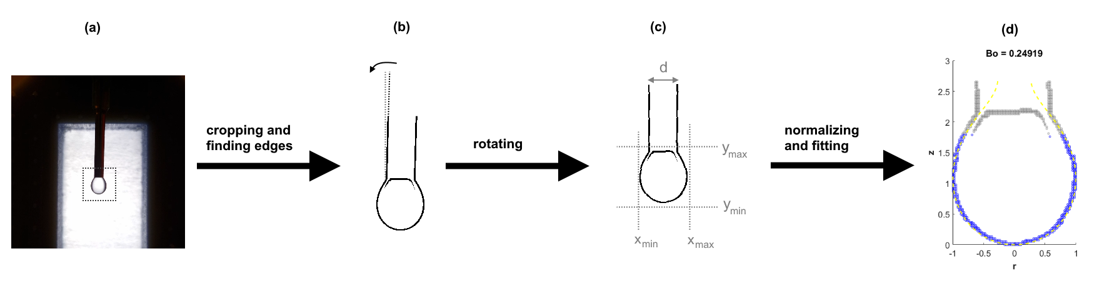
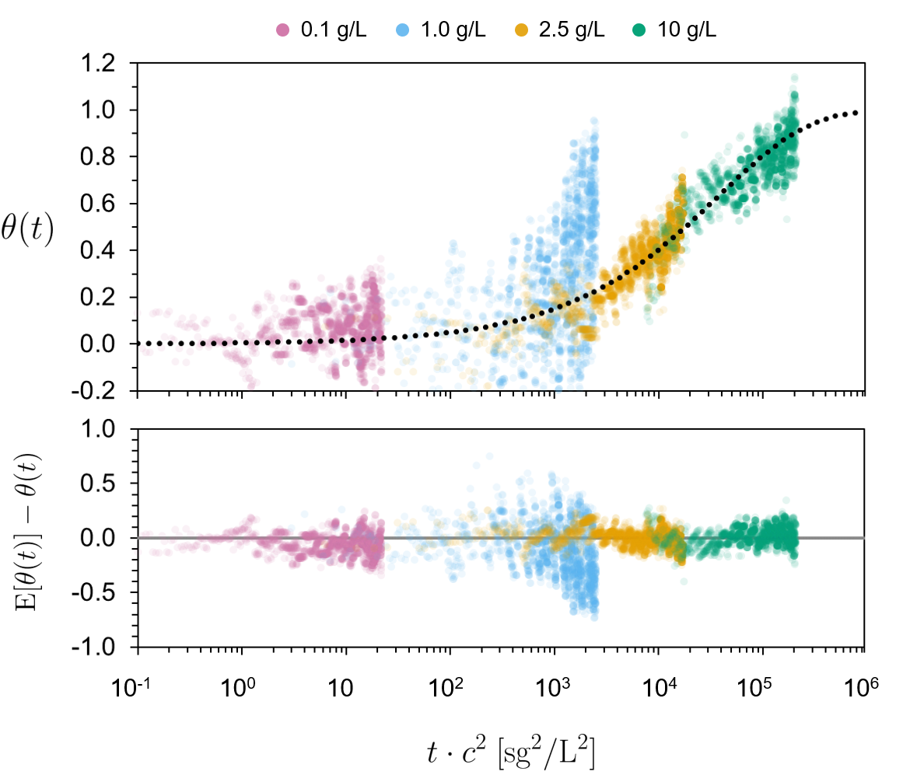
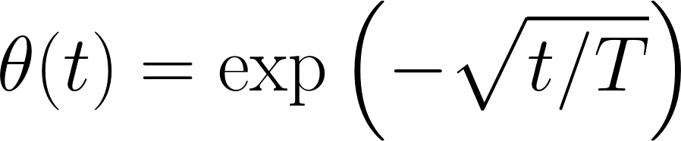


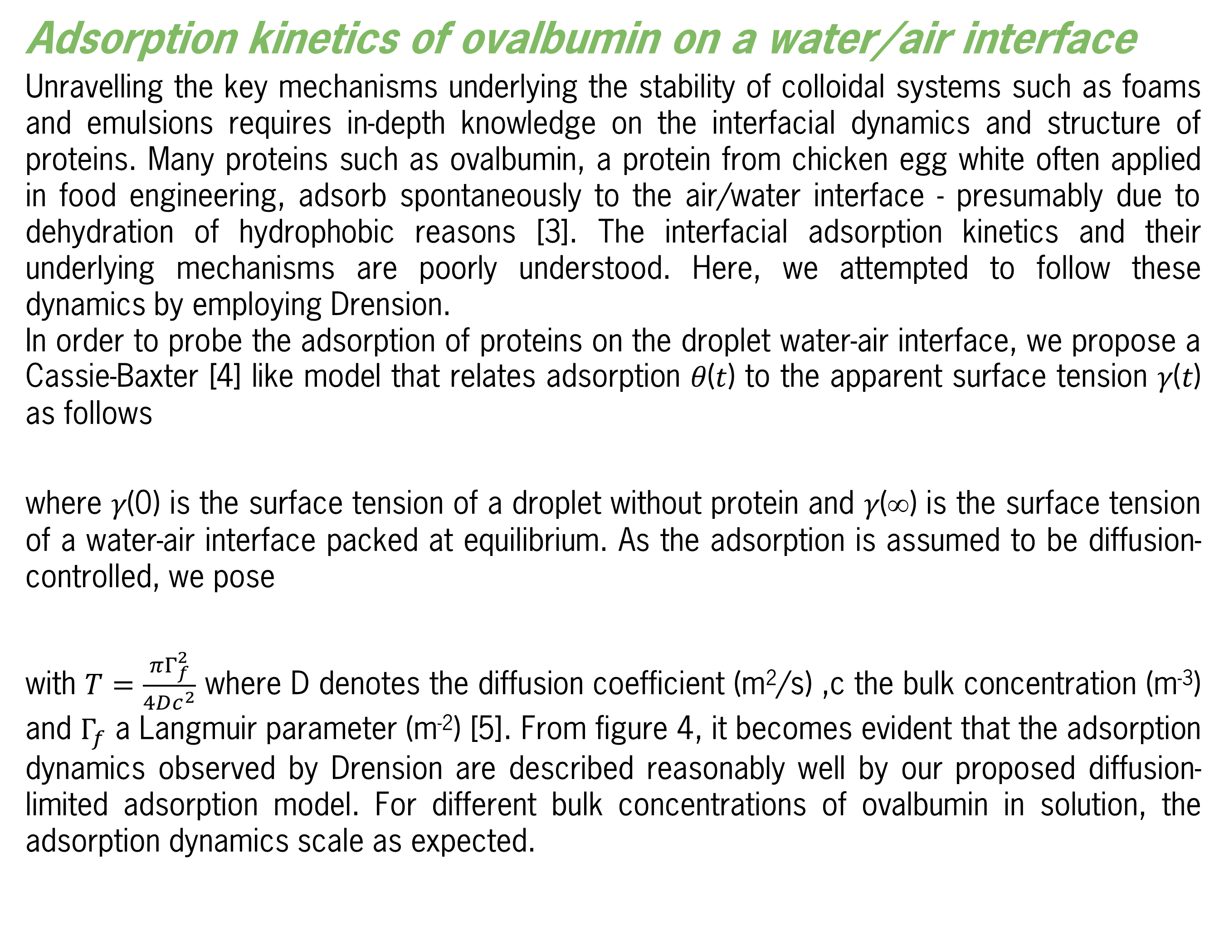
Drension: the low-cost, open-source
pendant drop tensiometer
Sjoerd van Dongen, Lars Kool, Zoë Peters
Aim
Surface tensiometry is widely used to study surfactants. However, due to the inherent inaccuracy of the Wilhelmy plate method [1] and the expensive and closed-source pendant drop setups, surface tensiometry is not used to its full potential [2]. We provide a low-cost, 3D printed pendant drop setup using a mobile phone as camera with open-source data-processing software (written in MATLab). To show the power of this setup and software, we used this setup to study the adsorption kinetics of ovalbumin to the water/air interface.
Sjoerd van Dongen, Lars Kool en Zoë Peters
Methodology
Pendant drop tensiometry determines the surface tension from the shape of a pendant liquid drop deformed by gravity. The shape of a pendant drop depends on the Bond number (Bo), which is determined by the balance between the Laplace pressure and gravity.
The surface tension of a droplet can be calculated if the drop radius R0 at the apex and Bond number associated with the droplet can be determined. This can be determined from a droplet image by fitting the Young-Laplace equation [2]. To make a picture of a pendant droplet a basic set up can be used, as is shown in Figure 2. To fit the image the drop profile needs to be extracted and normalized. This can then be fitted to a simulated droplet based on the bond number. This fitting process is shown in Figure 3. It is important collect enough data to improve accuracy by averaging. In 1.5 seconds a very reasonable estimate for the surface tension of water was found (Figure 1).
Figure 1. Distribution of the measured surface tension of water, with the theoretical surface tension (at 20°C) indicated with the dotted line. Using the fitted Gaussian distribution, an average of 69.5±6.2 mM/m is found, where 72.2 mN/m is expected.
Figure 2. 3D model of the pendant drop setup
Figure 3 Cartoon of the fitting process. (a) An image of a droplet is cropped to a pre-defined space and (b) rotated based on the needle. (c) The image is analysed to find the edges of the droplet, which are used to (d) transform and fit the droplet to the Young-Laplace equation.
Adsorption kinetics of ovalbumin on a water/air interface
Unravelling the key mechanisms underlying the stability of colloidal systems such as foams and emulsions requires in-depth knowledge on the interfacial dynamics and structure of proteins. Many proteins such as ovalbumin, a protein from chicken egg white often applied in food engineering, adsorb spontaneously to the air/water interface - presumably due to dehydration of hydrophobic reasons [3]. The interfacial adsorption kinetics and their underlying mechanisms are poorly understood. Here, we attempted to follow these dynamics by employing Drension.
In order to probe the adsorption of proteins on the droplet water-air interface, we propose a Cassie-Baxter [4] like model that relates adsorption 𝜃(𝑡) to the apparent surface tension 𝛾(𝑡) as follows
where 𝛾(0) is the surface tension of a droplet without protein and 𝛾(∞) is the surface tension of a water-air interface packed at equilibrium. As the adsorption is assumed to be diffusion-controlled, we pose
with $T=\frac{πΓ_{f}^{2}}{4Dc^{2}}$ where D denotes the diffusion coefficient (m²/s) ,c the bulk concentration (m⁻³) and $Γ_{f}$ a Langmuir parameter (m⁻²) [5]. From figure 4, it becomes evident that the adsorption dynamics observed by Drension are described reasonably well by our proposed diffusion-limited adsorption model. For different bulk concentrations of ovalbumin in solution, the adsorption dynamics scale as expected.
Figure 4. The adsorption of ovalbumin over time for different concentrations, with the residual between the measurement and the expected adsorption for diffusion limited adsorption below.
Conclusion
A low-cost, 3D printed, open-source pendant drop tensiometer was build, which can be employed to study complex phenomena like relatively fast interfacial adsorption kinetics of proteins relevant to food engineering.
References
[1] Harkins, William D., and Thomas F. Anderson (1937). JACS, 59:2189.
[2] Berry, Joseph D., et al (2015). J. Colloid Interface Sci., 454:226.
[3] Kudryashova, Elena V., et al (2003). European Biophysics J., 32:553.
[4] ​Cassie, A. B. D., and S. Baxter. (1944). Trans. Faraday Soc., 40:546.
[5] Rahn, J. R., and R. B. Hallock (1995). Langmuir, 11:650.
Relevant QR code (PCC website?) goes here.
Physical Chemistry and Soft Matter
Wageningen University & Research
Stippeneng 4
6708 WE Wageningen
The Netherlands
Find our 3D model and software on GitHub

