Slide 1
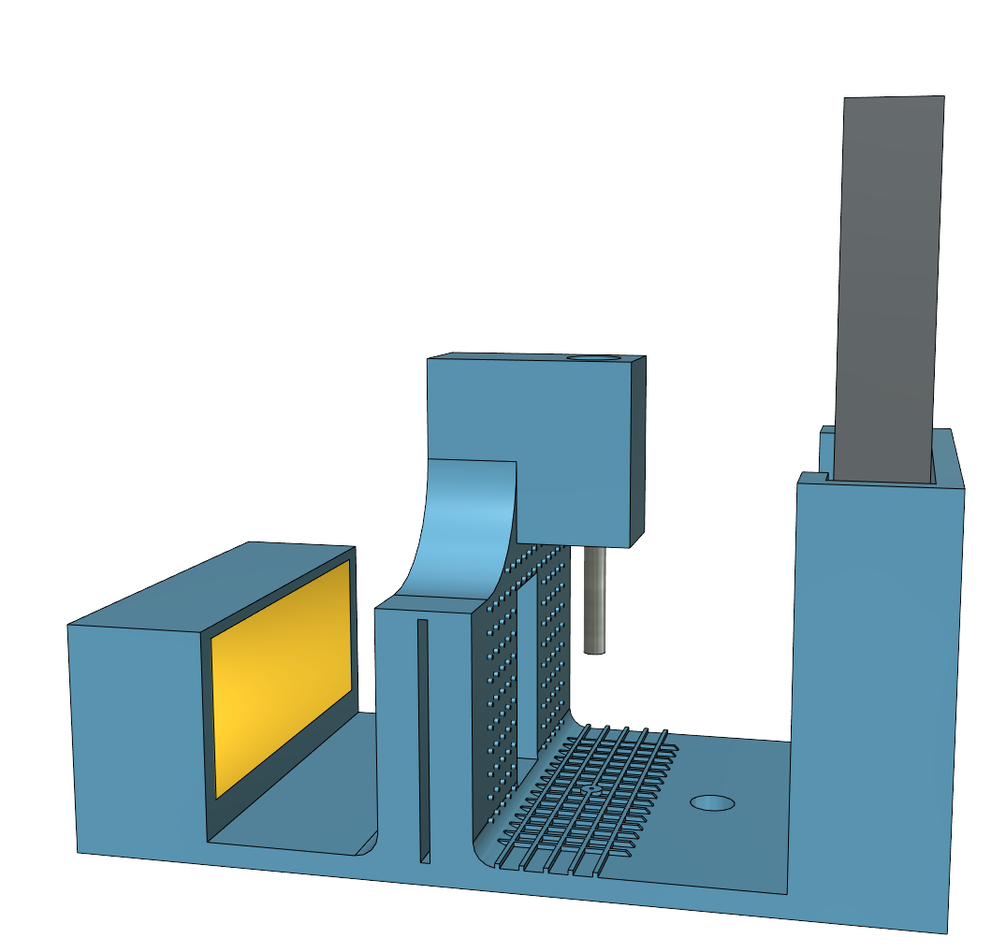

Photo(s) of the presenting author(s) go here.
Drension: the low-cost, open-source pendant drop tensiometer
Sjoerd van Dongen, Lars Kool en Zoë Peters
Theory
Pendant drop tensiometry determines the surface tension from the shape of a pendant liquid drop deformed by gravity. The shape of a pendant drop depends on the bond number. This bond number can be determined from a droplet image. From this bond number and the known quantities of density, gravity and drop size the surface tension can be calculated.
Aim
Surface tensiometry is widely used to study surfactants. However, due to the inherent inaccuracy of the Wilhelmy plate method (source) and the expensive and closed-source pendant drop setups, surface tensiometry is not used to its full potential. We provide low-cost, 3D printed pendant drop setup using a mobile phone as camera
Figure 1.
Heading 3
Text.
Figure 2
Heading 4
Text.
Figure 3.
Heading 5
Text.
Figure 4.
Conclusion
Text.
Physical Chemistry and Soft Matter
Wageningen University & Research
Stippeneng 4
6708 WE Wageningen
The Netherlands
E-mail:
Tel.:
[1] Ref 1.
[2] Ref 2.
Relevant QR code (PCC website?) goes here.

