Slide 1
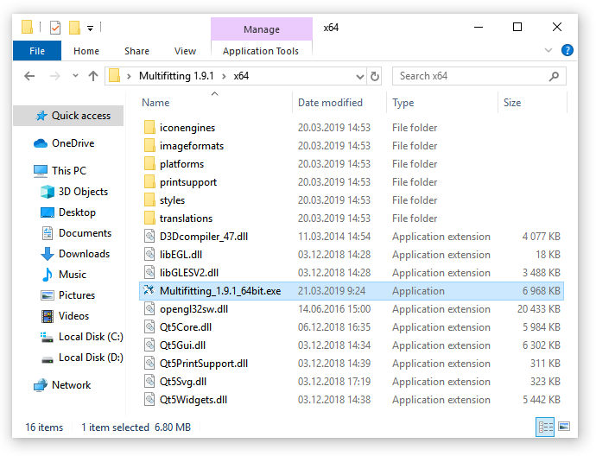

Slide 2
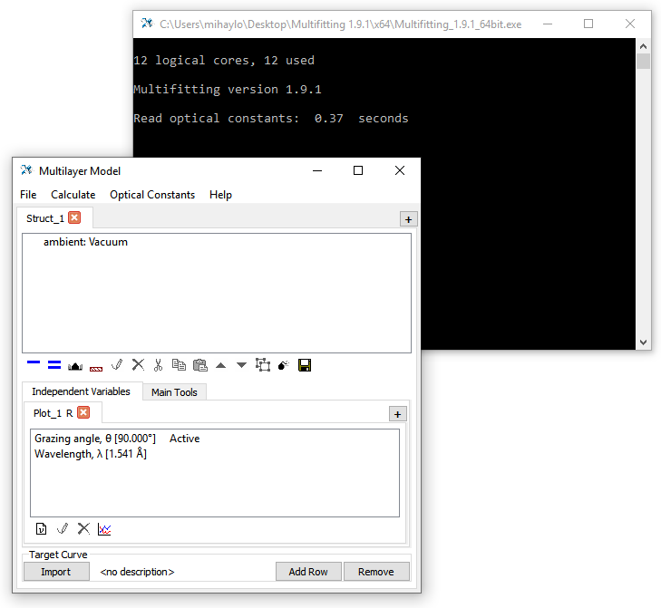
Menu
Structure
Toolbar
Parameters for curve calculation
Measured and target curves

Slide 3

2
1

Slide 4

current value
fitting on/off
min
max

Slide 5
