Slide 1
Aegis Transcript Intelligence
Executive Insights for Product & Engineering Leadership
32 ORGANIZATIONS
3.42 SENTIMENT
39 ESCALATION CALLS

Slide 2
Core Platform Capabilities
Automatically categorize meetings using intelligent keyword matching.
Monitor and Analyze sentiment trends across customers and call types.
Identify churn risks and at-risk customer accounts.
Track renewal activity and product adoption signals.
Analyze organizational health and engagement patterns from internal and external conversations.

Slide 3
Executive Summary
Transcript intelligence identified operational risk patterns, customer frustration signals, and adoption opportunities across 32 organizations.
Sentiment averaged 3.42/5.0 across 30.3-minute calls, with clear spikes tied to outages and product releases.
Escalation-related conversations were the dominant category (39 calls), highlighting reactive operational workload.
Support and external customer conversations exposed gaps in outage communication, redundancy planning and missing configurations.
Positive sentiment increased significantly after April feature/performance releases, validating roadmap prioritization.

Slide 4
Meeting Category Insights
Escalation calls: 39
Internal Planning: 15
Customer Support: 11
Compliance/Audit: 10
Product Implementation: 10
External Renewals: 7
External Feedback/Reviews: 7
Key Insight: Intelligent categorization enables the right operational team to quickly act on relevant conversations.

Slide 5
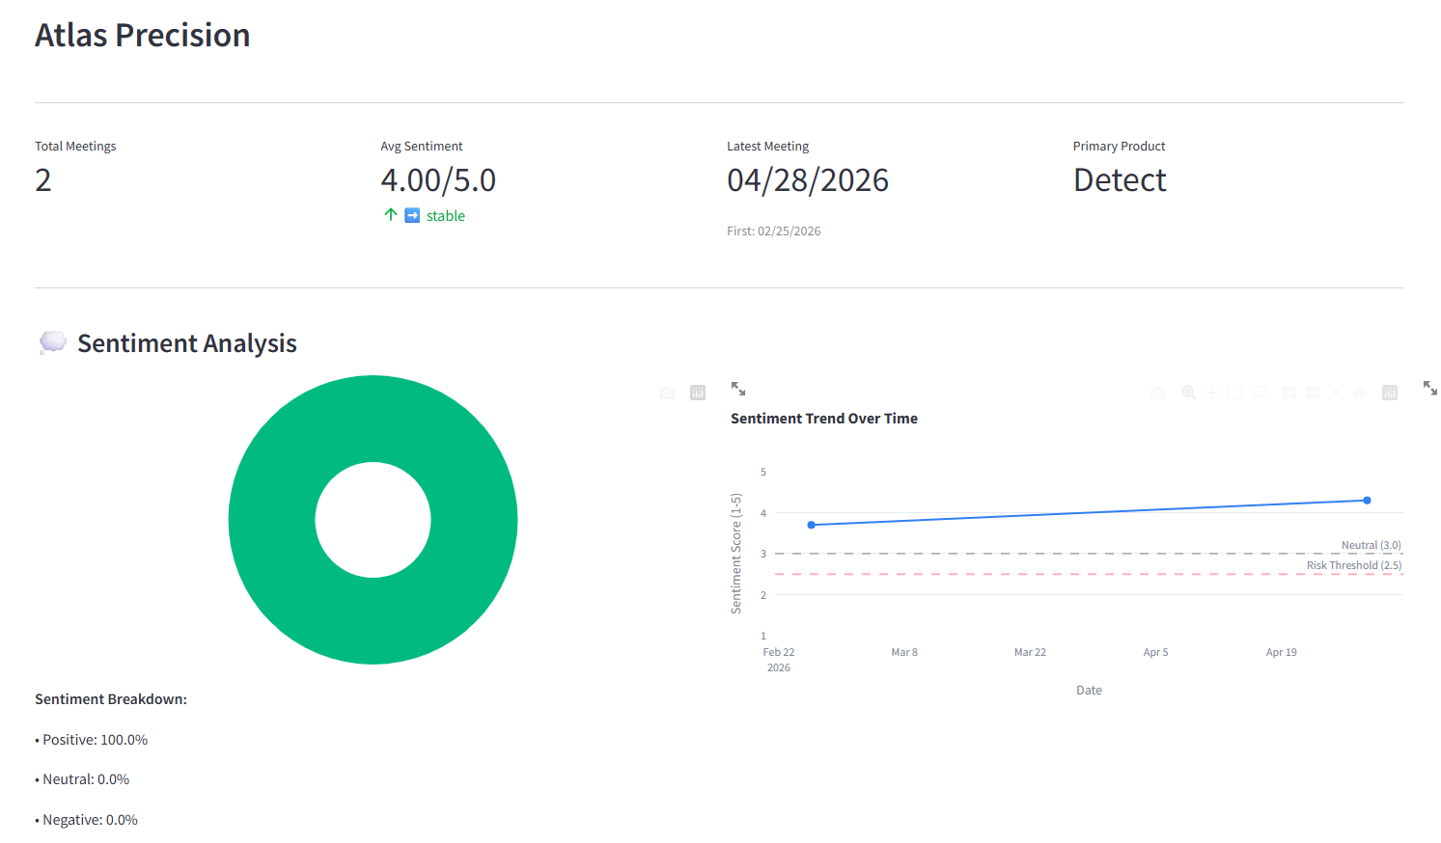
Organization-Level Health Dashboard
Dashboard highlights account-level health and engagement.
Tracks sentiment trends, churn risk, and renewal activity.
Example organization shows stable sentiment (4.0/5.0) and active renewal discussions.
Leadership teams can prioritize intervention before customer dissatisfaction escalates.

Slide 6
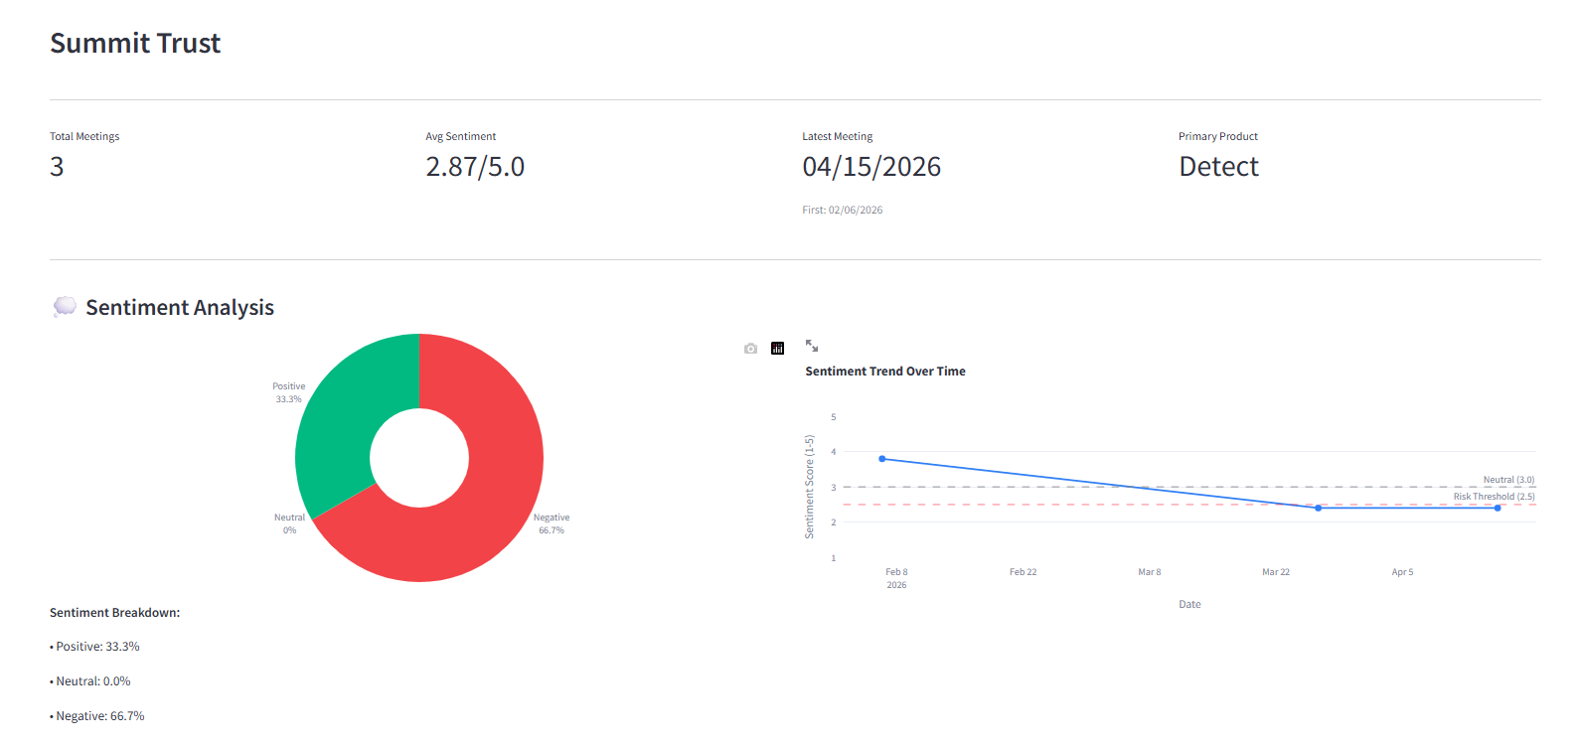
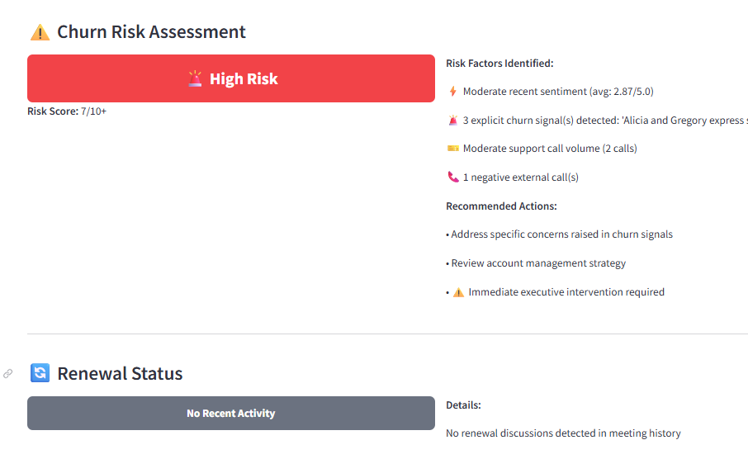
Organization-Level Health Dashboard
Dashboard highlights high churn risk assessment.
Leadership teams can prioritize intervention before customer dissatisfaction escalates.

Slide 7
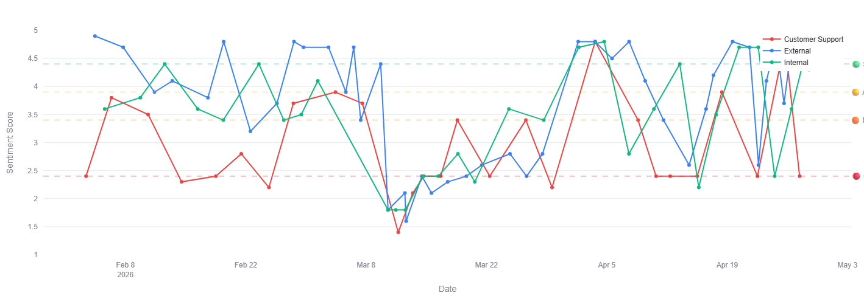
Sentiment Trends Across Call Types
External calls generally maintained the strongest sentiment trend.
Customer support sentiment showed the highest volatility during operational incidents.
Internal discussions reflected operational strain during outage periods.
Shared sentiment drops across all three call types indicate systemic platform issues rather than isolated incidents.

Slide 8
Sentiment Distribution & Organizational Health
Mixed-positive and mixed-negative conversations each accounted for 33 calls, indicating customers are engaged but still facing friction.
Very-positive conversations (21) significantly outnumbered strongly negative interactions (6 combined negative/very-negative).
Overall sentiment score: 3.42/5.0 across all transcript sources.
The distribution suggests the customer base is generally stable, but operational execution issues materially influence perception.
Internal and external call sentiment trends can serve as an early-warning system for churn and escalation risk.

Slide 9
Key Incident Findings & Leadership Insights
March 10 – March 14 low sentiment due to outage
3/10: Cobalt Software outage caused a major sentiment decline across all call types.
Root cause: ingestion pipeline primary node hit memory ceiling and crashed due to lack of redundancy.
Recommendation: Engineering should add redundancy validation to architecture approval checklists.
3/11: Trailhead Marketplace escalated concerns after threat-detection pipeline outage left retail systems blind to threats.
Customer frustration was amplified by lack of proactive communication during the incident.
Recommendation: Product and Customer Success teams should implement proactive outage communications with continuous status updates.

Slide 10
Product Release & Quality Engineering Insights
April 3 - Positive sentiment due to upcoming upgrades
4/03 sentiment surged to 4.8 after Forge Industries and Silverline Brands validated upcoming April 7 feature/performance releases.
This demonstrates strong correlation between roadmap delivery and customer confidence.
April 10 – April 12 – Negative sentiment due new feature bugs
4/10–4/12: Support sentiment dropped due to pricing-alert misconfiguration.
Recommendation: Add alert configuration validation into regression testcases.
Silverline Brands also reported backup windows extending from 1 AM–5 AM to 8–9 hours, impacting production performance.
Recommendation: Engineering should optimize SQL backup workflows and improve operational monitoring for long-running jobs and should add these to regression scenarios.

Slide 11
Additional Insights
Recurring Blocker Detection
The same problem surfaces in different meetings with different customers, but no single person sees the full pattern across all conversations.
This insight stitches signals together, surfaces organization-wide blockers early, and identifies which accounts to reach out to before they escalate.
These are the highest-leverage fixes — one resolved blocker can close a support ticket, save a deal, and win a competitive bake-off simultaneously.
Enables account teams to act proactively before the customer has to chase them, improving trust and retention.

Slide 12
Additional Insights
Speaker-Sentiment Gap Detection
Inside any customer-facing call, the tool measures each side’s average sentiment separately — the Aegis speaker (AM, support, CSM) and the customer.
When the gap is large — typically Aegis-side reading upbeat while the customer stays neutral or negative — the call is flagged as “talking past each other.”
The Aegis-side sentiment is what gets reported upstream as “the call went well” — but if the customer’s actual sentiment was lower, leadership is making decisions on a falsely positive read.
Catching the gap early reveals quiet disengagement before it surfaces as a renewal surprise — a signal that’s invisible from any single-number sentiment score.

Slide 13
Additional Insights
Conversation Thread Detection
Customers raise issues across multiple meetings until something changes — by linking topics across all calls for a given customer, the tool identifies unresolved threads spanning weeks or months without action items closing.
Active threads are distinguished from one-off mentions, and stalled threads from progressing ones.
Separates concerns with momentum from those that have gone quiet but aren’t resolved — the quiet threads are the ones that resurface in renewal calls as deal-breakers.
Gives leadership a one-glance answer to “what’s still outstanding for this customer?” — without pulling individual call notes from across the corpus.

Slide 14
Any Questions?
Thank you for your time
Aegis Transcript Intelligence | Executive Insights | May 2026

