Slide 3
Sven Machon
Major: Game Development
Academic Year: 2021-2022
Supervisor: Alex Vanden Abeele
Coach: Marijn Verspecht

Slide 4
Procedural Feather System
Creating realistic feathers for computer graphics can be challenging. This is due to the large amount of feathers to create a realistic effect, but also due to the interaction between the feathers individually and the wide range of different feather patterns and behaviour. While artists want control over the final look and feel, automating the process by procedurally generating the bulk of the feathers can be a big lifesaver. Explore different methods and tools to procedurally generate feathers.GD: integrate a feather system in a game engine while exploring the limitations/challenges of the system in a typical real-time evironment (e.g. procedurally generated damage patterns at runtime).

Slide 6
04/10-10/10
So far I have been looking into the different ways that feather generation has been done so far, more specifically I have been reading about feather generation through Bezier curves and field lines. I haven’t read a lot of papers completely yet but I have collected a bunch that I have skimmed and am preparing to read fully

Slide 7
11/10-17/10
This week I have mostly focussed on preparing for the unwrap festival and therefore I haven't had the chance to read a lot of new papers.

Slide 8
18/10-24/10
I have looked into multiple things this week, and some things seem very promising to continue with. Firs of all I have decided that Bezier curves are not the way to go. Field lines then again do seem like they could be interesting. By creating a vector field around the model and placing the feathers according to the field lines, you can ensure that the feathers do not intersect, due to the non-intersection property of field lines, as long as you don't make the feathers to wide at least. Using a few key orientations at certain locations allows for control over the feather orientation. I spent some time looking into what vector fields and field lines are to better understand the concepts presented. Just using field lines had the drawback that it will often mean that the feathers a created parellel, meaning you will not have they layered coat effect that a real feather coat has. That is where the ordering of feathers comes in.
Another way of generating feather is by using a skeleton. The distribution of feathers is often similar to that of the bones. If you then associate the guide feathers with the skeleton you can interpolate using the blend weights, giving you clear and predictable control. The order in which the feathers are generated is important for the final look of the feather coat. An incorrect ordering will cause intersections while if you order them correctly it allows for the feathers to be generated more closely to one another, making a more dense, full feather coat.

Slide 9
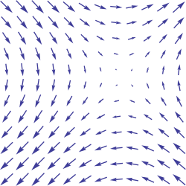
Animated feather coats using field lines
Specify key orientation vectors and then interpolate between
Specified direction by the user in a plane perpendicular to the surface normal
Define the vector field and the field lines within. The field needs an outward component to keep the feathers
from intersecting with the surface and closeby feathers. After the outwards component the field line needs to run parallel
to keep the shape of the underlying object
The feathers are placed at the vertices of the original mesh. Deform a duplicate of the base feather model with its own transformations
Transform the feather starting at the root working your way up.

Slide 10
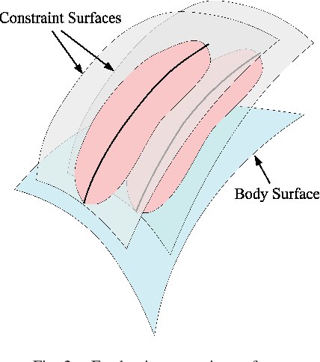
Collision-free construction of animated feathers using implicit constraint surfaces
Generate feathers by placing key feathers and interpolating
Avoid interpenetration by definining implicit constraint surfaces for each feather that does not intersect with
any other constraint surface.
Every constraint surface intersects the model through the root position of the feather
Using the Loft function the curavture of the feather surface is handled (inject/remove volume)
Construct the feathers along the surface preserving, direction of shaft, length, angle of barbs of off shaft and length

Slide 11
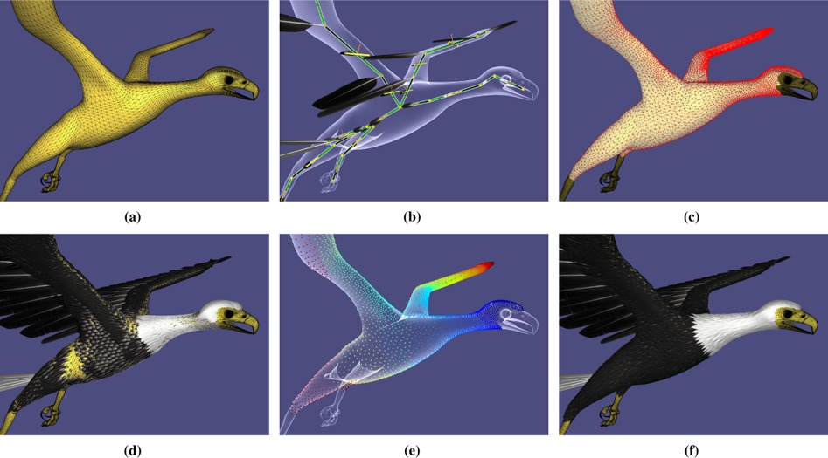
An efficient feathering system with collision control
By using a skeleton for the mesh it is possible to have sufficient control over the feathers with minimal guide feathers.
They assume that the distribution of the feathers is similar to that of bones
It is then possible to interpolate between the different guides, based on the weights of the joints, to create a feather coat. Making the outcome
more predictable.
The generation of the feathers happens serially,
to ensure that you get a nice thicker coat layer
you compare the nearby feathers,
as feathers far from eachother are unlikely to
interact

Slide 12
Iones, A., Kruph, A., Volodarsky, S., & Zhukov, S. (n.d.). Fur and Hair: practical modeling and rendering techniques.
Liu L., Li X., Chen Y., Liu X., Zhang J., & Wu E. (2015). efficient feathering system with collision control (Vol. 34, Issue 7).
Liu, L., Liu, X., Sheng, B., Chen, Y., & Wu, E. (2017). Incremental collision-free feathering for animated surfaces. Visual Computer, 33(6–8), 883–890. https://doi.org/10.1007/s00371-017-1369-6
Newport, M. (2005). Start to Finish Feathers Solution (SFFS) Masters Thesis.
Renee Baron, J. (2018). Procedurally Generating Biologically Driven Bird and Non-Avian Dinosaur Feathers. https://tigerprints.clemson.edu/all_theses/2967
Slay, Hannah., Bangay, Shaun., Spencer, S. N., SIGGRAPH., & European Association for Computer Graphics. (2007). Animated feather coats using field lines. Association for Computing Machinery.
Streit, L., & Heidrich, W. (n.d.). Generating Feather Coats Using Bezier Curves.
Streit, L. M. (1996). Modelling of Feather Coat Morphogenesis for Computer Graphics.
Unreal Engine. (n.d.). Creating Realistic Hair and Feathers in Unreal Engine | Webinar. Retrieved October 5, 2021, from` https://www.youtube.com/watch?v=lHOIvPoet04
Weber, A. J., & Gornowicz, G. (2009). Collision-free construction of animated feathers using implicit constraint surfaces. ACM Transactions on Graphics, 28(2). https://doi.org/10.1145/1516522.1516523
Zhang, E., Mischaikow, K., & Turk, G. (n.d.). Vector Field Design on Surfaces.
es.

Slide 13
<< Copy/Paste “Literature Study” feedback from the supervisor >>
<< Copy/Paste “Literature Study” feedback from the coach >>

Slide 15
<< Insert one or multiple research questions using a bullet point list >>

Slide 17
<< Insert (an image of) your planning and risk management >>

Slide 18
<< Copy/Paste “Research Question(s) & Planning” feedback from the supervisor >>
<< Copy/Paste “Research Question(s) & Planning” feedback from the coach >>

Slide 20
<< Insert entries recording your current progress >>

