Slide 1
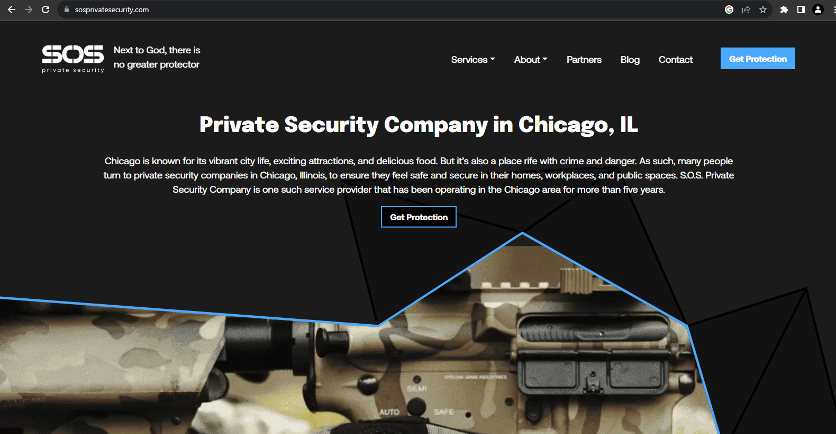
https://sosprivatesecurity.com/

Slide 2
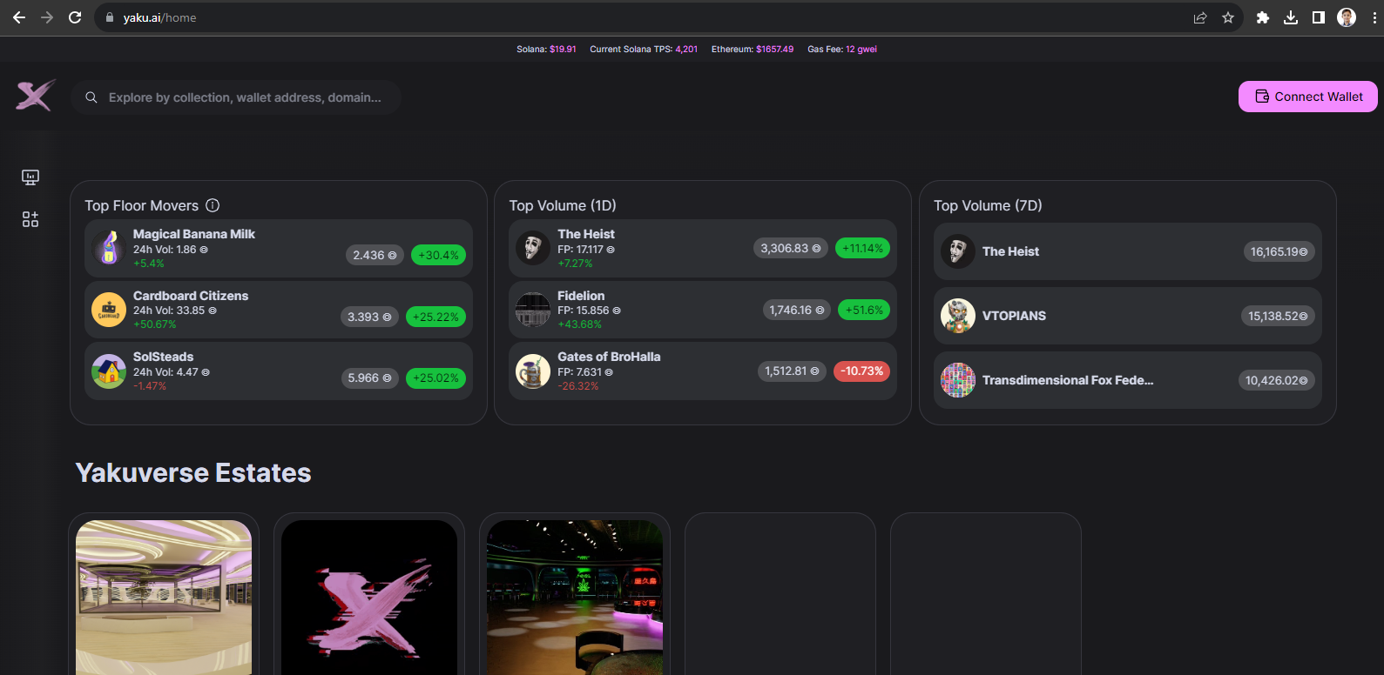
https://yaku.ai/home

Slide 3
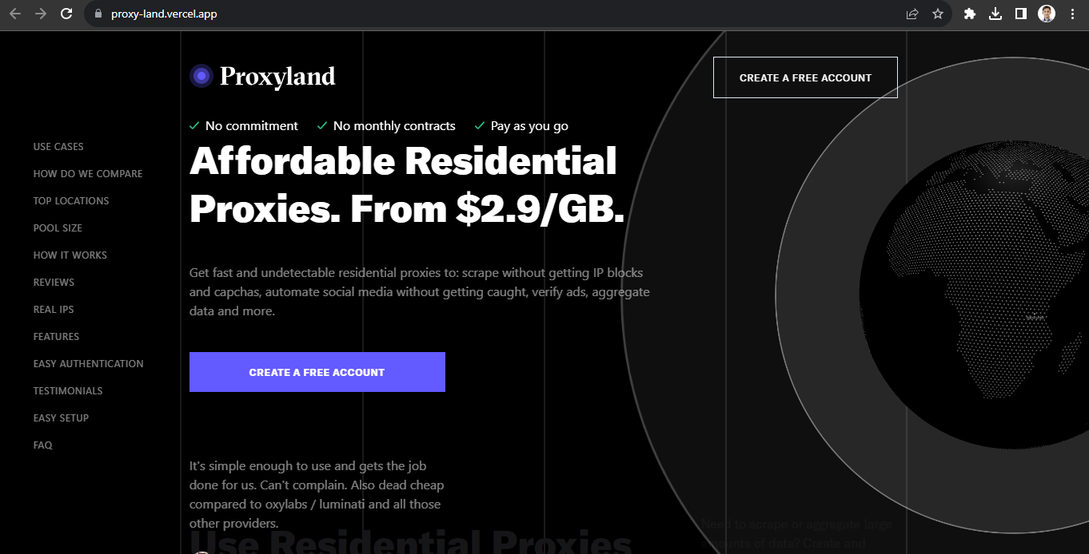
https://proxy-land.vercel.app/

Slide 4
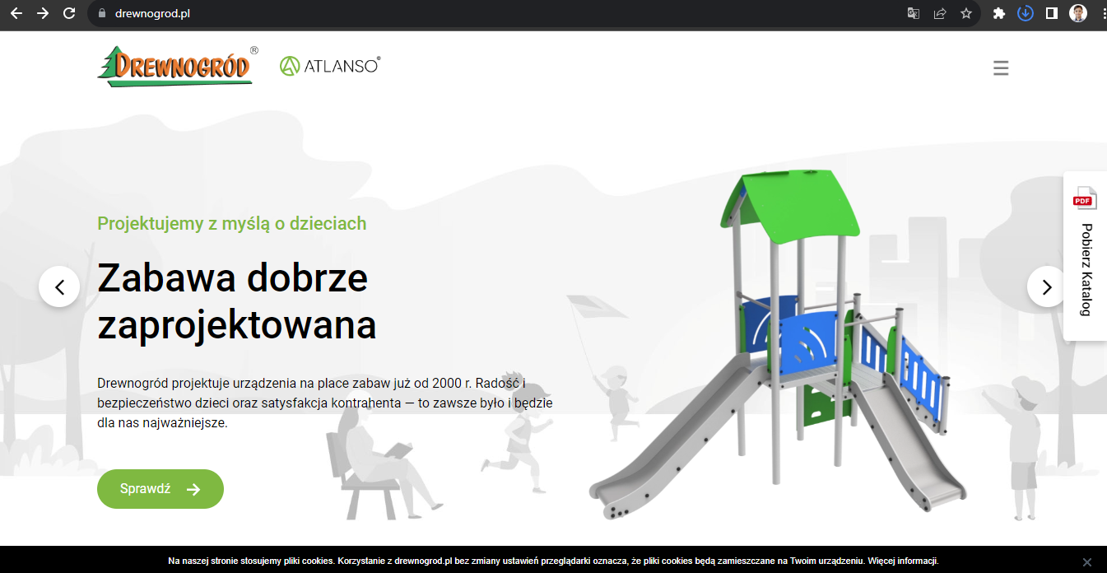
https://drewnogrod.pl/

Slide 5
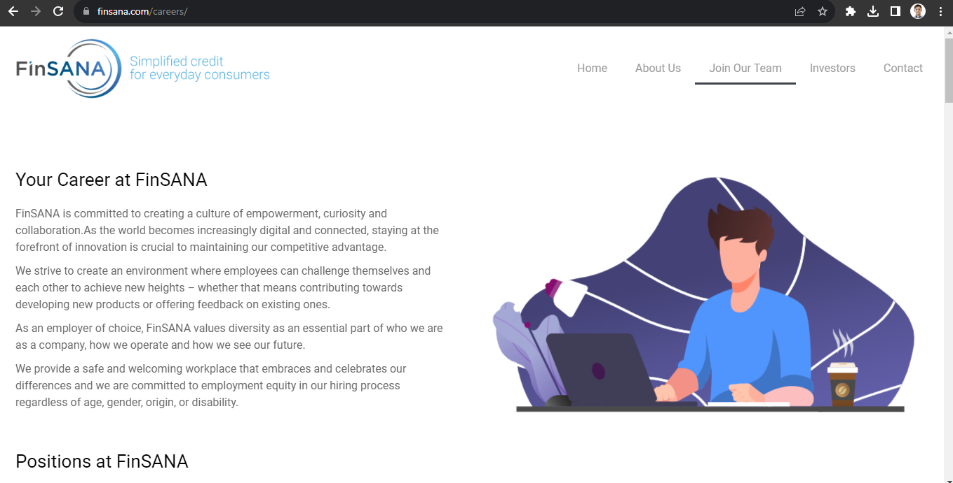
https://finsana.com/careers/

Slide 6

https://kessgame.com/story.html

Slide 7
https://www.figma.com/file/TpdSUIkt2ITtrAtG7hxosn/Advanced-Dental?type=design&node-id=139-170&mode=design
https://ad.dev-version.website/
https://www.figma.com/file/kTdXywSMSU6F6Jov1UUOtz/Wetherby-Trailers-v2?type=design&node-id=0-1&mode=design
https://wetherbytrailers.dev-version.website/

Slide 8
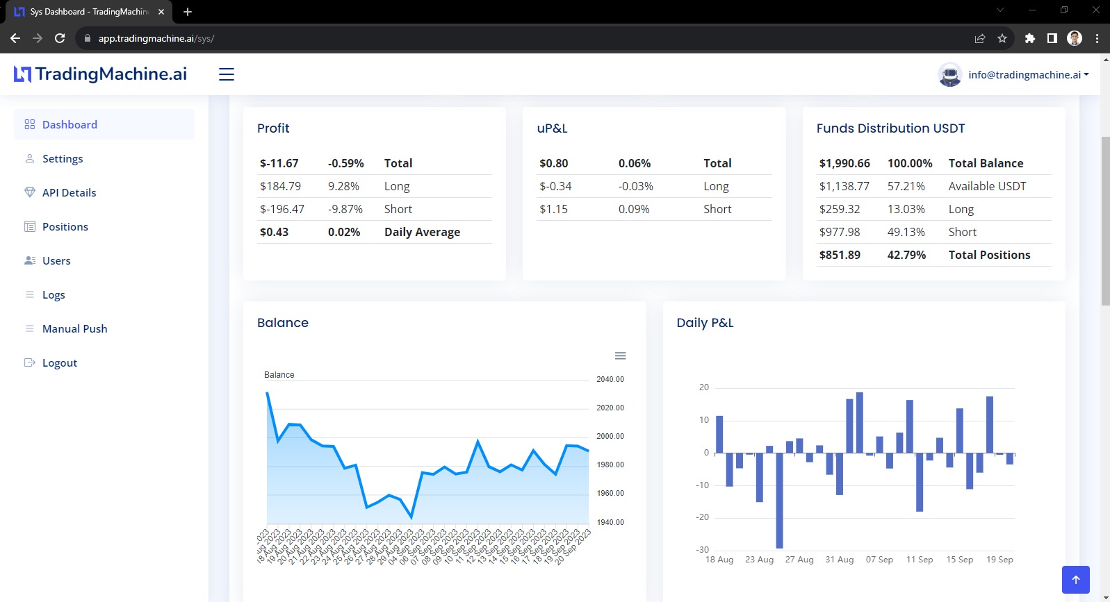
https://app.tradingmachine.ai/sys/

Slide 9
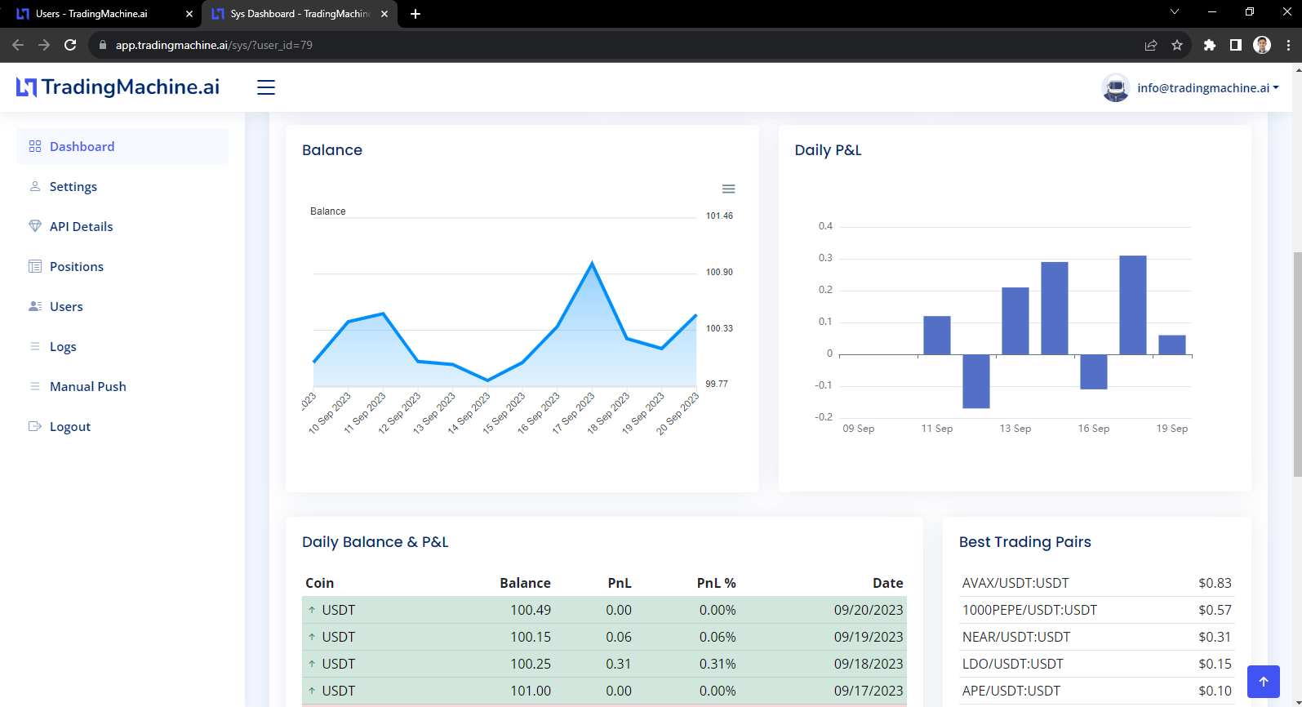
https://app.tradingmachine.ai/sys/

Slide 10
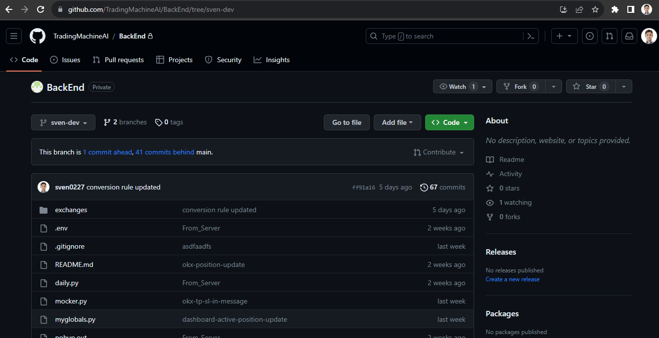
https://app.tradingmachine.ai/sys/

