Slide 1
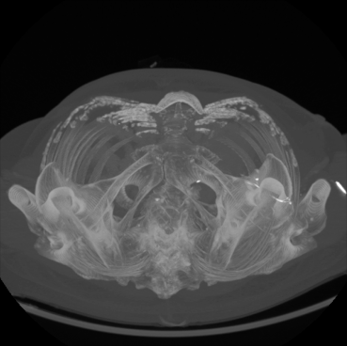
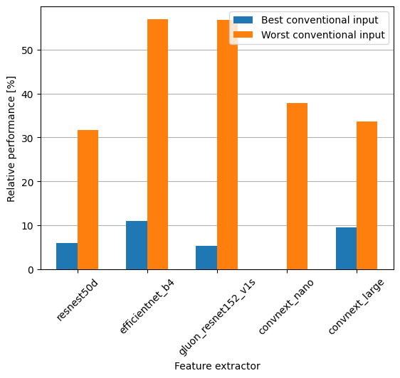
Revolutionizing ovarian cancer diagnosis: How AI could save thousands of lives
Sven Bierenbroodspot
The conventional input for a 3-channel 2D CNN feature extraction for medical images is to copy the only channel 3 times. With variable input the aim is to give the neural network more information in the form of different projections of the same image.
To evaluate these feature extraction results a simple SVM is trained 100 times and the best AUC considered as the resulting score for the feature extraction.
Results
Figure 2 shows the relative performance of the best input configuration compared the both the worst and the best scoring conventional input. The obtained results are inconsistent. One feature extractor is able to reach more than 10% better performance using a variable input compared to the best conventional input method. Another one is not able to reach any improvement using the variable input. The improvement compared to the worst conventional input is never below 30%.
Figure 1: 2D Maximum Intensity Projection
Introduction
Ovarian cancer, often diagnosed late, claims over 14,000 lives annually. Radiographic imaging, including CT and MRI scans, aid doctors with tumor classification in order to reach high accuracy. Inspired by successful AI applications in lung cancer, this study explores the applicability of AI techniques, specifically 2D CNNs, in ovarian cancer classification. This study concerns the input for the feature extraction using multiple 2D CNNs.
Figure 2: Relative performance of the best input configuration
Methods
The study utilized data from Catharina Hospital in Eindhoven. For this study, only the benign and malignant labels were considered. Since features were extracted using 2D CNNs, the 3D images needed to be projected onto 2D images. Five image projection methods were considered:
Maximum Intensity Projection (MIP): Selecting the maximum value along the vertical axis.
Average Intensity Projection (AIP): Calculating the average value along the vertical axis.
Slice: Considering a slice at a vertical height determined by the tumor's center.
Tumor MIP: Applying MIP only to the tumor by multiplying it with the mask.
Minimum intensity projection: Selecting the minimum value along the vertical axis.
Conclusion
There are improvements to be made when considering variable input configurations compared to conventional inputs. However, it is not guaranteed to improve results. In order to obtain the best results, all the configurations have to be considered.
DEPARTMENT OF ELECTRICAL ENGINEERING

