Slide 1
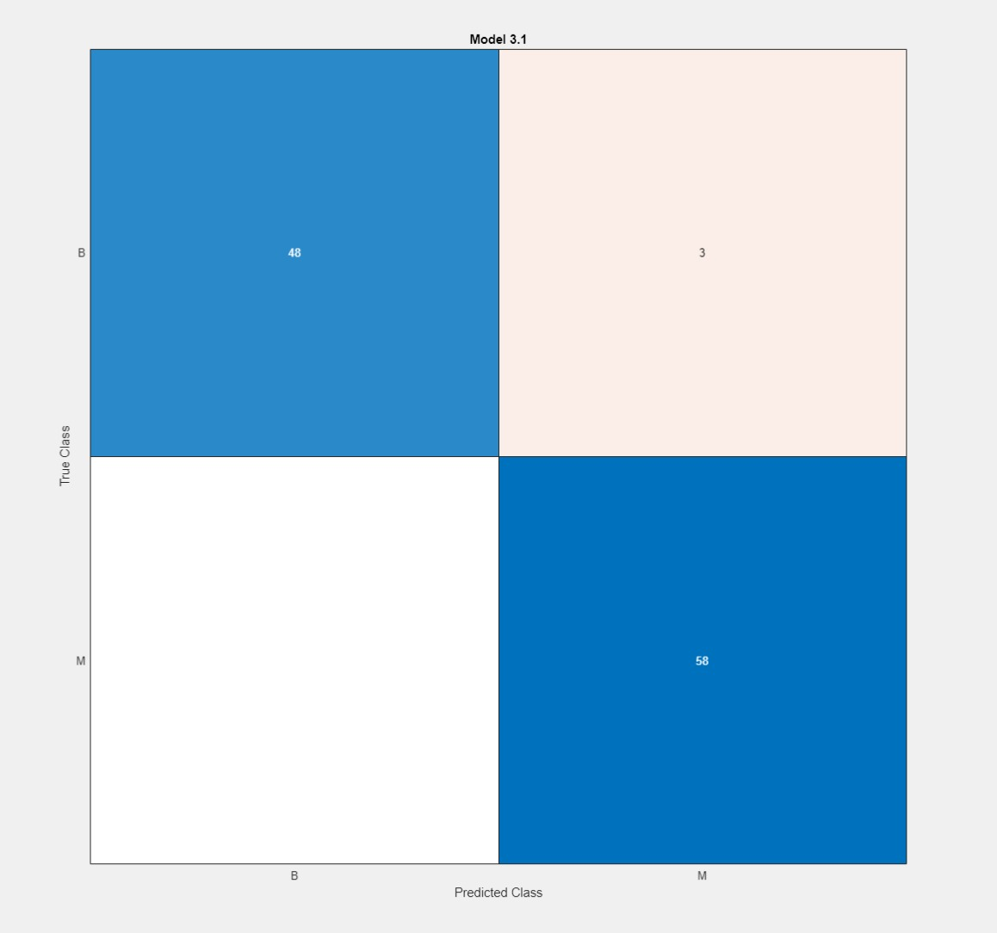
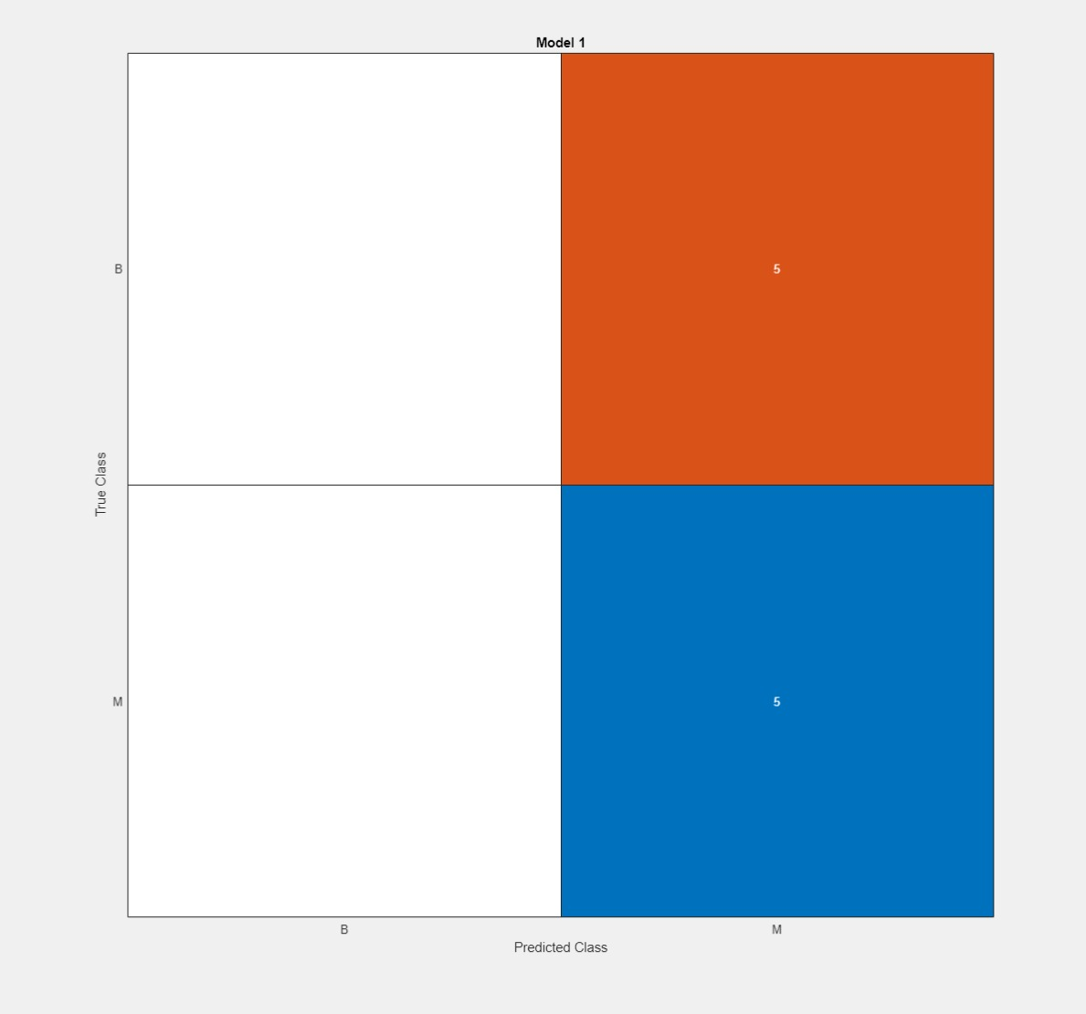
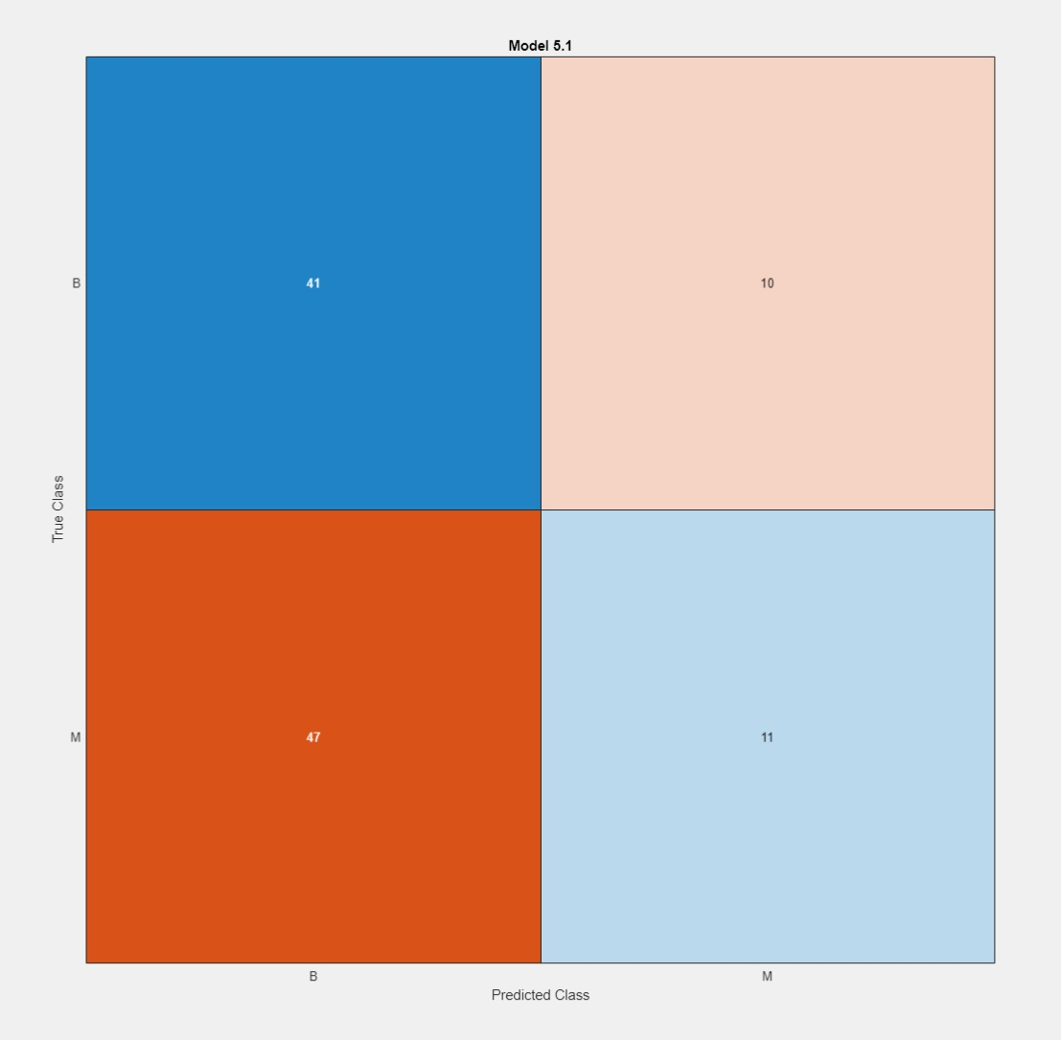
10-17 March
No cross fold validation - training
No cross fold validation - test
Past week
Introduction draft
Feature extraction with CT scan settings
Matlab classificationlearner trial + error
Potential issues
Feature extraction
cross fold validation

Slide 2
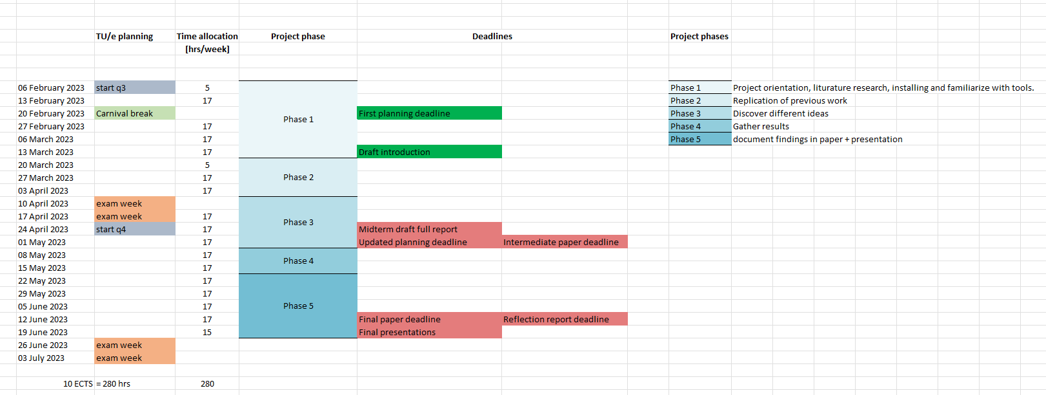
Revised planning 16-03-2023

Slide 3
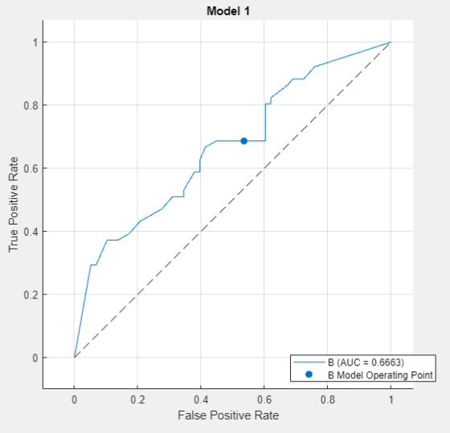
27 March – 6 April
Issue with Pyradiomics extraction, 1258 features
Started with transfer learning
Plan: use 3D conv NN medical application
Currently working with resnet

Slide 4
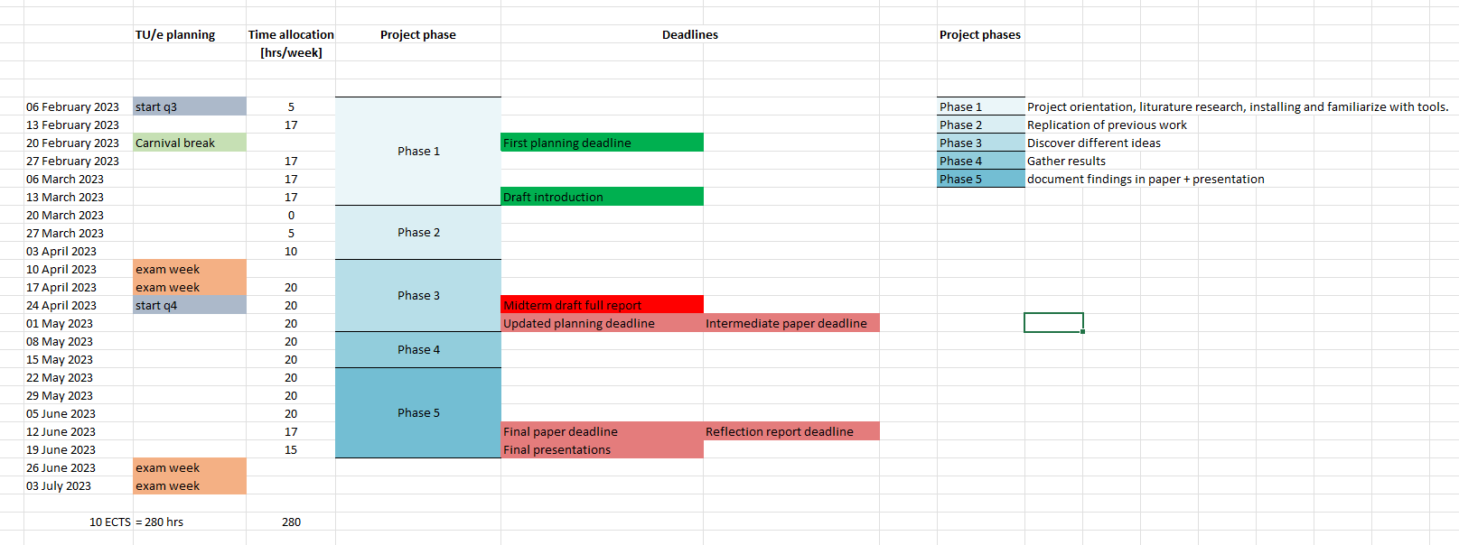
Revised planning 06-04-2023
Start of phase 3

Slide 5
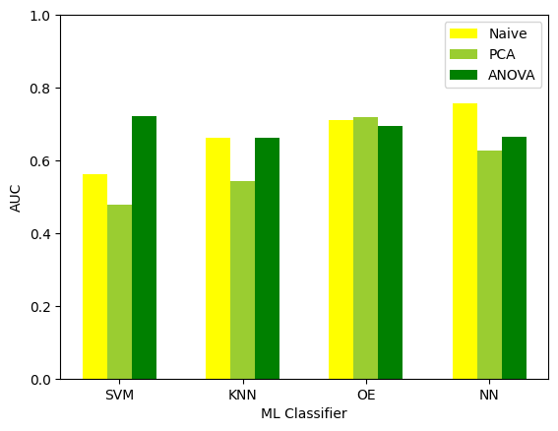
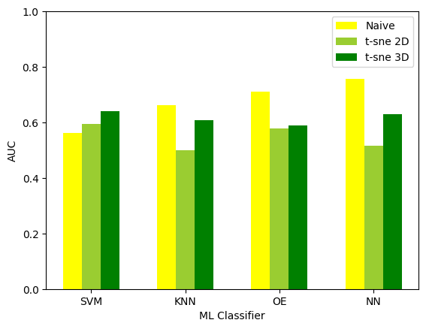
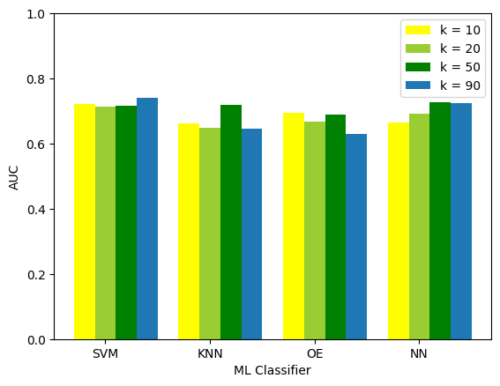
10-20 April
Erica reproduction
t-sne
ANOVA

Slide 6
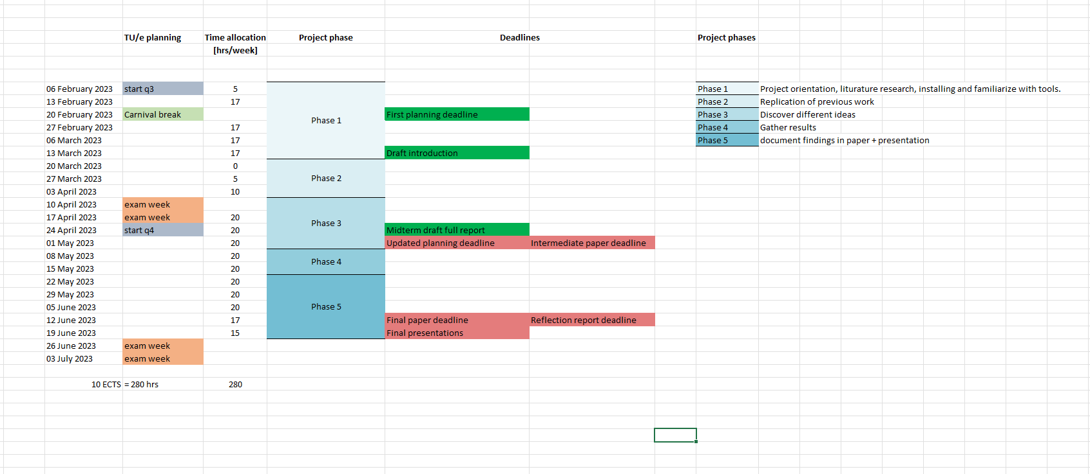
Revised planning 20-04-2023

Slide 7
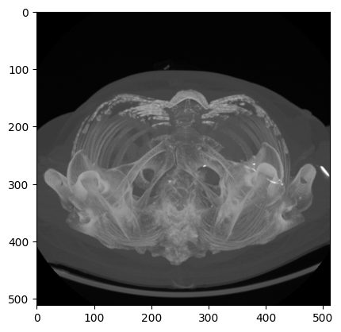
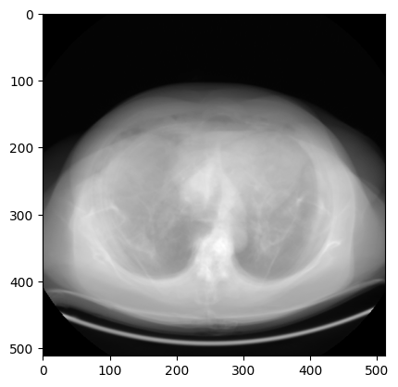
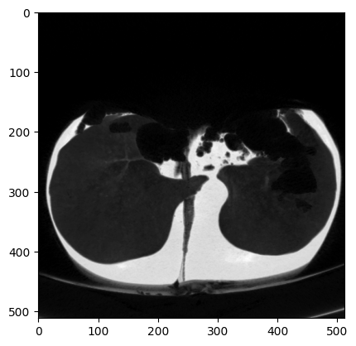
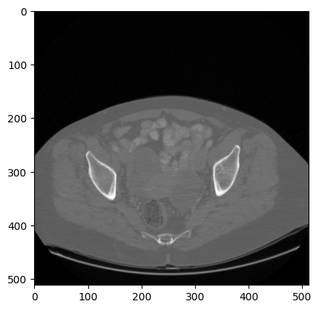
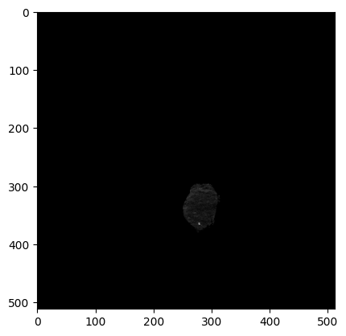
24 April – 4 May
3D to 2D
MIP
AIP
SLICE
TUMOR_MIP
MINIP

Slide 8
24 April – 4 May
125 combinations
7 feature extractors
Performance metric (SVM AUC max out of 100)

Slide 9
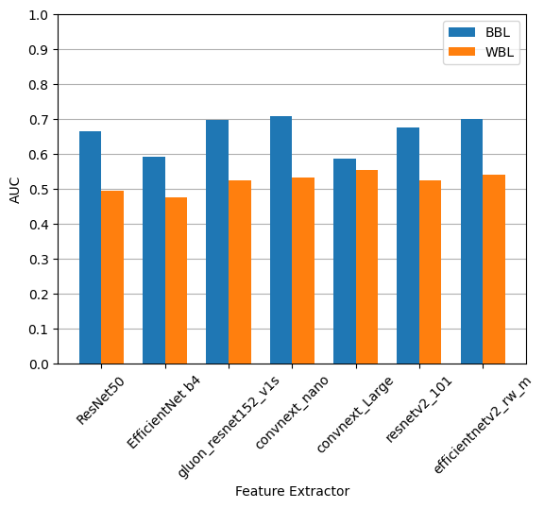
24 April – 4 May
Baselines
WBL = Worst Baseline
BBL = Best Baseline
Note that the combination is not the same for the worst and the best across all FEs
4
4
4
5
4
2
2
4
5
2
1
5
1
4

Slide 10
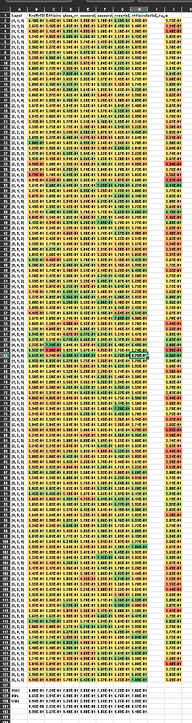
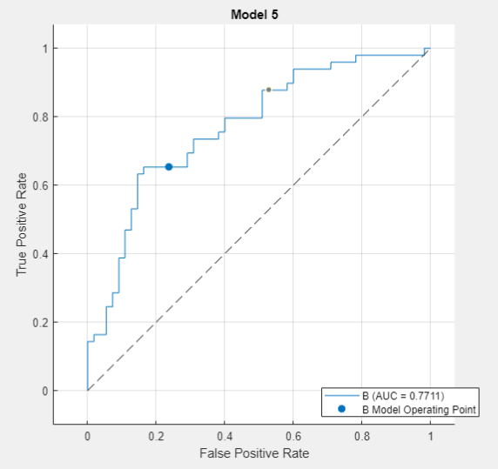
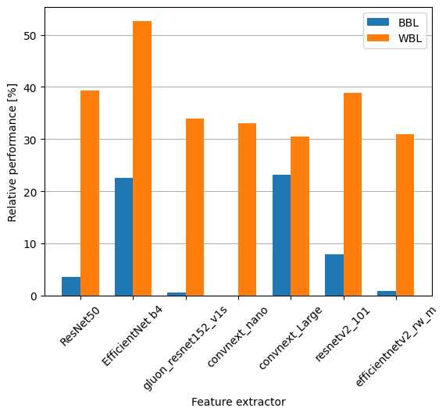
24 April – 4 May

Slide 11
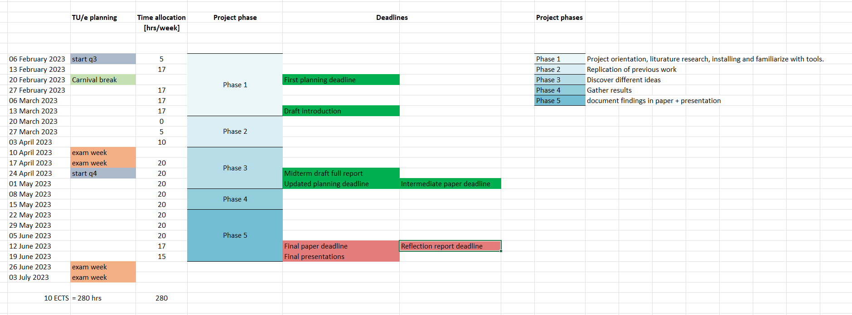
Revised planning 01-05-2023

Slide 12
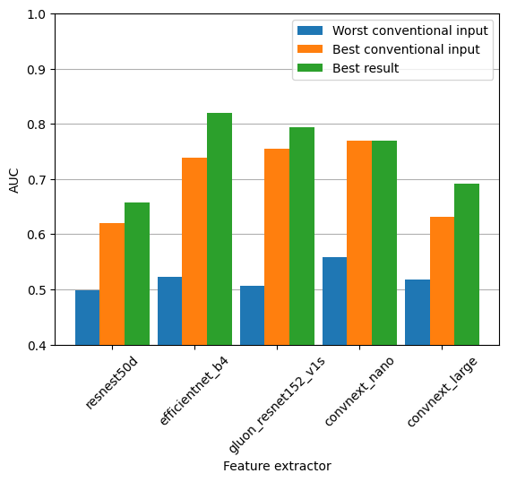
5 – 17 May
Normalization based on hounsville units
Clipped images between -100 and 300
Better results
Poster contest

Slide 13
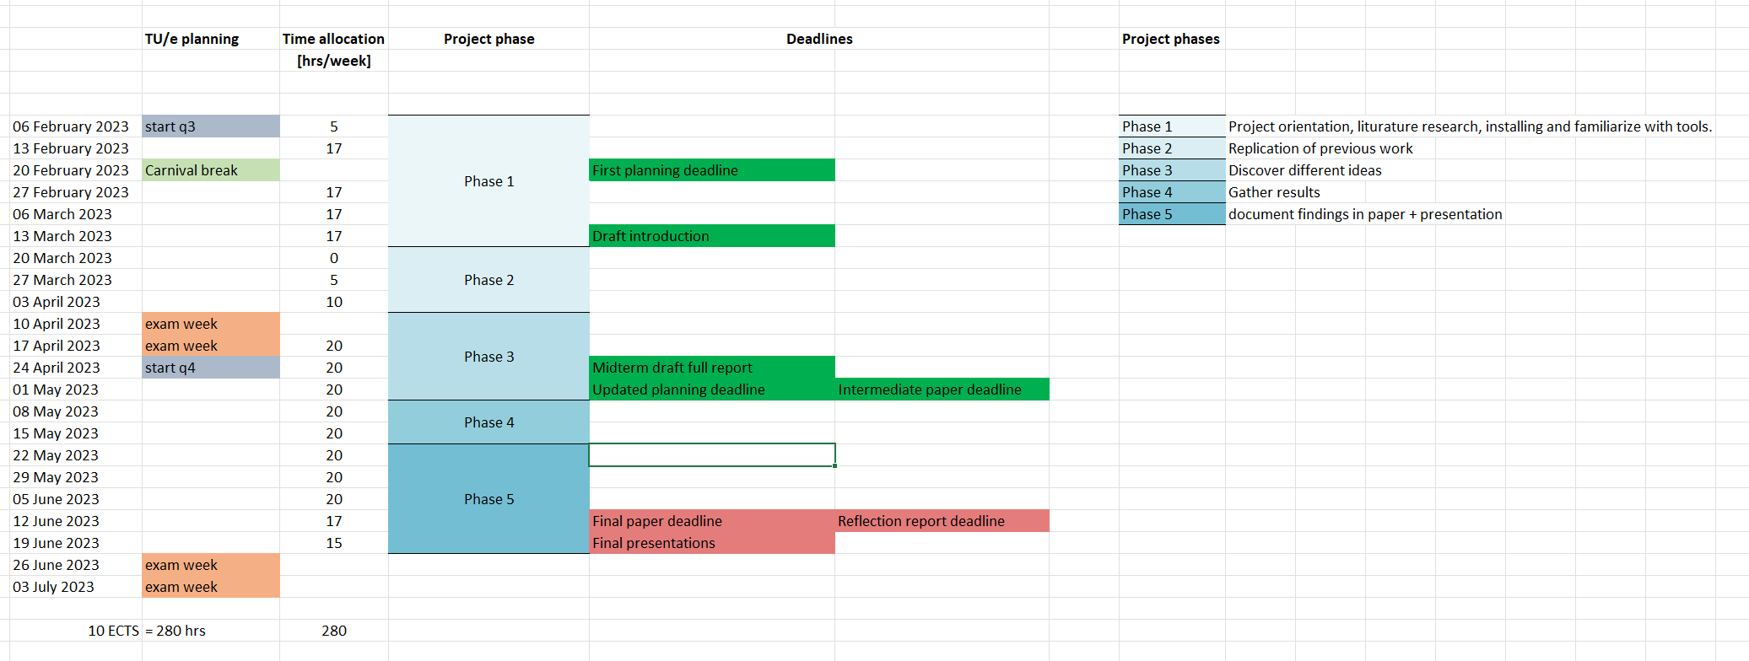
Revised planning 17-05-2023

