Slide 1
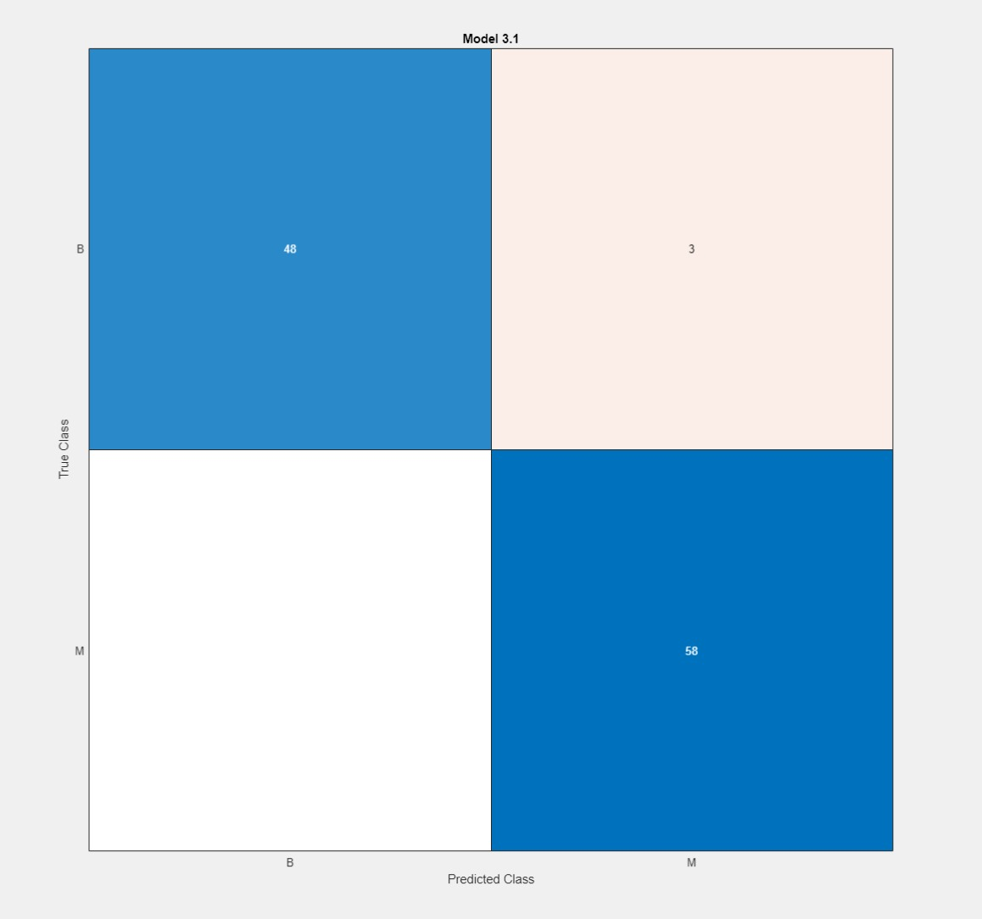
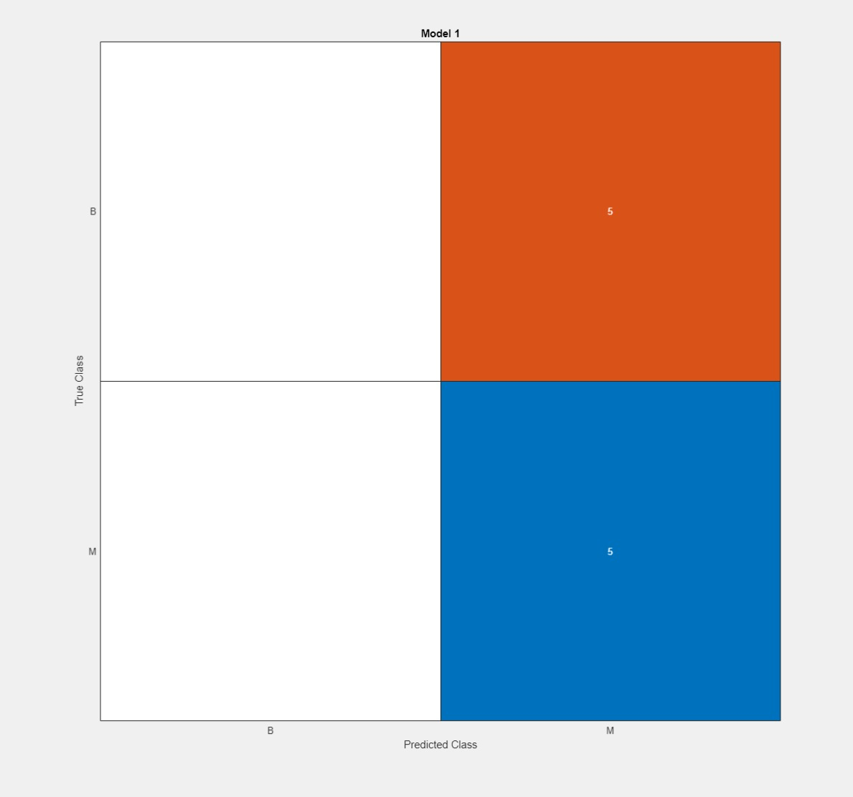
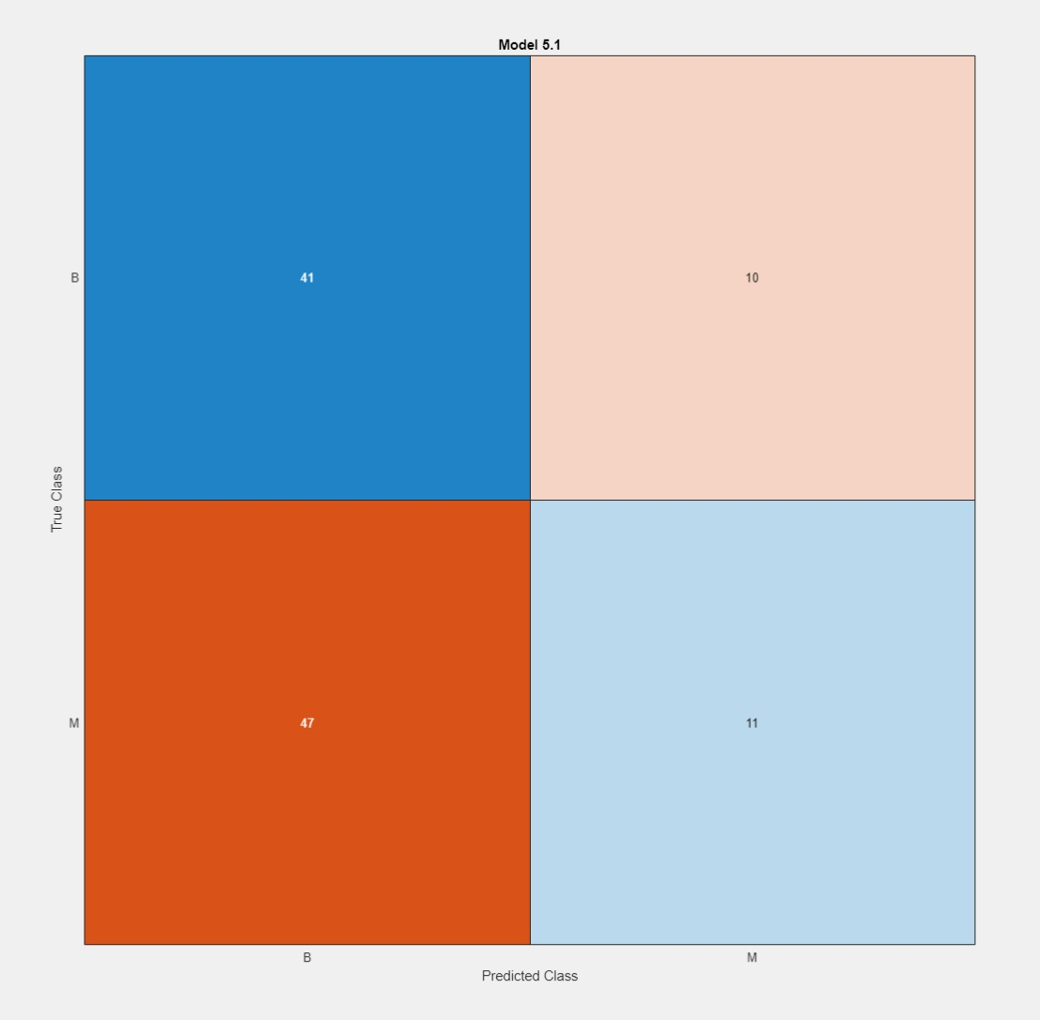
10-17 March
No cross fold validation - training
No cross fold validation - test
Past week
Introduction draft
Feature extraction with CT scan settings
Matlab classificationlearner trial + error
Potential issues
Feature extraction
cross fold validation

Slide 2
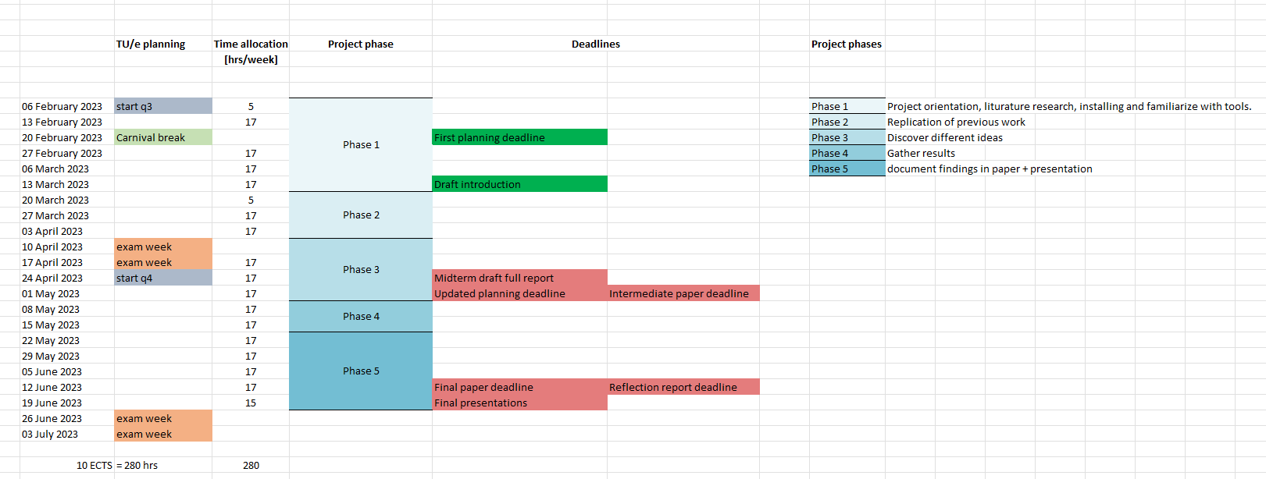
Revised planning 16-03-2023

Slide 3
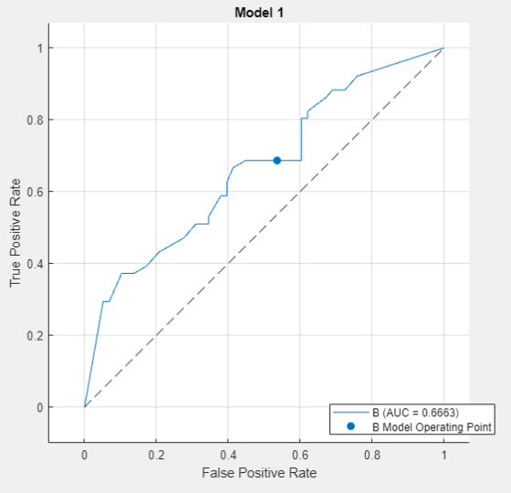
27 March – 6 April
Issue with Pyradiomics extraction, 1258 features
Started with transfer learning
Plan: use 3D conv NN medical application
Currently working with resnet

Slide 4
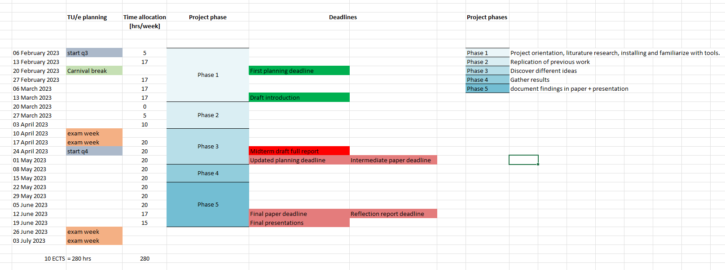
Revised planning 06-04-2023
Start of phase 3

Slide 5
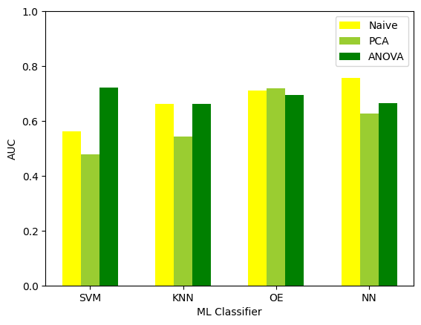
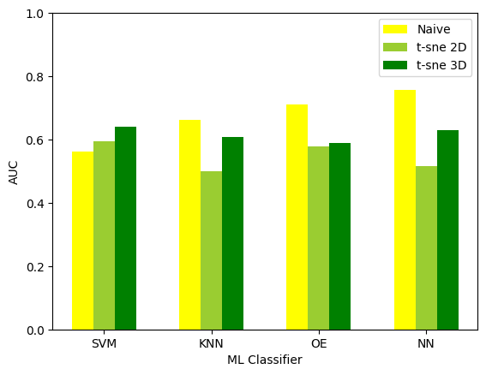
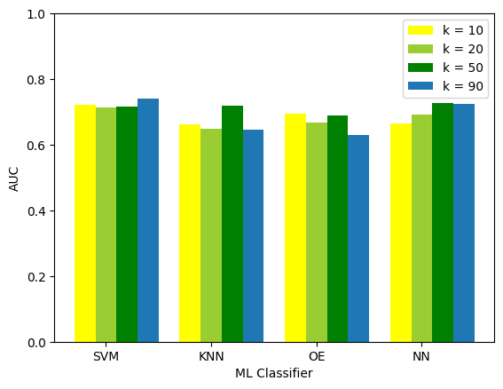
10-20 April
Erica reproduction
t-sne
ANOVA

Slide 6
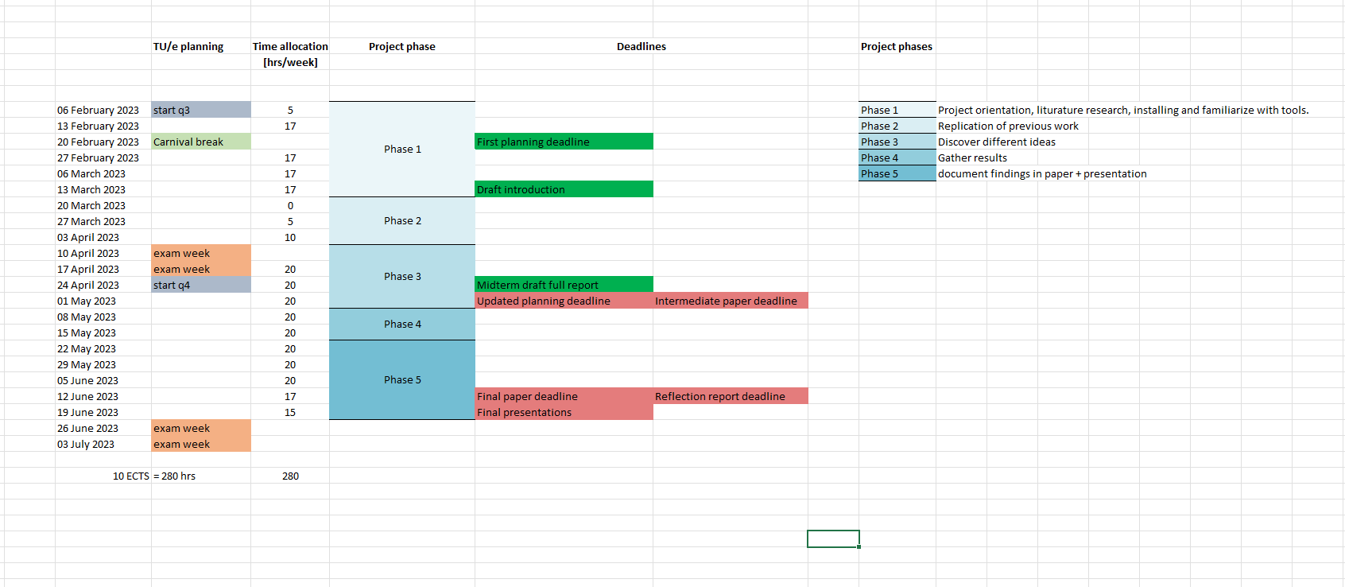
Revised planning 20-04-2023

