Slide 1
Transpiration
6 cm
Evaporation
⍦_{x}
13.5 cm
Lid
⍦_{s}
6 cm
Soil
⍦_{x} = Stem xylem pressure
⍦_{s} = Soil water potential (TEROS 21/ZL6)
%RH = Percentage relative humidity (Kestrel)
Soil = Sand and vermiculite (4:1), 50 ml of MS+PPM and XX ml H20.
11 cm diam.

Slide 2



H₂O
CO₂
[ABA] can increase up to 30-fold in response to drought stress.
Upregulation of NCED3 enzyme to produce ABA is observed within 15-30 minutes in leaves..
Stomata (guard cells)
Epidermis
Zeaxanthin
ZEP
Guard cell
Mesophyll
9’ cis-neoxanthin
NCED
ABA
Phosphorylation of key proteins initiating ion efflux
ABA biosynthesis
Xanthoxin
PYR/PYL/RCAR
ABA2
Clade A Phosphatase PP2C
P
Parenchyma
Abscisic aldehyde
P
AOO
KAT1/2
H⁺-ATPase
Xylem
ABA
P
P
ABA
Subclass III
SnRK2
(2.2/2.3/2.6)
ABCG25/40
Transcription
P
SLAC1
ALMT12/QUAC1
GORK
PIP, TIP?
Apoplast
AREB1/2
ABF2/3/4
or
Stress
ABA
Proteins for ion efflux and stomata closure
ABCG22
ABRE
ABRE
Activation of ABA related genes leading to stomatal closure
H₂O
CO₂
Notes:
https://journals.plos.org/plosone/article?id=10.1371/journal.pone.0200850
ABA → ABA receptor (PYR/PYL/RCAR) → Group A PP2C → Subclass III SnRK2 → Transcription factor (ABF) → ABA responsive cis elements → Gene transcriptions
https://www.ncbi.nlm.nih.gov/pmc/articles/PMC4679528/
The perception of ABA is achieved by members of the START protein family of ABA receptors, PYRABACTIN RESISTANCE 1 (PYR)/PYR1-LIKE (PYL)/REGULATORY COMPONENT OF ABA RECEPTOR (RCAR). In the presence of ABA, the PYR/PYL/RCAR proteins bind to and inhibit clade A protein phosphatases type 2Cs (PP2Cs) [19,20], followed by activation of the Ca²⁺-independent protein kinases SNF1-RELATED KINASE 2s (SnRK2s), most importantly OPEN STOMATA 1 (OST1/SnRK2.6), which phosphorylate multiple downstream targets (reviewed in [21]). In guard cells, ABA causes activation of two types of plasma membrane anion channels, called slow-sustained (S-type) and rapid-transient (R-type) anion channels, which drives plasma membrane depolarization and subsequent K⁺ efflux through voltage-dependent K⁺ channels (reviewed in [22–24]) (Figure 1). The release of anions and K⁺ causes a reduction in the turgor pressure of guard cells, resulting in stomatal closure. In Arabidopsis guard cells, S-type and R-type anion channels are mainly encoded by SLOW ANION CHANNEL-ACCOCIATED 1 (SLAC1) [25,26] and ALUMINUM-ACTIVATED MALATE TRANSPORTER 12/QUICKLY ACTIVATING ANION CHANNEL 1 (ALMT12/QUAC1) [27,28], respectively.

Slide 3
Opened (day)
Closed (night/stressed)
ABCG25
H⁺
H⁺-ATPase
ABA
KAT1/2
ATP
K⁺
ABI1/ABI2
PYR/PYL/
ABA
OST1
GORK
ABA
Malate²⁻
PP2C
ABCB14
K⁺
TIP
H⁺
TIP
NTR1.1
SLAC1
NO₃₋
H⁺
Malate²⁻
Cl⁻
QUAC1
Malate²⁻
H₂O
PIP
H₂O
PIP

Slide 4
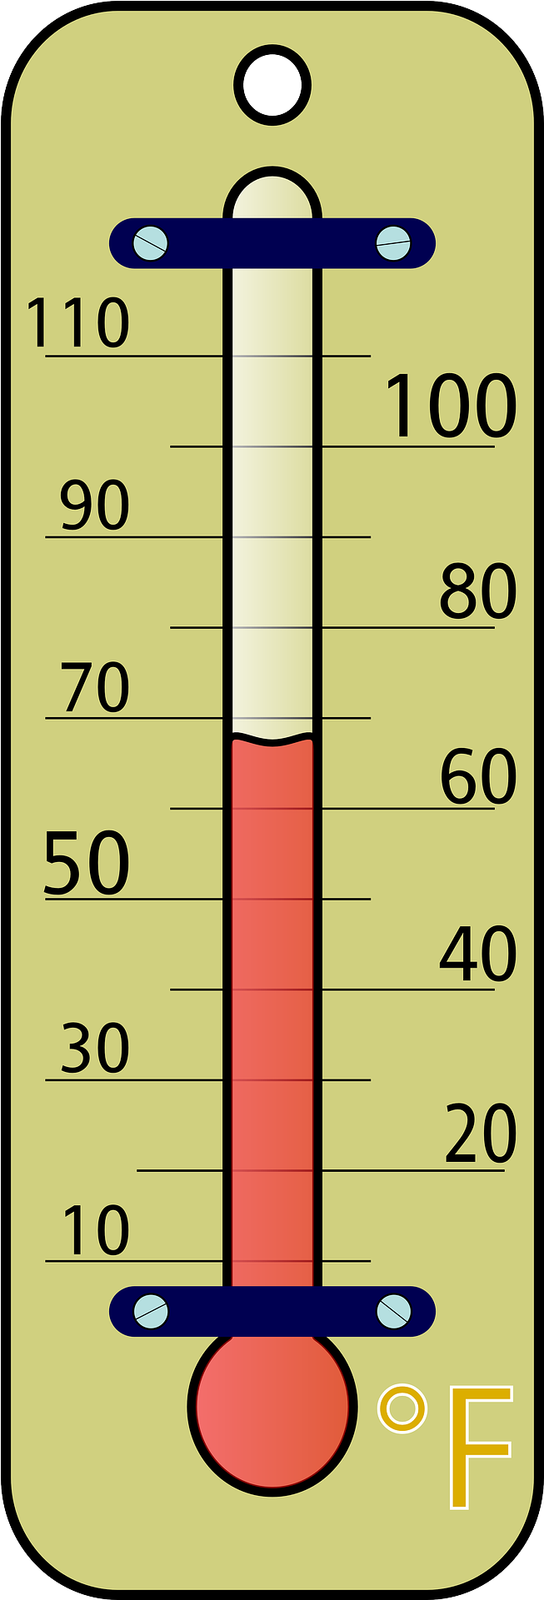

Temp.
Light
%RH
Transpiration
6 cm
⍦_{x}
13.5 cm
Evaporation
⍦_{s}
9.6 cm
6 cm
TEROS 21
3.5 cm
⍦_{x} = Stem xylem pressure
⍦_{s} = Soil water potential (TEROS 21/ZL6)
%RH = Percentage relative humidity (Kestrel)
11 cm diam.

