Slide 1
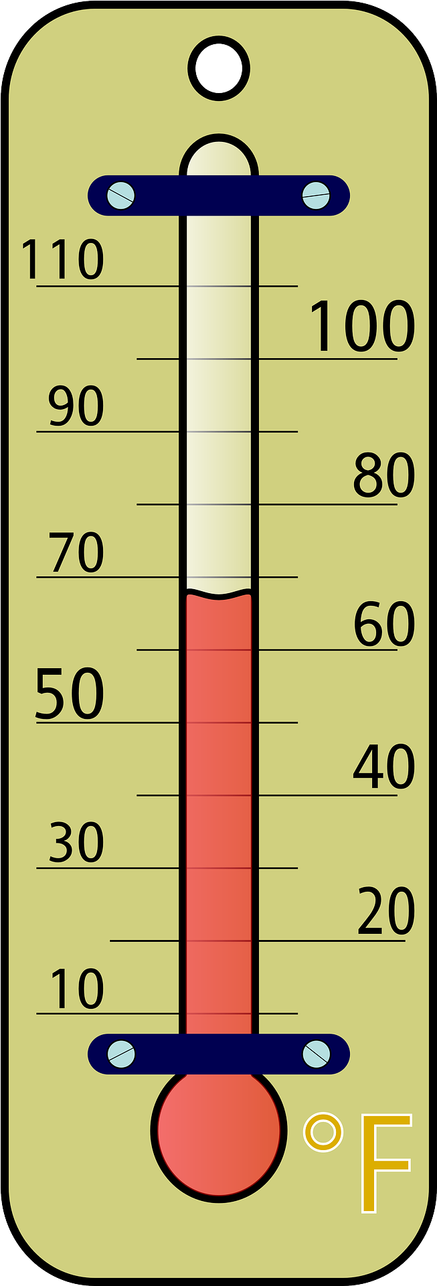

Temp.
Light
%RH
Transpiration
6 cm
Evaporation
K
13.5 cm
⍦_{s}
9.6 cm
6 cm
TEROS 21
3.5 cm
K = hydraulic conductance = flow rate/pressure difference (Marcelo)
⍦_{s} = Soil water potential (TEROS 21/ZL6)
%RH = Percentage relative humidity (Kestrel)
HC = Hydraulic conductivity (at sampling)
11 cm diam.

