Slide 1
Transpiration
6 cm
Evaporation
⍦_{x}
13.5 cm
Lid
⍦_{s}
6 cm
Soil
⍦_{x} = Stem xylem pressure
⍦_{s} = Soil water potential (TEROS 21/ZL6)
%RH = Percentage relative humidity (Kestrel)
Soil = Sand and vermiculite (4:1), 50 ml of MS+PPM and XX ml H20.
11 cm diam.

Slide 2
H₂O
CO₂
Stomata (guard cells)
Epidermis
Zeaxanthin
ZEP
Mesophyll
9’ cis-neoxanthin
NCED
ABA biosynthesis
Xanthoxin
ABA2
Parenchyma
Abscisic aldehyde
AOO
Xylem
ABA
ABA
ABCG25
Apoplast
ABA
ABCG25
Activation of ABA related genes
H₂O
CO₂

Slide 3
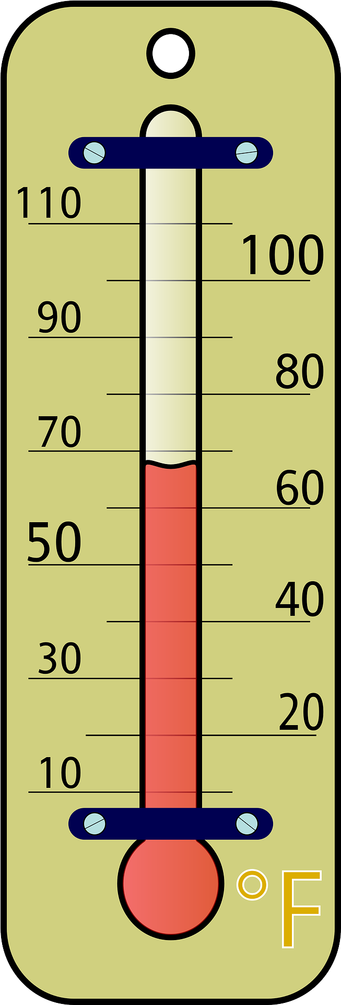

Temp.
Light
%RH
Transpiration
6 cm
⍦_{x}
13.5 cm
Evaporation
⍦_{s}
9.6 cm
6 cm
TEROS 21
3.5 cm
⍦_{x} = Stem xylem pressure
⍦_{s} = Soil water potential (TEROS 21/ZL6)
%RH = Percentage relative humidity (Kestrel)
11 cm diam.

