Slide 1

Hadoop
A framework for dealing with big data:
Data distributed across many failure-prone servers
Running code in parallel on this distributed data

Slide 2
Components of Hadoop
MapReduce
Map: converts data into key-value pairs (aka tuples)
Reduce: Converts output of Map into a smaller set of tuples
HDFS – Hadoop Distributed File System
Java – base code Hadoop uses
HBase – interactive table editor
Hadoop Streaming – interface to use Python instead of Java
Hadoop Hive – SQL-like interface for Hadoop
Hadoop Pig – simplified language specifically for MapReduce

Slide 3
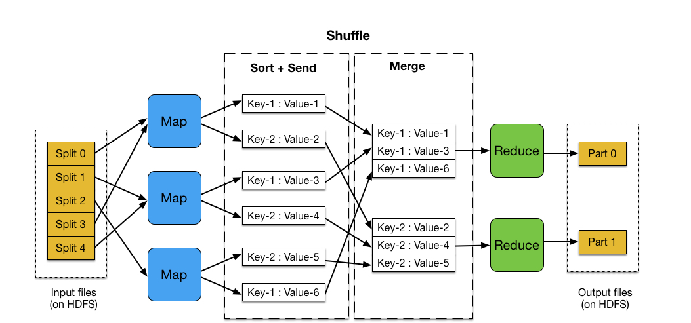
MapReduce
Run by JobTracker and its TaskTrackers

Slide 4
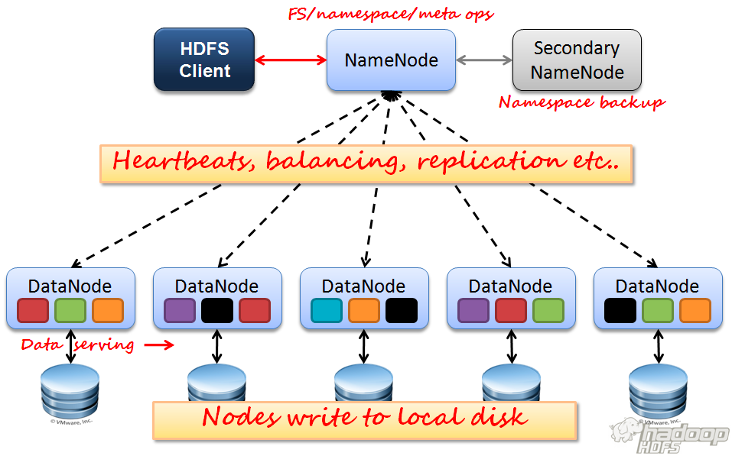
Hadoop Distributed File System
Bring the code to the data, not the data to the code!
Master/Slave architechture

Slide 5
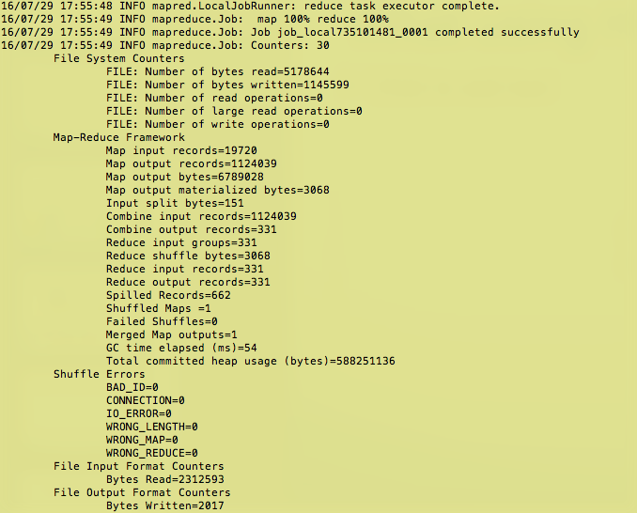
What using Hadoop looks like

Slide 6
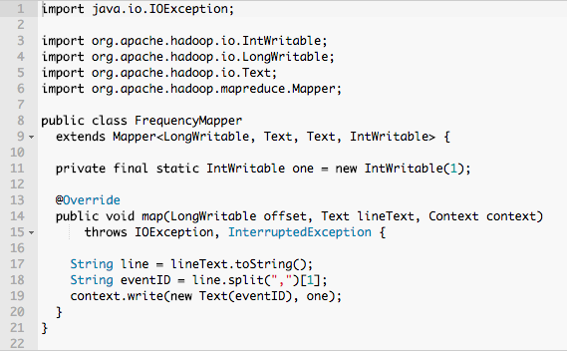
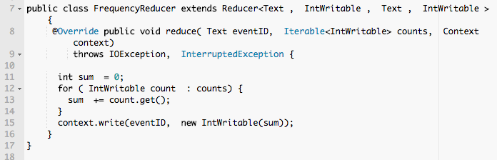
Example Java code
Map
Reduce

Slide 7
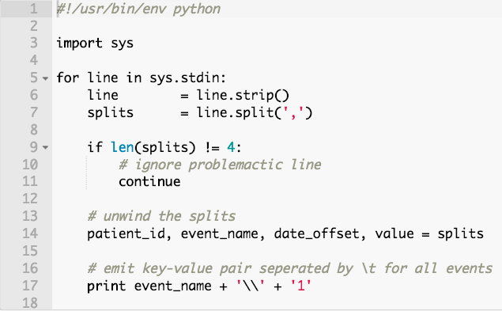
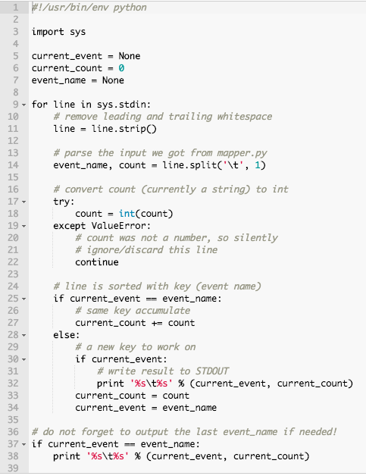
Example Python code
Map
Reduce
Example Goal: count instances of event-id for each patient sequence file

Slide 8
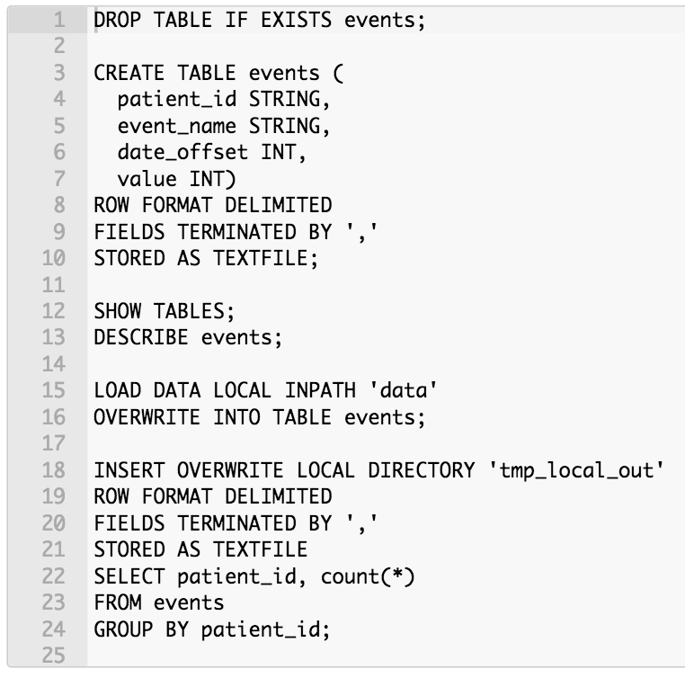
Example Hive code
Key Point: Unlike SQL, not in real time!
A queued task that should be expected to take a while!

Slide 9
Apache Spark
I want to do this in real time! Use R or Python:Pandas for small (all in memory) to medium data (e.g. you can buy enough RAM to hold at least a tenth of your table in memory at once.)
Want fast and huge? Go with Apache Spark
Spark uses the Scala language and SQL

Slide 10
A starter project for you
Installing Hadoop on mac with HomeBrew
1. install Java (check installation with $java –version)
2. $brew install hadoop (or install manually, check $hadoop version)
3. $brew info hadoop (copy the directory and $cd there)
4. navigate to your version of /usr/local/Cellar/hadoop/2.7.1/libexec/share/hadoop/mapreduce
5. $hadoop jar hadoop-mapreduceexamples-2.7.1.jar
Running one of the included example MapReduce scripts
$hadoop jar $HADOOP_HOME/share/hadoop/mapreduce/hadoop-mapreduceexamples-2.7.1.jar (should be a list of examples programs you can try)
create an input directory with a text file in it to count words of
hadoop jar $HADOOP_HOME/share/hadoop/mapreduce/hadoop-mapreduceexamples-2.7.1.jar wordcount input_file output_dir
examine the files in output dir
Notes:
Remember to remove the leading $ from terminal bash commands if copy/pasting!
Your path or hadoop version may differ, check these.
Output directory will be created if it does not already exist. If it does exist, it should be empty, will not overwrite (for safety, since you wouldn’t want to overwrite previous work).

