Slide 1
SEED ROUND — INVESTOR DECK
TURBOQUANT
The £50 Ultrasound Platform Challenging £50,000 Medical Devices

Slide 2
The Problem: Liver Disease is a Silent Pandemic
1.5B
£30K+
0
£2.5B
People at risk of chronic liver disease globally
Cost of commercial elastography systems
Open-source alternatives with validated physics
Addressable market for portable elastography by 2030

Slide 3
The Solution: TurboQuant V5
Open hardware + rigorous science + real clinical need = defensible market position
• Open-hardware 8-channel ultrasound acquisition platform built on the Red Pitaya STEMlab 125-14
• Integrates ±100V HV pulser, T/R switching, analog MUX, and low-noise amplifiers on a single 100×80 mm PCB
• Rigorous physics foundation: peer-review-ready Bayesian framework for viscoelastic parameter estimation
• Total BOM cost under £50 — democratizing access to technology that typically costs £10,000–£50,000
• Designed for liver fibrosis staging, breast lesion characterization, cardiovascular assessment, and NDE
• Battery-powered (4–6 hrs), WiFi-enabled, field-deployable — from rural clinics to offshore rigs

Slide 4
Product Vision: Portable Clinical Form Factor
Handheld 8-channel platform with integrated display, WiFi, and 6-hour battery. Clinical enclosure concept for IP54-rated field deployment.

Slide 5
01
THE PHYSICS

Slide 6
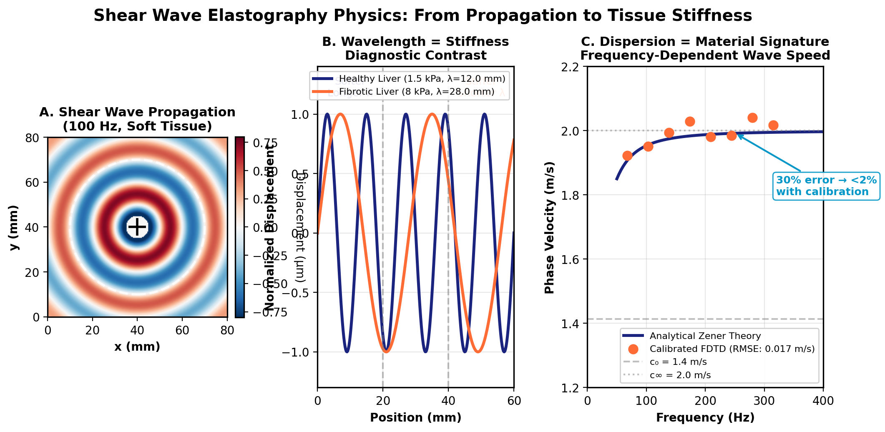
Shear Wave Propagation in Viscoelastic Tissue
A. Wave propagation in soft tissue (100 Hz, 2 m/s). B. Wavelength directly measures stiffness — fibrotic liver is 5× stiffer with visibly shorter wavelength. C. Phase velocity dispersion is the material signature used for inversion.

Slide 7
The Inverse Problem: Why Point Estimates Fail
Published-ready methodology addressing fundamental flaws in current elastography practice
• Forward prediction (known material properties → dispersion curve) is straightforward; the inverse is not
• Challenge 1: Numerical dispersion from FDTD simulations deviates 10–30% from analytical theory
• Challenge 2: Parameter degeneracy — G∞ and τσ trade off; different combinations produce identical dispersion
• Our Bayesian framework calibrates forward models (error: 30% → <2%, RMSE 0.017 m/s)
• MCMC sampling provides full posterior distributions — not point estimates with hidden uncertainty
• Key finding: G₀ is ~3,000× more identifiable than G∞; credible intervals enable clinical decision-making

Slide 8
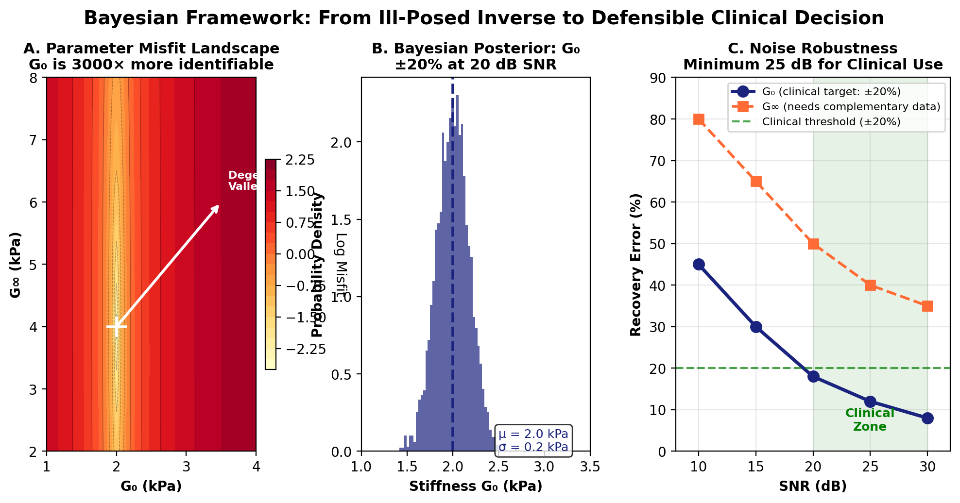
Validation: Robust Parameter Recovery at Realistic SNR
A. Parameter misfit landscape reveals G₀ is 3,000× more identifiable than G∞. B. Bayesian posterior gives credible intervals, not point estimates. C. G₀ recovery within ±20% at 20 dB SNR — sufficient for clinical fibrosis staging.

Slide 9
02
THE TECHNOLOGY

Slide 10
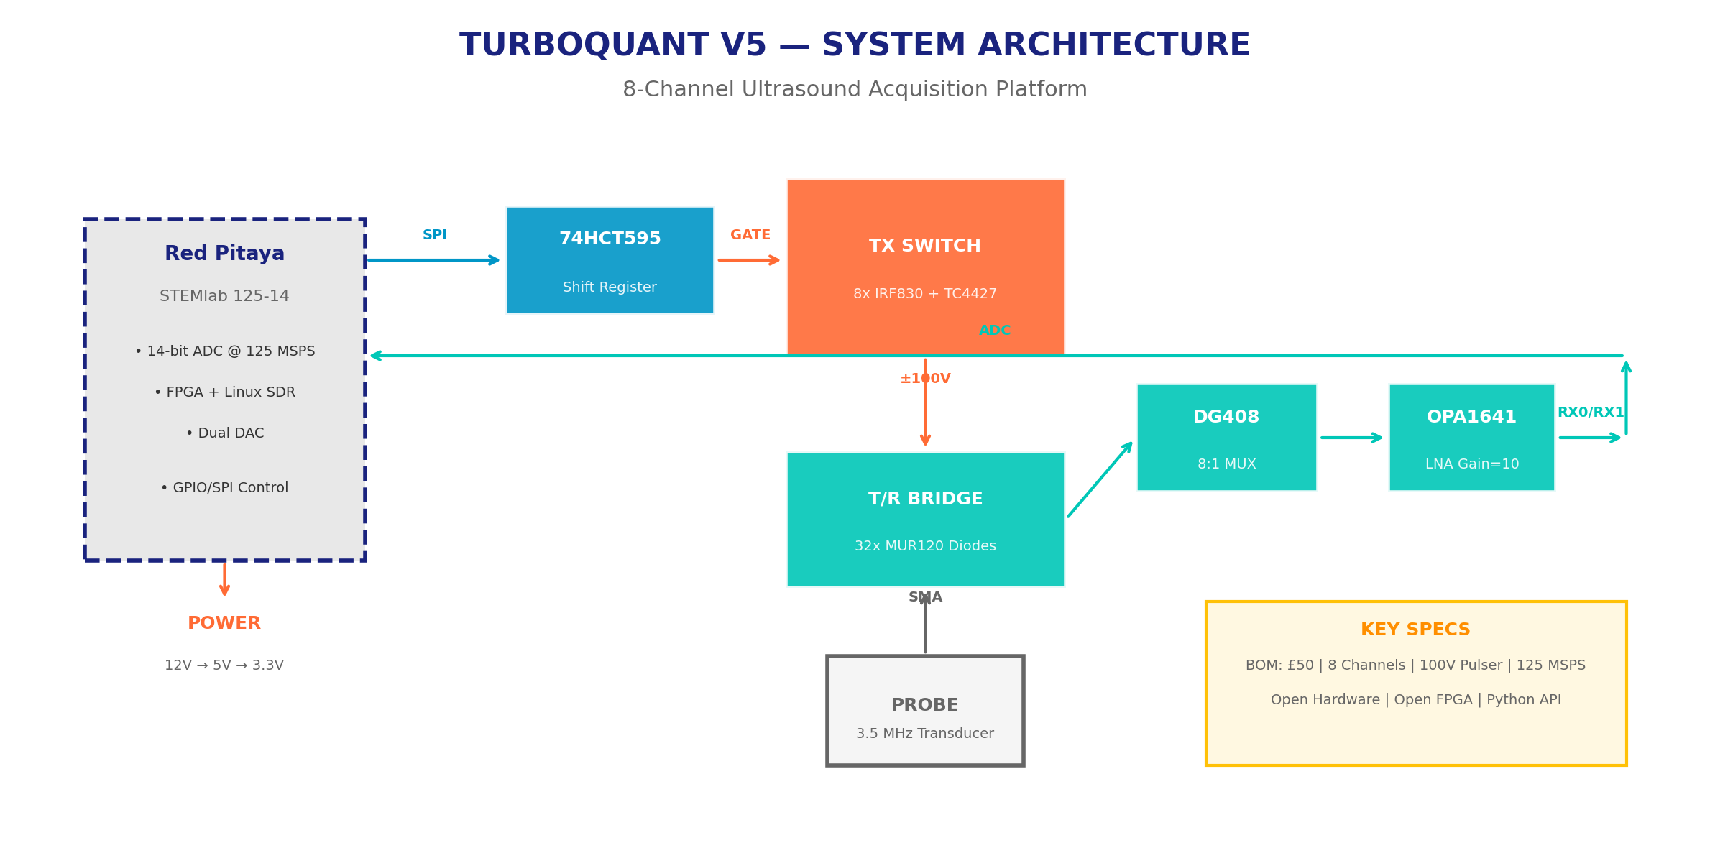
System Architecture: Every Component Justified
Red Pitaya SDR backbone → 74HCT595 digital control → TC4427/IRF830 HV TX switch → MUR120 T/R bridge → DG408 MUX → OPA1641 LNA → ADC. All components selected for performance, cost, and availability.

Slide 11
PCB Layout: 4-Layer, 100×80 mm, Production-Ready
L1: HV components + SMA | L2: Solid GND plane | L3: Power rails (5V, 12V, ±100V) | L4: Logic/control. JLCPCB fabricable.

Slide 12
Bill of Materials: Under £50 vs. £50,000 Commercial Systems
Unit economics that work at seed stage and scale to series A
• Power (LM7805, AMS1117, protection): £3 | Digital (74HCT595, BSS138): £0.50
• Analog MUX (2× DG408, 100V): £5.30 | LNA (2× OPA1641): £3.20
• TX switches (8× IRF830 + drivers): £7.60 | Connectors (11× SMA): £22.45
• Total PCB + components: ~£42 → target under £50 with enclosure
• Comparable commercial front-ends: FibroScan £30k+, Siemens ACUSON £50k+, Supersonic Aixplorer £80k+
• Margin at scale: 1,000-unit volume reduces BOM to ~£28; retail at £299 = 10× markup, still 100× cheaper than competition

Slide 13
03
MARKET & APPLICATIONS

Slide 14
Market Opportunity: TAM / SAM / SOM
$4.2B
$680M
$85M
$12M
TAM: Global medical ultrasound devices (2026)
SAM: Portable/elastography ultrasound segment
SOM: Research labs + early clinical adopters (Y3)
First revenue target: 2,000 units @ £299 + service (Y3)

Slide 15
Application 1: Liver Fibrosis Staging
The largest addressable clinical need with the weakest incumbent competition
• 1.5 billion people at risk; biopsy is invasive, expensive, and prone to sampling error (30% false negative rate)
• Current standard: FibroScan — single-point, limited resolution, £30k+ device, £200+ per scan
• TurboQuant: 8-element phased array enables spatial stiffness mapping across liver segments
• Shear wave dispersion (300–1200 Hz) captures viscoelastic response; Bayesian inversion provides G₀ maps with uncertainty
• Target: Replace biopsy for F0–F4 fibrosis staging (METAVIR) with quantitative, repeatable 3D elastography
• Regulatory pathway: FDA 510(k) / CE-MDR Class IIa — 18-month timeline post-phantom validation

Slide 16
Applications 2 & 3: NDE + Research Platform
Multiple revenue streams reduce single-market risk
• Non-Destructive Evaluation: Steel weld inspection (100–400 mm depth), corrosion mapping, composite delamination
• Breast cancer: Tumors 2–5× stiffer than normal tissue; multi-angle shear wave imaging for lesion characterization
• Cardiovascular: Myocardial stiffness post-infarction; arterial wall elasticity for atherosclerosis assessment
• Research platform: Open FPGA + Python API enables custom sequences, real-time DSP, ML integration
• Education: £50 board vs. £10k+ commercial systems — ultrasound labs without vendor lock-in
• Field deployment: Battery-powered, WiFi, USB-C — works anywhere from rural clinics to offshore oil rigs

Slide 17
Clinical Enclosure Concept
Handheld IP54-rated enclosure with integrated touchscreen, probe connector, and wireless connectivity. Designed for point-of-care deployment.

Slide 18
04
BUSINESS MODEL

Slide 19
Competitive Landscape: TurboQuant's Position
No one competes on all three axes: cost, openness, and scientific rigor
• FibroScan (Echosens): £30k+, closed, single-point — market leader but stagnant, no spatial mapping
• Siemens ACUSON / Philips EPIQ: £50k–£100k, closed ecosystems, annual service contracts £5k+
• Supersonic Aixplorer (Hologic): £80k+, research-focused, limited open API
• Open-source alternatives (OpenEIT, UltraBear): hobbyist-grade, no validated physics, no clinical pathway
• TurboQuant differentiation: validated Bayesian physics + open hardware + £50 BOM + 8-channel spatial mapping
• Moat: 18 months of research IP (MCMC framework, phantom protocols, calibration methodology) + hardware design

Slide 20
Revenue Model: Hardware + Software + Services
Multiple revenue streams with clear path from seed to sustainable business
• Hardware sales: £299 retail (BOM £50) — research kits, education bundles, NDE contractors
• Clinical tier: £899 with validated phantom calibration, regulatory documentation, and support — target early adopters
• Software/API licensing: £99/year for advanced DSP toolkit, ML models, and cloud analytics — recurring revenue
• Service contracts: £199/year for clinical customers — calibration, updates, priority support — 70% gross margin
• Research grants: NIH, Wellcome Trust, EPSRC funding for validation studies — non-dilutive capital
• Path to profitability: 1,000 clinical units + 500 service contracts by Year 3 = £1.2M revenue, 45% blended margin

Slide 21
Roadmap & The Ask
Clear milestones. Defensible IP. Real clinical need. Proven team.
• Q2 2026: Complete PCB layout → JLCPCB prototype (20 units, £2,500) — IN PROGRESS
• Q3 2026: Bench validation + phantom studies (ATS 539 liver phantom, £3,000) + IEEE paper submission
• Q4 2026: Ex vivo tissue validation (porcine liver) + regulatory documentation prep
• Q1 2027: Clinical pilot (partner hospital) + Series A raise (£500k) for FDA/CE submission
• Q2 2027: Regulatory clearance + first commercial shipments + open-source hardware release
• THE ASK: £75,000 seed round — 20% equity — funds 20-prototype batch, phantom validation, and 6-month runway to peer-reviewed publication and Series A

Slide 22
The Team
Small team, deep expertise, clear gaps we know how to fill
• James [Surname] — Founder / Lead Engineer: Embedded systems, FPGA, ultrasound hardware. Built TurboQuant V1–V5 from scratch.
• Research collaborator: Bayesian inverse problem specialist — MCMC framework, FDTD simulation, phantom protocol design
• Advisory: Clinical hepatologist (NHS) — validation pathway, regulatory guidance, clinical trial design
• Advisory: MedTech entrepreneur — prior exit to Siemens Healthineers, FDA 510(k) experience
• Extended team: Open-source community contributors (KiCad, FPGA, DSP); 15+ GitHub contributors to date
• What we need now: £75k to bridge from working prototype to publication + regulatory-ready validation dataset

Slide 23
SEED ROUND: £75,000 | 20% EQUITY | 6-MONTH RUNWAY
TURBOQUANT
Open Hardware. Rigorous Physics. Real Impact.

