Slide 1
Git
Introduction

Slide 2
What is git
It is a file versioning system with remote storage
Think of it like
Versions + (backups)
Zip + (compressed)
Shared Folder (collaboration)
Versions

Slide 3
why do we need Git
Remote working makes our systems vulnerable
Sharing and collaborating become easier
Permanent storage of files independent of the system
Protected by power/hardware failures

Slide 4
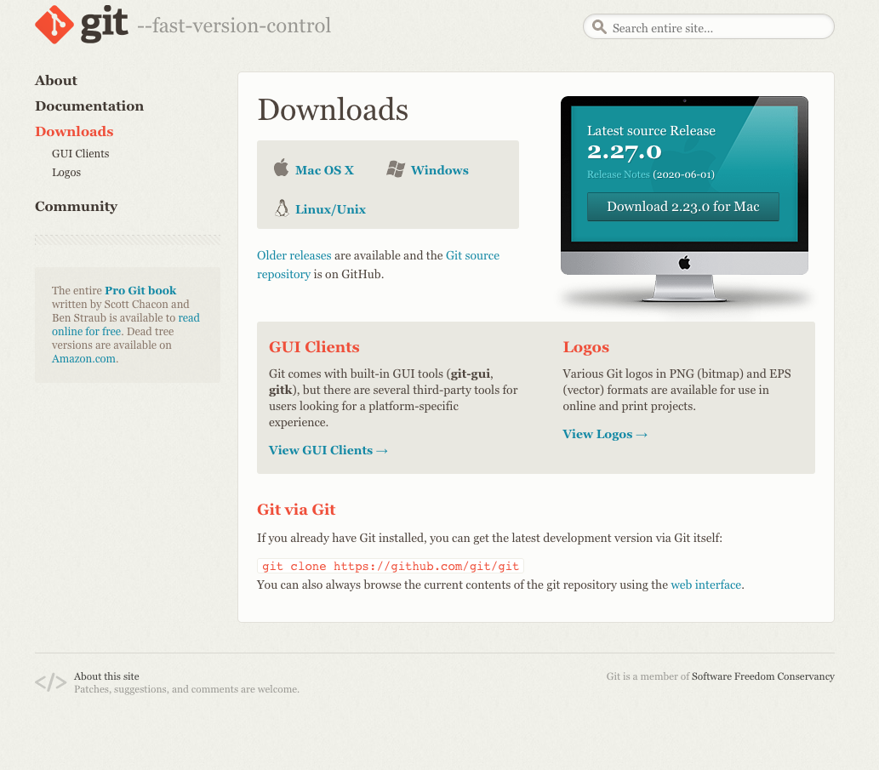
how to get it
download it and run the installer
https://git-scm.com/downloads

Slide 5
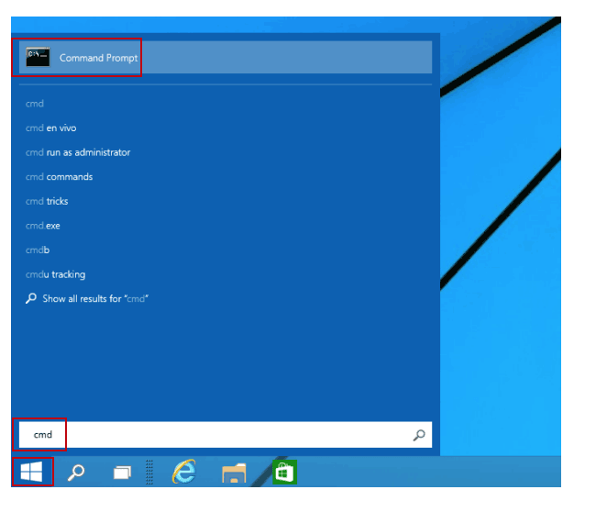
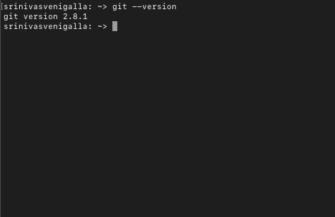
how to use it
make sure git is installed and available
Go to CMD prompt
Run the command
git —version
3. go to your folder
cd <your folder>
4. run the command
git init

Slide 6
set your identity
git config --global user.name “your name”
git config --global user.email “you.uoy@maseke.com”

Slide 7
Your first use
Create a file called “my first file.txt”
Add some text
close the file
Run these commands
git status
git add .
git commit
repeat this workflow

Slide 8
Install a GUI client
install Github Desktop
Add repository
View history
Check the changes
checkout versions

