Slide 1
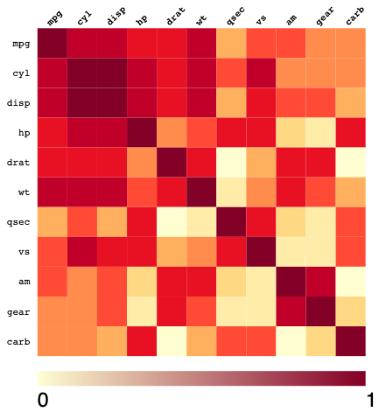
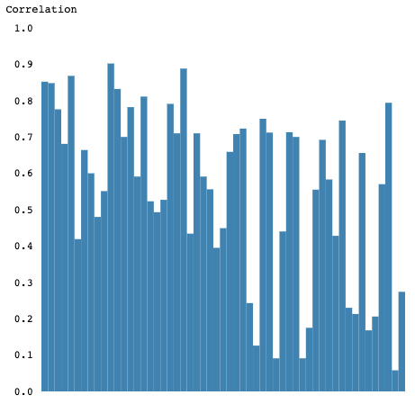
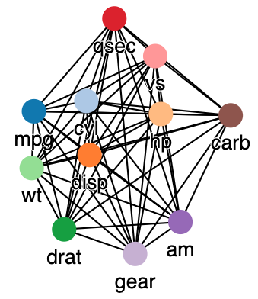
Interactive Visualization of Correlations in
High-Dimensional Streams
Yimin Zhang | July 19, 2019
INSTITUTE FOR PROGRAM STRUCTURES AND DATA ORGANIZATION

Slide 2
Outline
Motivation
Challenges
Related Work
Interface
Evaluation
Summary
Motivation
Challenges
Related Work
Interface
Evaluation
Summary

Slide 3
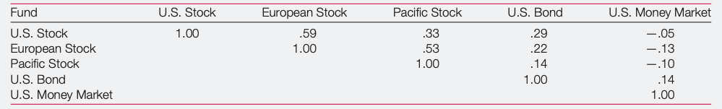
Motivation
Correlation analysis aims at discovering and summarizing the relationship between the attributes of a data set
Pearson correlation is in [-1,+1]
An example on financial investments
Fig: Correlations Among the Five Funds’ Returns, Monthly Returns, from 1980 to 1998 by Katrina Simons [8]
Motivation
Challenges
Related Work
Interface
Evaluation
Summary
Notes:
Knowing the relationship between a set of variables, one can infer useful knowledge about external, a priori unknown outcomes.
stock markets are positively correlated, indicates a similar behavior during this period. Based on the situation of a stock market, predict the behavior of other stock markets due to the positive correlation.
If minimize the risks -> invest in uncorrelated stock markets.

Slide 4
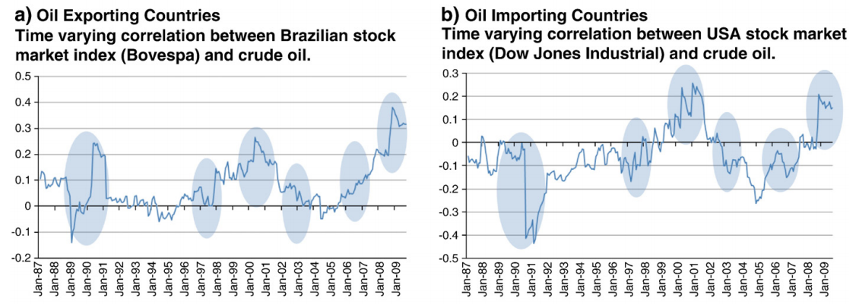
Motivation
During the period 1987 – 2009:
Iraq invasion in Kuwait/first war in Iraq
Asian economic crisis
Housing market boom
Chinese economic growth
Second war in Iraq
Global financial crisis
Fig: Dynamic correlation between
stock market index and the crude
oil price by George Filis et al. [3]
Motivation
Challenges
Related Work
Interface
Evaluation
Summary
Notes:
In general, the correlations between attributes may change in unforeseeable ways. If the correlation structure changes brutally, which often indicates a sudden peak or valley, we can infer that one of the attributes may have an enormous change or the relationship between them may differ thoroughly.
These events signed the brutal changes in the correlation between markets and oil price, which are printed in blue circles in the Figure.

Slide 5
Challenges - 1. Streaming setting
Data evolves over time
Correlation analysis should not be static
Fig: Dynamic correlation between
stock market index and the crude
oil price[3]
Motivation
Challenges
Related Work
Interface
Evaluation
Summary
Notes:
In contrast to static data, the data is often available as a stream, i.e., it is an infinite, ever evolving sequence of observations. As the concepts learned at a certain time cannot be expected to hold in the future, correlation analysis should be a continuous process. We can see from Figure 1.2 that the correlation between market and oil price is always changing throughout the time. The correlation values even have brutal changes, when meet up with important events. Therefore, it is difficult for the data scientists to predict the correlation value at next timestamp.

Slide 6
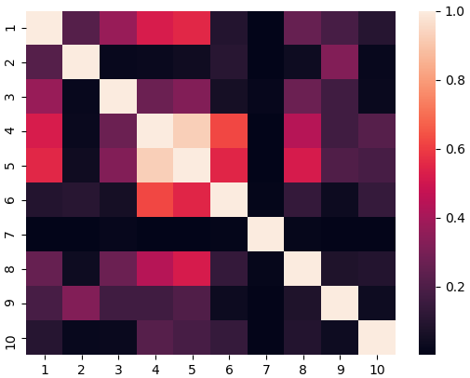
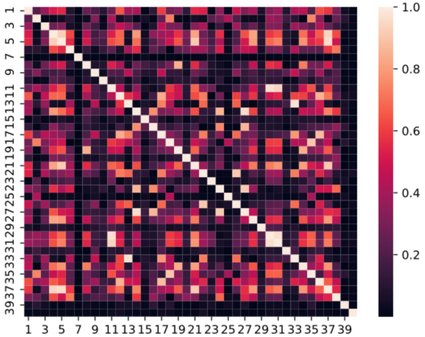
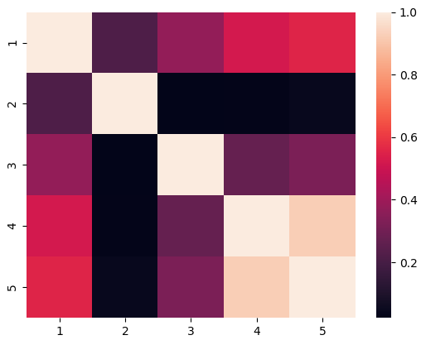

Challenges - 2.The high-dimensionality
Compute the correlation between $\frac{n(n−1)}{2}$ pairs for the pairwise correlation analysis of any data steam with n components
Difficult to extract actionable insights from the correlation analysis
Impossible to understand the result of the correlation analysis
Fig: Correlation matrix of different number of attributes
Motivation
Challenges
Related Work
Interface
Evaluation
Summary
Notes:
As global stock markets contains hundreds or thousands of variables, this leads to the challenge of high-dimensionality.
In the case of streams with many dimensions, , 5:10 10:45
Therefore, it becomes difficult to visually keep track of correlation
As an instance, with the developing number of attributes, it becomes even harder for users to compare the correlation value between two pairs using Heatmap as the standard tool to visualize the data.

Slide 7
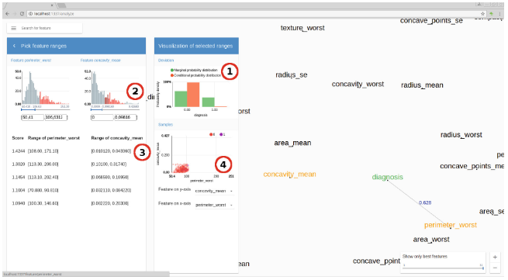
Related Work – „FEXUM“ [2]
Simultaneously visualize all feature correlations to the target and pairwise correlations using Force-Directed-Graph
Nodes represent features
and weighted edges
represent distances
Smaller distance between two features denotes a greater redundancy
Figure: „FEXUM“ by Louis Kirsch et al. [2]
Motivation
Challenges
Related Work
Interface
Evaluation
Summary
Notes:
interactive Framework for Exploring and Understanding Multivariate Correlations
Features drawn using a force-directed graph (right), with the target highlighted in green. An analysis view of two features (left) for inspecting the correlations.

Slide 8
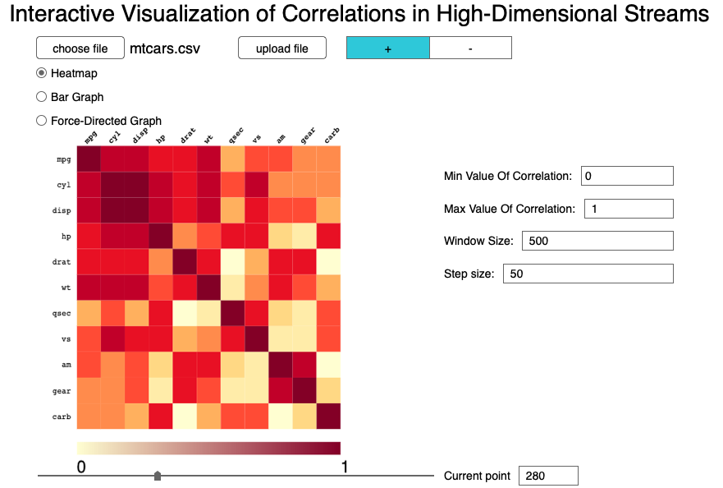
Interface – Mock-up
Fig: Mock-up of the interface
Motivation
Challenges
Related Work
Interface
Evaluation
Summary
Notes:
visualizes all pairs of attributes in the data set
The interface can be used with a wide range of data sets as csv files, supplied through upload by the user. After the calculation in the back-end, the visualization of data correlation is shown in the website, for example, via a Heatmap.
The window size represents the size of the selected timestamps of the current data set. Timestamp represents the instance of data set. As we aim at data stream, each instance of data set is the representation for values of attributes at a certain timestamp. The step size gives out the difference between two adjacent movements of slider. Combined with the step size, the user is able to get the visualization of a certain time period by sliding the sliding window. The current point represents the starting point of current selected group of timestamps.

Slide 9
Interface – Visualization Methods
Heatmap: variables with strong correlation (high values) are printed in dark colour and those with low correlation are in light colour
Fig: Heatmap of the Data Set Mtcars
Motivation
Challenges
Related Work
Interface
Evaluation
Summary

Slide 10
Interface – Visualization Methods
Bar Graph: presents categorical data with rectangular bars with heights or lengths proportional to the values that they represent
Fig: Bar Graph of the Data Set Mtcars
Motivation
Challenges
Related Work
Interface
Evaluation
Summary

Slide 11

Interface – Visualization Methods
Force-Directed-Graph
assigns forces among the set of edges and the set of nodes of a graph drawing
length of link between two nodes: $200∗\sqrt{\left(1−x^{2}\right)}$ $x is the correlation value$
Fig: Force-Directed-Graph of the Data Set Mtcars
Motivation
Challenges
Related Work
Interface
Evaluation
Summary

Slide 12
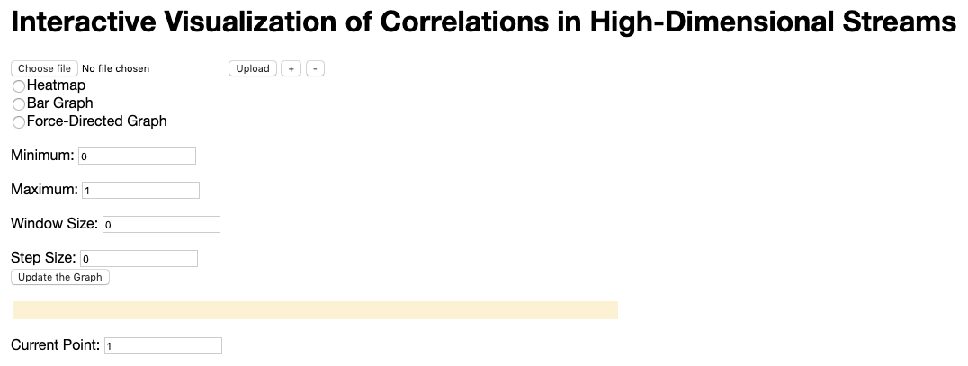
Interface
Javascript (D3.js for producing dynamic, interactive data visualizations in web browsers)
Motivation
Challenges
Related Work
Interface
Evaluation
Summary

Slide 13
Evaluation – Reasearch Questions
What visualization method is the most appropriate to visualize correlation for various specific user information needs?
What visualization method is the most suitable to visualize characteristics of a data set?
What are the desirable features of a correlation monitoring interface?
Motivation
Challenges
Related Work
Interface
Evaluation
Summary

Slide 14
Evaluation – Experimental Settings
A preliminary study (sample size might be too small)
Large-scale study -> Future work
Participants are assigned randomly to different conditions:
Condition A: Participants can only use the Heatmap
Condition B: Participants can only use the Bar Graph
Condition C: Participants can only use the Force-Directed-Graph
Condition D: Participants can use any visualization method they want, which are mentioned in Condition A, B and C
Real-world data set at random: modifications on Data set Bioliq
Data Set 1 (DS1): 10 attributes within 2000 instances
Data Set 2 (DS2): 20 attributes within 2000 instances
Data Set 3 (DS3): 40 attributes within 2000 instances
The window size is set to 200 and the step size is set 50 for all three data sets
Motivation
Challenges
Related Work
Interface
Evaluation
Summary
Notes:
As this is a minor study, it may lead to some different conclusions based on bias. As a result, the future work can be conducted at a bigger scale to increase the accuracy.

Slide 15
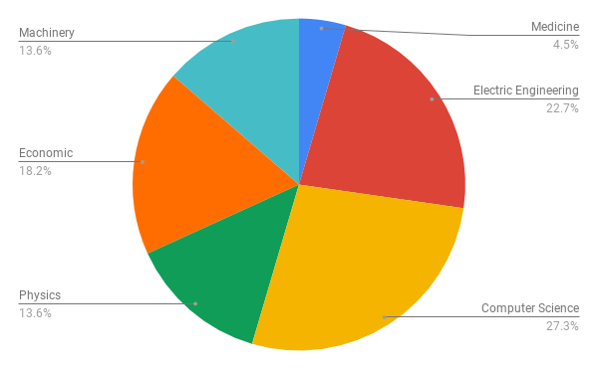
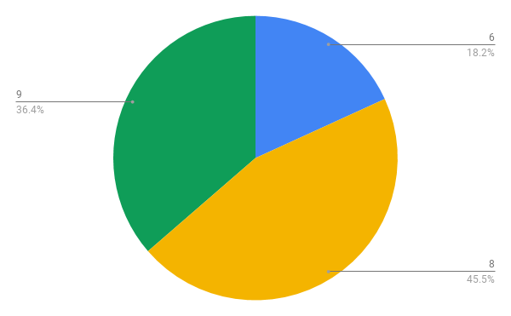
Evaluation – Statics
1.Basic Information:
22 participants from KIT, studying different majors
Q1.1: Field of study
Q1.2: Number of semester
a) Field of study
b) Number of semester
Motivation
Challenges
Related Work
Interface
Evaluation
Summary

Slide 16
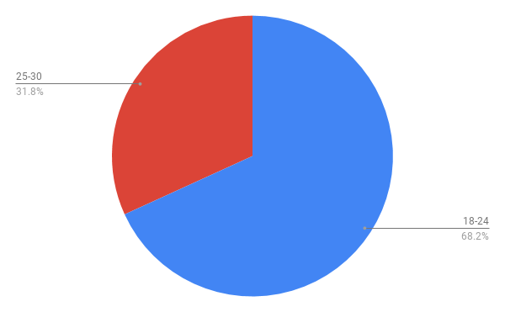
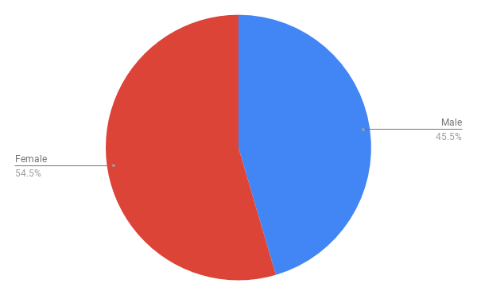

Evaluation – Statics
1.Basic Information:
Q1.3: Age: 18-24 25-30 More than 30
Q1.4: Gender: M F Do not wish to answer
a) Age
b) Gender
Motivation
Challenges
Related Work
Interface
Evaluation
Summary

Slide 17
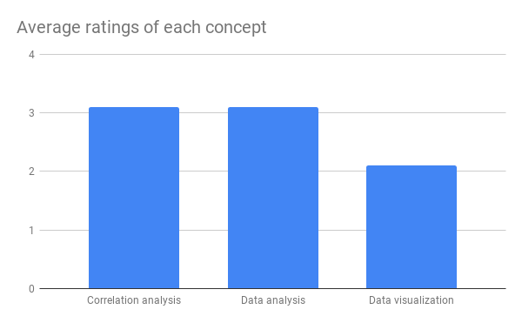
Evaluation – Statics
1.Basic Information:
Q1.5: How familiar are you with the following concepts?
Using LIKERT scale (1-7)
1: unfamiliar
7: very familiar
Motivation
Challenges
Related Work
Interface
Evaluation
Summary

Slide 18
Evaluation
Q2.1: How many attributes are available in this data set?
Q2.2: How many pairs of attributes are available in this data set?
Whatever method the user uses, the user can get the correct answer.
Motivation
Challenges
Related Work
Interface
Evaluation
Summary

Slide 19
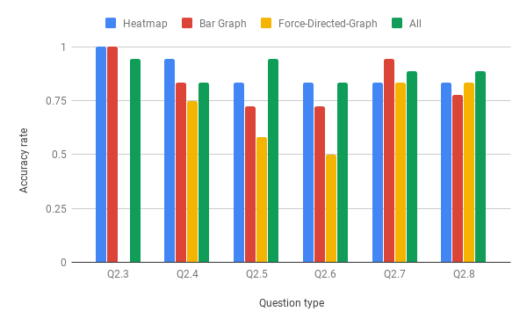
Evaluation
Q2.3: What is the correlation value between Attribute A and Attribute B at Timestamp T (with precision +- 0.1) ?
Fig. Accuracy rate of each question type using different visualization methods
Motivation
Challenges
Related Work
Interface
Evaluation
Summary

Slide 20
Evaluation
Q2.4: Which pair of attributes has the biggest correlation at Timestamp T ?
Fig. Accuracy rate of each question type using different visualization methods
Motivation
Challenges
Related Work
Interface
Evaluation
Summary
Notes:
fdg < 75%

Slide 21
Evaluation
Q2.5: Which pair of attributes has the smallest correlation at Timestamp T ?
Fig. Accuracy rate of each question type using different visualization methods
Motivation
Challenges
Related Work
Interface
Evaluation
Summary
Notes:
Only heatmap & Interface > 75%

Slide 22
Evaluation
Q2.6: The following statement is true or false: “The correlation value between Attribute A and Attribute B remains the same at Timestamp T1 and at Timestamp T2”?
Fig. Accuracy rate of each question type using different visualization methods
Motivation
Challenges
Related Work
Interface
Evaluation
Summary
Notes:
Fdg < 50%
Heatmap > 75% highest

Slide 23
Evaluation
Q2.7: Which pair(s) of attributes has/have a correlation value that is not smaller than X at Timestamp T ?
Fig. Accuracy rate of each question type using different visualization methods
Motivation
Challenges
Related Work
Interface
Evaluation
Summary
Notes:
All > 75%
Bar highest

Slide 24
Evaluation
Q2.8: Which pair(s) of attributes has/have a correlation value that is not bigger than X at Timestamp T ?
Fig. Accuracy rate of each question type using different visualization methods
Motivation
Challenges
Related Work
Interface
Evaluation
Summary
Notes:
All > 75%

Slide 25
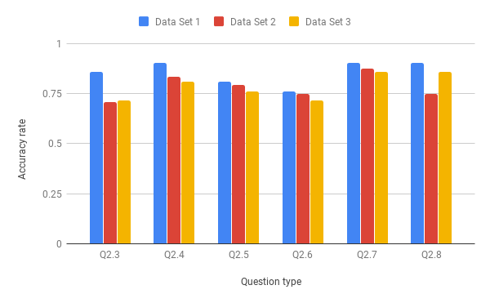
Evaluation
Accuracy rate by using Data Set 1 is always the biggest and reaches over 75%
Fig. Accuracy rate of each question type using different data sets
Motivation
Challenges
Related Work
Interface
Evaluation
Summary
Notes:
In most cases, the accuaracy rate decreaces with the increasing number of attributes in data sets

Slide 26
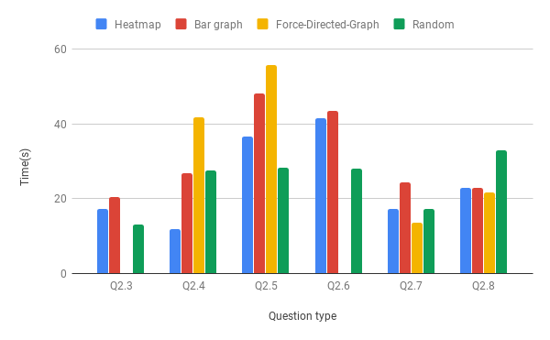
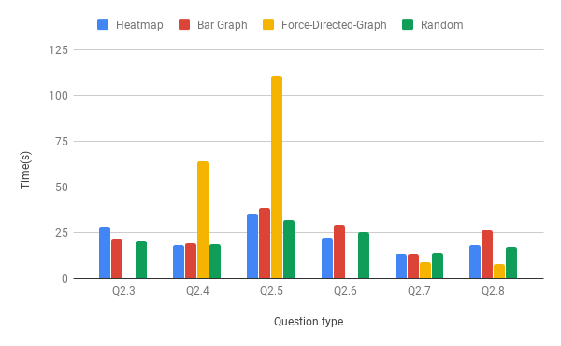
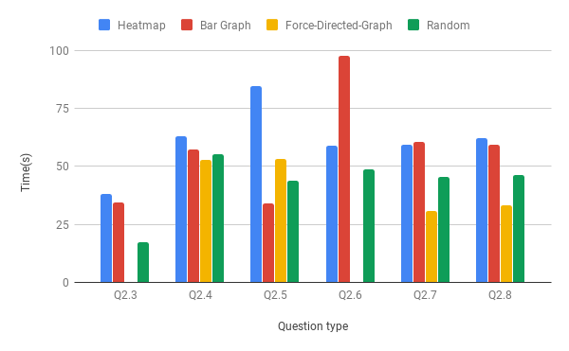
Evaluation
Both the average time of using Heatmap and Bar Graph is close in most cases, whatever data set the participants use
Q2.3 & Q2.6 cannot be answered by using Force-Directed-Graph
c) Use Data Set 3
a) Use Data Set 1
b) Use Data Set 2
Fig: Average time of participants finishing each question type using different data sets
Motivation
Challenges
Related Work
Interface
Evaluation
Summary
Notes:
Q2.3: What is the correlation value between Attribute A and Attribute B at Timestamp T (with precision +- 0.1) ?
Q2.6: The following statement is true or false: “The correlation value between Attribute A and Attribute B remains the same at Timestamp T1 and at Timestamp T2”?

Slide 27
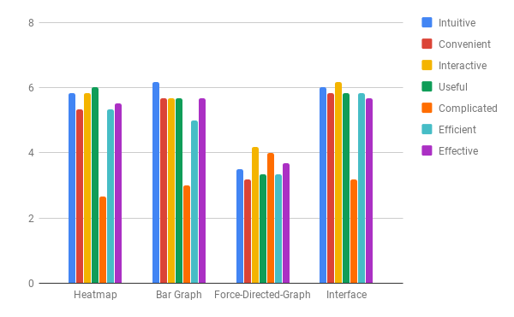
Evaluation – Feedback
Please write down the visualization method you have used and rate for it:
Using LIKERT scale (1-7)
1: unfamiliar
7: very familiar
Motivation
Challenges
Related Work
Interface
Evaluation
Summary
Notes:
Fdg:Complicated

Slide 28
Evaluation – Verbatim
Only show related links when point to one node
Hard to read exact value
Easy to see the smallest and biggest
Convient and fast
Having different graphs for different uses
More convient functions/buttons should be added
Intuitively show the correlation of data, which is effective for further data processing. In addition, it meets many demands for data processing.
Reflect a tendency of the data correlation
Motivation
Challenges
Related Work
Interface
Evaluation
Summary

Slide 29
Summary
Correlation analysis is one of the fundamental task of Data Mining
Streaming setting and high-dimensionality are challenges of data visualization
Interface using three visualization methods for visualizing correlation in high-dimensional streams
Using Force-Directed-Graph is difficult to get the exact/probable value
Heatmap is intuitive for finding biggest/smallest value correctly
Motivation
Challenges
Related Work
Interface
Evaluation
Summary

Slide 30
References
[1] Albuqerqe, G., Eisemann, M., Lehmann, D. J., Theisel, H., and Magnor, M. Quality-Based Visualization Matrices. In Proceedings of the Vision, Modeling and Visualization (2009), 341–350.
[2] B,L.K.,Riekenbrauck,N.,Thevessen,D.,Pappik,M.,Stebner,A.,Kunze,J.,Meiss- ner, A., Shekar, A. K., and Emmanuel, M. Machine Learning and Knowledge Dis- covery in Databases. 404–408.
[3] Filis, G., Degiannakis, S., and Floros, C. Dynamic correlation between stock mar- ket and oil prices: The case of oil-importing and oil-exporting countries. International Review of Financial Analysis 20, 3 (2011), 152 – 164.
[4] Kelley, W. M.; Donnelly, R. A. The humongous book of statistics problems. New York (2009).
[5] Kobourov, S. G. Spring embedders and force-directed graph drawing algorithms. eprint arXiv:1201.3011 (2012).
[6] Murray, S. Interactive data visualization for the web, an introduction to designing with d3. 272.
[7] Rodgers, J. L.; Nicewander, W. A. Thirteen ways to look at the correlation coefficient. The American Statistician (1988).
[8] Simons, K., et al. Should us investors invest overseas? New England Economic Review (1999), 29–40.
[9] Wilkinson,Leland;Friendly,M.Thehistoryoftheclusterheatmap.TheAmerican Statistician (2009).
Motivation
Challenges
Related Work
Interface
Evaluation
Summary

