Slide 1
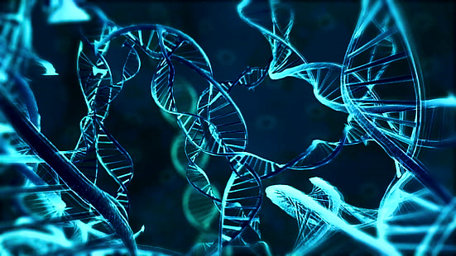
Classification of proteins into binders and non binders

Slide 2

PROBLEM STATEMENT
Determine Binding Affinity of Protein-Ligand
Description: You will need to generate a scoring function which could classify compound poses as binders or non binders.
Input: Structure of Protein and Ligand
Output: Whether a binder or non binder
Dataset that can be used: scPDB, PDBBind

Slide 3
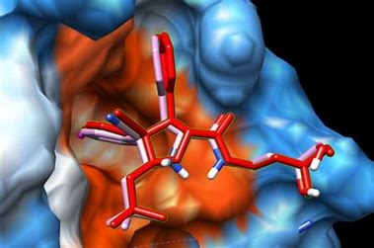
INTRODUCTION
Protein-protein docking is a computational method used to predict how two proteins interact and bind to each other, based on their structures and properties.
It helps to understand the structure and function of protein complexes and is used in drug discovery and design.
A scoring function is a mathematical equation used in protein docking to evaluate the quality of the predicted protein-protein complex structures.
It is used to rank and select the best possible docking solutions from a large number of potential solutions.

Slide 4
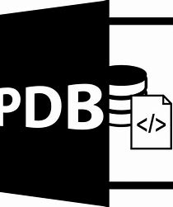
INPUT
A CSV file with the various data points (different energies) for the protein ligand complex will be the model's input.
Several computational techniques and tools, including molecular dynamics simulations, docking analyses, and free energy calculations, can be used to convert a PDB file to a text file containing details on the protein-ligand combination. These techniques replicate the behavior of the protein-ligand complex and forecast the energy involved in interactions between the two molecules.
HOW PDB IS CONVERTED TO THE INPUT?

Slide 5

ABOUT THE MODEL
To train and increase the model's accuracy, a dataset was used to train it. A series of labelled examples are given to a machine learning model during training, and its parameters are changed to reduce errors. An independent dataset of labelled samples that wasn't utilized for training can be used to assess the model's precision.
Overall Researchers can learn more about the molecular mechanisms behind biological processes and create new medications that target particular proteins by identifying binders and non-binders.

Slide 6
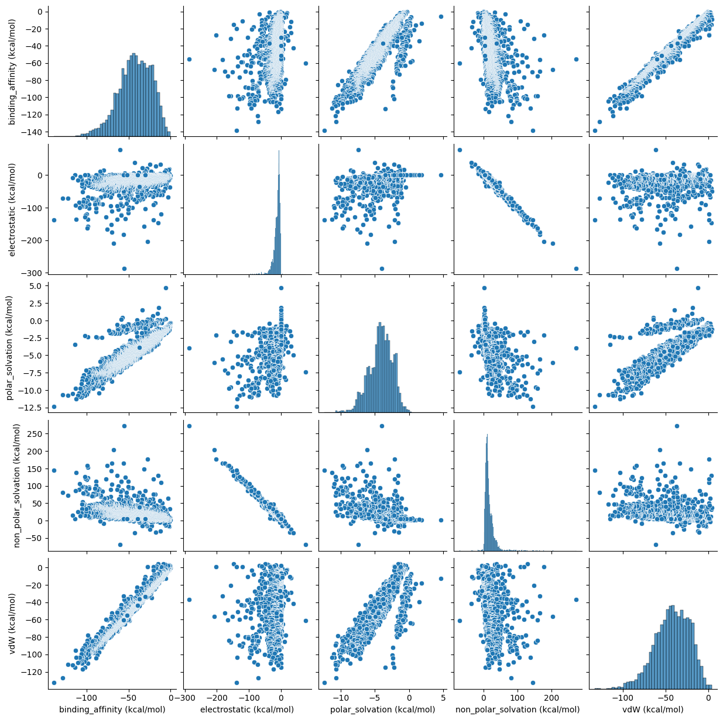
DATASET
pdbid | binding_affinity (kcal/mol) | binding_affinity_sd (kcal/mol) | electrostatic (kcal/mol) | electrostatic_sd (kcal/mol) | polar_solvation (kcal/mol) | polar_solvation_sd (kcal/mol) | non_polar_solvation (kcal/mol) | non_polar_solvation_sd (kcal/mol) | vdW (kcal/mol)
The columns from electrostatic to vdW from the provided dataset are used to train from the dataset to predict the binding affinity of the complex.
The graphs of this dataset are generated using Seaborn's pairplot function, and it is discovered that they vary linearly.

Slide 7
WHICH ALGORITHMS & WHY?
MODEL | OBSERVED ACCURACY
LINEAR REGRESSION | 99.993080%
POLY REGRESSION | 99.992579%
SVM KERNEL | 99.991968%
THE ML BASED SCORING FUNCTIONS ARE USED TO PREDICT BINDING AFFINITY IN OUR CASE .
THE GIVEN DATASET FOLLOWS LINEAR VARIANCE HENCE THE FOLLOWING ALGO’S ARE USED:
1) LINEAR REGRESSION
2) POLY REGRESSION
3) SVM KERNEL

Slide 8
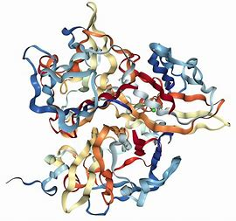
OUTPUT
The output is the statement determining the classification of the given protein ligand complex as a BINDER or NON BINDER by using the emperical scoring function, generated by the trained model on the basis of a fixed threshold value .

Slide 9
CONCLUSION
The protein prediction model uses SVM, polynomial regression, and linear regression algorithms to predict binding affinity of proteins.
The model considers various factors, including electrostatic, polar solvation, non-polar solvation, and van der Waals interactions.
The model can accurately predict whether a protein is a binder or non-binder, and can identify potential drug targets.
The model has important applications in drug discovery and development, and can aid in designing more effective drugs.
Overall, the protein prediction model is a powerful tool with the potential to revolutionize the field of drug discovery and development.

Slide 10
THANK YOU!
TEAM MEMBERS:
20CS30035 - SAI SAHAN
20CS10016 – AARSHA
20CS10052 - VENKAT VIGNAN

