Slide 1
What Is the Smallest (AI) Platform
That Could Possibly Work?
The most common AI request I see is access to an LLM. Giving an engineer an API key takes minutes and solves exactly one problem. What the key does not do:
show finance which team created which cost
help compliance understand where the data goes
give incident response a system it can observe
tell anyone whether the agent still works
That work arrives later — sometimes weeks after the part that felt like the job. It lands on us, and it lands again with the next team.
Two questions for today
▸ Does that repeated work justify a platform used by several teams?
▸ If it does, what is the smallest platform that could possibly work?
This is an introduction to how far I got. I am looking for reactions and disagreement, not a decision.
Agent, throughout: software built with LLMs, skills, and integrations with internal or external tools.
An introduction · looking for input, not a decision
1

Slide 2
SLIDE 2 · WHEN IT BECOMES A PLATFORM PROBLEM
No single request is a platform problem
A collection of experiments does not become a platform problem just because the experiments use AI.
It becomes a platform problem when several teams repeatedly need the same access controls, cost attribution, evaluation, observability, or audit evidence — and solving each case separately creates more work, inconsistent controls, or unnecessary risk.
The test is not how much AI activity we have
Does the same problem keep appearing?
What happens if we ignore it?
Would solving it once for several teams remove more work than it creates?
Even when the answer is yes, the answer may be to extend a platform we already own. A dedicated AI platform is justified only when our existing systems cannot solve the repeated problem without every team rebuilding the same AI-specific parts.
Smallest AI platform · when it becomes a platform problem
2

Slide 3
SLIDE 3 · THE EVIDENCE
What is actually repeating for us
Deployment support repeats
Analysts and product managers build something with a coding agent — often a dashboard. It works on their machine. Making it available to others means the company runtime and the service contract in the developer portal, which still requires engineering experience.
So we help. Manually. Again.
Signal: the same setup and translation work returns with every new builder.
Access without controls repeats
Engineers build AI-powered Slack apps and ask for an LLM key. The request itself is cheap. The key answers none of the operational questions from slide 1.
Signal: easy access creates the same unanswered questions every time.
Where we already stand
The AI Playground removes part of the first pattern: a person names an agent in the developer portal and receives a repository with a working agent deployed to test, plus a starter prompt for a coding agent. What it removes is the repeated setup, the allowed technologies, and the practices we want people to inherit as skills.
Pattern one was real, and a template was the right size of answer for it. Pattern two is still open — and it is the one producing the questions from finance, compliance, and incident response.
Smallest AI platform · the evidence
3

Slide 4
SLIDE 4 · THE DISCIPLINE
Build less than you think you need
The order matters. Documentation → convention → template, library, or CLI → managed service. Build the service only when the simpler interventions cannot remove the repeated work.
Documentation
→
Convention
→
Template · library · CLI
→
Managed service
expensive · last resort
Teams also repeat work because they are still learning. Centralizing too early turns experiments into a service nobody needs. Before building a shared service, ask whether the repeated work can be removed rather than served — the apparent platform problem may be unclear ownership, missing training, or a workflow that should not exist.
I have paid for getting this wrong — though not with a platform
Manifold was an AI coding IDE for individual developers. I spent six months of evenings on it, convinced someone needed it. Nobody did. The software was not the problem. The problem was that I treated my own conviction as evidence that the demand existed.
An internal platform fails the same way, but more quietly. A team that stops using a platform rarely says so — it routes around the platform and keeps working. We keep the mandate and lose the users, so the mandate stops being evidence that anyone needs the thing.
That is why I no longer trust the sentence "teams need this" when I am the one saying it. Everything after this slide argues for building less than I think is necessary.
Smallest AI platform · the discipline
4

Slide 5
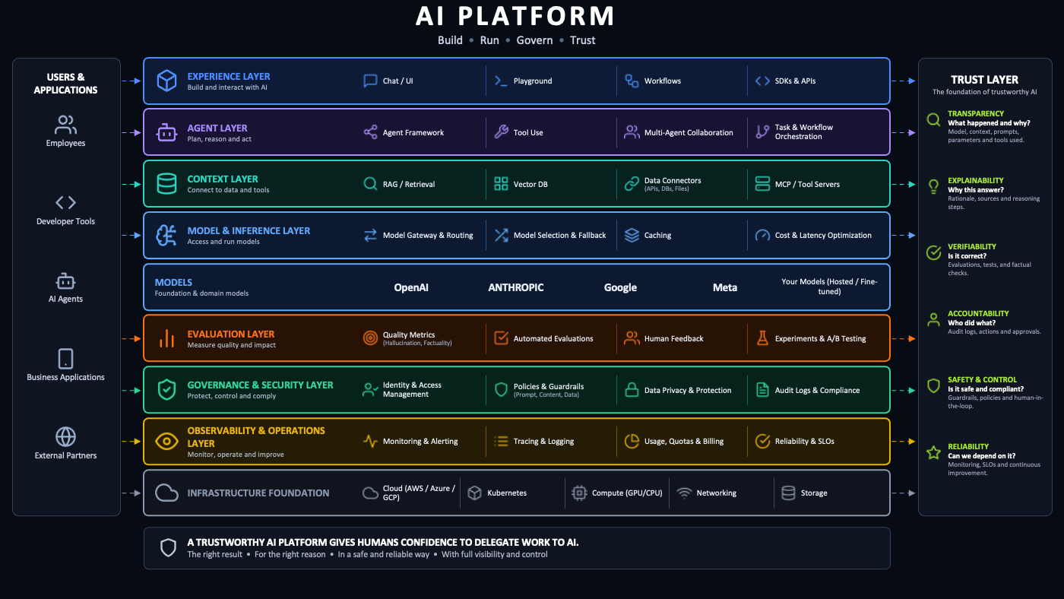
SLIDE 5 · THE FULL PICTURE
What a complete AI platform looks like
The picture most of us have in mind when someone says "AI platform" — Build · Run · Govern · Trust
Nothing here is wrong
Every box is a real capability that someone has to provide. That is what makes it dangerous as a plan: about forty capabilities, and it reads as a roadmap.
So the question is not which layers exist
▸ Which do we already have, under a different name?
▸ Which belong to the team building the agent?
▸ Which are not needed yet?
▸ What is the cheapest thing that makes the trust column answerable per agent?
Nine layers, from experience down to infrastructure — with the trust layer running down the right side.
Smallest AI platform · the full picture
5

Slide 6
SLIDE 6 · THE MEASURE
What "smallest" has to mean
Counting features, services, or lines of configuration makes a config file look smaller than a gateway. Convenient, but not the measure that matters.
The smallest useful AI platform is the system that creates the least total work, lets a defined group complete one valuable workflow, meets the minimum required controls, and remains cheaper to change or remove than the repeated work it removes.
Outcome
Can the intended user finish the job?
Risk
Are the minimum controls there for the possible harm?
Total work
Is central and local work reduced?
Change and removal
Can it be retired at an acceptable cost?
"Smallest" is the simplest thing that passes all four — for one particular workflow.
Smallest AI platform · the measure
6

Slide 7
SLIDE 7 · THE PROPOSAL
A versioned agent contract
The smallest platform I can justify is a narrow service built around a versioned agent contract: a configuration file stored with the code that describes the agent and the systems it uses. The contract alone is not the platform. The contract and the service are: CI validation, connections to the systems that own operational facts, and a view in the developer portal.
Scope for version 0.1: one simple, internal, read-only agent. Not a general contract for every kind of agent.
Prototype 0.1 · agent.yaml
How it works
agent:
name: settlement-explainer
owner: payments
purpose: explain settlement deviations
lifecycle: experimental
risk: internal-read-only
allowed_data: internal
model_access: approved-eu-provider
runtime: application-platform
cost_id: payments-settlement
trace_id: settlement-explainer
evaluation: evals/settlement.yaml
incident_contact: payments-on-call
disable: runbooks/disable-agent.md
01
An engineer creates or changes the agent and its contract in the same repository
02
CI validates identity, ownership, risk, data class, operational references, incident contact and disable instructions
03
Delivery, evaluation, observability and billing systems continue to produce and own their operational facts
04
The developer portal brings declarations, current facts and links to their sources into one view
05
The agent keeps running on the existing application runtime
Every field exists to make one internal, read-only workflow accountable and observable. If a field cannot be justified for this workflow, it does not go in yet.
No new runtime, no AI gateway, no evaluation service, no new GUI to start.
Smallest AI platform · the proposal
7

Slide 8
SLIDE 8 · WHERE THE PLATFORM ENDS
The same picture, marked up
One question per layer: who owns this, and do we need it yet?
WHO OWNS IT
Contract declares it; existing systems own the facts
Declared reference; the rest waits for a signal
Already have it, the team owns it, or untouched
That is the whole boundary: one file, CI validation, and a portal view — the cheapest thing on this diagram to walk away from. The other eight layers are already owned, belong to the team, or are waiting.
Transparency, accountability, verifiability and safety now trace back to a declared field plus the system that owns the fact.
Smallest AI platform · where the platform ends
8

Slide 9
SLIDE 9 · WHAT IT IS NOT
The contract connects decisions. It does not enforce them.
Responsibility | Owner
Decide which outcome is required | The person accountable for the harm or obligation
Define representative cases and evidence | The team that understands the workflow
Encode and validate the rule | The platform team
Prevent a disallowed action | A system with the context and authority to stop it
A gateway can enforce allowed models. A deployment system can require evaluation evidence before release. A downstream service must authorize the business action.
A YAML file cannot stop an agent from using a credential with too much access.
Workflow-specific decisions stay with the team: model choice, prompts, business rules, authorization, acceptance levels, alerts, and when to release or roll back.
When teams still need the same manual help, the declared information becomes unreliable, or every system needs a custom adapter — the next addition (generator, gateway, authorization service, evaluation service, runtime) is a response to that signal, not a roadmap item.
The condition on anything we add after the contract: it states its exit cost before we build it. The same standard applies to this platform — reduce, replace or remove it when something simpler achieves the same result.
Smallest AI platform · what it is not
9

Slide 10
SLIDE 10 · WHAT I DON'T KNOW YET
What I don't know yet
Prototype 0.1 has one problem worth stating directly: no team has used it. It is a file I wrote to find out whether the idea holds together — which is the same kind of evidence I said on slide 4 that I no longer trust.
So the open question is not what the contract should contain. It is how a contract nobody asked for reaches its first team. I see three ways and I do not know which is right.
Put it in the template
Wait for the pull
Don't build it
What it buys Fastest adoption. Every agent generated through the internal template gets a contract by default; teams receive it without asking
What it buys Real demand. We build when a team asks for something it enables: cost attribution, audit evidence, or a way to disable an agent during an incident
What it buys Cheapest. Add the fields to the service contract the developer portal already uses. No new system to own, nothing to leave
What it costs Nobody chose it. The adoption numbers would look good and mean nothing — the exact failure mode from slide 4. And if CI validates it and audit depends on it, no team can ship without one
What it costs The request arrives after agents are already in production — the most expensive moment to introduce a contract, and the least likely to get engineering time
What it costs Puts AI-specific facts into a system that was not designed for them. Unclear whether that is reuse or a problem that grows slowly
The first option is the one I want to pick, and wanting it is the reason I have not.
What would help me most
Which of the three would you pick — and where does it break in your context? A concrete objection beats agreement.
What would change my mind
A team that was handed a contract by default and actually used it. If you have been here before, what did it cost?
Smallest AI platform · what I don't know yet
10

Slide 11
APPENDIX A1 · NOT PRESENTED
Nine layers, capability by capability
Use when someone wants the full picture read out rather than shown.
Layer | What it provides
Experience | Chat/UI, playground, workflows, SDKs and APIs
Agent | Agent framework, tool use, multi-agent collaboration, task orchestration
Context | RAG/retrieval, vector DB, data connections, MCP and tool servers
Model & inference | Model gateway and routing, model selection and fallback, caching, cost and latency optimization
Models | OpenAI, Anthropic, Google, Meta, our own hosted or fine-tuned models
Evaluation | Quality metrics, automated evaluations, human feedback, experiments and A/B testing
Governance & security | Identity and access management, policies and guardrails, data privacy, audit logs and compliance
Observability & operations | Monitoring and alerting, tracing and logging, usage/quotas/billing, reliability and SLOs
Infrastructure | Cloud, Kubernetes, GPU/CPU compute, networking, storage
The trust layer spans all of them: transparency (what happened and why), explainability (why this answer), verifiability (is it correct), accountability (who did what), safety and control (is it safe and compliant), reliability (can we depend on it).
A trustworthy AI platform gives humans confidence to delegate work to AI: the right result, for the right reason, in a safe and reliable way, with full visibility and control.
Appendix · not presented
A1

Slide 12
APPENDIX A2 · NOT PRESENTED
Which system owns each fact
Use when asked whether the contract becomes a second source of truth.
Kind of fact | Examples | Source
Declared with the code | Purpose, owner, lifecycle, risk class, allowed data, model-access reference, incident contact | Agent contract
Observed while building or running | Deployed revision, evaluation result, traces, cost | CI, delivery, evaluation, observability, billing
Confirmed by an accountable owner | Approval, accepted exception, review decision, expiry | The system where that decision is made
A developer portal can combine these facts into one view without copying all of them into the repository. The contract carries identifiers and requirements; the original systems remain responsible for the current state.
High-impact actions, tool approvals, accepted exceptions and retained evidence get added when a workflow requires them. They do not need to be part of the initial scope.
Appendix · not presented
A2

Slide 13
APPENDIX A3 · NOT PRESENTED
Status of every layer for version 0.1
Use when asked to justify the boundary layer by layer.
Layer | Status for version 0.1
Experience | Already have it. The Playground covers the entry point; the product surface belongs to the team
Agent | Team owns it. Framework, tool use, orchestration. The contract only declares identity, purpose, owner and lifecycle
Context | Team owns it. Retrieval, vector stores, data connections. The contract declares the allowed data class, not the wiring
Model & inference | Declared reference + deferred. The contract points at approved model access. Gateway, routing, fallback and caching wait for a signal
Models | External. Approved provider and region are a declared reference, not something we build
Evaluation | Reference now, runner later. The domain team defines the cases, the possible harm, and what is good enough to release
Governance & security | Existing systems + contract. Our identity platform issues identities; the resource owner authorizes business actions. CI validates the declarations
Observability & operations | Existing systems + identifiers. Observability and billing own the data; the contract carries the trace and cost identifiers
Infrastructure | Untouched. The existing application runtime and cloud. We introduce no new runtime
One file, CI validation, and a portal view.
Appendix · not presented
A3

Slide 14
APPENDIX A4 · NOT PRESENTED
The trust column, answered per agent
Use when asked what the contract actually buys.
Trust property | What makes it answerable | Who answers it
Transparency | Declared purpose, model access, data class, runtime | Contract
Accountability | Declared owner and lifecycle; approvals and exceptions | Contract + the deciding system
Verifiability | Evaluation reference | Contract + evaluation system
Safety & control | Risk class, allowed data, incident contact, disable instructions | Contract + enforcing systems
Reliability | Trace and cost identifiers | Contract + observability and billing
Explainability | Sources and reasoning steps | The team's product, not the platform
One file, validated in CI, is the cheapest thing I can find that makes six trust properties answerable for a specific agent rather than for the platform in general.
Appendix · not presented
A4

