Slide 1
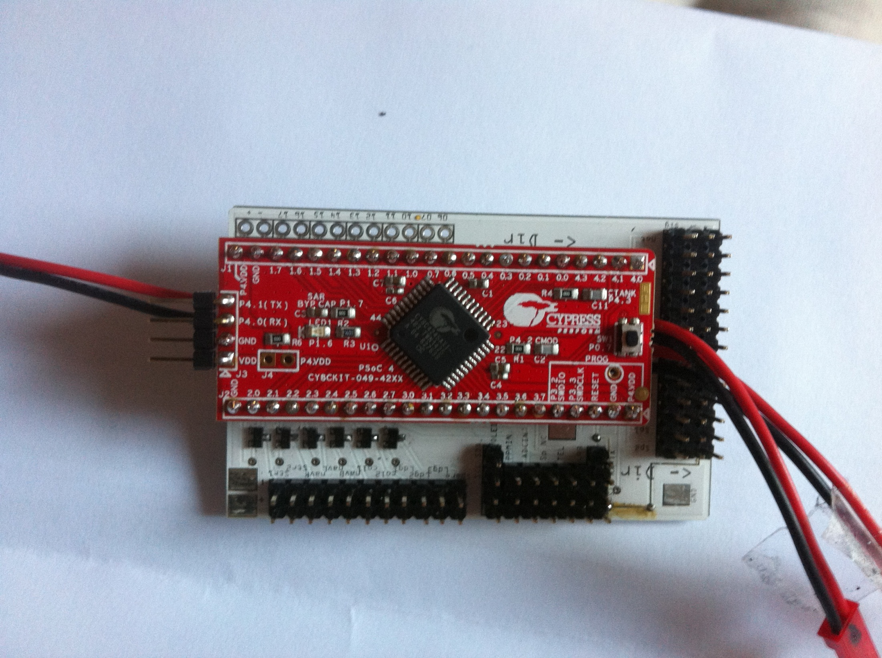
CY8CKIT-049-42xx
Servo
outputs
Connects to progger
FETs for Light switching
Pins for lights
IMU connectors
Sensor inputs

