Slide 1
DS PBA2 Flowchart and process flow

Slide 2
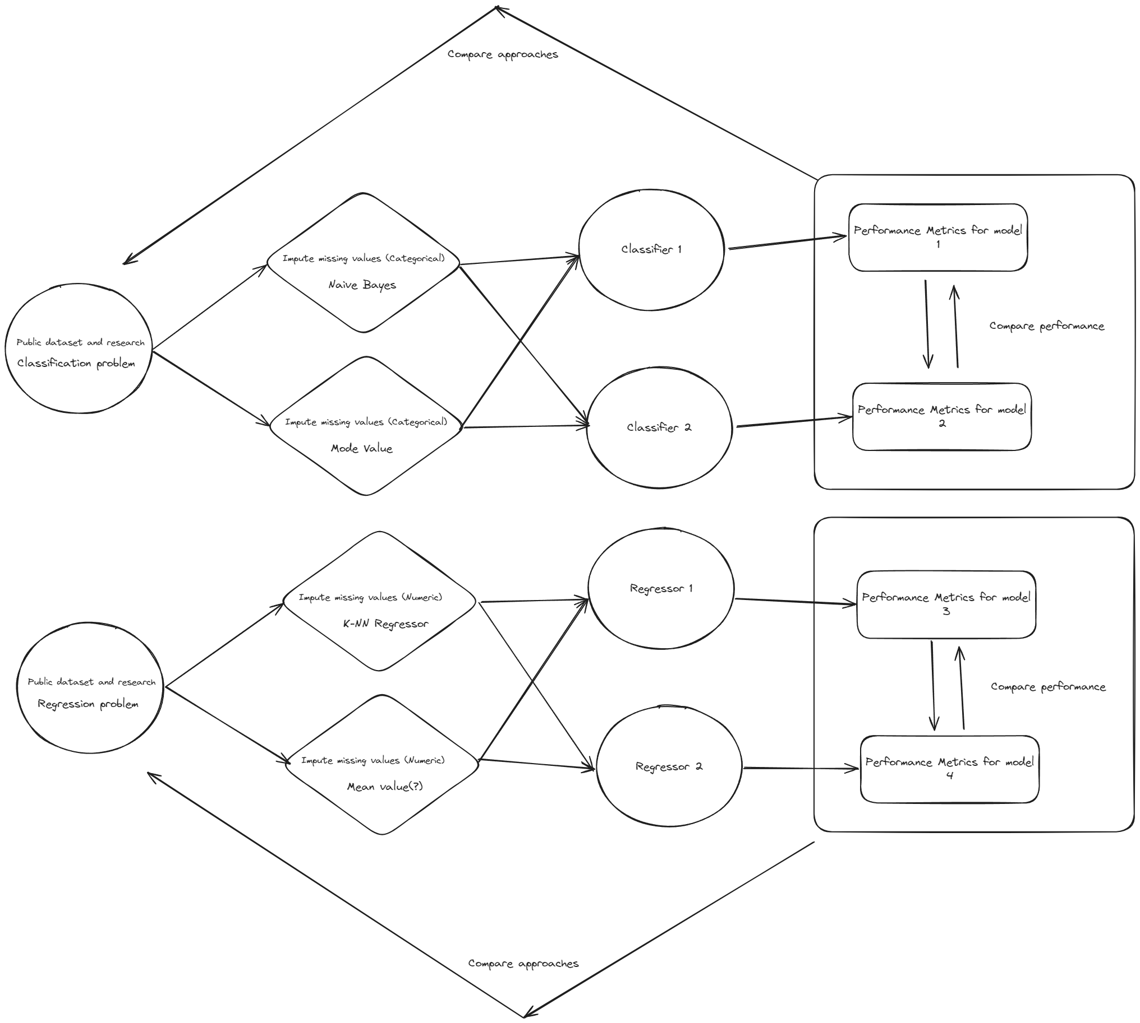

Slide 3
Notes:
Imputation Monday
Regression and evaluation Tuesday (Regressors is ~DT and kNN)
Wednesday is writeup
Thurday writeup and flowchart
Friday Presation
Saturday prestation

Slide 4
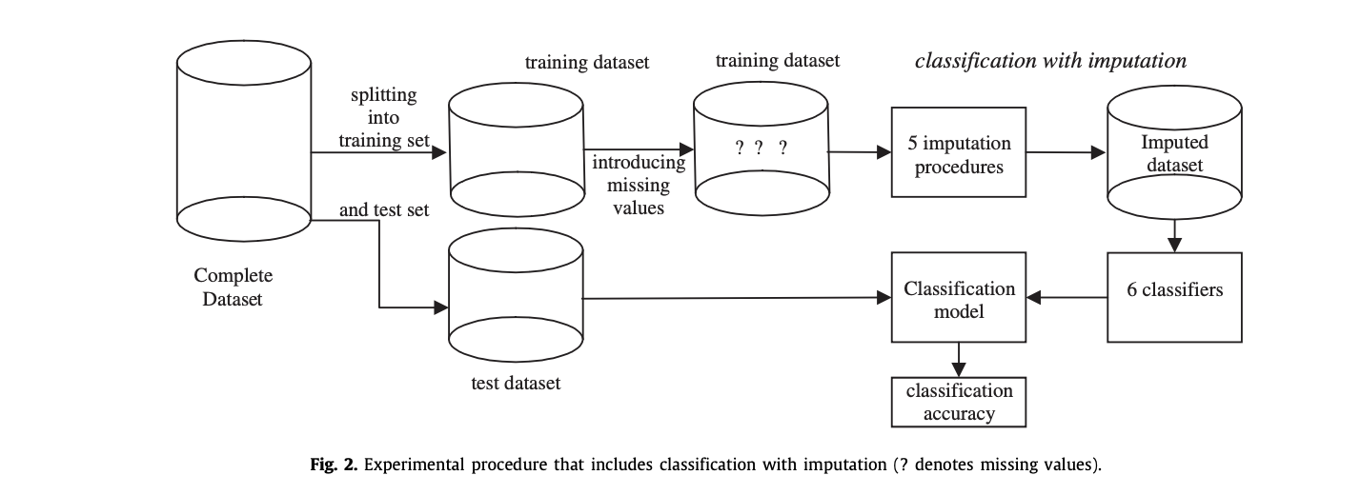
Induce random missing values
Training – 70%
MCAR – 10%
Imputed 10%
Training – 70%
Copy data in 3 sets
Induce random missing values
Training – 70%
MCAR – 40%
Data Imputation
Imputed 40%
Induce random missing values
Training – 70%
MCAR – 70%
Imputed 70%
Concrete Dataset
Split data (70:30)
Model performance evaluation
Model1
Model 2
Testing – 30%
Notes:
Split dataset
Copy training
Pollute with MCAR values
Export polluted dataset and testing to excel
Share
Image at the bottom is from the article

