Slide 1
MENG PROPOSED WORKFLOW

Slide 2
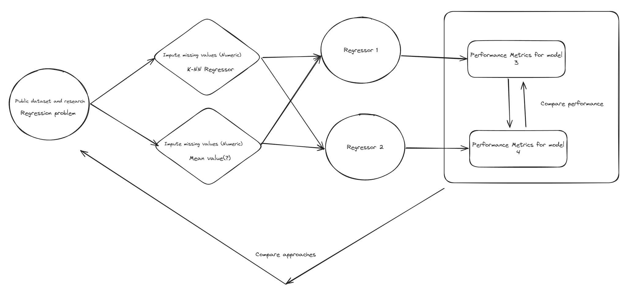
Notes:
Imputation Monday
Regression and evaluation Tuesday (Regressors is ~DT and kNN)
Wednesday is writeup
Thurday writeup and flowchart
Friday Presation
Saturday prestation

Slide 3
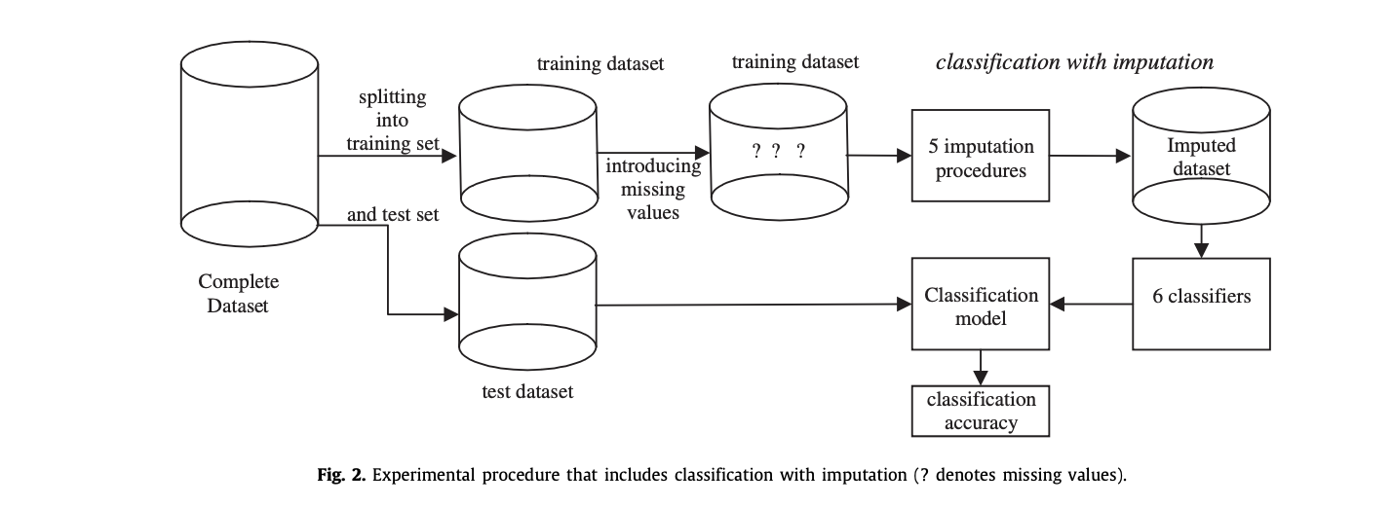
Induce random missing values
Training – 70%
MCAR – 10%
Imputed 10%
Training – 70%
Copy data in 3 sets
Induce random missing values
Training – 70%
MCAR – 40%
Data Imputation
Imputed 40%
Induce random missing values
Training – 70%
MCAR – 70%
Imputed 70%
Concrete Dataset
Split data (70:30)
Model performance evaluation
Model1
Model 2
Testing – 30%
Notes:
Split dataset
Copy training
Pollute with MCAR values
Export polluted dataset and testing to excel
Share
Image at the bottom is from the article

Slide 4
MENG MISSING DATA FLOW CHART

Slide 5
The following missing data flowchart was constructed with the hrep of information gained by
listwise deletion
Ignoring Missing Values
pairwise deletion
Methods of Handling Missing Data
Imputation with the constant
Mean Imputation
Single Imputation
Imputation with distributions
Imputation of missing values
Regression Imputation
kNN Imputation
Multiple Imputation

Slide 6
The following missing data flowchart was constructed with the hrep of information gained by
Low
Deletion of instance
Decision Tree
Mode/Naïve Bayes
Categorical features
Degree of missing values
Medium
Imputation
Model choice
K-NN
Mode
Degree of missing values
Feature deletion
Dataset with missing values
Low
Deletion of instance
Skew/Large difference in range
kNN
Numeric Features
Degree of missing values
Medium
Imputation
Range of numeric data
Mean
Data in same range
Degree of missing values
Feature deletion

