Slide 1

Data Science Assignment 2
Sarel Vermaak- 190980235
Isabel de Waal- 20805055
Kebaabetswe Tlhoaele- 28816749
Lize Mostert- 23537140
Difedile Rasenyalo- 28294882

Slide 2






Content
1
2
3
4
5
Data Exploration/Cleaning
Introduction
Data preprocessing
Data analysis/Insights
Conclusion

Slide 3

1. Introduction
The presentation aims to provide a recruitment agency with valuable insights into the data science job market and demanded skills. Analysis of LinkedIn job postings using R Studio and Orange coding data mining software yielded three key insights shaping the agency's hiring strategy. The first insight examines the correlation between advertised and searched job titles. Insight two explores hybrid and remote workstyles. The final insight investigates the connection between advertised job locations and search origins, city-based or country-wide. Based on these insights, a comprehensive recruitment strategy was developed.
Data science utilizes scientific methods, algorithms, insights, and knowledge derived from data. While data science is a burgeoning field, it has become essential for drawing fundamental insights and knowledge from big data.

Slide 4
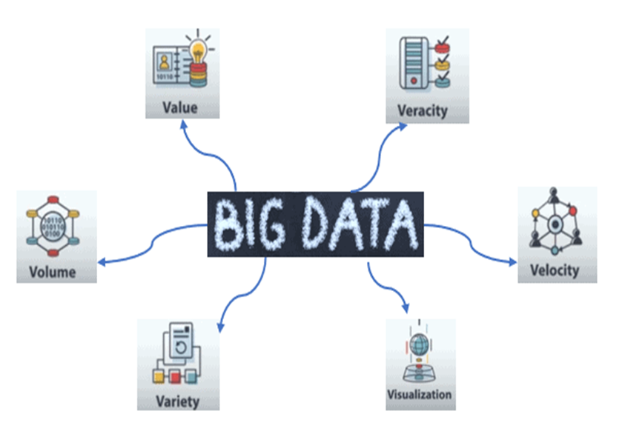
1. Introduction
Big Data complexities
Privacy
Fairness
Transparency
Ethics: Big Data
Accountability
Notes:
Working with big data poses several challenges, including volume, velocity, variety, and veracity. Volume refers to the sheer size and complexity of the dataset, requiring specialized processing methods. Velocity relates to the speed at which data is generated and processed, often necessitating real-time analytics capabilities. Variety encompasses the diverse range of data types and formats found within the dataset. Veracity concerns the reliability and quality of the data, including issues such as noise and uncertainty. Extracting value from big data requires sophisticated analytics techniques to uncover hidden patterns and trends. Additionally, visualizing and interpreting big data effectively can be challenging due to its size and complexity.
When working with big data it is crucial to prioritize the privacy of data, ensure transparency in data and algorithmic processes, uphold fairness, and strive for unbiased and equitable treatment in all aspects of data analysis. These principles serve as the ethical foundation guiding our work

Slide 5



2. Data Exploration
Data Structure
The table is already in an Analytics Base Table (ABT) format and will not need to be reshaped
Data Type- Meta data
'JobLink': URL
'last_processed_time': Timestamp
'last_status', 'got_summary', 'got_ner', 'is_being_worked': Boolean
'job_title', 'company', 'job_location', 'search_city', 'search_country', 'search_position', 'job_level', 'job_type': Categorical
Potential Insight- Informed by our questions
Analysis of job titles and companies can provide insights into which organizations are hiring and the types of roles available in the data science job market.
Exploring job locations and search cities can help identify geographic trends in demand for data science professionals.
Investigating job levels and types can reveal the distribution of roles across different seniority levels and employment types (e.g., full-time, contract).
Data Cleaning
Drop unnecessary columns or rows with missing values if they do not provide relevant information for analysis.
Identifying and handling missing values.
Notes:
I am Lize Mostert and I will be discussing the data exploration portion of this assignment
Upon investigation of the dataset, we observed that the data was already in an analytical base table format. This meant that we did not need to reshape the data into another formatted type.
The dataset can be divided into several different categories of data based on the characteristics thereof:
The data consisted of URLs, Timestamps, Boolean and categorical data, of which the last class was used to gather our insights.
Our initial questions upon data exploration led us to the following potential insights that could be drawn from the data at hand:
We determined that job titles and companies could be analysed to provide us with insight into which organisations or industries are looking for candidates and the types of roles that are currently available in the job market.
We also noted that exploring job locations and the cities where they were searched from can help identify any geographic trends in demand for data scientists and related professionals.
Finally, we asked whether the investigation of job levels and types can reveal any distribution of roles across different seniority level and employment types.
With respect to data cleaning, unnecessary columns were removed and the effect of missing values after preprocessing was evaluated and dealt with during the visualisation stage.

Slide 6


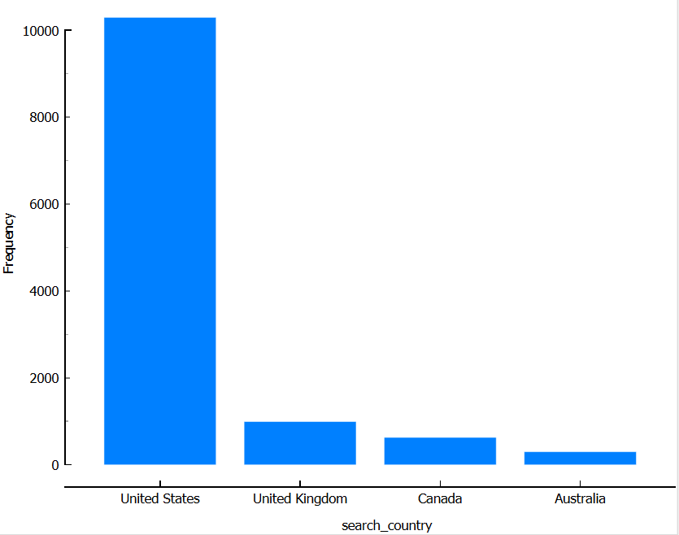
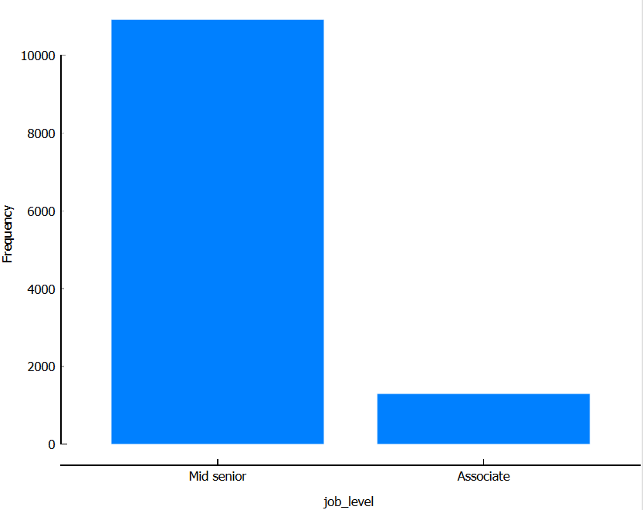
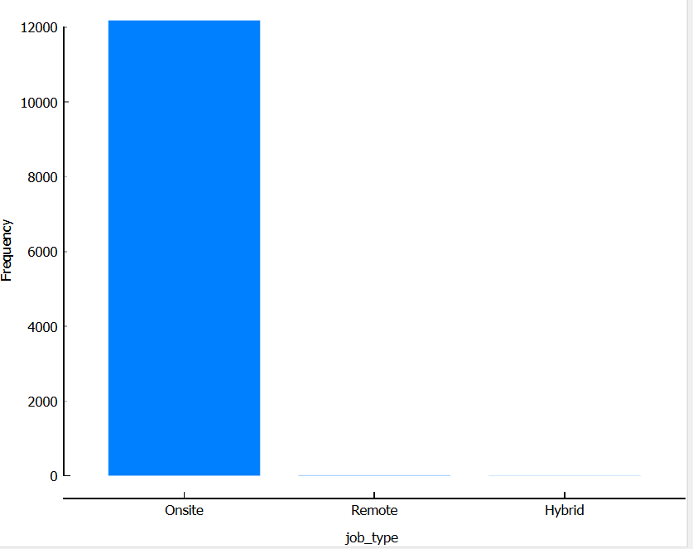
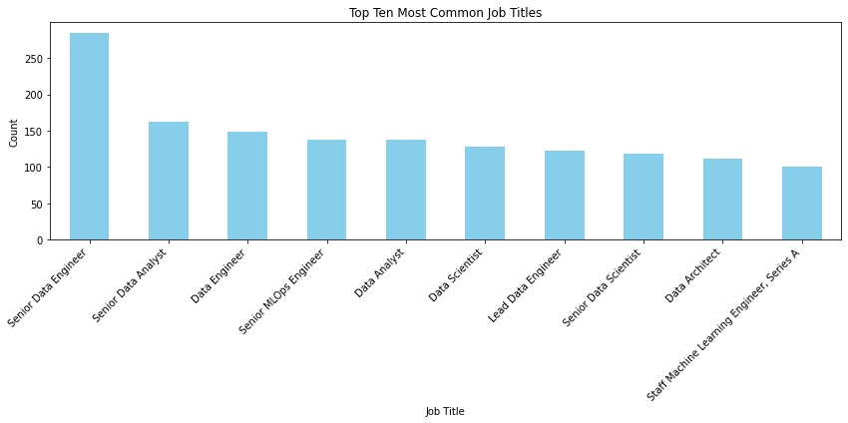
2. Data Exploration
Data visualisation – Feature Statistics
General visualisations that illustrate the distribution of the features
Data Quality
The overall quality of the data was high this is attributed to :
Completeness of information, there are no missing values within the dataset.
Relevance and consistency of categorical data, the values in these categorical columns are consistent and follow similar format
Cardinality
Notes:
From our data exploration, you can see that there is a quite skewed distribution of features in this dataset, but overall, the quality of the data before preprocessing was quite high. We observed no missing values in the dataset at this stage, and the variables within the categorical features were more or less consistent except for the job title and search position which had quite a high amount of variation, but this was dealt with during the preprocessing stage

Slide 7
3. Data Preprocessing
Convert data types
Remove irrelevant features
Normalize text data
Data Preprocessing
Standardise text data
Notes:
Hi, I am Sarel Vermaak.
Data preprocessing is part of the Data Understanding and Data Preparation components of the CRISP-DM process.
Based on the data exploration done previously, we removed columns that contained no variation, and a single instance with a missing value.
During exploration we picked up that the job_title and job_city features contain a lot of useful information, but was not in a useable state.
Both features were forced to lowercase, and useful subsets of features were extracted, such as job seniority and job country.
The subsets were also recombined into more sanitized versions of the original feature, removing a lot of variability due to differing naming conventions.

Slide 8
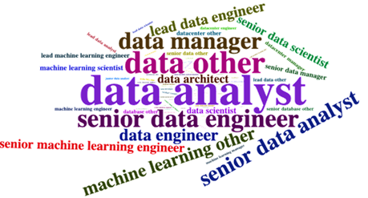
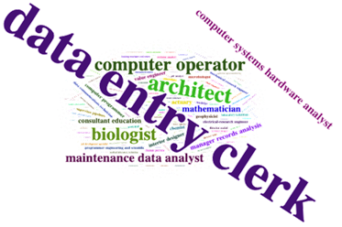
5. Data Analysis: Insight 1
Insight
The initial insight highlights the correlation between advertised job titles and searched titles.
Recruitment strategy
Optimizing Search Terms and Keywords for Enhanced Advertisement Awareness.
Word Cloud of the job titles = Advertised jobs
Word Cloud of the search position: jobs searched
Notes:
I am Isabel de Waal and I will be discussing our first two insights. For the first insight, we were interested to see if there was any discrepancies between the jobs advertised by the employers, and the jobs searched for by possible new employees. We did this by using wordclouds. What we found was fascinating. It would seem that the employers are advertising jobs for data analyst, data manager, data engineer. On the other hand the possible employees are mostly searching for data entry clerk positions.
So there was a distinct difference between the terms that was used in the search and the terms used in the job advertisement.
This could point to two possibilities:
Either there is a misunderstanding between employers and employees on what the terms mean, and they boath mean the same thing and just use different terms for them
The other possibility is that there is a distinct gap between the type of skillset available for hire, and the skillset and experience that is in demand for the employer.
Our recommendation for recruitment is to concretise with your clients (the employers) what it is exactly that they want and expect from the position and then optimising the Keywords in the job advertisement to alighn more closely to what is available in the market.

Slide 9
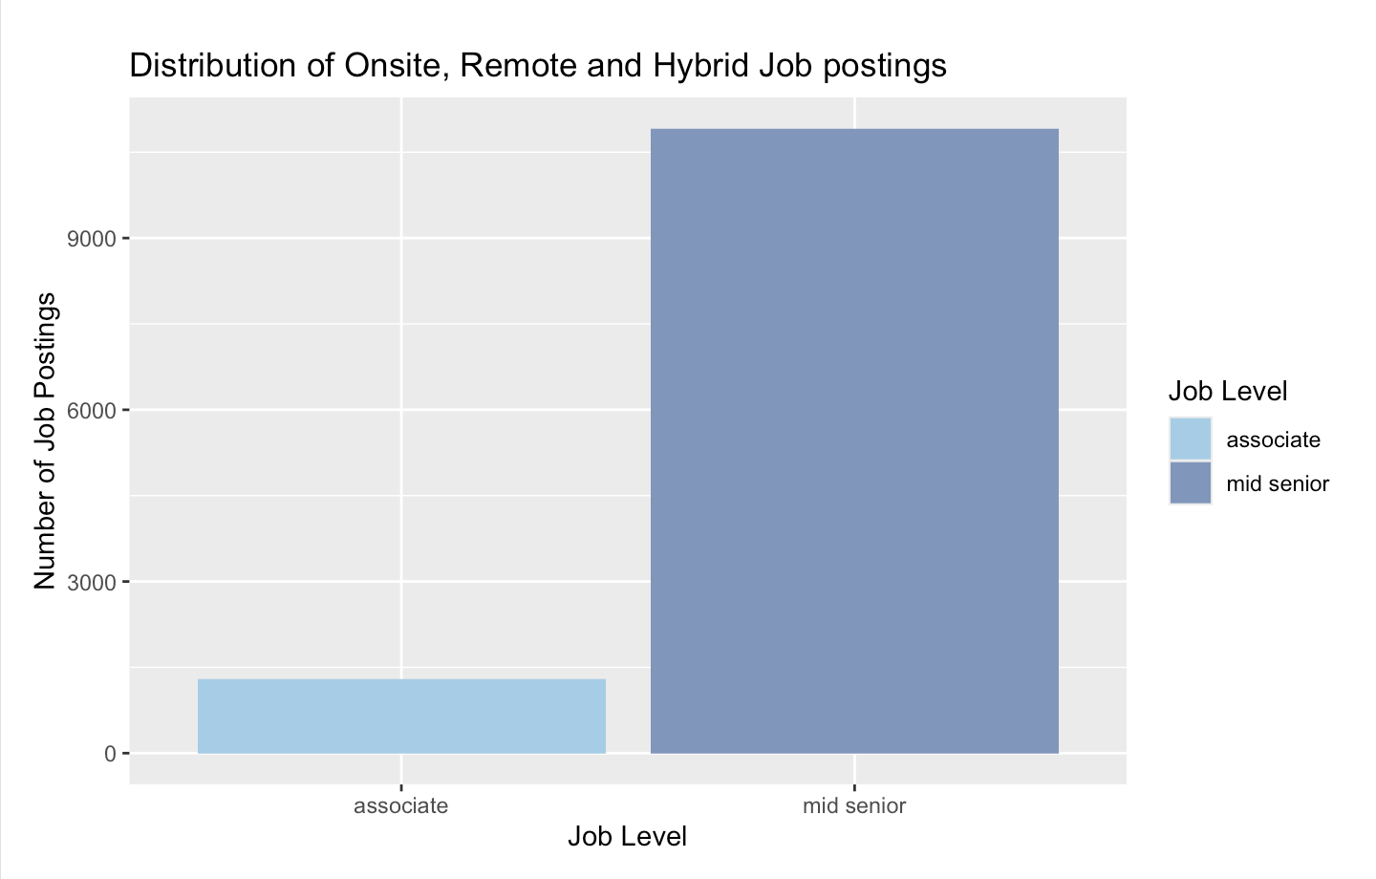
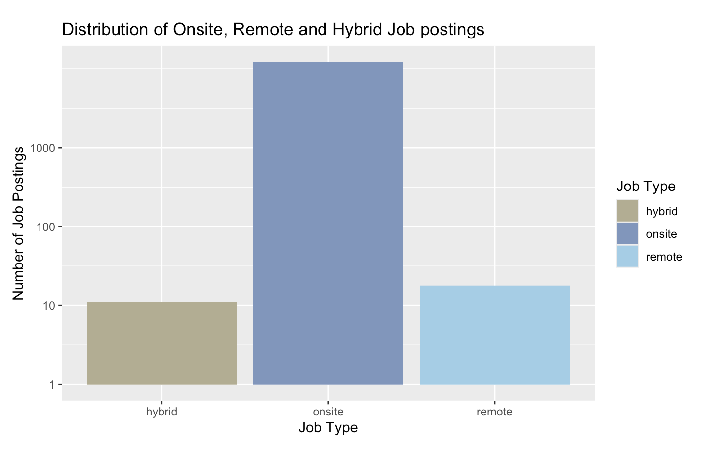
5. Data Analysis: Insight 2
Insight
Insight two delves into the dynamics of hybrid and remote work arrangements, shedding light on their impact, benefits, and challenges in today's professional landscape.
Recruitment Strategy
Explore the advantages of adopting hybrid and remote work setups, especially emphasizing the benefits they offer to Associates.
Notes:
So coming off the back of the previous insight, we wanted to see what proportion of the jobs available were for junior positions and which were for mid senior
there are x more senior positions available, than junior, but the types of positions searched for were decidedly entry level positions.
Moving on along this vein, we looked at the different working arrangement.
One of the big advantages of jobs in the data science field, is the possibility for hybrid or remote working arrangements. This is expecially attractive for younger employees. The jobs advertised were overwhelmingly “onsite” jobs.
For the reqruitment strategy, we recommend going to the employers and asking them if it would be possible to rewrite the post to fit a more junior role, as there is an abundance of these employees in the field. They may also attract a much larger pool of potential employees by offering hybrid and remote working arrangements.

Slide 10
5. Data Analysis: Insight 3
Search Country | Job Country | Occurrence Frequency | Relative Frequency
United States | United States | 10 235 | 84.1%
United Kingdom | United Kingdom | 994 | 8.2%
Canada | Canada | 624 | 5.1%
Australia | Australia | 301 | 2.5%
United States | Mexico | 10 | 0.1%
United States | Canada | 1 | 0.0%
United States | India | 1 | 0.0%
Canada | United States | 6 | 0.0%
Insight
The third insight examined the connection between advertised job locations and the locations from which job searches originate.
Recruitment Strategy
Focus efforts on the United states, and potentially consider hiring senior talent from other countries on an online basis.
Notes:
From this we could see that the majority of data science and data science-related jobs are advertised in the United States (84%), with smaller numbers of jobs coming from the UK, Canada, Australia, Mexico, and India.
We can also see that almost all applicants only consider jobs within their own country, but this could be due to the fact that the majority of jobs analyzed were hybrid or on-site.

Slide 11


5. Conclusion
The presentation has provided valuable insights into the data science job market and demanded skills, obtained through the analysis of LinkedIn job postings using R Studio and Orange coding data mining software. Three key insights were derived, each shaping the recruitment agency's hiring strategy.
By leveraging these insights and strategies, the recruitment agency is well-positioned to effectively navigate the dynamic landscape of the data science job market and attract top talent to meet their clients' needs through the optimisation of the of the job search, effective communication through advertisement and advanced working conditions.

Slide 12

Thank You

