Slide 1

Data Science Assignment 3
Isabel de Waal- 20805055
Difedile Rasenyalo- 28294882
Notes:
Greetings, everyone. My name is Difedile Rasenyalo, and I'm joined by Isabel. Together, we'll guide you through our presentation

Slide 2






Content
1
2
3
4
5
Introduction
Methodology
Results & Discussion
Decision Tree
Conclusion
Notes:
Today, we're excited to walk you through our presentation, covering the introduction, data exploration and cleaning, data preprocessing, clustering, and evaluation of our dataset.

Slide 3

1. Introduction
Background
Missing values are a common occurrence in datasets. It's not unusual to encounter datasets where a significant portion, sometimes up to half, of the entries are missing. Such datasets pose challenges for data analysis methods that require complete data. To address this issue, imputation methods are often employed to fill in the missing values. This paper delves into the influence of various imputation methods on classifier performance when applied to imputed data. Specifically, it investigates the effects of mean imputation and K-nearest neighbour classifier imputation. The evaluation employs two widely used classifiers, K-nearest-neighbour, and decision tree classifiers, to gauge the effectiveness of these imputation techniques.
Objectives
Task A: The objective is to evaluate the effectiveness of a baseline imputation compared to Naïve Bayes imputation on classification model performance. Additionally, the study explores the influence of the proportion of missing values on the effectiveness of the imputation method.
Task B: Building upon Task A, this objective involves using the K Nearest Neighbours classifier to address missing numerical values. Furthermore, this approach's effectiveness will be compared against a baseline numerical value imputation method using two distinct machine learning models.
Notes:
The normalisation and standardisation was the most significant portion of the data pre-processing.
A corpus was used to ease working with the text data. Prior to constructing the corpus, the data was transformed to lowercase, all leading and trailing white spaces removed. An important step in this dataset was to replace any white space between a two word phrase that refers to one skill, with an underscore

Slide 4




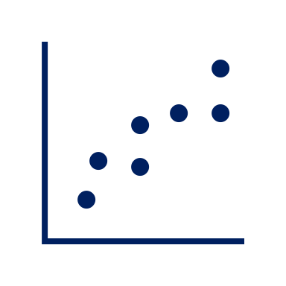
2.Methodology
Selecting Dataset
A dataset with documented research on handling missing feature values was selected. The Adult dataset was selected in the study done by A. Farhangfara, L. Kurganb, and J. Dyc.
Inducing Missing Values
Missing data were randomly introduced into each of the datasets using the Missing Completely at Random (MCAR) mechanism. The missing values were added to all attributes across all datasets at three different rates: 10%, 40%, and 70%.
Model Comparison
The results from the K-NN and decision tree classifiers are evaluated using performance metrices including accuracy, precision, recall, and F1-score, will be evaluated and compared.
Imputation Approach
The K-NN and mean imputation technique were used to address this issue, of missing values.
Notes:
Today, we're excited to walk you through our presentation, covering the introduction, data exploration and cleaning, data preprocessing, clustering, and evaluation of our dataset.

Slide 5
3.Results: Classification tree
Notes:
Looking at the performance of the classification tree. When one compares the the performance of the model trained mean imputed (the orange bars) and the knn-imputed (blue bars) datasets, to that of the control(original dataset, in grey), one can see that at a low proportion of imputed values, both mean imputed and knn imputed performed quite well. At larger proportions, the performance of the models trained with knn-imputed values decreased rapidly, where the mean imputation remained surprisingly constant.

Slide 6
3.Results: k-Nearest Neighbours
Notes:
Moving on to the k-Nearest Neighbour model. Here we can observe almost the exact same pattern as in the classification tree. Again both imputation methods performed better at low levels of imputed data, with the mean only slightly decreasing as the imputation proportion increases, with the models’ performance that were trained with the k-nn imputed datasets decreasing rapidly as the proportion of imputed values increase.
Again, it is in contrast to what we found in literature

Slide 7

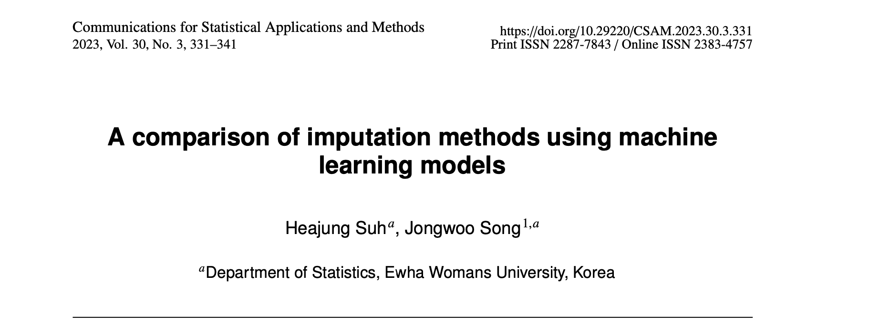
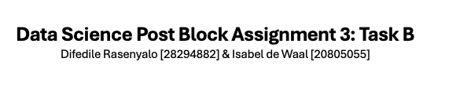
4. Discussion
Notes:
A similar study was done by Suh and Song, also utilising the same dataset.
According to Suh & Song, the type of dataset is an important factor when deciding on a imputation method [1]. They found that k-NN worked better for some datasets than others. Comparing our results to those of Suh & Song we found that our results were different. In their study the k-NN performed better than the mean imputation [1]. The difference is probably due to the different performance evaluation methods used. Where we evaluated the effectiveness of the imputation by evaluating the performance of two classification models Suh & Song constructed their own performance metric (the imputation performance metric – IPM), specifically designed to evaluate the effectiveness of imputation. This metric can handle mixed datasets of both categorical and numeric features.

Slide 8
4. Decision Tree

Slide 9

5.Conclusion
Notes:
In conclusion, the analysis of the analysis of the effectiveness of two different single imputation methods indicated that in some cases the simplest mean imputation may sometimes be the best. To get a clearer picture of this, it is recommended that the study is repeated using multiple datasets, and a variety of ways to calculate the effectiveness and performance of the imputation method. This study further confirmed what was seen in Task A: that the effectiveness of the imputation method depends on the dataset and purpose of the study. There is no single ‘best’ imputation method.

Slide 10

Thank You

