Slide 1
IBM University Engagement Project Submission
“Exploring the Power of Agentic AI with IBM Granite and IBM Bob”

Slide 2

Project Tile – [IoTAssist AI – Smart IoT Device Troubleshooting Assistant]
Domain of Project – [Internet of Things & Technical Support Automation]
Student Name | Recent Passport Photo | Email ID | Mobile number [WhatsApp]
Shubham verma |  | sv9365617@gmail.com | 6377982124

Slide 3
Problem Statement -
Problem Statement : Smart IoT Device Troubleshooting Agent (IoTAssist AI)
The Challenge
Smart home and IoT device adoption is rapidly growing, but users constantly struggle with device connectivity failures, firmware update glitches, and complex network configurations. Technical manuals and troubleshooting steps are scattered across unorganized documentation. Without intelligent, real-time diagnostic guidance, users fail to resolve device offline statuses, sensor errors, or communication failures efficiently.
The Objective
Build an AI-powered Smart IoT Device Troubleshooting Agent that delivers real-time diagnostic insights and step-by-step guidance for smart home users, IT technicians, and IoT administrators. The solution should:
Device Issue Diagnosis – Classify problem descriptions and pinpoint root causes.
Technical Knowledge RAG Retrieval – Fetch and summarize technical manuals, setup guides, and protocols (MQTT, Zigbee, BLE) from reliable IoT documentation.
Step-by-Step Troubleshooting – Provide structured diagnostic workflows, checklists, corrective actions, and preventive maintenance steps.
Knowledge RAG Retrieval – Fetch and summarize technical manuals and protocol guides (MQTT, Zigbee, BLE).
Guided Troubleshooting – Generate step-by-step repair workflows and diagnostic checklists.
Conversational Chatbot – Provide interactive, real-time follow-up support.
Multi-Agent Architecture – Combine issue analysis, retrieval, troubleshooting, and chat agents into one orchestrator.
Status Dashboard – Display real-time device health, connectivity metrics, and active workflows.

Slide 4
Proposed Solution -
Proposed Solution: AI-Powered Smart IoT Device Troubleshooting Agent (IoTAssist AI) The proposed solution is a multi-agent AI-powered IoT Troubleshooting Assistant built using IBM Bob, IBM watsonx.ai, and Granite Models to provide real-time diagnostic and technical guidance. The system addresses challenges in device connectivity, configuration failures, and unorganized technical documentation through an intelligent, modular architecture. At its core, the solution uses a Retrieval-Augmented Generation (RAG) pipeline to fetch accurate technical documentation, setup manuals, and protocol standards (Wi-Fi, Zigbee, BLE, MQTT). This data is embedded and stored in a vector database, enabling the system to retrieve and summarize relevant troubleshooting guides using Granite models.
The system consists of four key agents:
Device Issue Understanding Agent analyzes natural language descriptions to identify problem categories, root causes, and device health.
Knowledge Retrieval Agent fetches and summarizes technical documentation and setup guidelines using RAG.
Step-by-Step Troubleshooting Agent provides structured diagnostic checklists, corrective actions, and repair workflows. Conversational IoT Support Agent offers an interactive chatbot experience for real-time follow-up support and configuration assistance.
The solution includes a user-friendly dashboard (built with Flask and Bootstrap 5) that visualizes device status, network connectivity indicators, and active troubleshooting workflows. IBM Bob is used to orchestrate agent workflows, while watsonx.ai ensures scalable model deployment, embeddings, and AI governance. Granite models power reasoning, summarization, and diagnostic generation.
Overall, this solution delivers an end-to-end intelligent IoT troubleshooting assistant that minimizes device downtime through instant diagnostics, step-by-step guidance, and real-time conversational support.

Slide 5
Technology Used
IBM Bob platform -For designing and orchestrating multi-agent workflows visually
IBM Granite model - for eg – ibm-granite-3-2-8b – For natural language understanding, reasoning, and device diagnostic generation
IBM Cloud – It provides the infrastructure to build, deploy, and scale the IoTAssist AI Agent efficiently. IBM Cloud enables a reliable, secure, and scalable environment for deploying the IoTAssist AI Agent.
RAG– RAG to fetch real technical data first, then generate intelligent answers, making the IoTAssist AI Agent more trustworthy and effective.
IBM Watsonx.ai - For model deployment, embeddings, and AI governance
Vector Database (FAISS/Chroma) – For RAG-based IoT technical documentation retrieval

Slide 6
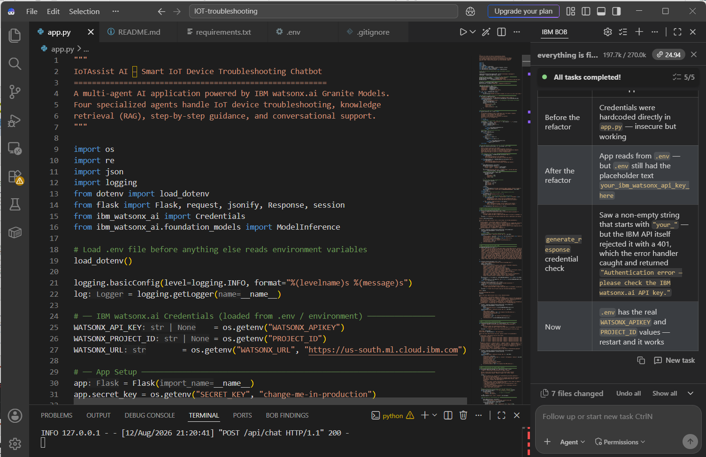
Required Files created using IBM bob -
App.py
Requirements.txt
.gitignore
.env
README.md

Slide 7

IBM Bob Screenshots:

Slide 8
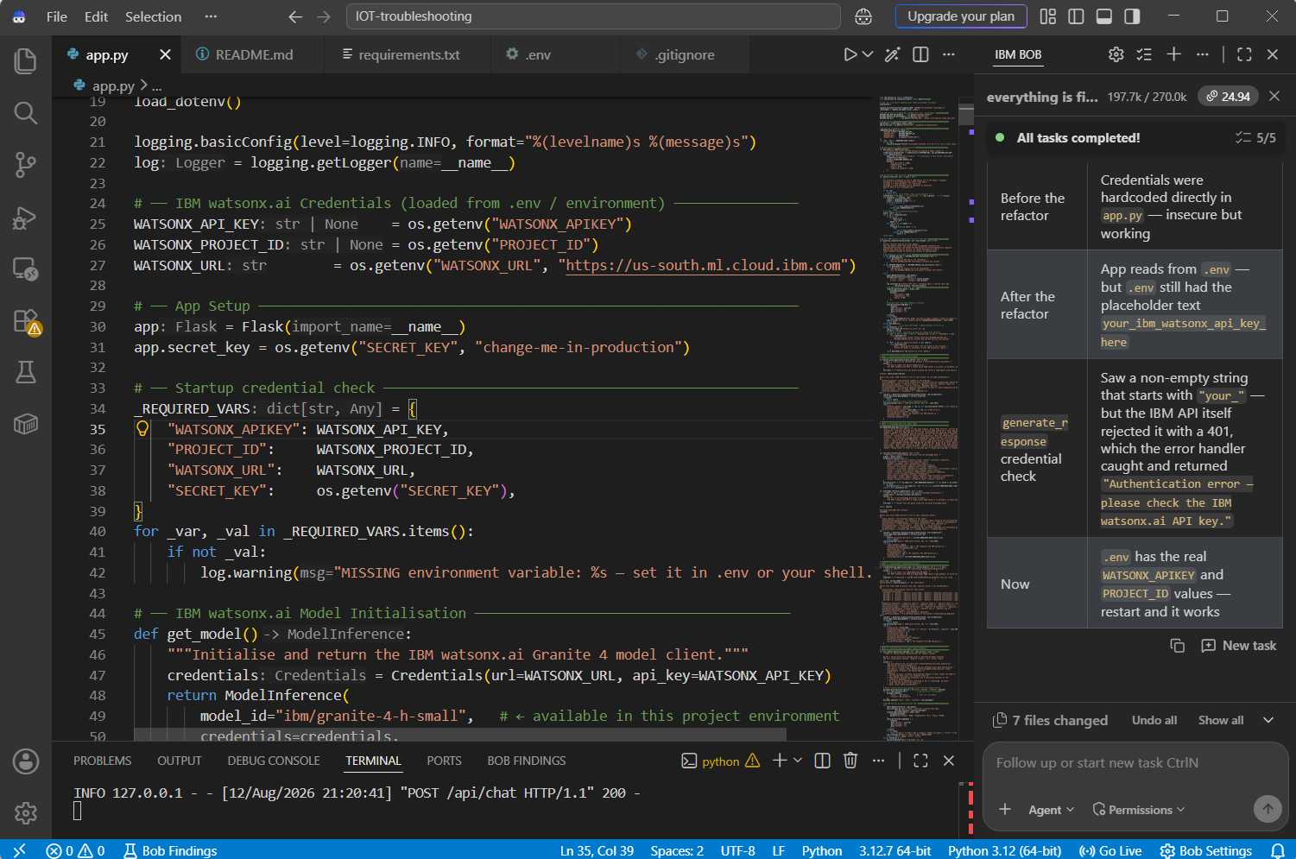

Slide 9
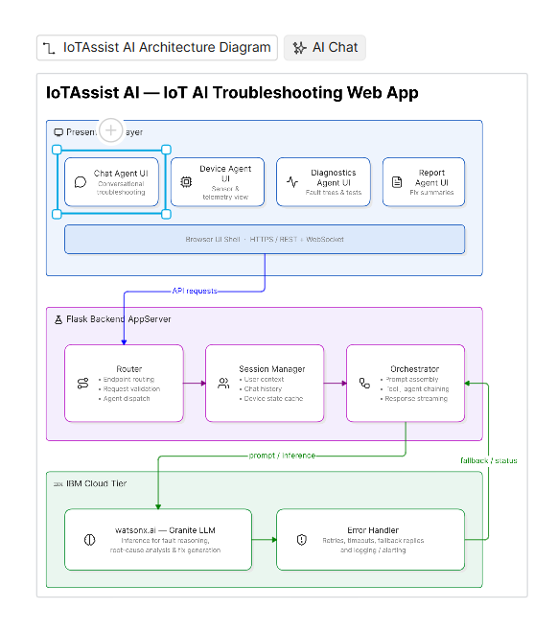
Architecture blueprint for IBM bob:

Slide 10

Role of Agentic AI in the solution
Role of Agentic AI in IoTAssist AI
Agentic AI enables IoTAssist AI to function as an intelligent, autonomous system rather than a simple rule-based chatbot.
Using IBM watsonx.ai and IBM Granite models, it coordinates multiple specialized agents to deliver precise, end-to-end device troubleshooting guidance. Each agent performs a specific role—such as analyzing hardware logs, retrieving manual and protocol knowledge, executing step-by-step resolution workflows, and offering conversational support—while working collaboratively.
This multi-agent approach ensures efficient task execution and accurate root-cause isolation. Agentic AI also brings context awareness, understanding device models, error states, and session history to generate tailored troubleshooting steps. It supports real-time adaptation, continuously updating suggestions based on user feedback and diagnostic responses. Additionally, agents communicate seamlessly through a central orchestrator, enabling better decision-making and improved outcomes. Overall, Agentic AI makes the system proactive, context-driven, and goal-oriented, acting like a smart digital IoT technician that helps users resolve smart home and network issues effortlessly.

Slide 11
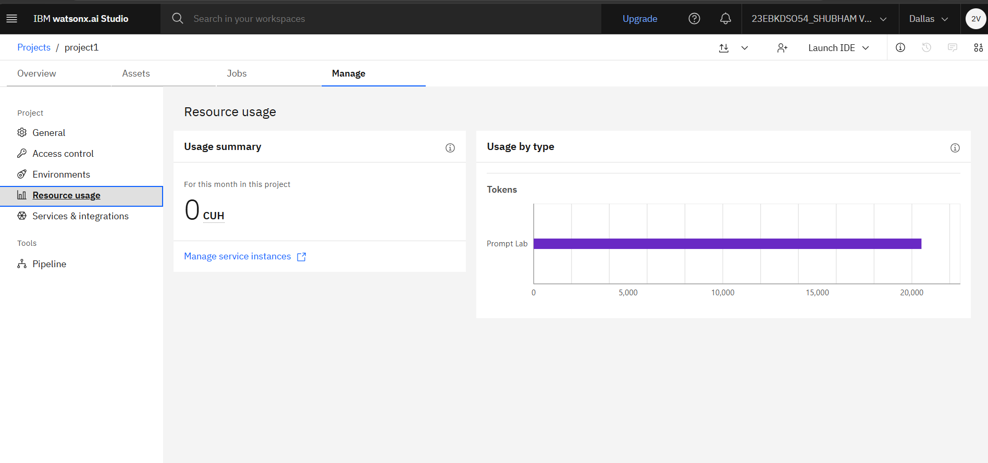
Token Usage
After the Prompt
·
·
·

Slide 12
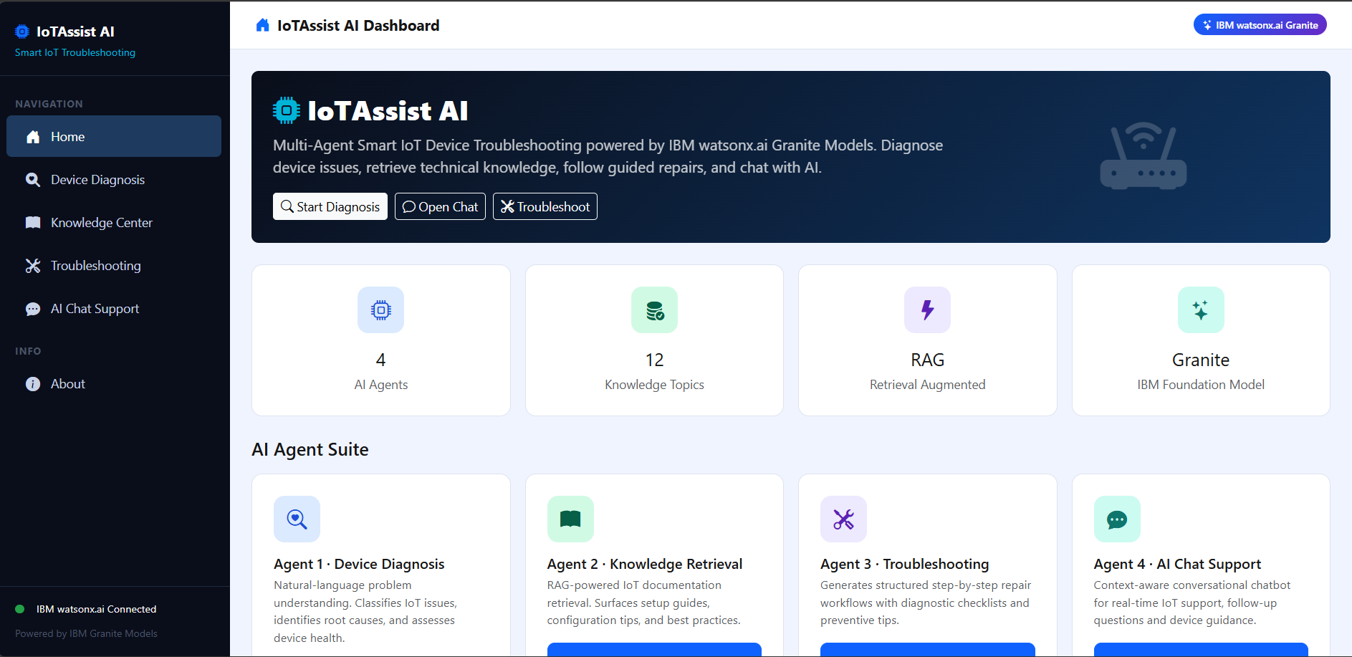
Project Output Screenshot
Please put IBM Bob output screenshots with 2-3 prompts.
You can take 2-3 more slides for each screenshot
·
·
·

Slide 13
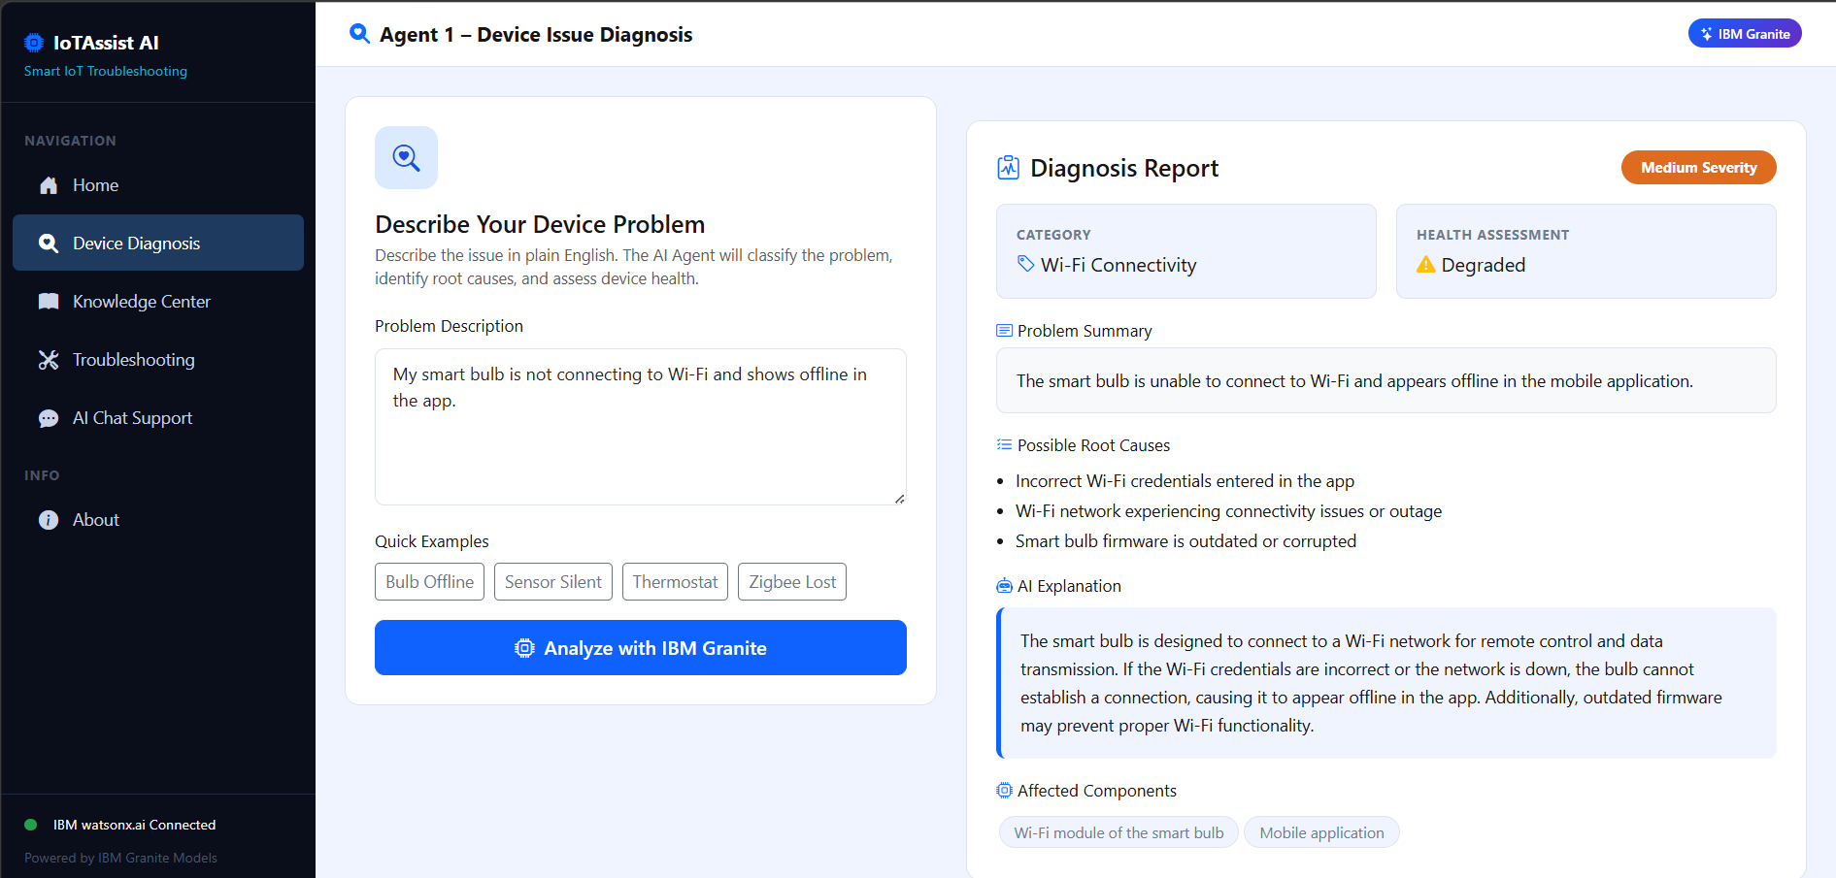
Project Output Screenshot
Please put IBM Bob output screenshots with 2-3 prompts.
You can take 2-3 more slides for each screenshot
·
·
·

Slide 14
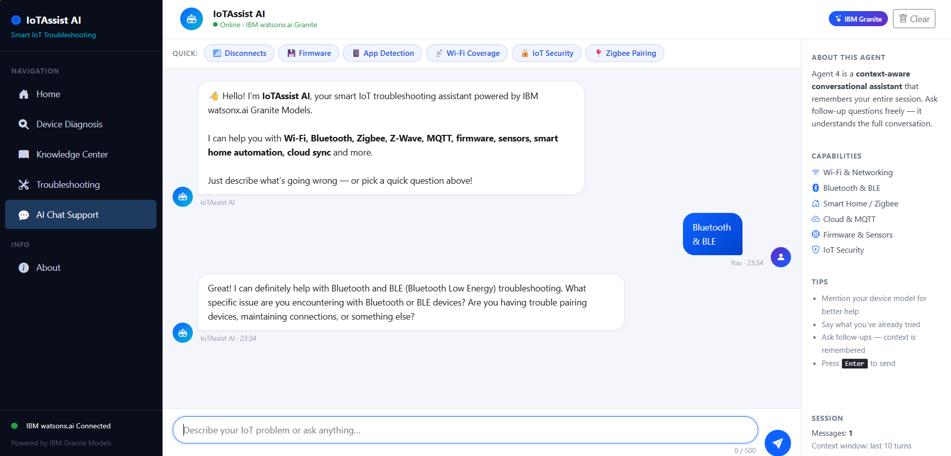
Project Output Screenshot
Please put IBM Bob output screenshots with 2-3 prompts.
You can take 2-3 more slides for each screenshot
·
·
·

Slide 15
Novelty and Uniqueness
The proposed IoTAssist AI platform stands out by combining Agentic AI, RAG knowledge retrieval, and interactive troubleshooting into a single intelligent system.
Multi-Agent Intelligence – Instead of a single chatbot, multiple specialized agents collaborate (Device Diagnosis, Knowledge Center, Guided Fixes, and AI Chat Support) to deliver context-aware technical resolution.
RAG-Based Diagnostic Accuracy – Integrates real-time device manual and protocol retrieval with AI generation, drastically eliminating hallucinations and ensuring accurate technical advice.
Context-Aware Session Tracking – Retains multi-turn conversation history and device specifications to provide tailored, step-by-step fixes without requiring repeated user explanations.
Interactive Troubleshooting Workflow – Continuously adapts troubleshooting steps in real time based on user feedback and diagnostic test results.
Proactive Root-Cause Isolation – Analyzes raw hardware error logs and failure patterns directly rather than relying on generic keyword manual searches.
Quick-Action Usability – Incorporates preset query chips and multi-turn chat interfaces for rapid issue triage and zero-friction navigation.
Scalable & Enterprise-Ready – Built on IBM watsonx.ai with IBM Granite models, ensuring enterprise-grade reliability, data governance, and high system availability.

Slide 16
Git Hub Link
GitHub Repository URL:
[https://github.com/sverma1407/IOT-troubleshooting](https://github.com/sverma1407/IOT-troubleshooting)
Repository Contents:
Source Code: app.py, requirements.txt, .gitignore, README.md
Documentation: yourproblemstatement.pdf
Presentation: projectpresentation.pptx
·
·
·

Slide 17
Future Scope
1. Integration with Real-Time IoT Gateways & Telemetry – The system can be integrated directly with smart home hubs, edge gateways, and IoT communication protocols (MQTT/WebSockets) to collect live hardware metrics and error logs automatically. This will enable IoTAssist AI to proactively detect device degradation, isolate fault codes, and trigger automated resolution workflows before total system failure occurs.
2. AI-Powered Voice Assistant & Multilingual Support – Enhancing the platform with hands-free voice interaction and support for multiple regional languages will significantly improve accessibility for field technicians and diverse end users. Technicians can navigate step-by-step troubleshooting workflows hands-free while inspecting equipment, communicating naturally in their preferred language.
3. Automated Remote Action & Self-Healing Workflows – Integrating API-driven remote execution triggers will allow agents to perform over-the-air (OTA) firmware updates, remote device reboots, and network configuration resets directly from the troubleshooting interface, resolving routine technical glitches with zero manual intervention.
·
·
·

Slide 18
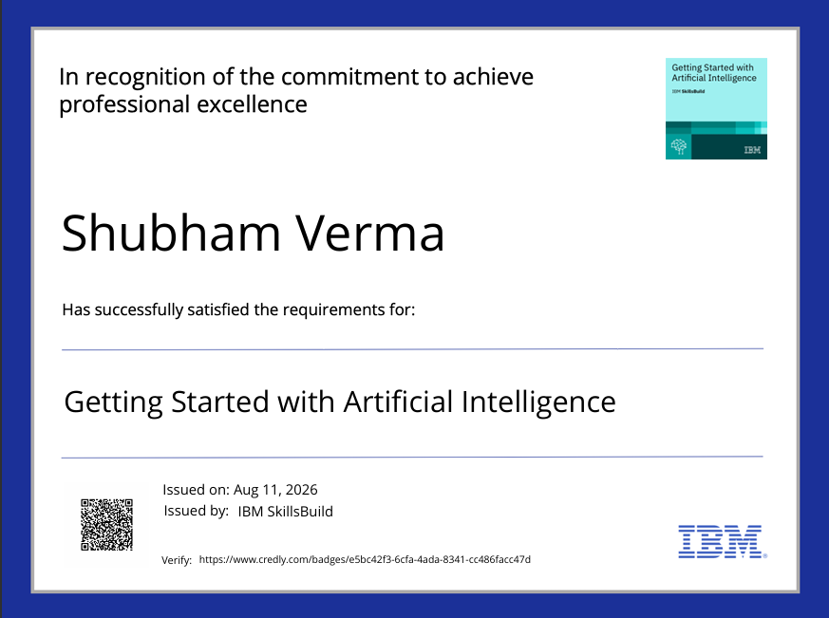
Certificates Earned:

Slide 19
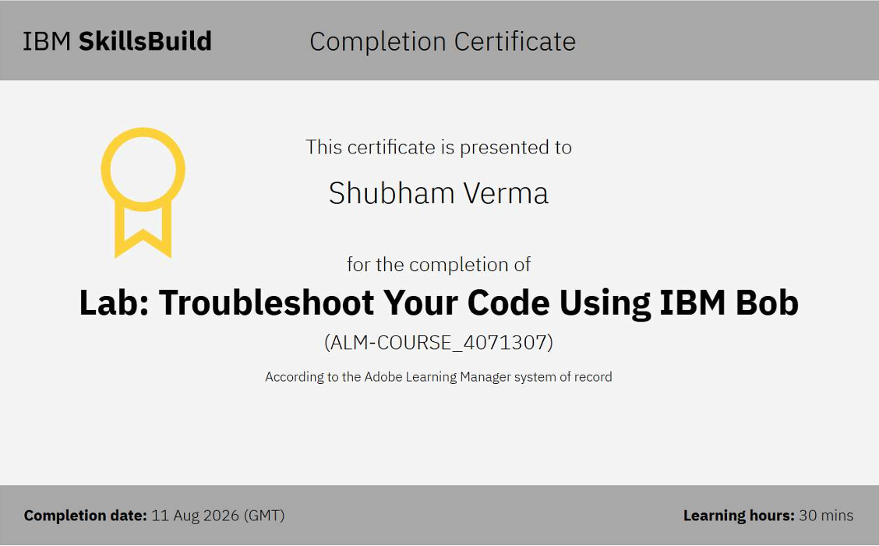
Certificates Earned:​

Slide 20


