Slide 1
APS Sensor Fault Detection System
Improving Efficiency and Reducing Costs in Air Pressure System (APS) Maintenance for Heavy-Duty Vehicles

Slide 2
Saving of $196,944

Slide 3
Outline
Introduction: Problem
Proposed Solution
End-to-End Data Science Pipeline
Baseline Analysis
Metrics
Cost Analysis and Conclusion

Slide 4


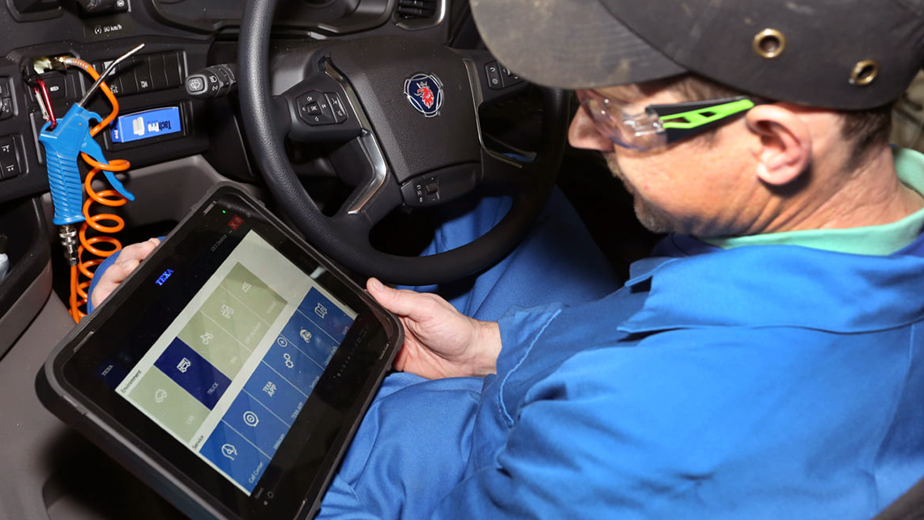

Introduction: Problems
2. APS diagnostics complexity: Challenges in pinpointing faults increase maintenance costs.
1. APS reliability: Critical for heavy-duty vehicles, prone to costly failures.
3. Early detection need: Crucial for preventing downtime, optimizing repair schedules.
4. Fault identification impact: Accurate diagnosis saves expenses, enhances operational efficiency.

Slide 5
Proposed Solution
Utilizing Scania Truck Dataset
APS Related Failure or Not
Fault Classification with Machine Learning
Minimizing False Positives or Negatives for Cost Optimization

Slide 6
False Positive and False Negative
False Positive: System notifying that fault is due to APS, but APS is healthy.
False Negative: System notifying that fault is not related to APS, but APS is faulty.

Slide 7
Baseline Analysis
Original Monthly Costs:
Preemptive Checkup Costs: $9,000
APS Failure Costs: $10,000
Total Monthly Cost: $19,000
Yearly Total Cost:
$19,000 x 12 = $228,000
Assumptions:
Preemptive Checkup Cost: $300 per truck
30 trucks undergo preemptive repairs monthly
Truck Repair Cost due to APS Failure: $2,000 per truck
Average of 5 trucks experience APS failure monthly

Slide 8
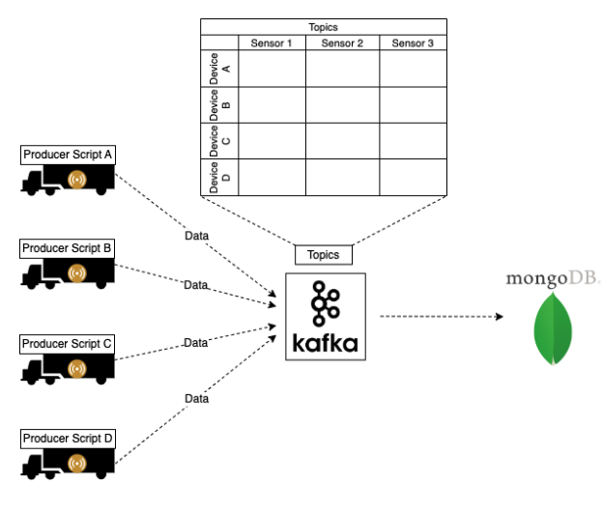
End-to-End Data Science Pipeline: Data Collection

Slide 9
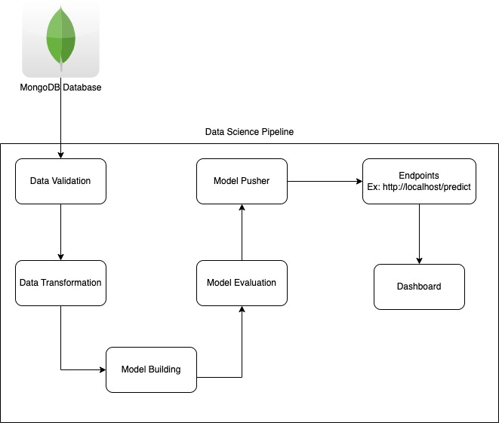
End-to-End Data Science Pipeline: ML Pipeline

Slide 10
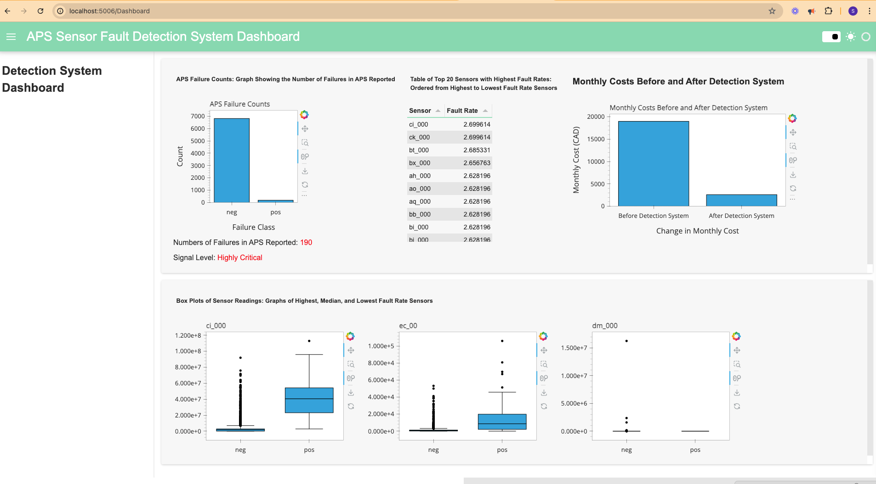
Dashboard

Slide 11
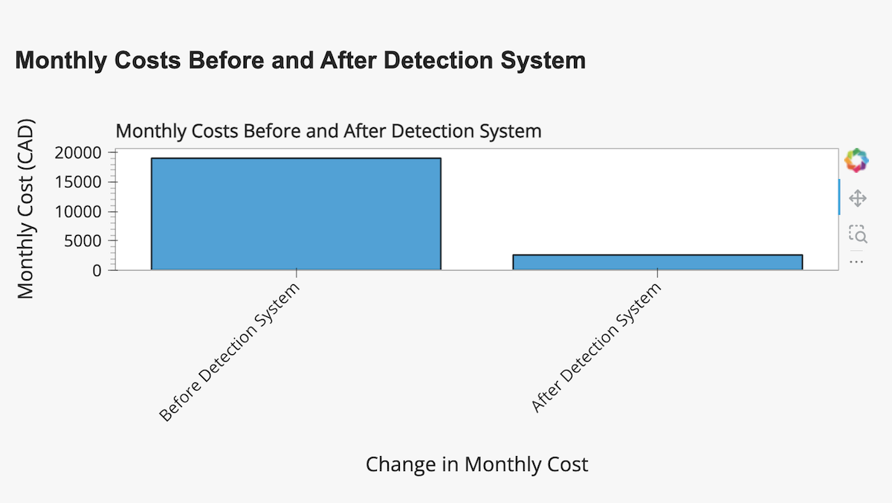
Cost Analysis
Reduction preemptive checkups.
Reduction in APS related failures.
Overall, APS sensor fault detection system could reduce monthly cost from $19,000 to $2,588.
Yearly saving of $196,944 !

Slide 12
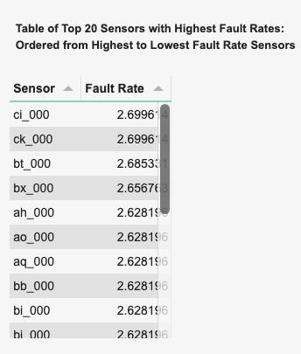
Cost Analysis
You can also optimize most faulty sensors for better APS reliability.
Each sensor represent different areas of APS system.
Prioritize the most frequent areas of APS system.
This could further reduce time and cost during APS system repair.

