Slide 1
Resource Allocation Problem For Efficient IOT Application In Fog Computing
Submitted To:
Mr Naveen Tiwari
Presented By :
Shubham Verma
1683910042

Slide 2
About Research Paper
Published in Scopus Indexed Journal
Published in ITBT Conference 2019
Best Paper Award in ITBT 2019
Proceeded to Publish in International Journal Of Mathematical, Engineering and Management Sciences (IJMEMS)
Compared Former Algorithms With Proposed Algorithm RECK Algorithm in Context of Various Prospects.
Authors : Shubham Verma 1683910042
Dr Vivek Srivastava

Slide 3
Contents
Introduction
Problem Statement
Literature Reviews
Former Deferred Algorithm
Approaches and Algorithms ( RECK Algorithm )
Analogy and Problem Formulation
RECK Mechanism And Algorithm Strategy
Network Tactics And Problem Formulation
Decision Parameter Analysis
Simulations
Conclusion

Slide 4
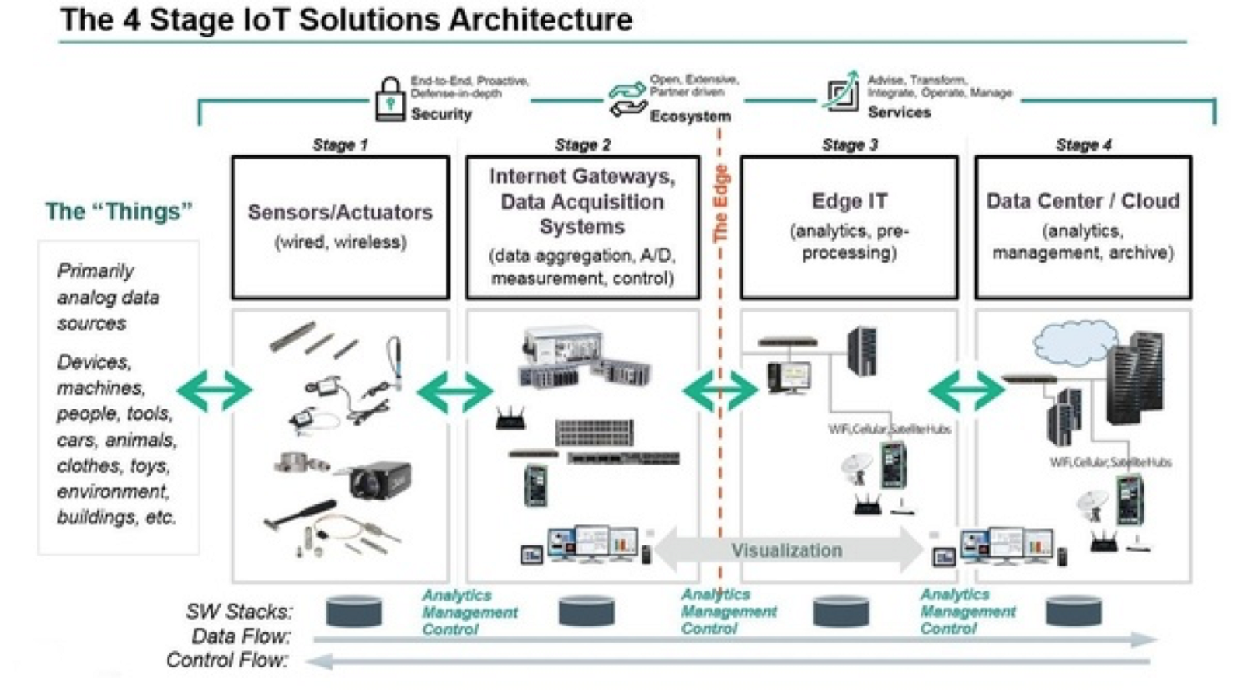
Introduction
In IOT Architecture , There lies an Resource Management Layer.

Slide 5
Problem Statement
Main Issue in Resource Management Layer in Context with cloud Computing is to perform Automated Provisioning Of resources.
To provide the better QOS( Quality Of Services) .
Low Energy Consumption.
To provide Maximum Utilization Of Resources.
Limited network bandwidth in Fog Computing so need Of Joint architecture : A better Framework
To Provide best Network Service.
Along with above points the main goal should be Designing the best Resource Allocation Scheme so as to Obtain Maximum Efficiency ( Throughput) and designing best resource Modelling Solution in IOT Layered Model.

Slide 6
Approaches & Algorithms
Systematic ladder Process
INTRODUCTION : Quality Of Services : Mobile Broadband Services , Resource Capacity , Network Services , Reliable Low latency Communication.
We determine Priority of different Qos requirement Of heterogenous IOT devices
Then we design a framework for RECK process and then formulate 2 sided matching games.
We apply best fit resource allocation scheme during matching considering delays in result to higher stability and more efficiency.

Slide 7
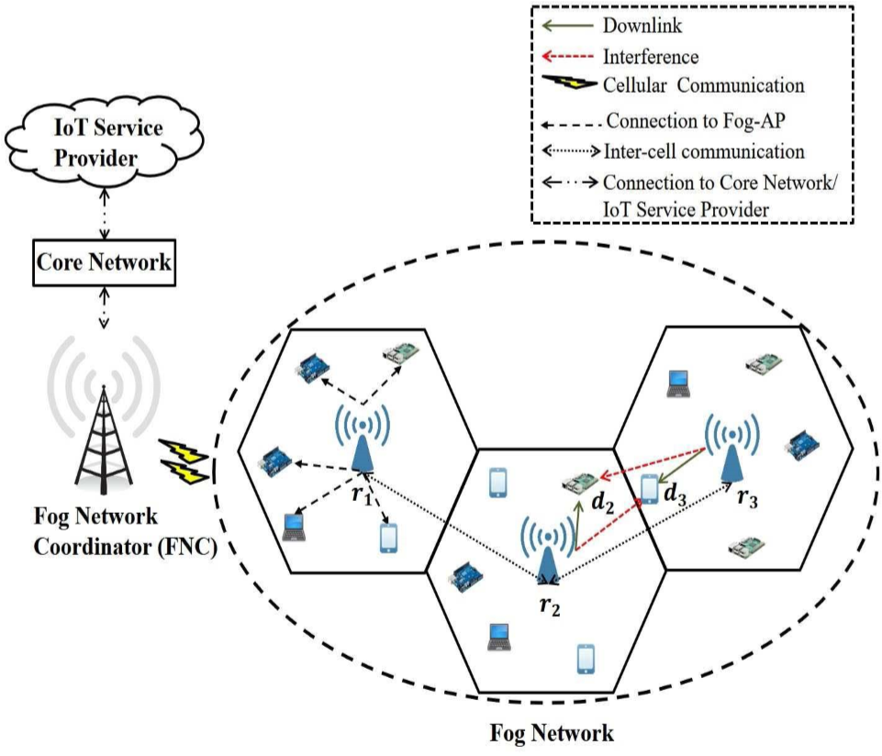
Analogy And Problem Formulation

Slide 8
Literature Reviews

Slide 9
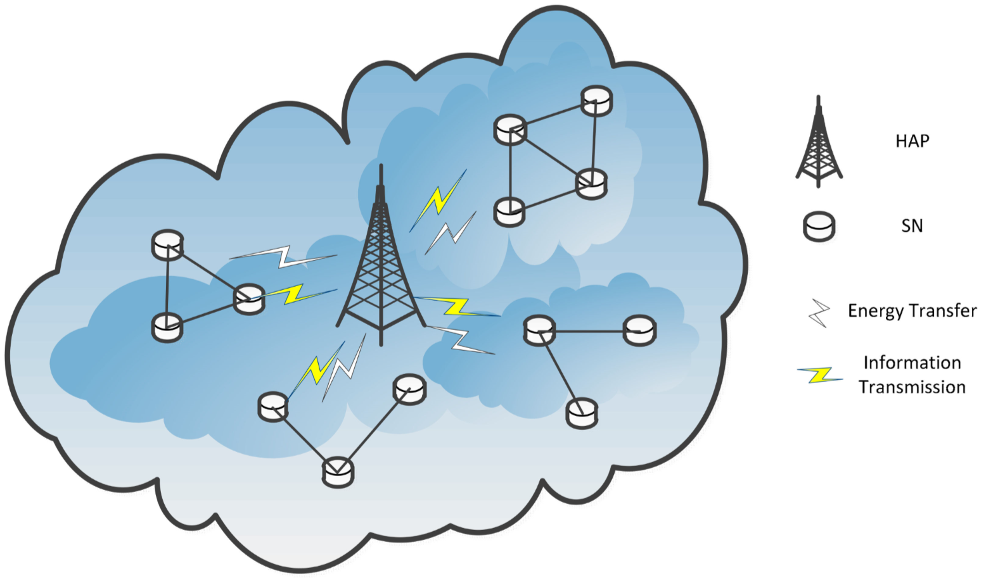
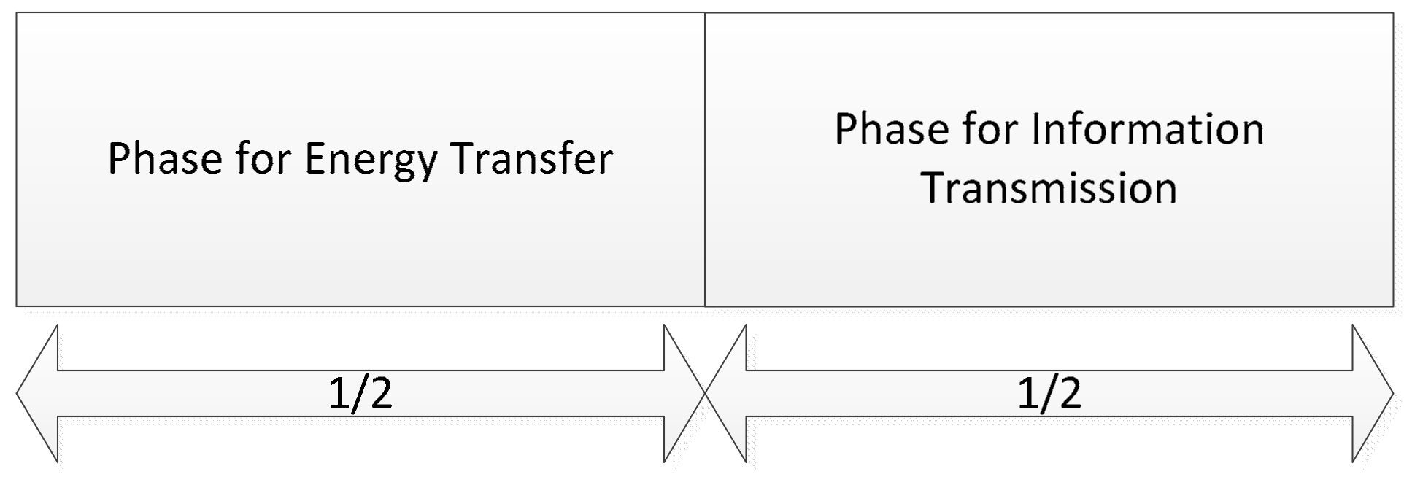
A Mean Field Stackelberg Game-Based Approach – Algorithm 2 : IEEE 2018
A wireless powered IoT system with one dedicated hybrid access point (HAP) and N sensor nodes (SNs).
Located at the appropriate place, the HAP can be considered as an aggregation to collect information from the sensor nodes, and can be considered as an energy source to the sensor nodes through RF-based wireless energy transfer.
Each SN should upload the information to the HAP, and harvest energy from the HAP using the equipped energy harvesting circuit. As each SN’s energy is limited by the battery capacity, it mainly uses the energy from the HAP for information transmission.

Slide 10
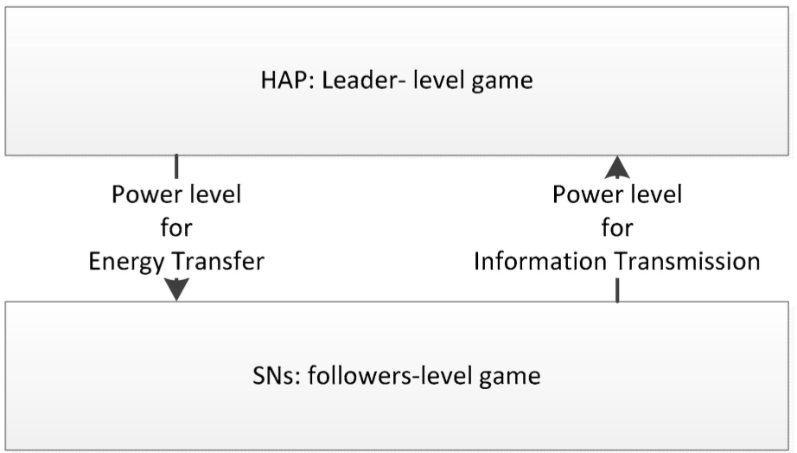
Stackelberg Game-Based : Elsivier 2018
Leader-level game : As the HAP can significantly affect the performance of the SNs, it is considered as the leader. The HAP will transfer the energy to the SNs based on its own aspiration, and announces its strategy of power level for energy transfer to the SNs.
Follower-level game : As the SNs are affect by the HAP, they can be considered as the followers of the game. The SNs control their power for information transmission under the HAP’s energy transfer strategy, by playing a Stackelberg game.

Slide 11

System state & Energy level Calculation
The energy level of the HAP denoted by x₀(t), and the energy level of SNi denoted by {x_{i}(t), 1 ≤ i ≤ N}
Energy of the HAP: dx₀(t) = [α0x₀(t) + β0p₀(t)]dt
For any specific SN, the evolution of the energy is described by:
dx_{i}(t) = [αix_{i}(t) + βip_{i}(t) + ρih_{i}p₀(t)]dt
Problem Formulation :
For the HAP, the optimal power strategy for energy transfer could be obtained by minimize the following utility function i.e the first utility function
Cost function Estimation

Slide 12
Algorithm
Set up the parameter for the HAP and sensor nodes.
The HAP announce the power strategy for energy transfer to the sensor nodes.
Start the mean field game of the HAP and sensor nodes.
Calculate the mean field control solutions for the sensor nodes first.
Setup the objective function and state function for the sensor nodes.
Calculate the solutions for the sensor nodes based on Equations.
Get the mean field estimation of the sensor nodes for the HAP.
Calculate the mean field control solutions for the HAP.
Setup the objective function and state function for the HAP.
Calculate the solutions for the HAP based on Equations .

Slide 13
Deferred Acceptance Algorithm : Spinger 2018
Deferred Accepting Algorithm states that the resource allocation must be in a fashion that atleast one stable matching should exist for the available list of resources available.
Algorithm goes as
Start
Initialise the user specified resource list or the preference list
Each of its user puts a proposal of its favourite resource requests to delete rest of the resources available in the resource list
Acceptance or Rejection Phase : Accepting its favourite and rejecting rest by deletion
Check If the users are matched or not
If matched go 8 to else 7
Check if the resource list is empty or not , if yes goto 8 else goto 3
Terminate : Output is the stable matching between the user and its respective resources
End

Slide 14
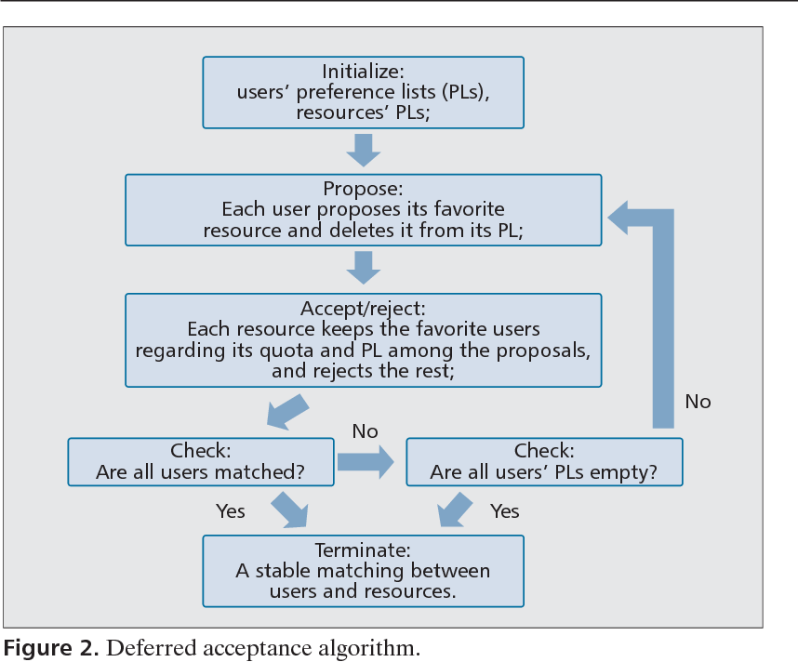
`

Slide 15
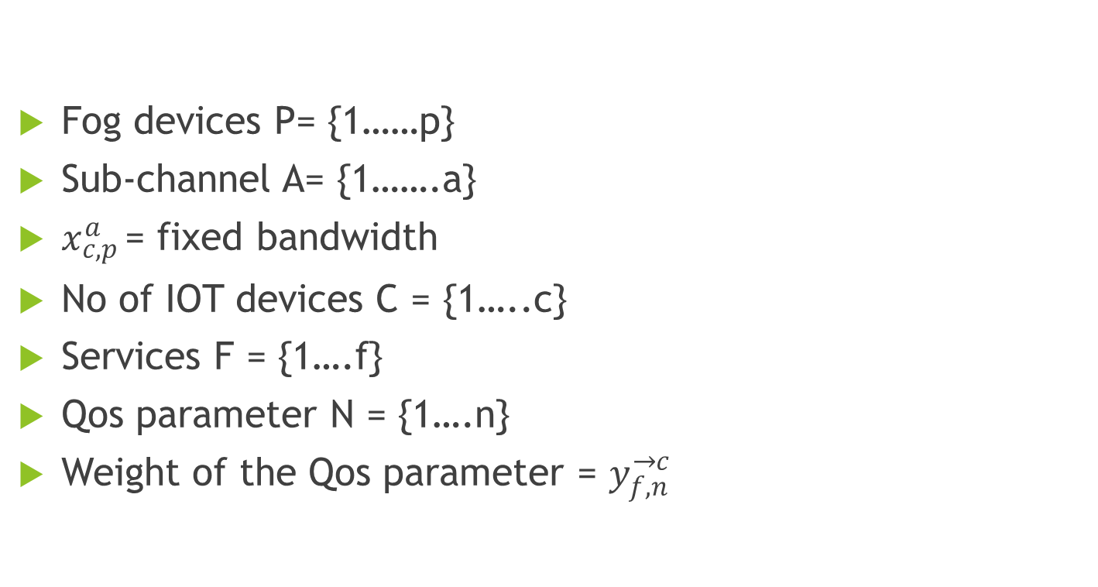
Network Tactics and Allocations
Fog devices P= {1……p}
Sub-channel A= {1…….a}
$x_{c,p }^{a}$= fixed bandwidth
No of IOT devices C = {1…..c}
Services F = {1….f}
Qos parameter N = {1….n}
Weight of the Qos parameter = $y_{f,n}^{→c}$

Slide 16
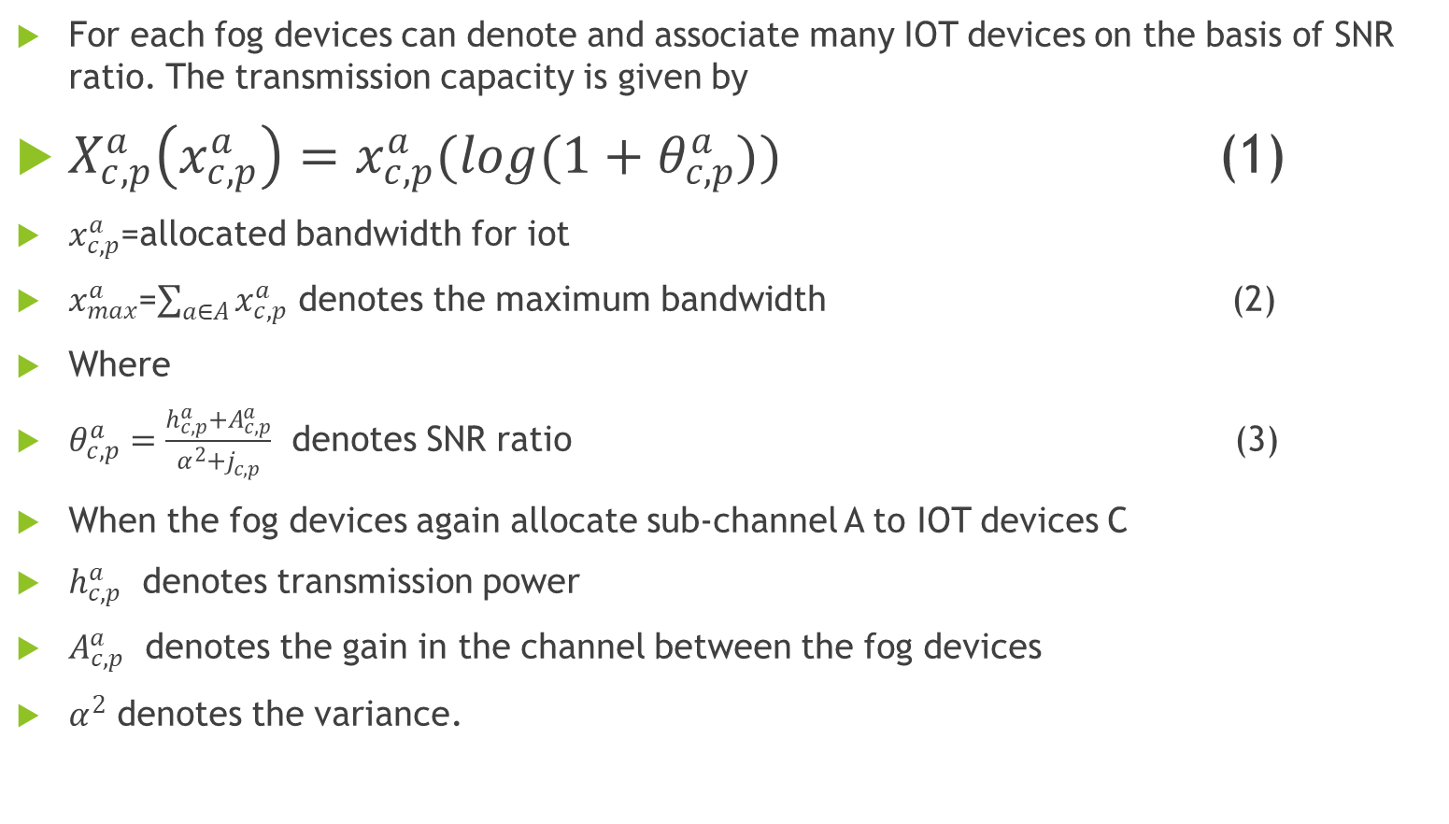
Bandwidth Allocation
For each fog devices can denote and associate many IOT devices on the basis of SNR ratio. The transmission capacity is given by
$X_{c,p}^{a}\left(x_{c,p}^{a}\right)=x_{c,p}^{a}(log(1+θ_{c,p}^{a}))$ (1)
$x_{c,p}^{a}$=allocated bandwidth for iot
$x_{max}^{a}$=$\sum_{a∈A}^{ }{x_{c,p}^{a}}$ denotes the maximum bandwidth (2)
Where
$θ_{c,p}^{a}=\frac{h_{c,p}^{a}+A_{c,p}^{a}}{α^{2}+j_{c,p}^{ }}$ denotes SNR ratio (3)
When the fog devices again allocate sub-channel A to IOT devices C
$h_{c,p}^{a}$ denotes transmission power
$A_{c,p}^{a}$ denotes the gain in the channel between the fog devices
$α^{2}$ denotes the variance.

Slide 17
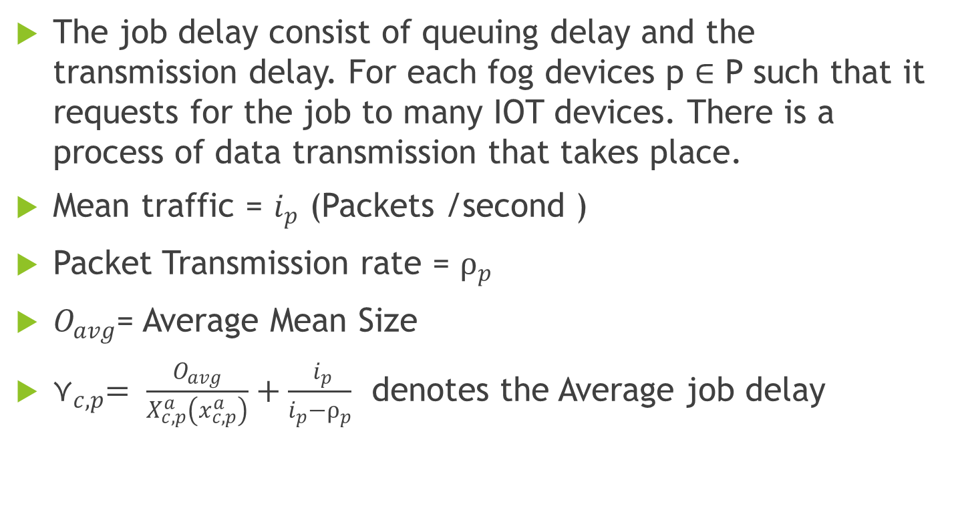
Job delay
The job delay consist of queuing delay and the transmission delay. For each fog devices p $∈$ P such that it requests for the job to many IOT devices. There is a process of data transmission that takes place.
Mean traffic = $i_{p}^{ }$ (Packets /second )
Packet Transmission rate = $⍴_{p}^{ }$
$O_{avg}^{ }$= Average Mean Size
$⋎_{c,p}^{ }= \frac{O_{avg}^{ }}{X_{c,p}^{a}\left(x_{c,p}^{a}\right)}+\frac{ i_{p}^{ }}{i_{p}^{ }−⍴_{p}^{ }}$ denotes the Average job delay

Slide 18
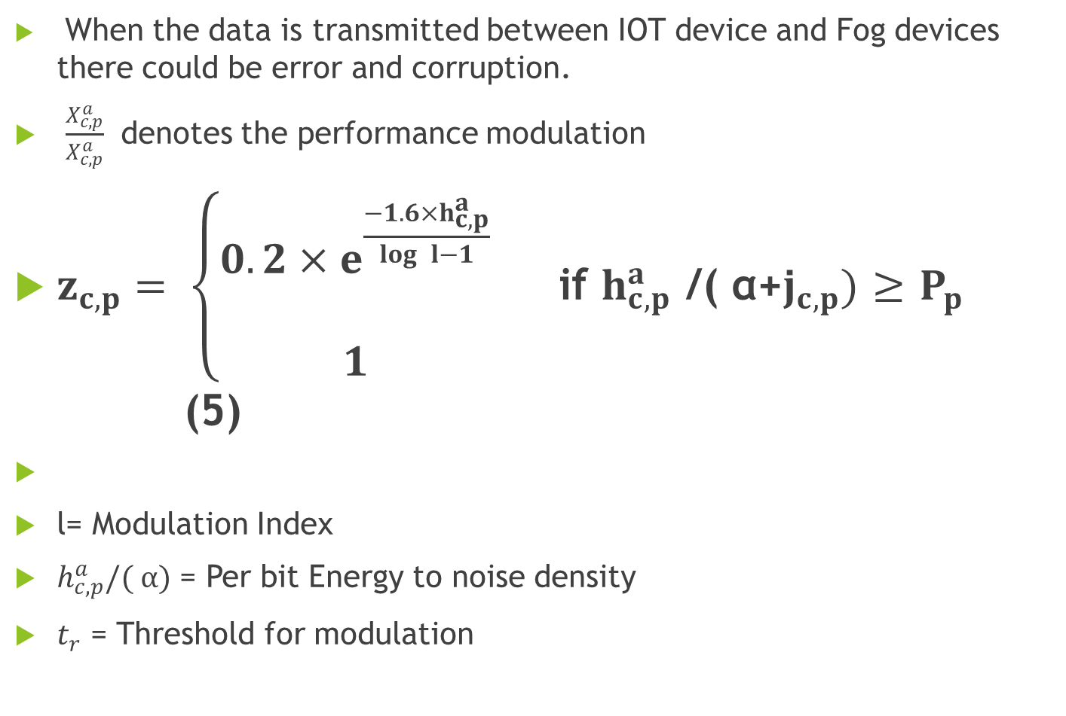
Bit Error Rate
When the data is transmitted between IOT device and Fog devices there could be error and corruption.
$\frac{X_{c,p}^{a}}{X_{c,p}^{a}}$ denotes the performance modulation
$z_{c,p}^{ }=$ $\left\{\begin{aligned}0.2×e^{\frac{−1.6×h_{c,p}^{a}}{\log{ }l−1}} \\ \\ 1\end{aligned}\right.$ if $h_{c,p}^{a}$ /( α+$j_{c,p}^{ })$ $≥$ $P_{p}$ (5)
l= Modulation Index
$h_{c,p}^{a}/( α)$ = Per bit Energy to noise density
$t_{r}$ = Threshold for modulation

Slide 19
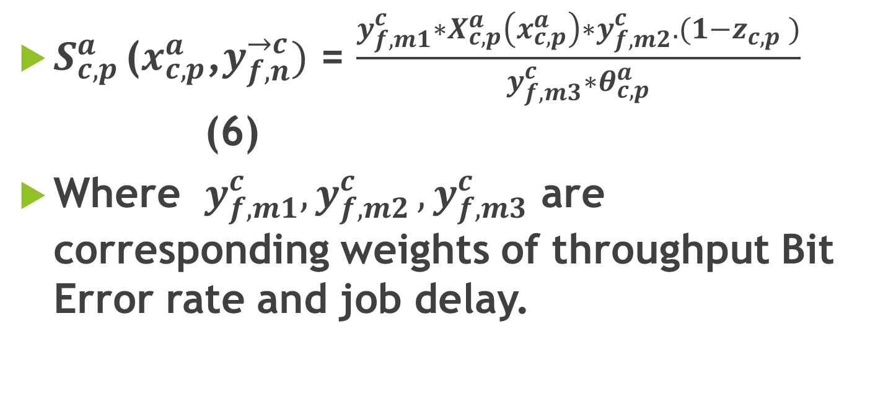
Qos Benefit Parameter
$S_{c,p }^{a}$($x_{c,p}^{a}$,$y_{f,n}^{→c})$ = $\frac{y_{f,m1}^{c}∗X_{c,p}^{a}\left(x_{c,p}^{a}\right)∗y_{f,m2}^{c}.(1−{z_{c,p}^{ }}_{ })}{y_{f,m3}^{c}∗θ_{c,p}^{a}}$ (6)
Where $y_{f,m1}^{c}{, y}_{f,m2}^{c}{,y}_{f,m3}^{c}$ are corresponding weights of throughput Bit Error rate and job delay.

Slide 20
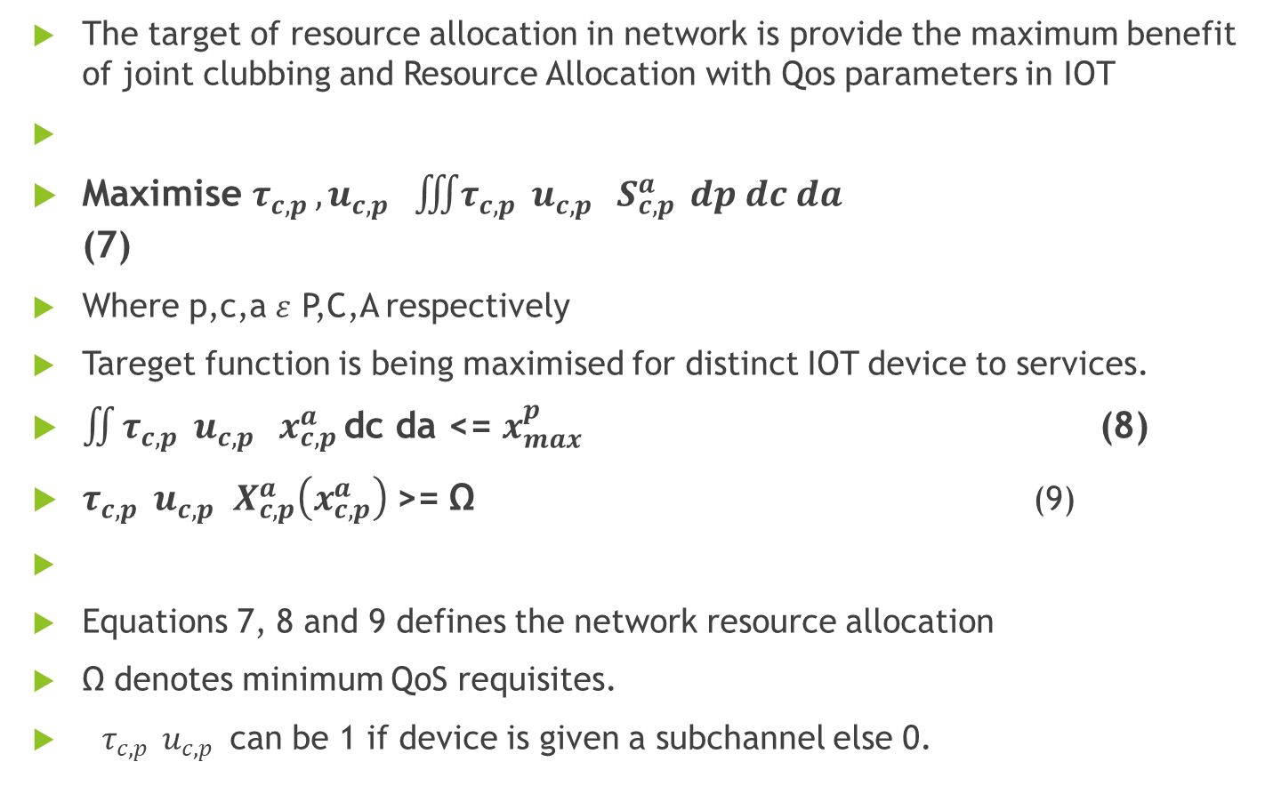
Problem Formulation
The target of resource allocation in network is provide the maximum benefit of joint clubbing and Resource Allocation with Qos parameters in IOT
Maximise $τ_{c,p }, u_{c,p }\iiint{τ_{c,p } u_{c,p }}S_{c,p }^{a} dp dc da$ (7)
Where p,c,a $ε$ P,C,A respectively
Tareget function is being maximised for distinct IOT device to services.
$\iint_{ }^{ }{τ_{c,p } u_{c,p }}x_{c,p }^{a}$dc da <= $x_{max}^{p}$ (8)
$τ_{c,p } u_{c,p }X_{c,p}^{a}\left(x_{c,p}^{a}\right)$>= Ω (9)
Equations 7, 8 and 9 defines the network resource allocation
Ω denotes minimum QoS requisites.
$τ_{c,p } u_{c,p }$can be 1 if device is given a subchannel else 0.

Slide 21
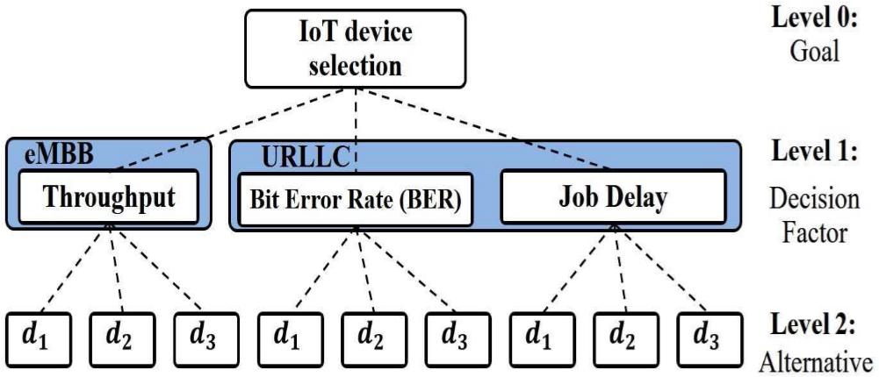
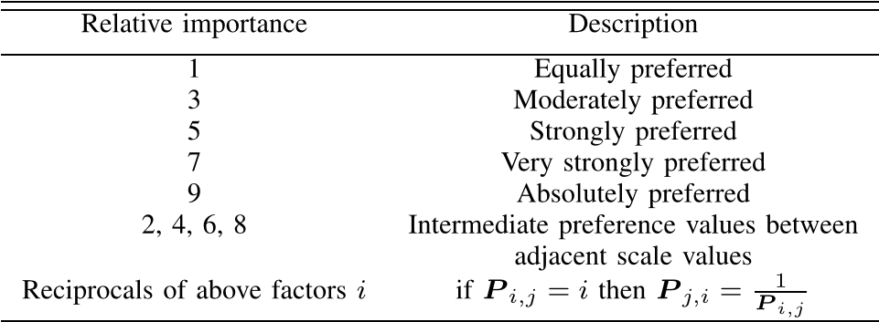
SLP MECHANISM AND ALGORITHM STRATEGY

Slide 22
Decision parameter Methodolgy & Algorithm
The decision problem in can be reduced to a base problem of 0/1 multiple-knapsack problem.
Complexity of the problem is O(2^{D×R×K}) which grows exponentially depending on the number of IOT devices, Fog devices, and sub-channels in the corresponding sets in order to maximize the network utility.
RECK Algorithm

Slide 23
RECK Algorithm
Start
Let there are three cases Case 1, Case 2, Case 3 denoting device allocation by throughput, Bit error rate, job delay.
Priority is assigned in the order of Case 1, Case 2, Case 3 because job delay would be tolerated to an extent provided if there is minimised error.
Allocate the same normalised weight Wa to all devices say d1,d2,d3
Calculate the throughput, bit error rate and job delay for each devices say d1, d2, d3.
Case 1: For Each device: Throughput > ( Job delay, Bit Error rate)
Preference of allocation will be according to throughput as preference is allocated to case 1 first.
(Randomised) allocation of weights according to throughtput to the devices d1, d2,d3 as w1,w2,w3
Calculate f1 = Wa*w1 , f2= Wa*w2 , f3= Wa*w3
Maximum ( f1, f2,f3) will fetch with the selection as d1,d2,d3 respectively for f1,f2,f3 being maximum value.
Case 2: Throughput < ( Job delay > Bit Error rate) this will be given second preference for allocation of devices as job delay could be tolerated as compared to the error rates.
Randomised Weight allocation to devices according to job delay as w4, w5, w6 for d1,d2,d3 respectively.
Calculate f4 = Wa*w4, f5= Wa*w5 , f6= Wa*w6
Minimum (f4,f5,f6) will be given the allocation to devices d1,d2,d3 for f4,f5,f6 being minimum.
Case 3: Throughput < ( Job delay < Bit Error rate) this will be given third preference for allocation of devices as job delay could be tolerated as compared to the error rates.
Randomised Weight allocation to devices according to bit error rate as w7,w8,w9 for d1,d2,d3 respectively.
Calculate f7 = Wa*w7, f8= Wa*w8 , f9= Wa*w9
Minimum (f7,f8,f9) will be given the allocation to devices d1,d2,d3 for f4,f5,f6 being minimum.
END

Slide 24
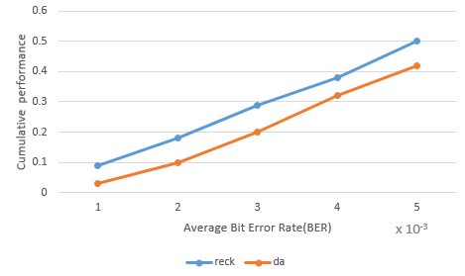
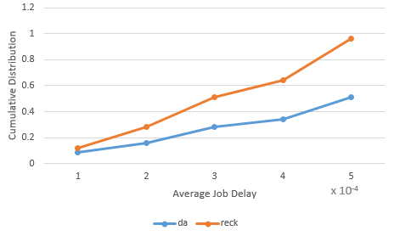
Simulations

Slide 25
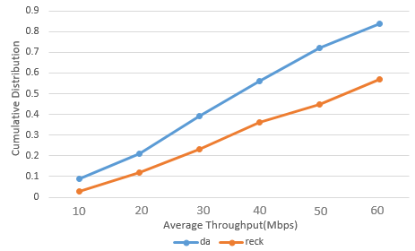
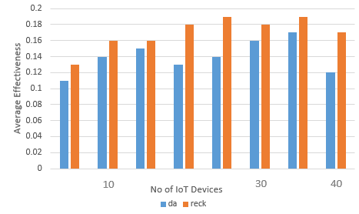

Slide 26
Conclusion
In this paper, we have tried to draw attention to ensure the QoS quality of services for end-users by allocation of the resources being limited with efficiency to the heterogenous applications associated with IOT.
Thereby we tried to propose RECK algorithm approach for self-organizing distributed association of users and resource allocation that are better applicable and have scalability to the dense environment of fog computing.
Unlike various schemes of resource allocation schemes for the applications associated with IOT with taking RECK algorithm into consideration in context with this algorithm analytics, resource demands, type of applications associated with QoS parameters.
The simulations came out with a proposed approach inculcating the best resource allocation strategy and we compared the significant performance gains as compared to many resource allocation schemes available.
The research carries a greater impact in creating the joint architecture of fog computing networks with better QoS, enhanced efficiency, low latency communication.
It would be beneficial in the quick development of the internet and cloud technologies in our daily day to day life by reducing time in an IOT application in cloud & fog computing with better performance.
As the technology demands transformation one day the better algorithm would replace the concurrent algorithm with a better set of parameters, complexity and ideology.

Slide 27
THANK YOU ……….

