Slide 1


Lab Section 2
Linux-GCC Primer (continued), Functions & Pointers
CS-202
Bahadir Pehlivan, Spencer Gibb, Jun Yi
University of Nevada, Reno

Slide 2


Consulting / Asking for Assistance
Discussion Board first: You should always post your questions to the WebCampus Discussions section.
TAs and other students will answer your questions.
Email your primary TA : If you have a specific code question, or a question about your grades, then email your TAs.
Visit during Office Hours to get hands-on assistance.
If you still cannot handle your issue, then you may contact your PASS Leader / your Instructor via email.
CS-202 Lab Sections

Slide 3
Consulting / Asking for Assistance
Bahadir Pehlivan : Lab Section 2
bpehlivan@nevada.unr.edu Lab Section 4
Office Hrs: Tu-Th 12:00-1:00 pm @ SEM211
Spencer Gibb : Lab Section 1
sgibb@nevada.unr.edu
Office Hrs: Mo-We 12:00-1:00 pm @ ECC
Jun Yi : Lab Section 3
junyi@nevada.unr.edu
Office Hrs: We-Fri 12:00-1:00 pm @ ECC
Responsible for:
Responsible for:
Responsible for:
CS-202 Lab Sections

Slide 4
Extra Help with Learning/Projects
NV Peer-Assisted Study Sessions (PASS)
Kurtis Rodrigue :
kurtisr@nevada.unr.edu
PASS Hrs: Monday(s) 5:40-7:40 pm @ ECC Lab B
Tuesday(s) 7:30-9:30 pm @ ECC Lab C
Make sure you benefit from ALL FORMS OF HELP available to you !
CS-202 Lab Sections

Slide 5
Reminders
Code does not compile: ~0 Credit !
Code improperly formatted / unreadable: ~0 Credit !
Code has to be properly indented in matching Curly Braces “{}”
Variable names have to convey their utility
Code Organization (the components of a program in order):
Include statements importing Header Files.
Global Constants (avoid global variables at all costs).
Function Prototypes.
The program’s main() function.
Function Implementations.
CS-202 Lab Sections

Slide 6
Reminders
#include <iostream>
using namespace std;
const int MAX_STR_SIZE = 255;
void cStringPrint(char * cstr);
int main(){
char my_cString[MAX_STR_SIZE] = "Hello World!";
cStringPrint ( my_cString );
cout << endl;
return 0;
}
void cStringPrint(char * cstr){
while( *cstr ){
cout << *cstr++ ;
}
}
Headers
Global Constants
Prototypes
The main()
Implementations
CS-202 Lab Sections

Slide 7
Reminders
Turning in Projects
Specific instructions in respective Project Description file (pdf)
Archive file (.zip , .tar.gz , etc) with at least:
Source Code (.cpp) files and Documentation (.pdf , .txt , .doc(x) , etc.)
Named PA#_Lastname_Firstname.zip (e.g. PA2_Smith_John.zip)
Do not include the executable file
Using NoMachine Client program
Develop & compile your code as you were shown (g++) remotely
Instructions on WebCampus https://unr.canvaslms.com/files/1234675
Interface also accessible online via https://ubuntu.cse.unr.edu
CS-202 Lab Sections

Slide 8
Functions
All good programming should be modular:
Each part of a program that performs a unique action or task should be a separate function.
Functions make your code more readable:
Functions should have a descriptive name.
Comments with Pre/Post-conditions etc. help “inline” documentation.
Functions enable code re-use:
Eliminate the need to have repeated blocks of “copy-pasted” code.
CS-202 Lab Sections

Slide 9
Compilation Semantics
Compiling
A compiler is a computer program that takes source code written in a specific programming language and transforms it into a program that can be run on a computer.
Compilation checks the code for syntax errors:
Error that results from not following the rules of the language.
(e.g. missing semicolon(;) , data type mismatch, missing/duplicate function declarations, missing/duplicate variable declarations, …)
CS-202 Lab Sections

Slide 10
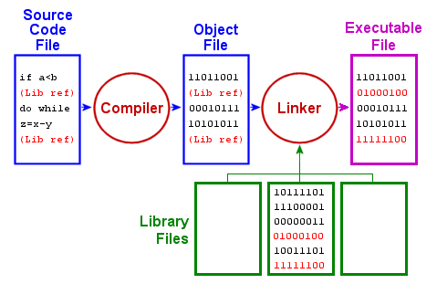
Compilation Semantics
Compiling – Assembling – Linking
Remember:
g++ -o my_program my_program_code.cpp
CS-202 Lab Sections

Slide 11
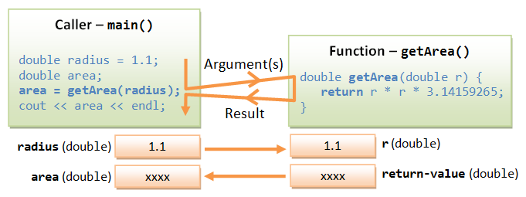
Compilation Semantics
Executing
The process where a computer actually performs the instructions of the compiled/assembled/linked program.
Sequential operations is basic to all computer programs.
Every line is executed in a top down order:
Remember:
./my_program
CS-202 Lab Sections

Slide 12
Remember: Pointers
Pointer
A Pointer is “Just a Variable”.
Its Value: an Address in memory (instead of storing an int/float/char/etc.)
Its Type: what type of variable resides in that memory Address.
int
int*
num
ptr
Addresses
0x1015
0x5286
Pointer Value: Where it points-to
in memory
18
0x5025
Values
CS-202 Lab Sections

Slide 13
Remember: Pointers
Pointer Assignment
Assignment means telling the pointer what memory Address to point to:
int num = 18;
int *ptr = &num;
int
int*
num
ptr
Addresses
0x1015
0x5286
Pointer Value: Where it points-to
in memory
18
0x1015
Values
CS-202 Lab Sections

Slide 14
Remember: Pointers
Dereference Operator (*) or “Value-Pointed-By”
To get the Value-Pointed-By a pointer, we pre-pend the star (*) operator to its name.
… = *ptr
*ptr = …;
int
int*
num
ptr
Addresses
0x1015
0x5286
18
0x1015
Values
CS-202 Lab Sections

Slide 15
Basic Pointer Arithmetic
Moving through an Array with Pointers
int num_array[10] = {0, 1, 2, 3, 4, 5, 6, 7, 8, 9};
int* num_ptr;
num_ptr = num_array; //or equivalently, num_ptr = &num_array[0];
cout << *num_ptr;
num_ptr++;
cout << *num_ptr;
num_ptr += 8;
cout << *num_ptr;
num_ptr--;
cout << *num_ptr;
num_ptr-=5;
cout << *num_ptr;
num_ptr = num_array;
cout << *num_ptr;
0 Pointer points to Address of array 1st element.
1 Pointer moves to point 1 position ahead (++) in memory,
therefore pointing to Address of array 2nd element.
9 Pointer moves to point 8 positions more ahead (+=8) in memory,
therefore pointing to Address of array 10th element.
8 Pointer moves to point 1 position backwards (--) in memory,
therefore pointing to Address of array 9th element.
3 Pointer moves to point 4 positions more back (-=5) in memory,
therefore pointing to Address of array 4th element.
0 Pointer reassigned to points again to Address of array 1st element.
CS-202 Lab Sections

Slide 16
Remember: Parameters in Functions
i) Pass-by-Value
The “default” way.
Implies Data Copy operation.
void printVal (int x);
int x = 5;
int *xPtr = &x;
printVal(x);
printVal(*xPtr);
Valid Calls
CS-202 Lab Sections

Slide 17
Remember: Parameters in Functions
ii) Pass-by-Reference
Uses (&) operator once (function declaration).
Address passed, Data Copy unnecessary.
void changeByRef (int &x);
int x = 1;
int &xRef = x;
changeByRef(x);
changeByRef(xRef);
Note:
Variable might be changed.
Have to bear in mind the function prototype !
Valid Calls
CS-202 Lab Sections

Slide 18
Remember: Parameters in Functions
iii) Pass-by-Address
Uses pointers, and uses (*) and (&) operators.
Address passed, Data Copy unnecessary.
void changeVal (int *x);
int x = 5;
int *xPtr = &x;
changeVal(&x);
changeVal(xPtr);
No guarantees pointer is valid.
Note:
Have to check for NULL pointer inside function calls !
Valid Calls
CS-202 Lab Sections

Slide 19
Remember: Functions and Arrays
Pass-by-Address
Arrays are Pointers, they are always Passed-by-Address to functions.
Program does not make a copy of an array.
Changes made to an array inside a function will persist after the function exits.
Remember entire Arrays as Function Arguments:
double array[10] = {};
void arrayWholeFunction(double vals[], int num);
void arrayWholeFunction(double *vals, int num);
arrayWholeFunction(array, 10);
arrayWholeFunction(&array[0], 10);
or
Valid Definitions
by-Address
by-Reference (1st element)
or
CS-202 Lab Sections

Slide 20
A Comprehensive Example
#include <iostream>
using namespace std;
const int MAX_STR_SIZE = 255;
void cStringPrint(char * cstr);
int main(){
char my_cString[MAX_STR_SIZE] = "Hello World!";
cStringPrint ( my_cString );
return 0;
}
void cStringPrint(char * cstr){
while( *cstr ){
cout << *cstr++ ;
}
}
A C-string i.e. char array
A Function with a char* parameter
A Function that:
Iterates through an array by employing Pointer-Arithmetic (++)
Accesses elements of an array by employing Pointer-Dereferencing (*)
CS-202 Lab Sections

Slide 21
Time for Questions !
CS-202
CS-202 Lab Sections

