Slide 1
CS 202 Lab – Session 03
<number>
Notes:
<number>

Slide 2
Coding Reminders
Always use functions – better helps organize and read your code
Use the proper loops
String copy should use a while loop
Global constants should be used instead of #defines:
const int MAX_SIZE = 10;
Notes:
<number>

Slide 3
Sorting
Problem: want to order a set data from lowest to highest based on a given key
List of test scores
Order by first or last name alphabetically
Sort by an ID number
Several algorithms can do this:
Bubble sort
Insertion sort
Selection sort
Merge sort
Quick sort
Notes:
<number>

Slide 4
Bubble Sort
Is a simple and intuitive way to sort data
Not commonly used in practice due to the slow performance when sorting large amounts of data
Algorithm:
Compare each pair of adjacent elements from the beginning of an array and, if they are in reversed order, swap them.
If at least one swap has been done, repeat step 1.
Notes:
<number>

Slide 5
Bubble Sort – Example
5
1
7
-5
9
Unsorted
5
1
7
-5
9
5 > 1, swap
1
-5
5
7
9
1 > -5, swap
1
5
7
-5
9
5 < 7, ok
-5
1
5
7
9
1< 5, ok
1
5
7
-5
9
7 > -5, swap
-5
1
5
7
9
-5 < 1, ok
1
5
-5
7
9
7 < 9, ok
-5
1
5
7
9
Sorted
1
5
-5
7
9
1 < 5, ok
1
5
-5
7
9
5 > -5, swap
1
-5
5
7
9
5 < 7, ok
Notes:
<number>

Slide 6
Bubble Sort - Code
void BubbleSort(int num[], int numItems) { int i = 0, temp; bool swap = true; while(swap) { swap = false; for (int i=0; i < (numItems-1); i++) { if (num[i] > num[i+1]) { temp = num[i]; num[i] = num[i+1]; num[i+1] = temp; swap = true; } } } }
Notes:
<number>

Slide 7
Selection Sort
Another simple sorting algorithm
Can be very efficient if the data is almost sorted
Algorithm:
Search through the list and find the smallest element
Swap the smallest element with the first element
Repeat the process by starting at second element and find the second smallest element, then third, etc.
Notes:
<number>

Slide 8
Selection Sort - Example
5
1
7
-5
9
2
7
8
Unsorted
5
1
7
-5
9
2
7
8
Swap -5 and 5
-5
1
2
5
7
7
9
8
Swap 8 with 9
-5
1
7
5
9
2
7
8
1 is already in place
-5
1
2
5
7
7
8
9
Sorted
-5
1
7
5
9
2
7
8
Swap 2 and 7
-5
1
2
5
9
7
7
8
5 is already in place
-5
1
2
5
9
7
7
8
Swap 7 with 9
-5
1
2
5
7
9
7
8
Swap 7 with 9
Notes:
<number>

Slide 9
Selection Sort - Pseudocode
SELECTION-SORT(A) 1. for j ← 1 to n-1 2. smallest ← j // use the current index as the smallest val 3. for i ← j + 1 to n 4. if A[ i ] < A[ smallest ] 5. smallest ← i 6. Exchange A[ j ] ↔ A[ smallest ]
Notes:
<number>

Slide 10
Insertion Sort
Only goes through the entire array once
Actually used in practice to sort small data sets
Array is imaginarily split into a sorted and unsorted section
Algorithm:
Assume the first element is sorted
Compare second element with the first – if second is less, then swap
For the rest of the rest of the elements – shift the sorted elements down until the proper spot is found
Notes:
<number>

Slide 11
Insertion Sort - Example
7
-5
2
9
4
Unsorted
7
-5
2
9
4
-5 to be inserted
-5
2
7
9
4
4 to be inserted
?
7
2
9
4
7 > -5, shift
-5
2
7
?
9
9 > 4, shift
-5
7
2
9
4
Insert -5
-5
2
?
7
9
7 > 4, shift
-5
2
4
7
9
2 < 4, insert 4
-5
7
2
9
4
2 to be inserted
-5
?
7
9
4
7 > 2, shift
-5
2
4
7
9
Sorted
-5
2
7
9
4
-5 < 2, insert 2
-5
2
7
9
4
9 to be inserted
-5
2
7
9
4
7 < 9, insert 9
Notes:
<number>

Slide 12
Insertion Sort - Pseudocode
INSERTION-SORT(A) 1. for j = 2 to n 2. key ← A [j] 3. // Insert A[j] into the sorted sequence A[1..j-1] 4. j ← i – 1 5. while i > 0 and A[i] > key 6. A[i+1] ← A[i] 7. i ← i – 1 8. A[j+1] ← key
Notes:
<number>

Slide 13
Advanced Sorting Algorithms
Merge Sort
A divide and conquer algorithm where the problem gets split down into smaller sub-problems
Efficient, but requires additional memory (can be an issue for large datasets)
Splits the data in half in every iteration until two elements are left
Sorts the subarrays and merges back up
Quick Sort
A recursive divide and conquer algorithm that is very efficient and used in practice
Uses a pivot to split the data and values less than the pivot go to the left side and greater values go to the right side
Notes:
<number>

Slide 14
Searching
Sometimes you want to find a piece of data based on a given key
ID number
Name
Zip code
Several Algorithms
Linear Search
Binary Search
Notes:
<number>

Slide 15
Linear Search
Simple algorithm
Uses a loop to iterate through all of the data
Compares each element with the desired value
Stops at the end of the array or when the value is found
Allows for the array to be unordered
Not efficient for large amounts of data
Notes:
<number>

Slide 16
Binary Search
Allows you to quickly find data by repeatedly cutting the dataset in half
Requires the data to be sorted before searching
Algorithm
Start with the middle element in the array and compare.
If value < middle then search in left sub-array
If value > middle then search right sub-array
Get the middle of the sub-array and repeat the process
Stops when either the value is found or when the sub-array can’t be subdivided
Notes:
<number>

Slide 17
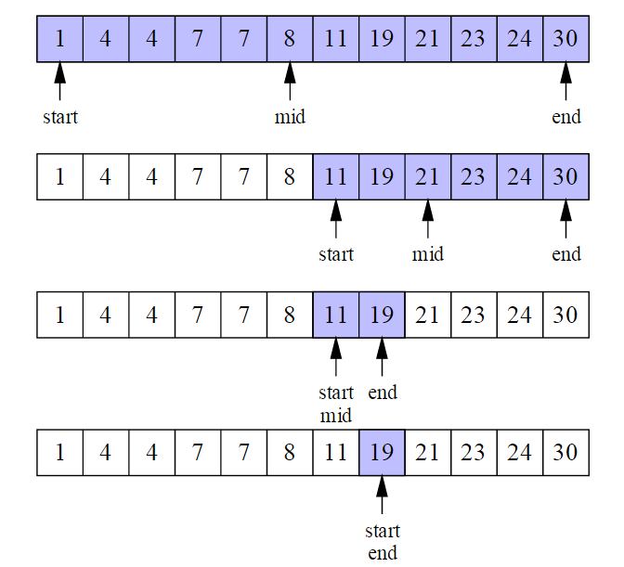
Binary Search
Search for 19:
Notes:
<number>

Slide 18
Questions?
Questions?
Notes:
<number>

