Slide 1

ÖSSUR WAlkAbout APP Proof of Concept
Hannes Sverrisson

Slide 2
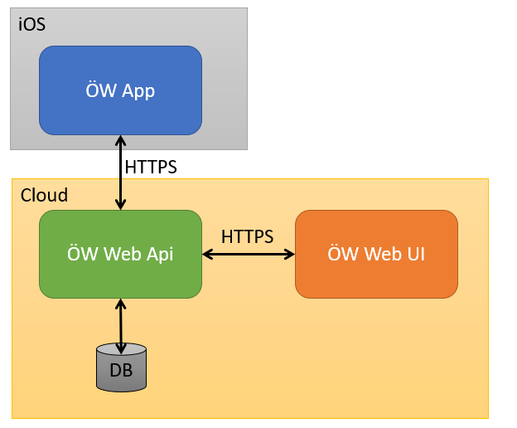
Objective
Design a system to analyse walking motion.
Consists of three parts:
APP
API + Database Storage
WEB UI

Slide 3
Design
Walkabout APP
Allows the user to create sessions and store data.
Sends data to API server.
SQLITE3 database for storage.
Walkabout Server
Nodejs express server.
SQL Server 2017 from microsoft for linux.
Docker used to create server container.
Docker compose to set up server and SQL Server db.
Walkabout Web Client
React framework.
Redux backend for data storage and flow.
Note: not yet implemented.

Slide 4
Walkabout App

Slide 5
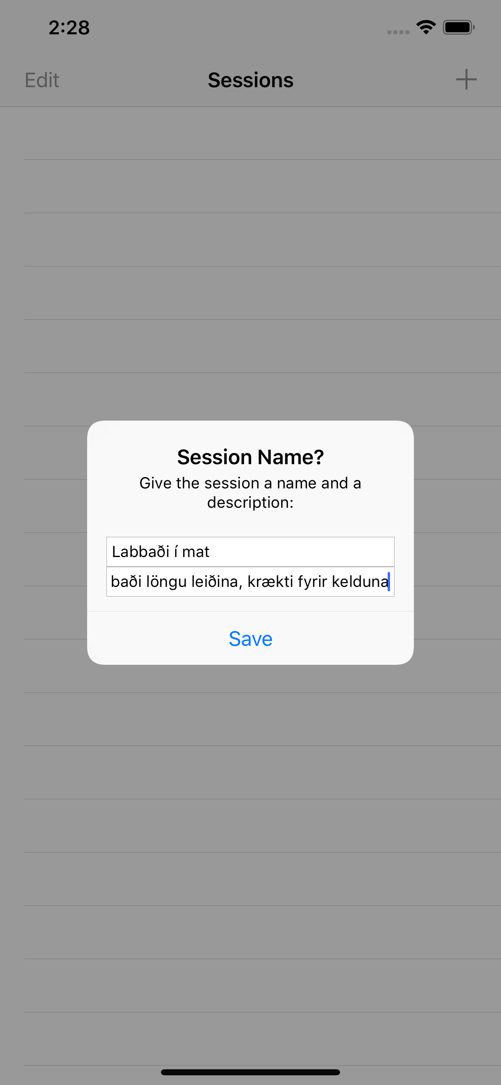
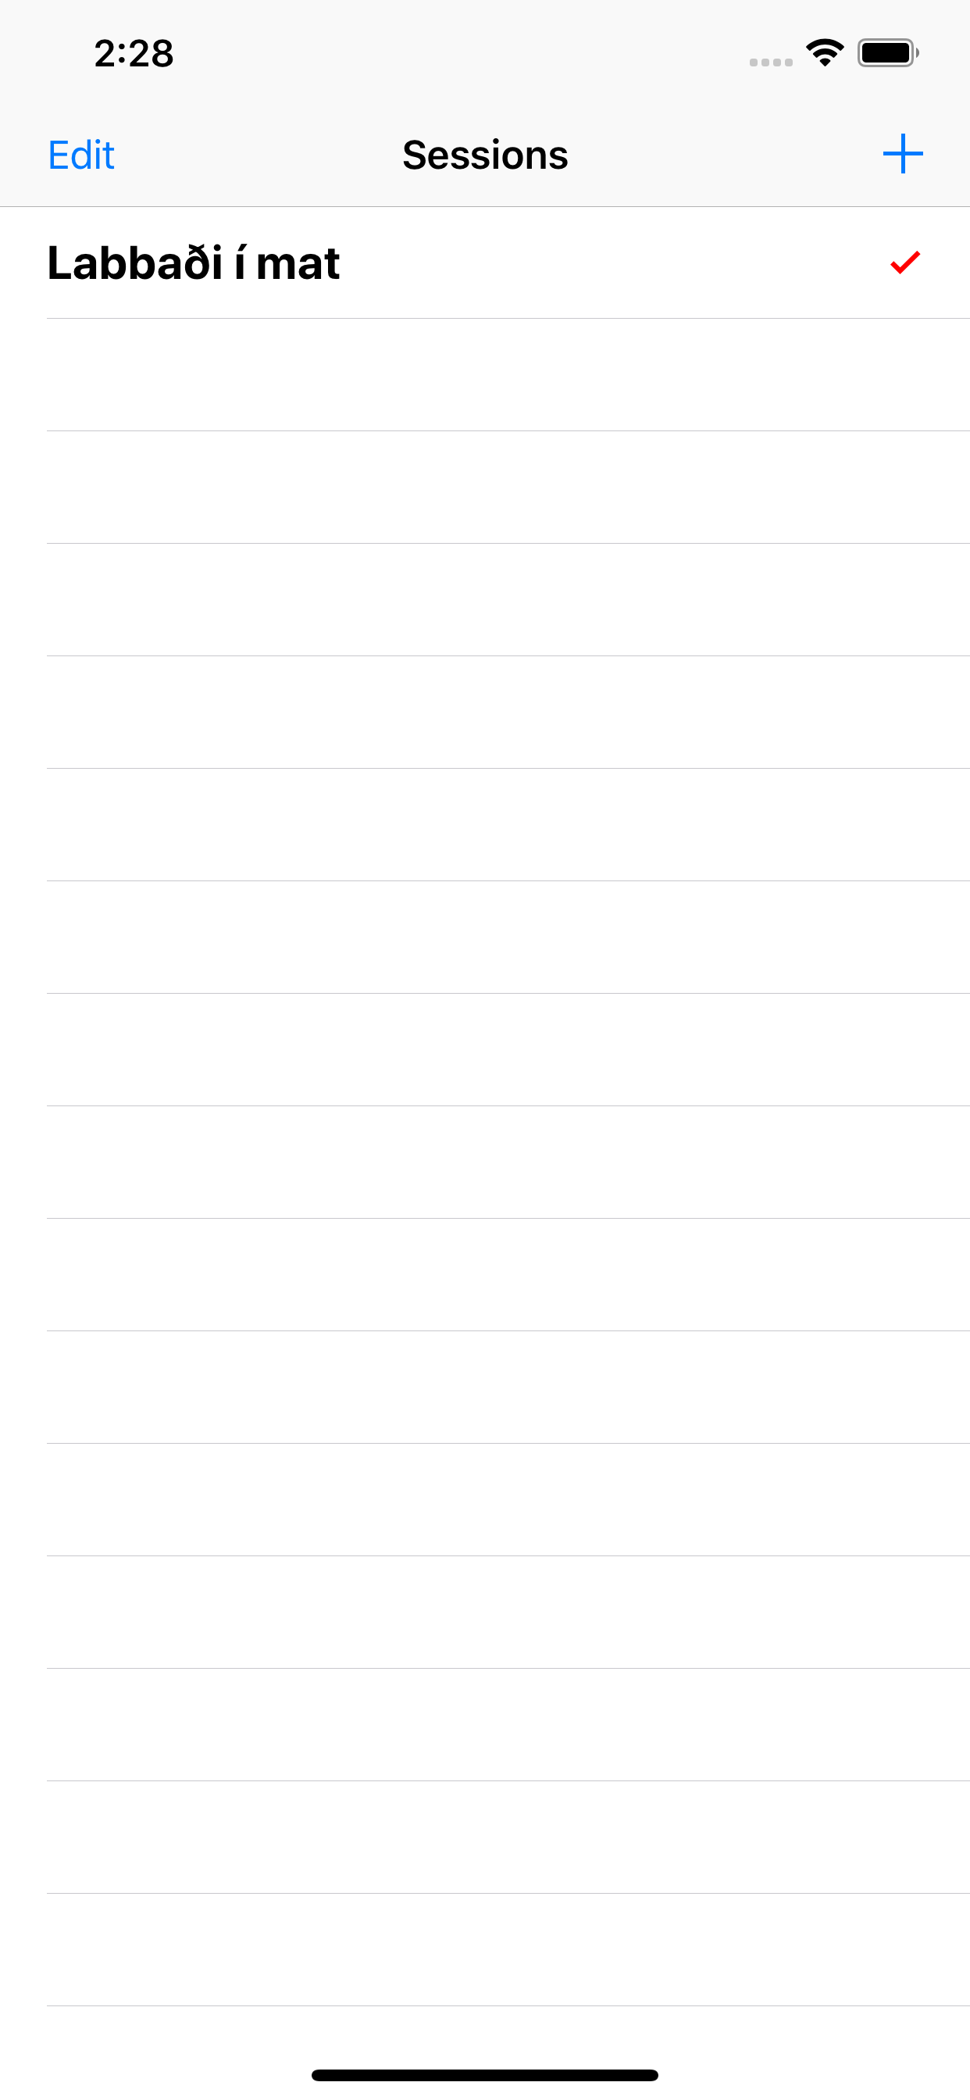
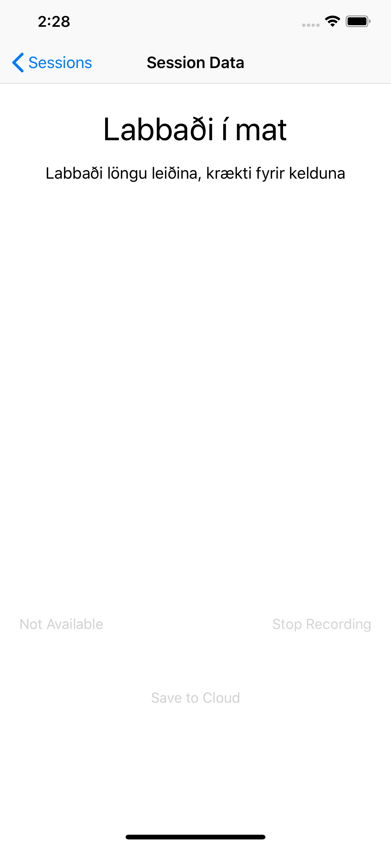
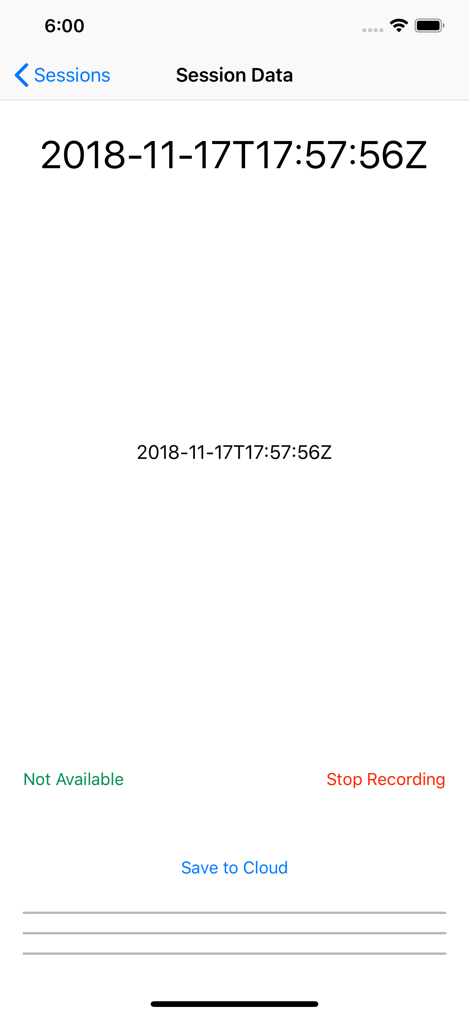

Slide 6
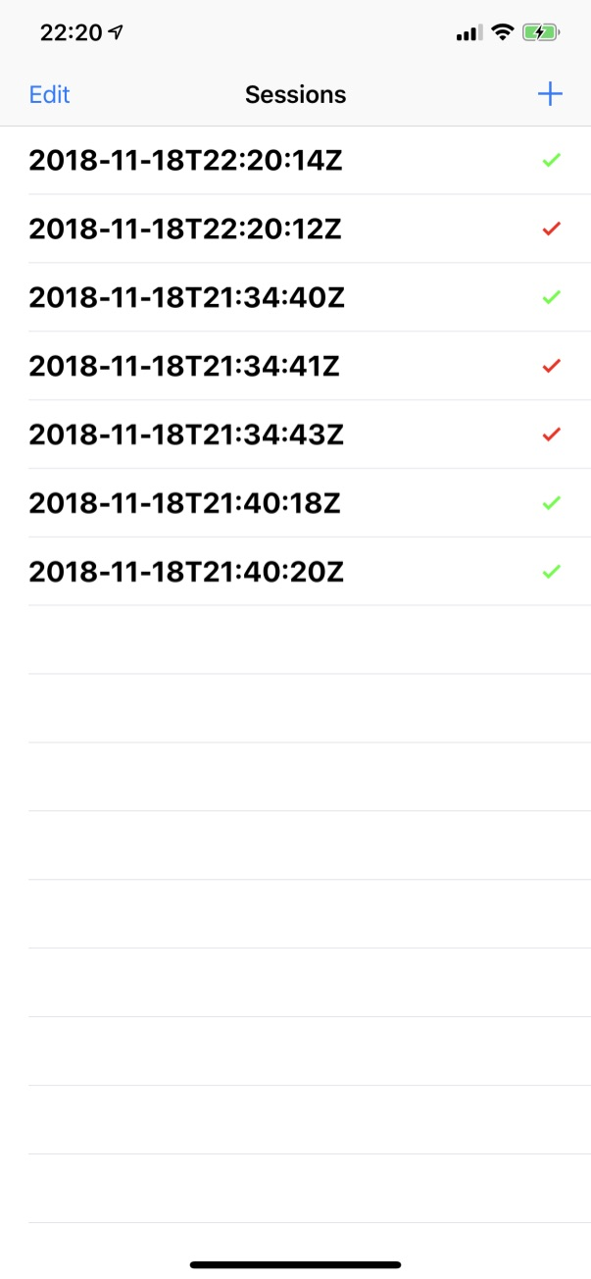
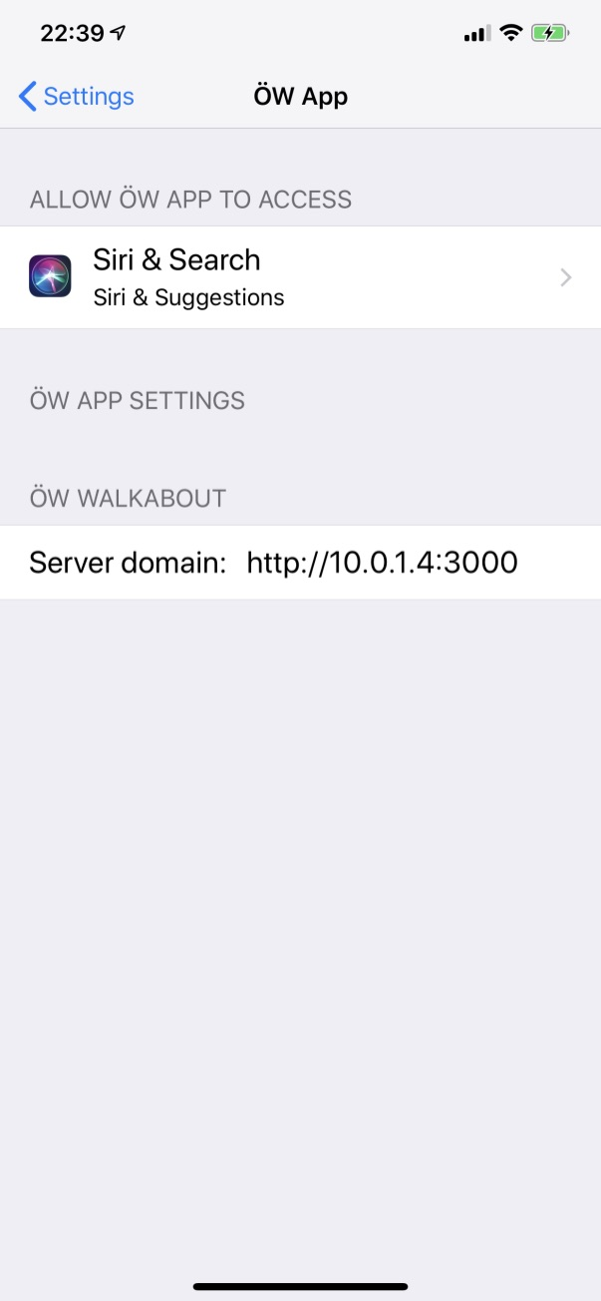

Slide 7
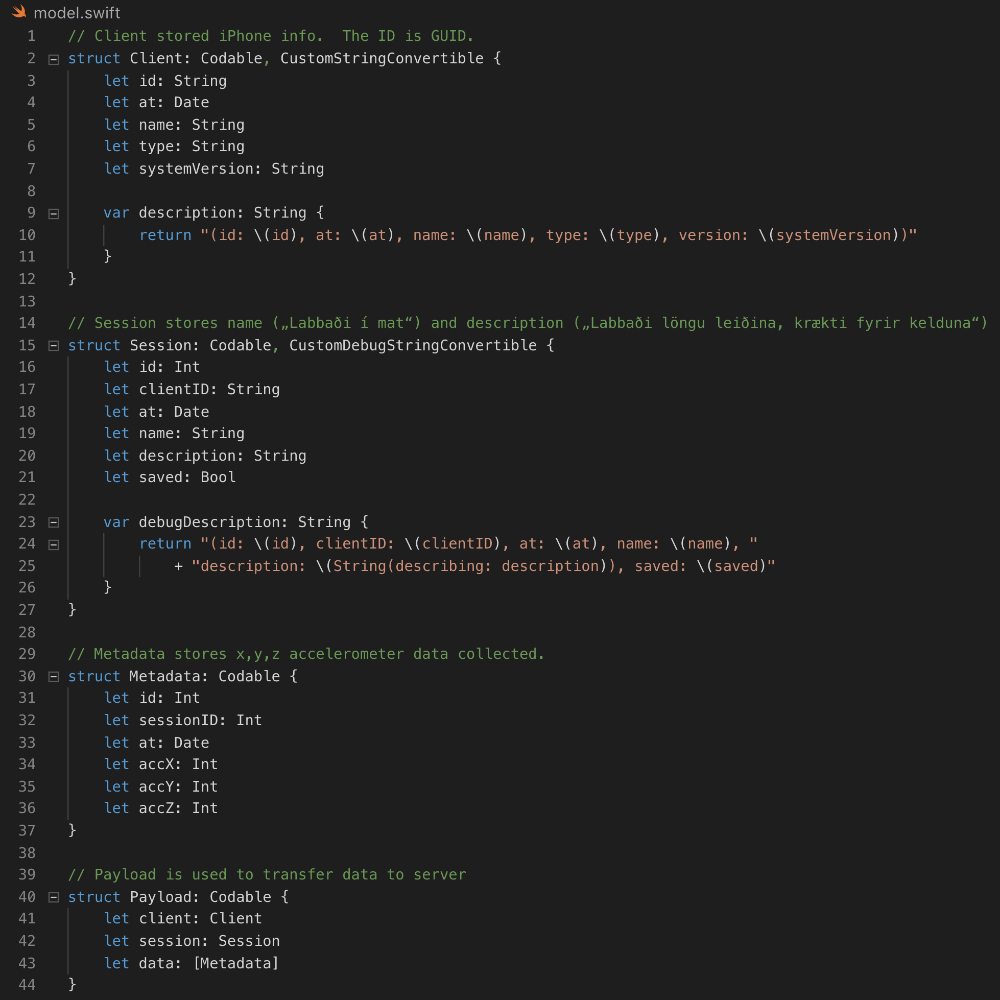
Walkabout APP
Allows the user to create sessions and store data.
Sends data to API server.
Codable Protocol used for JSON Serialization.
SQLITE3 database for storage.

Slide 8
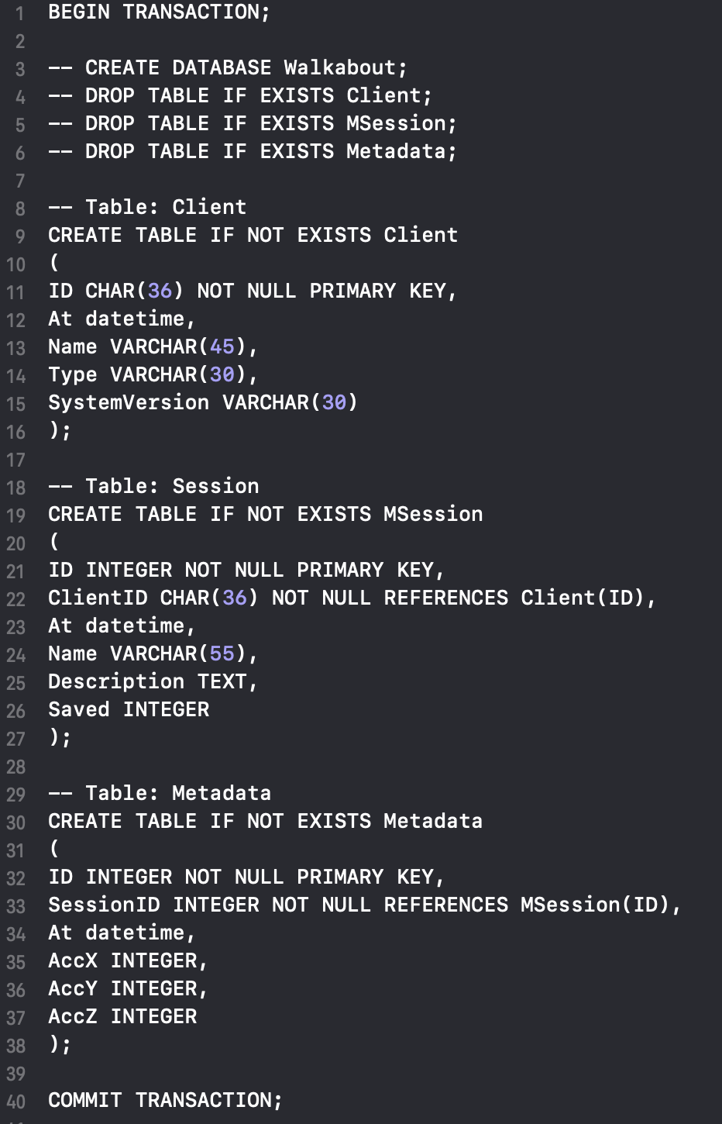
Walkabout APP
SQLITE3 database for storage.
Added SystemVersion in Client table for storing, i.e. IOS 12.1.

Slide 9
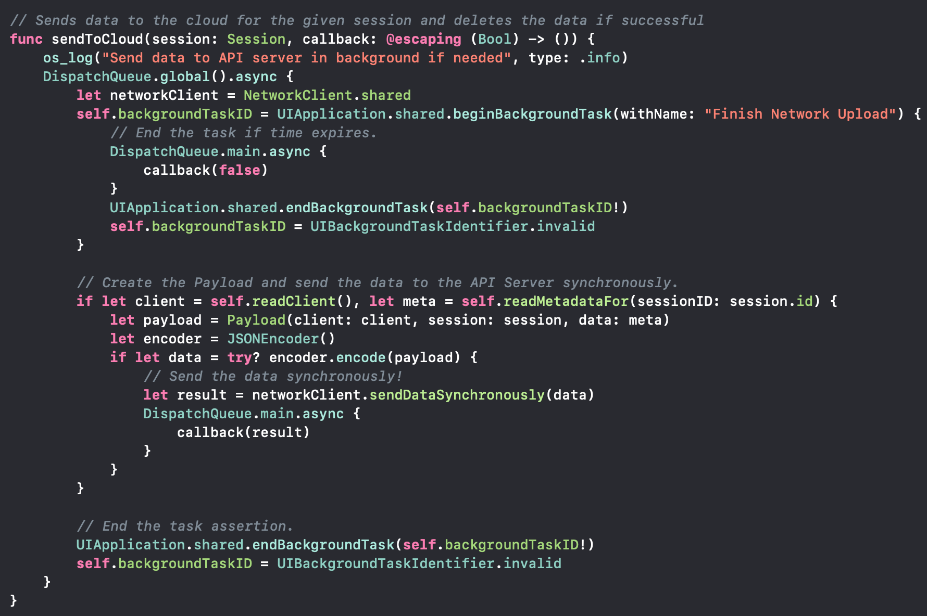
Walkabout APP
Data Sent synchronously to continue in the background if the user closes the app.
Replication Conflict
The server responds if the payload was successfully stored, if not then the client data is not deleted from the local database.
Same applies if the app crashes or runs out of time, the callback returns false or nothing.

Slide 10
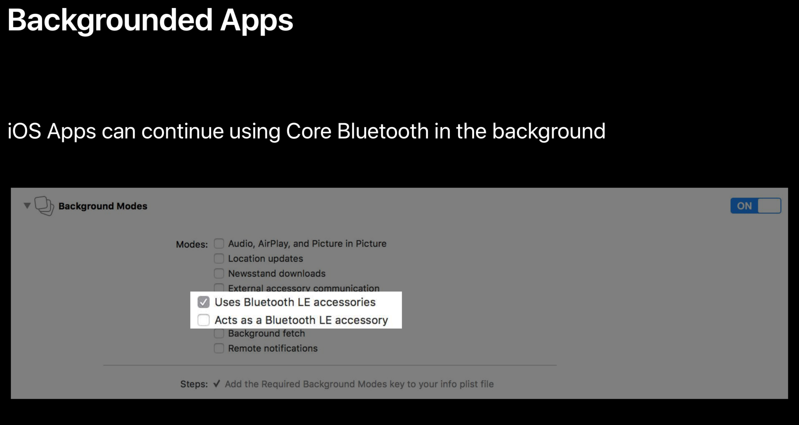
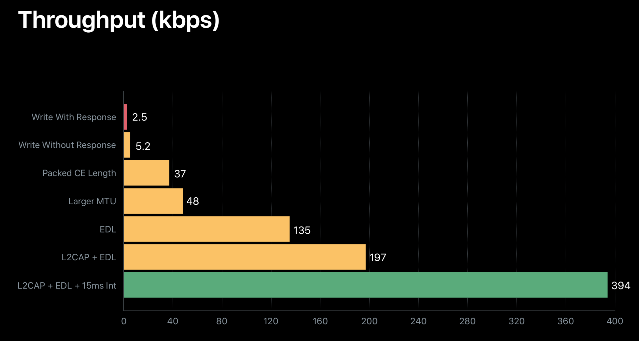
Walkabout APP
Background data collection on ios
After a user exits the app, it has 5 seconds to finish any work in the background before being shut off.
This can be addressed by registering for background work and monitoring bluetooth le devices.
Might be Possible to apply for using the CMMovementDisorderManager that collects motion data on the user in the background over long time. Used for parkinsons tremor & kinesias analysis.

Slide 11
Walkabout APP
SQLite vs. CoreData
Coredata is kind of a blackbox with no access to the code base.
Changes to the database in an app update can be challenging.
Strongly typed is an advantage as is support by Apple.
Coredata uses SQLite database.
Coredata can be called from other than the main thread.
SQLite is a c-codebase which can be tricky to communicate with.
There are some open source packages to allow interactions with it in a more typesafe and swiftier way.
All code is accessble and thus easier to understand what it going on and the dataflow.

Slide 12
Walkabout APP
Challenges
With more time - implement the sqlite with type safety instead of using schema (schema is valuable in development for quick changes).
Improved user interface with more icons and graphics would improve the look of the app.
Realtime updating the Acc data on a Trigraph chart.
Complete CRUD not finished in time.
Metadata primary key.

Slide 13
Walkabout Server

Slide 14
Walkabout Server
Walkabout Server
NodeJS Express server.
SQL Server 2017 from Microsoft for Linux.
Docker used to create server container.
Docker compose to set up server and SQL Server db.

Slide 15
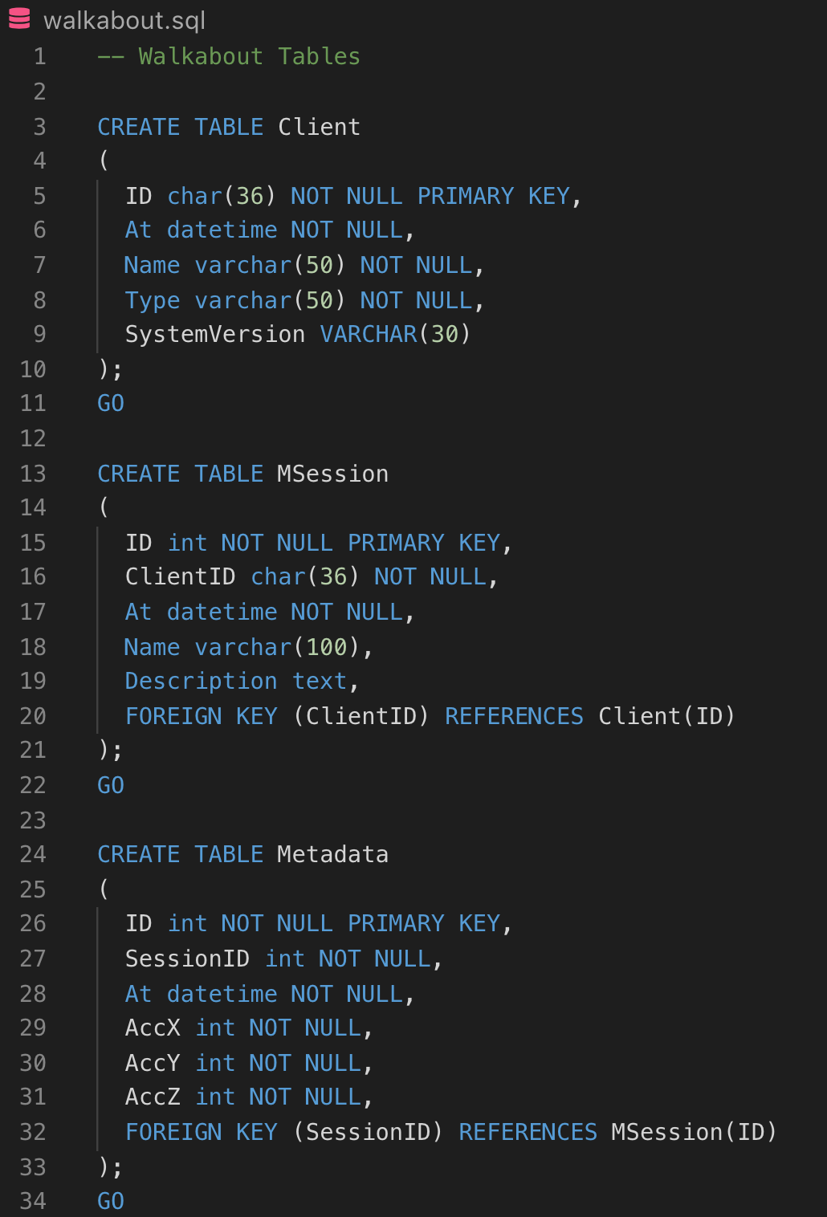
Walkabout Server
Challenges
Session keyword, thus Session table renamed to Msession.
Lacking support for Nodejs Express integration.
With more time would prefer to implement with .net core or use Postgres sql db.
Complete CRUD not finished in time.
Currently a payload can only be sent once to the server. Next payload will collide with a previous Client.

Slide 16
Walkabout Server
Replication conflict
The server should always check if session is already stored, before trying to store anything and respond to the client. If data is seen before the server should verify the data is identical and then send a success response to the client.
The server should not respond to the client until the database has finished storing the data with a successful return and then send a success response to the client.

Slide 17
Walkabout WEB Client
React Framework.
Redux backend for data storage and flow.
Note: Not yet implemented.

Slide 18
General project ideas

Slide 19
Data safety
HTTPS for all communications over the network.
Client shall register at initial start and send a public key to the server.
All data sent over network shall be encrypted, server can use the initial key to decrypt.
All data stored in databases shall be encrypted with a password and a salt. Thus, if there is a data breach, it is still costly to break the encryption as each salt is unique.
Allow the user to turn on: log in with face id or touch id on the phone.

Slide 20
Other ideas
Using and contributing to Researchkit. Apple framework for medical research.
Using the Apple watch to gather more data and could also be attached to limbs to get more measurement points on the rotation of the limb, as well as accelerometer data.
Use bluetooth le to wake up app, for sending data in the background to the server.
Utilising Healthkit for more data on the user.
Utilising sportkit, i.e. workoutkit, for possible modes of running in the background.

Slide 21
Questions?

Slide 22
Thank YOu

