Slide 1

AUTOMATED TESTING
Company: Svetislav Simic, Programmer
Itekako

Slide 2
GIT
Version control is a system that records changes to a file or set of files over time so that you can recall specific versions later.
Git is a distributed revision control and source code management system with an emphasis on speed. Git was initially designed and developed by Linus Torvalds for Linux kernel development.

Slide 3
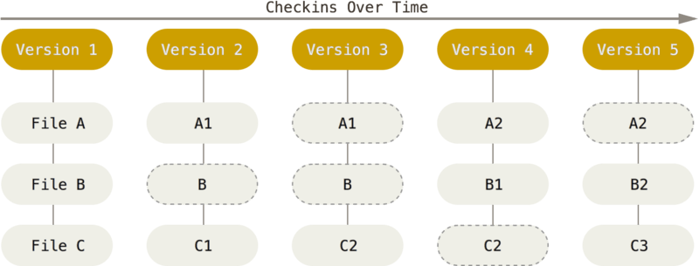
Git Basics
Snapshots, Not Differences
Nearly Every Operation Is Local
Git Generally Only Adds Data

Slide 4
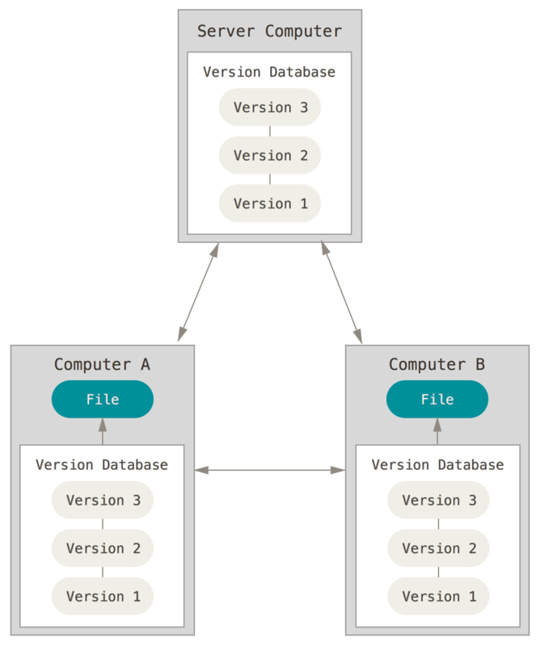
Distributed Version Control Systems
Clients don’t just check out the latest snapshot of the files; rather, they fully mirror the repository, including its full history

Slide 5
The Three States
Git has three main states that your files can reside in: committed, modified, and staged:
Committed means that the data is safely stored in your local database.
Modified means that you have changed the file but have not committed it to your database yet.
Staged means that you have marked a modified file in its current version to go into your next commit snapshot.

Slide 6
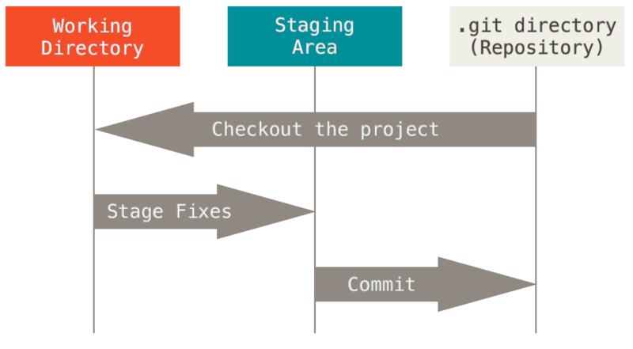
Main sections of a Git project
Git directory
Working tree
Staging area.

Slide 7
Main section
The Git directory is where Git stores the metadata and object database for your project. This is the most important part of Git, and it is what is copied when you clone a repository from another computer.
The working tree is a single checkout of one version of the project. These files are pulled out of the compressed database in the Git directory and placed on disk for you to use or modify.
The staging area is a file, generally contained in your Git directory, that stores information about what will go into your next commit. Its technical name in Git parlance is the “index”, but the phrase “staging area” works just as well.

Slide 8
Basic Git workflow
You modify files in your working tree.
You selectively stage just those changes you want to be part of your next commit, which adds only those changes to the staging area.
You do a commit, which takes the files as they are in the staging area and stores that snapshot permanently to your Git directory.

Slide 9
First-Time Git Setup
The first thing you should do when you install Git is to set your user name and email address. This is important because every Git commit uses this information, and it’s immutably baked into the commits you start creating:
$ git config --global user.name "John Doe"
$ git config --global user.email johndoe@example.com

Slide 10
Getting a Git Repository
You typically obtain a Git repository in one of two ways:
You can take a local directory that is currently not under version control, and turn it into a Git repository with command: $ git init
You can clone an existing Git repository from elsewhere with command: git clone <url>

Slide 11
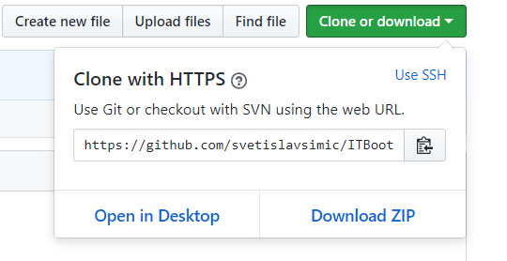
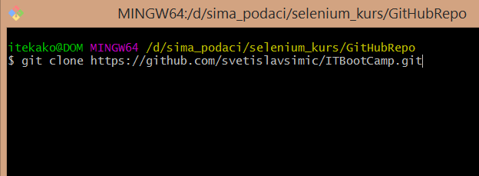
Cloning our repositorium
Go to: https://github.com/svetislavsimic/ITBootCamp/tree/master
Click on Clone or download and copy the url
In Git bash execute a command: git clone <url>

Slide 12
Git commands
Checking the Status of Your Files: git status
Tracking New Files and staging Modified Files: git add name_of_file
Committing Your Changes: git commit (usually with option -m)

Slide 13
Reference
https://git-scm.com/book/
https://www.tutorialspoint.com/git/

