Slide 1

Final Project.
Determining Conversion probability.
Background, Project Problem and Hypothesis
Dataset description
EDA
Models: Logistic Regression / k-NN
Models improvement
Conclusions

Slide 2
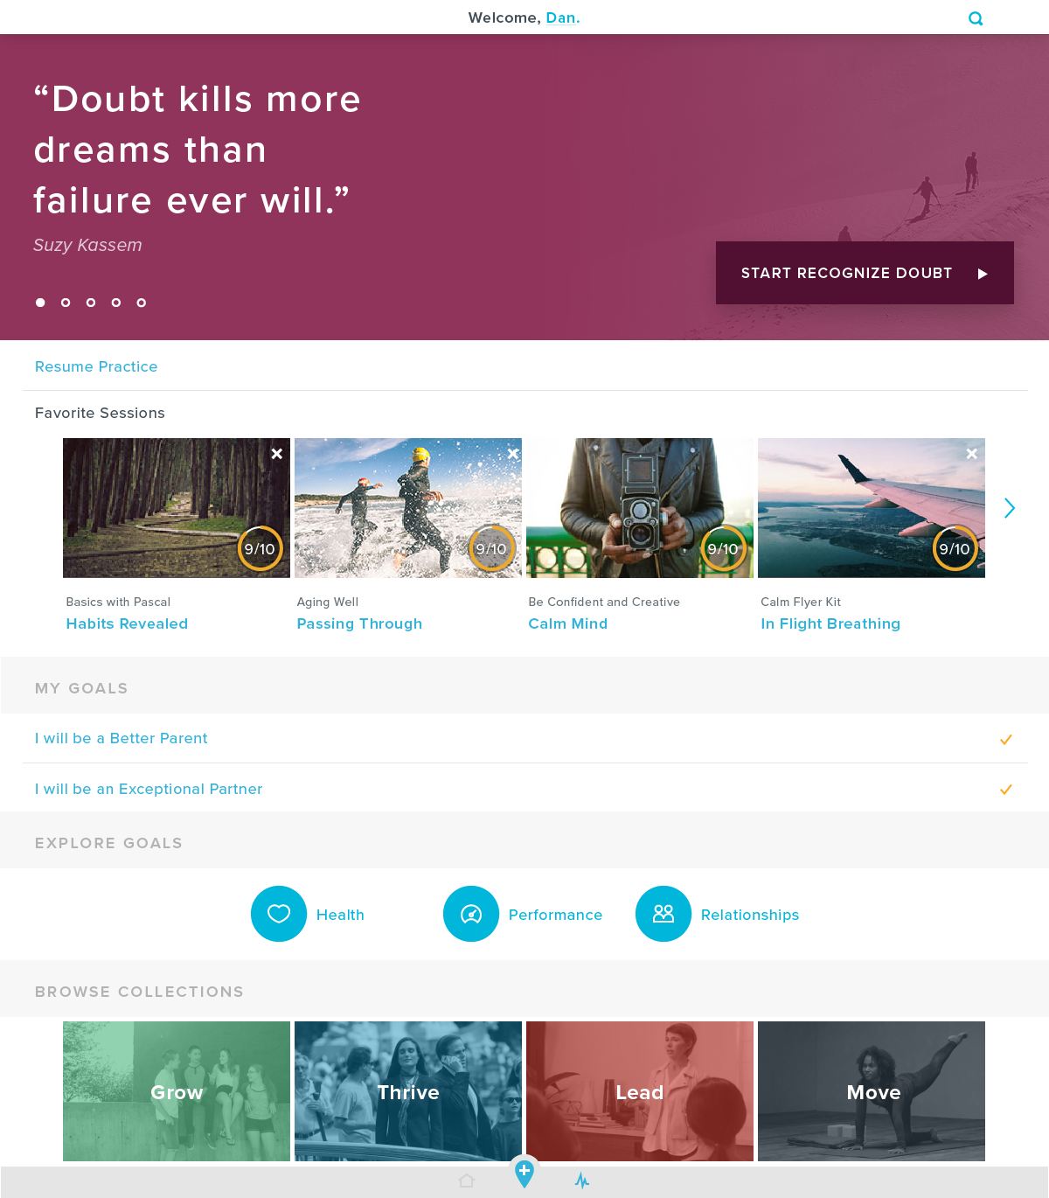
About the product.
Problem Statement and Hypothesis
Whil website: www.whil.com
Problem. I would like to predict how likely Whil users who sign up for the trial period are to become paid customers based on the data provided when signing up and user engagement.
Hypotheses: experienced and active mindfulness users are more likely to convert into paid customers

Slide 3
Dataset
Data is taken from Whil production db (v1)
Data I used:
User info: gender, dob, focus, experience level
User activity info during trial period: sessions and series completed, seconds spent watched content, subscribedYN
Total users: 18730 / Subscribed 1099 (5.87%)
Some SQL preprocessing:
removed test users (exp/focus), corporate users, whil internal team, users with low or 0 activity, users who didn’t complete onboarding
event counts, duration, time period

Slide 4
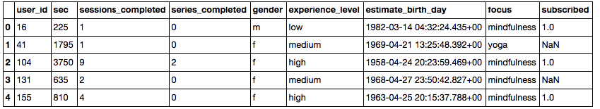
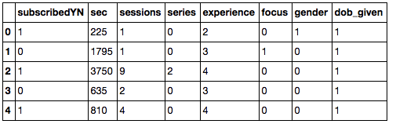
EDA
From:
To:
No Missing Data in the final dataset
DoB, Focus, Gender, Experience, Subscription variables transformation

Slide 5
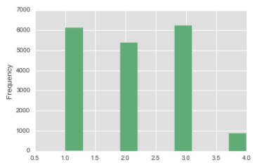
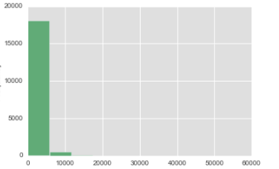
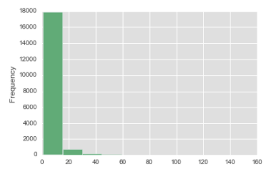
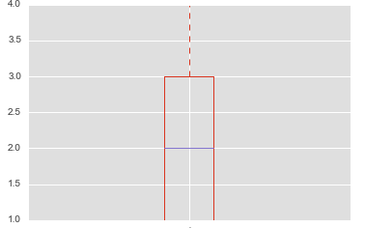
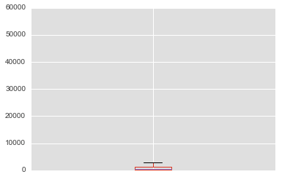
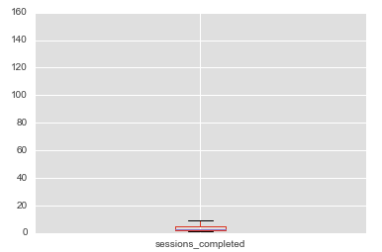
Histograms and boxplots
User experience
Seconds spent
Sessions completed

Slide 6
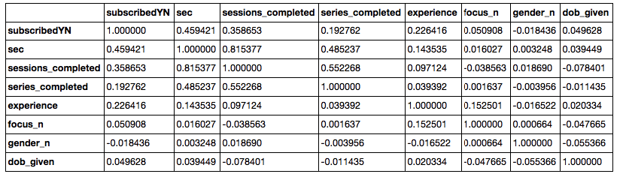
Summary
Most important features: seconds and sessions completed, experience.
Highly correlated: seconds and sessions completed.
Data is not normally distributed.
High variance of seconds and sessions completed.
I kept outliers (if I drop outliers, I lose most of subscribed users).

Slide 7
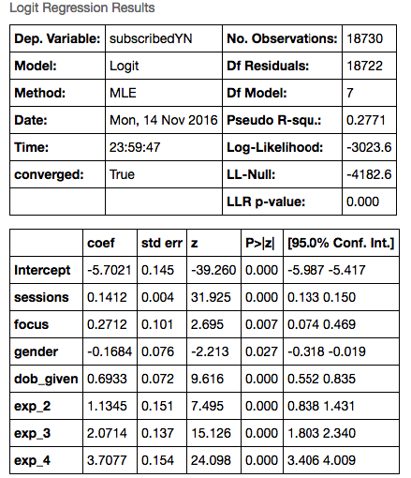
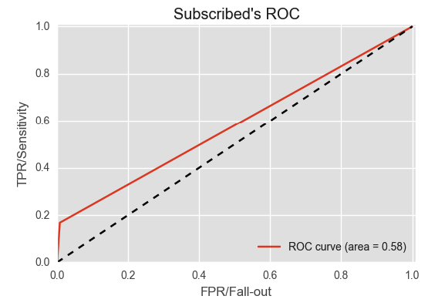
Attempt 1: Logistic Regression Model
I built Logistic Regression Model, using: sessions, focus, gender, dob, and experience
Model score: 0.94
But AUC = 0.58

Slide 8
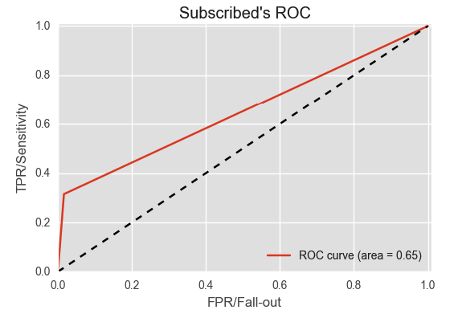
Attempt 1: k-NN
I built k-NN Model, using: sessions, focus, dob, and experience.
Model score: 0.95
But AUC = 0.65
Looks like both models are overfitting towards the largest class of users who didn’t subscribe.
Let’s sample the data and try again …

Slide 9
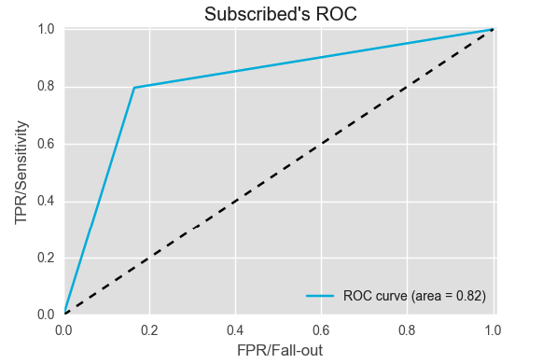
Attempt 2: k-NN
New dataset: 2198 observations (50% subscribed, 50% not subscribed)
I built k-NN Model, using: sessions, focus, dob, and experience
Used grid search and 10-fold validation
Best k = 13, weights ‘uniform’
Model score: 0.82
AUC = 0.82
This model works, predictions seems accurate, experience level influence user's subscription.

Slide 10
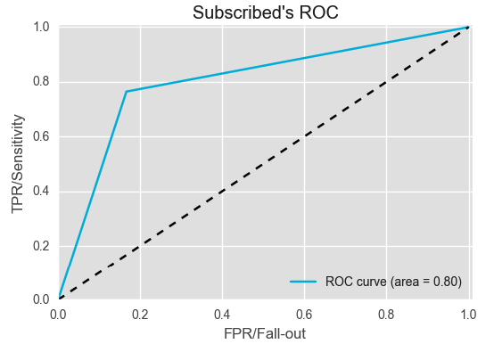
Attempt 2: Logistic Regression
New dataset: 2198 observations (50% subscribed, 50% not subscribed)
I built Logistic Regression Model, using: sessions, dob, focus, and experience
Model accuracy: 0.80
AUC = 0.80
Good, but can it be better?..

Slide 11
Attempt 3: k-NN, new feature
New feature: seconds per session.
I built k-NN Model, using: sessions, seconds per session, dob, and experience
Used grid search and 10-fold validation
Best k = 21, weights ‘uniform’
Model score: 0.85
AUC = 0.82

Slide 12
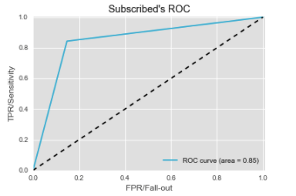
Attempt 3: Logistic Regression, new feature
New feature: seconds per session.
I built Logistic Regression model, using: sessions, sessions per second, dob, and experience.
Model score: 0.86
AUC = 0.85

Slide 13
Let’s compare the predictions:
k-NN:
# | Sessions | Dob | SecPSession | Experience | Prediction, Subscribed (1 – Y/ 0 - N)
1 | 10 | 0 | 210 | 1 | 0
2 | 10 | 0 | 210 | 2 | 0
3 | 10 | 0 | 210 | 3 | 1
4 | 10 | 0 | 210 | 4 | 1
Logistic Regression:
# | Sessions | Dob | SecPSession | exp2 | exp3 | exp4 | Prediction, Subscribed (1 – Y/ 0 – N)
1 | 10 | 0 | 210 | 0 | 0 | 0 | 0
2 | 10 | 0 | 210 | 1 | 0 | 0 | 0
3 | 10 | 0 | 210 | 0 | 1 | 0 | 1
4 | 10 | 0 | 210 | 0 | 0 | 1 | 1

Slide 14
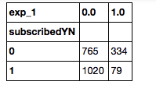
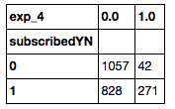
About user experience lvl:
Odds of subscribing for not experienced users:
79/334 = 0.24
Other users: 1020/765 = 1.33
Odds ratio: 0.18
Odds of subscribing for highly experienced users:
271/42 = 6.45
Other users: 828/1057 = 0.78
Odds ratio: 8.27

Slide 15

Conclusions
Both models: k-NN and Logistic Regression showed similar score, but Logistic regression was a little better
Both models had the same predictions (when using the same data)
More experienced users are more likely to subscribe
Product/content needs to be improved in order to retain non-experienced users

