Slide 1

Gradle for Android 101

Slide 2
Contents
What is Gradle?
Gradle Concepts
The New Project Structure
Gradle Scripts
Dependencies
Build Variants
Deploying an APK

Slide 3
What is Gradle?
Flexible general purpose build system
Support for multi-project builds
Dependency management
Support for existing Maven or Ivy repository infrastructures
Supports Ant tasks and builds
Groovy build scripts

Slide 4
Gradle Concepts
Projects
every build.gradle file represents a project
every project has at least one task
Tasks
“a single atomic piece of work” – Gralde docs
Task.dependsOn(), Task.mustRunAfter(), Task.shouldRunAfter()

Slide 5
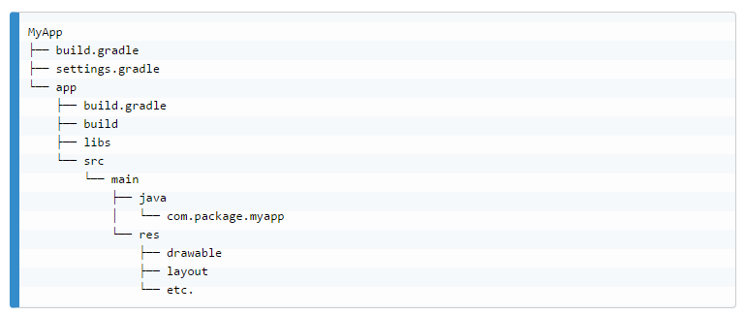
The New Project Structure
Notes:
The new project structure. Gradle files and their role: settings.gradle, main buid.gradle and module build.gradle

Slide 6
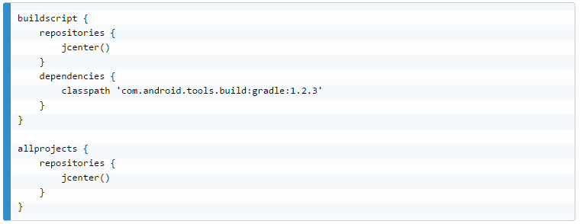
Gradle Scripts
Written in DSL, base on Groovy, executed by JVM
Notes:
Explain top level build.gradle

Slide 7
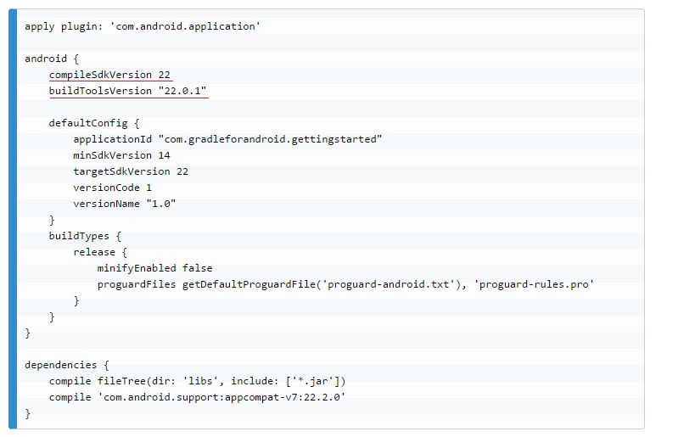
Module Level build.gradle

Slide 8
Dependencies
Remote repositories
compile group:name:version
dynamic version - group:name:version+
File dependencies
compile fileTree(dir: ’libs’, include: [‘*.jar’])
Library projects
compile project(‘:library’)

Slide 9
Build Variants
Build types
different builds of the same app
Product flavors
different versions of the same app
flavorDimensions
buildTypes + productFlavors = buildVariants

Slide 10
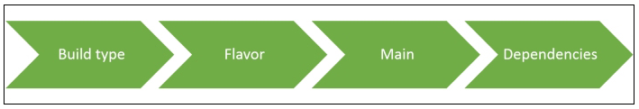
Source Sets and Files Merging
Source sets, combinations
Resources and manifest merging
Merging priority

Slide 11
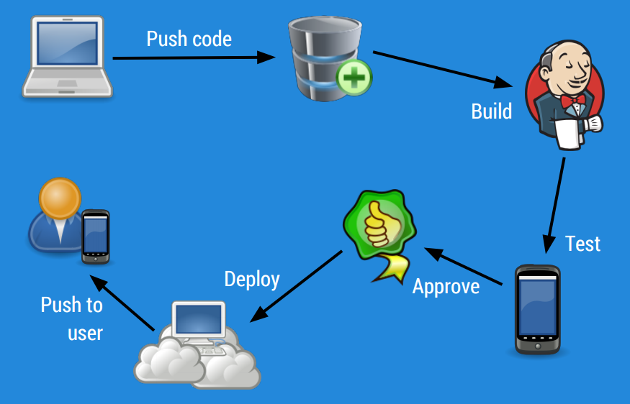
Deploying an APK
Automatic signing
Continuous integration - Jenkins
Automatic HockeyApp Deploy

Slide 12
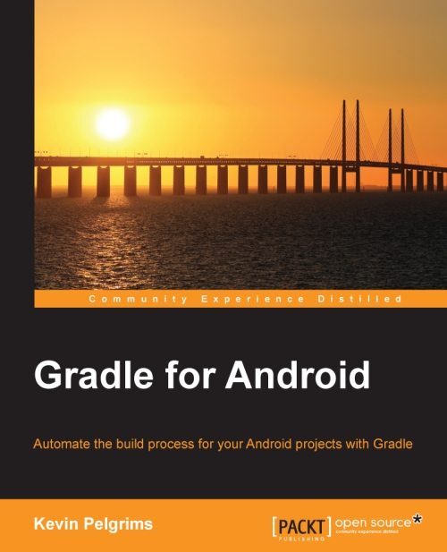
Resources
Gradle for Android, Kevin Pelgrims
Gradle Plugin User Guide
Gradle Docs

